Slide 2
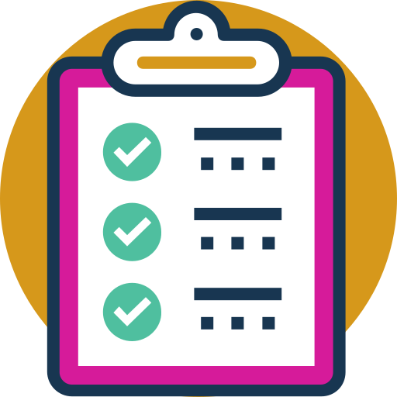
Syllabus
What is Cloud Computing?
Virtualization vs Containerization
History and Cloud Evolution
Cloud Models
Application Architectures

Slide 3
What is Cloud Computing?
On-premise Vs Cloud
location
Control
Security
Compliance
Cost
Time To Market (TTM)
Cloud computing is the on-demand delivery of IT resources over the Internet with pay-as-you-go pricing. Instead of buying, owning, and maintaining physical data centers and servers, you can access technology services, such as computing power, storage, and databases, on an as-needed basis from a cloud service provider.

Slide 4
What is Cloud Computing?
On-premise Vs Cloud
Key Differences of On-Premise vs. Cloud
Deployment (Location)
On Premises: In an on-premises environment, resources are deployed in-house and within an enterprise’s IT infrastructure. An enterprise is responsible for maintaining the solution and all its related processes.
Cloud: In a public cloud computing environment, resources are hosted on the premises of the service provider, but enterprises are able to access those resources and use as much as they want at any given time.

Slide 5
What is Cloud Computing?
On-premise Vs Cloud
Key Differences of On-Premise vs. Cloud
Control
On Premises: In an on-premises environment, enterprises retain all their data and are fully in control of what happens to it, for better or worse. Companies in highly regulated industries with extra privacy concerns are more likely to hesitate to leap into the cloud before others because of this reason.
Cloud: In a cloud computing environment, the question of ownership of data is one that many companies – and vendors for that matter, have struggled with. Data and encryption keys reside within your third-party provider, so if the unexpected happens and there is downtime, you maybe be unable to access that data.

Slide 6
What is Cloud Computing?
On-premise Vs Cloud
Key Differences of On-Premise vs. Cloud
Security
On Premises: Companies that have extra sensitive information, such as government and banking industries must have a certain level of security and privacy that an on-premises environment provides. Despite the promise of the cloud, security is the primary concern for many industries, so an on-premises environment, despite some of its drawbacks and price tag, make more sense.
Cloud: Security concerns remain the number one barrier to cloud computing deployment. There have been many publicized cloud breaches, and IT departments around the world are concerned. From personal information of employees such as login credentials to a loss of intellectual property, the security threats are real.

Slide 7
What is Cloud Computing?
On-premise Vs Cloud
Key Differences of On-Premise vs. Cloud
Compliance
On Premises: Many companies operate under some form of regulatory control, regardless of the industry. Perhaps the most common one is the Health Insurance Portability and Accountability Act (HIPAA) for private health information, and other government and industry regulations. For companies that are subject to such regulations, they must remain compliant and know where their data is all the time.
Cloud: Enterprises that do choose a cloud computing model must ensure that their third-party provider is up to code and in fact compliant with all of the different regulatory mandates within their industry. Sensitive data must be secured, and customers, partners, and employees must have their privacy ensured.

Slide 8
Expense | On-Premise | Cloud
Upfront Cost | Requires significant CapEx to get the hardware and infrastructure. | Typically operates on a subscription-based pricing model. It requires less upfront investment.
Maintenance Cost | Requires continuous maintenance resources. It includes space, power, and expert staff. | The service provider maintains the software. It reduces the need for internal maintenance resources.
Scalability Cost | Additional hardware and setup may be necessary for growth, leading to extra costs. | Cloud is scalable with the ability to adapt quickly. Changing business needs without significant additional costs.
Upgrade Cost | Upgrades can be costly as they may require new hardware or system re-configurations. | Software updates are typically included in the subscription cost. These are performed automatically by the provider.
Data Loss Cost | Potential for permanent data loss in case of system malfunctions. Cyberattacks can lead to financial losses. | More robust data protection measures reduce the risk and cost of potential data loss.

Slide 9
What is Cloud Computing?
On-premise Vs Cloud
Key Differences of On-Premise vs. Cloud
Time To Market (TTM)
On Premises:
Procurement Delays
Setup and Configuration
Geographic Limitations
Upfront Payment
Cloud:
No Hardware Procurement Delays
Pre-configured Services
Global Reach
Pay-as-You-Go Model

Slide 10
Advantages
Faster time to market
You can spin up new instances or retire them in seconds, allowing developers to accelerate development with quick deployments. Cloud computing supports new innovations by making it easy to test new ideas and design new applications without hardware limitations or slow procurement processes.
Scalability and flexibility
Cloud computing gives your business more flexibility. You can quickly scale resources and storage up to meet business demands without having to invest in physical infrastructure.
Companies don’t need to pay for or build the infrastructure needed to support their highest load levels. Likewise, they can quickly scale down if resources aren’t being used.

Slide 11
Advantages
Cost savings
Whatever cloud service model you choose, you only pay for the resources you actually use. This helps you avoid overbuilding and overprovisioning your data center and gives your IT teams back valuable time to focus on more strategic work.
Better collaboration
Cloud storage enables you to make data available anywhere you are, anytime you need it. Instead of being tied to a location or specific device, people can access data from anywhere in the world from any device—as long as they have an internet connection.

Slide 12
Advantages
Advanced security
Despite popular perceptions, cloud computing can actually strengthen your security posture because of the depth and breadth of security features, automatic maintenance, and centralized management.
Reputable cloud providers also hire top security experts and employ the most advanced solutions, providing more robust protection.
Data loss prevention
Cloud providers offer backup and disaster recovery features. Storing data in the cloud rather than locally can help prevent data loss in the event of an emergency, such as hardware malfunction, malicious threats, or even simple user error.

Slide 13
Disadvantages
Vendor Reliability and Downtime
Because of technological difficulties, maintenance needs, or even cyberattacks, cloud service providers can face outages or downtime. Users may not be able to access their data or applications during these times, which can interfere with business operations and productivity.
Internet Dependency
A dependable and fast internet connection is essential for cloud computing. Business operations may be delayed or interrupted if there are connectivity problems or interruptions in the internet service that affect access to cloud services and data.

Slide 14
Disadvantages
Limited Control and Customization
Using standardized services and platforms offered by the cloud service provider is a common part of cloud computing. As a result, organizations may have less ability to customize and control their infrastructure, applications, and security measures. It may be difficult for some organizations to modify cloud services to precisely match their needs if they have special requirements or compliance requirements.
Data Security and Concerns about Privacy
Concerns about data security and privacy arise when sensitive data is stored on the cloud. Businesses must have faith in the cloud service provider's security procedures, data encryption, access controls, and regulatory compliance. Unauthorized access to data or data breaches can have serious repercussions, including financial loss, reputational harm, and legal obligations.

Slide 15
Disadvantages
Hidden Costs and Pricing Models
Although pay-as-you-go models and lower upfront costs make cloud computing more affordable, businesses should be wary of hidden charges. Data transfer fees, additional storage costs, fees for specialized support or technical assistance, and expenses related to regulatory compliance are a few examples.
Dependency on Service Provider
When an organization depends on a cloud service provider, it is dependent on that provider's dependability, financial security, and longevity. Users may have disruptions and difficulties switching to alternate options if the provider runs into financial difficulties, changes their pricing policy, or even closes down their services.

Slide 16
History
Time-sharing mainframe
Amazon
computing model where multiple users can access a single computer system concurrently, sharing its resources such as CPU time, memory,
Amazon launched AWS (Amazon Web Services) in 2006, offering EC2 (compute) and S3 (storage) services.
1960s
1990s
2000s
Today
Salesforce
Cloud era
Salesforce offered Software-as-a-Service (SaaS), one of the earliest forms of cloud computing.
Cloud is ubiquitous, enabling artificial intelligence, IoT, and other advanced technologies.

Slide 17
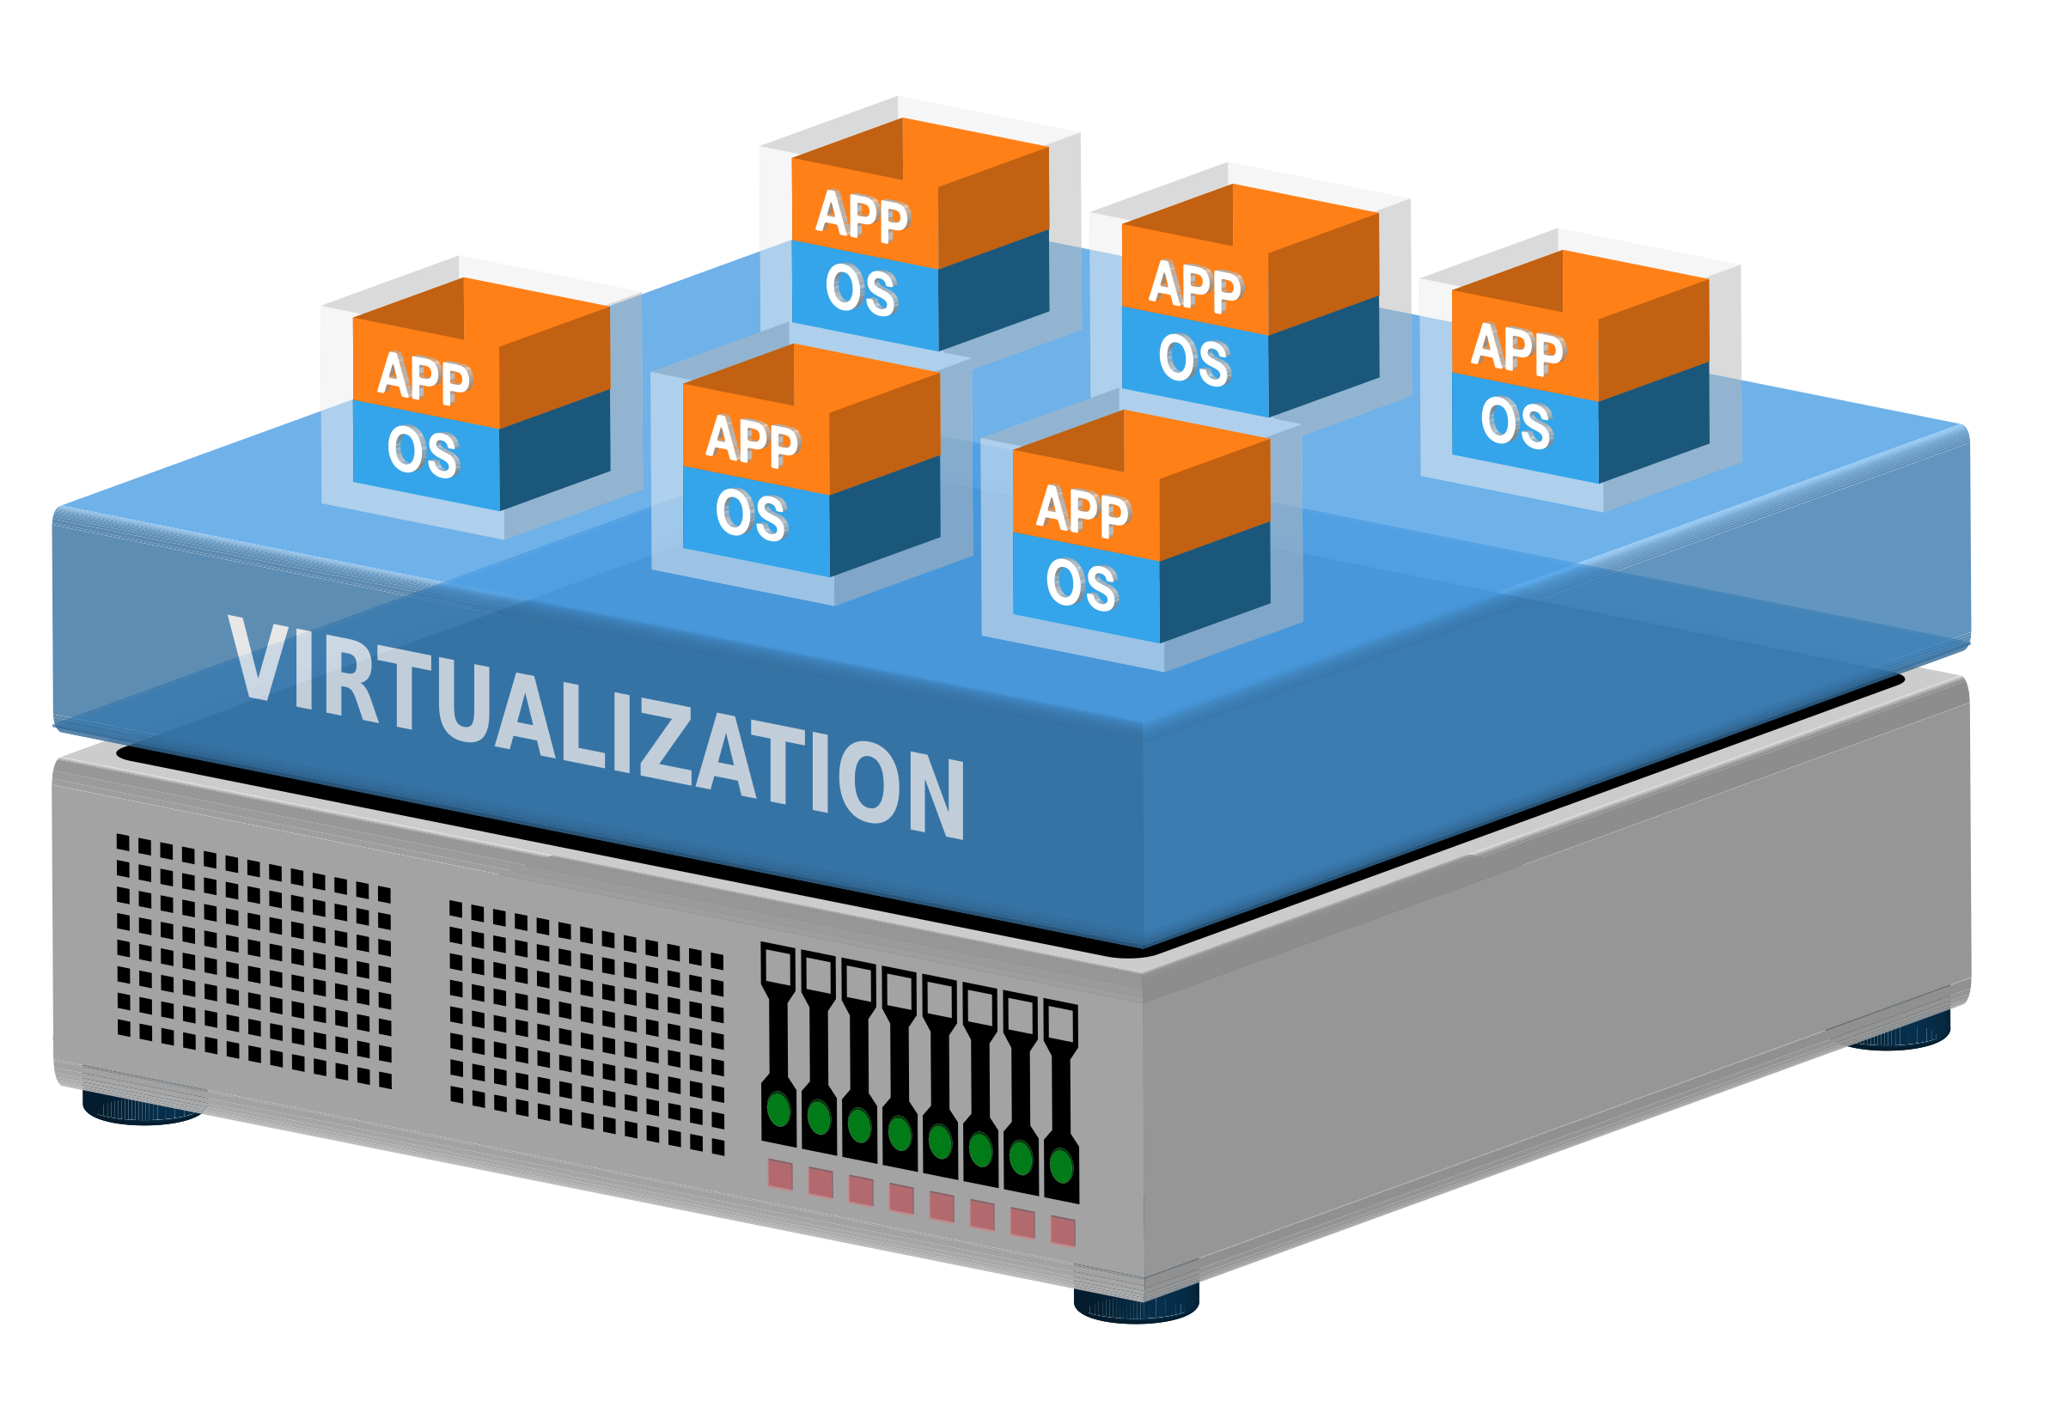
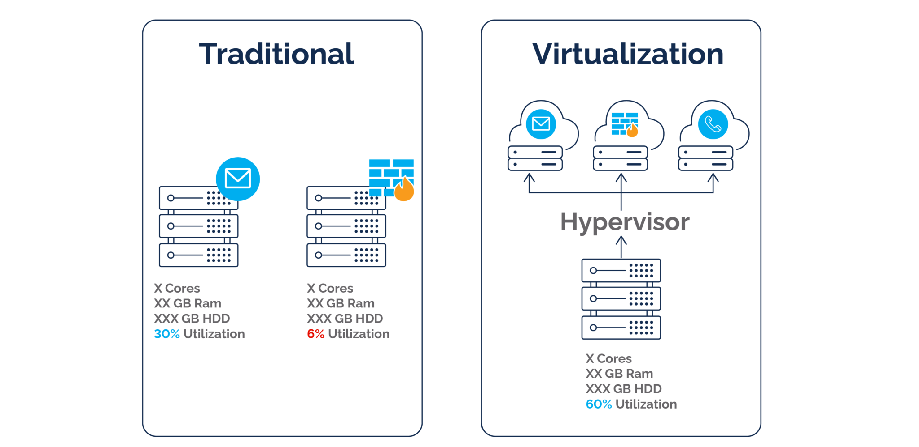
Virtualization
Virtualization is used to create an abstraction layer over computer hardware, enabling the division of a single computer's hardware components—such as processors, memory and storage—into multiple virtual machines (VMs). Each VM runs its own operating system (OS) and behaves like an independent computer, even though it is running on just a portion of the actual underlying computer hardware.

Slide 18
Virtualization
Virtualization is used to create an abstraction layer over computer hardware, enabling the division of a single computer's hardware components—such as processors, memory and storage—into multiple virtual machines (VMs). Each VM runs its own operating system (OS) and behaves like an independent computer, even though it is running on just a portion of the actual underlying computer hardware.

Slide 19
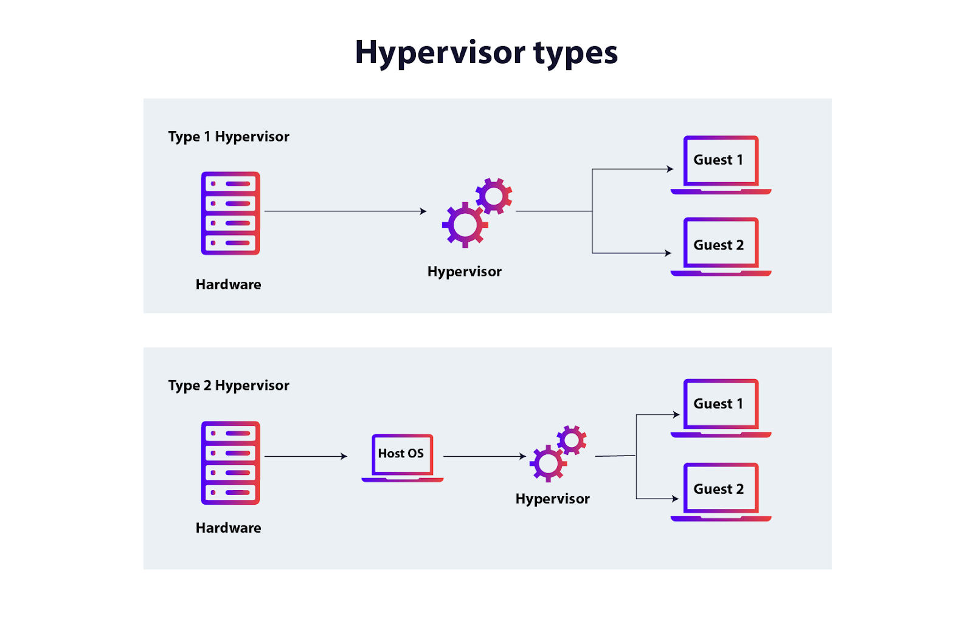
Virtualization
Hypervisor A hypervisor is a type of software or hardware used to create virtual machines and then run those virtual machines day to day. You’ll sometimes see the same technology referred to as a ‘virtual machine monitor,’ or VMM, which is a reasonable encapsulation of what a hypervisor does.

Slide 20
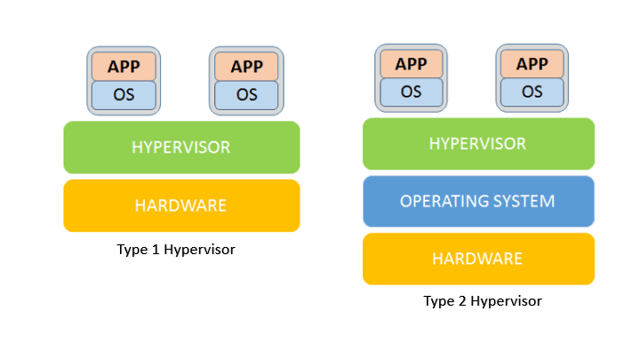
Hypervisor
Type 1 Hypervisor
Most common in enterprise data centers, a type 1 hypervisor replaces the host’s operating system and lies right on top of the hardware. For this reason, type 1 hypervisors are also called bare metal hypervisors or embedded hypervisors.
Type 1 Hypervisor Examples
VMware hypervisors like vSphere, ESXi
Microsoft Hyper-V
Oracle VM Server
Citrix Hypervisor

Slide 21
Hypervisor
Type 2 Hypervisors
A type 2 hypervisor is hosted, running as software on the O/S, which in turn runs on the physical hardware. This form of hypervisor is typically used to run multiple operating systems on one personal computer, such as to enable the user to boot into either Windows or Linux.
Type 2 Hypervisor Examples:
VMware Workstation
Oracle VirtualBox

Slide 22
Virtualization
What’s an example of virtualization?
Here’s a common virtualization scenario: a business has three physical servers that each have a specific purpose: One supports web traffic, One supports company email, One supports internal business applications. With each physical server only being used for its dedicated purpose, the business is probably only using one-third of each server’s computing capacity—even though it pays 100% of the server’s maintenance costs.
With virtualization, you could split one of the servers into two virtual machines and cut your maintenance costs by 33%. This means one server could handle email and web traffic, another could host all business applications, and the third could be retired to save costs or repurposed for some other IT service.

Slide 23
Containerization
Containerization is "OS-level virtualization". It doesn't simulate the entire physical machine. It just simulates the OS of your machine.
Multiple applications can share the same OS kernel.
Most common container technology is "Docker".
Containerization is the process of bundling the application code along with the libraries, configuration files, and dependencies required for the application to run cross-platform.
It is an application-packaging approach where the code is written once and capable of executing anywhere.
It provides less isolation than virtualizations as the containers share the same kernel unlike virtualization where each virtual machine is completely isolated from the other machines.

Slide 24
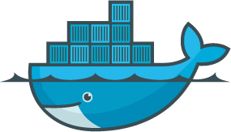
Containerization
Docker
Docker is an open-source framework that enables
developers to build, deploy, run, update and manage
containers.
Docker utilizes LXC (Linux Containers) which refers to capabilities of the Linux kernel (specifically namespaces and control groups) which allow sandboxing processes from one another and controlling their resource allocations.
On top of this low-level foundation of kernel features, Docker offers a high-level tool with several powerful functionalities.
Namespace gives the isolation for the container with the underline host.
Cgroups gives the ability to allocate resources to the containers.

Slide 25
1. Docker Engine: The core component of Docker that enables container management. It includes the Docker daemon (dockerd), which runs as a background service, and the Docker CLI (docker), which provides a command-line interface for interacting with Docker.
2. Docker Image: A read-only template that contains the application code, libraries, and dependencies required to run a container. Images serve as the building blocks for containers. Docker images can be based on other images, and they are versioned to allow for reproducibility.
3. Docker Container: A running instance of a Docker image. Containers are isolated from the host system and other containers, but they share the host OS kernel. This isolation ensures that applications can run consistently regardless of the underlying infrastructure.
4. Docker Registry: A repository that stores Docker images. Docker Hub is the default public registry that allows developers to access and share images. Private registries can also be used for more secure image storage.

Slide 26
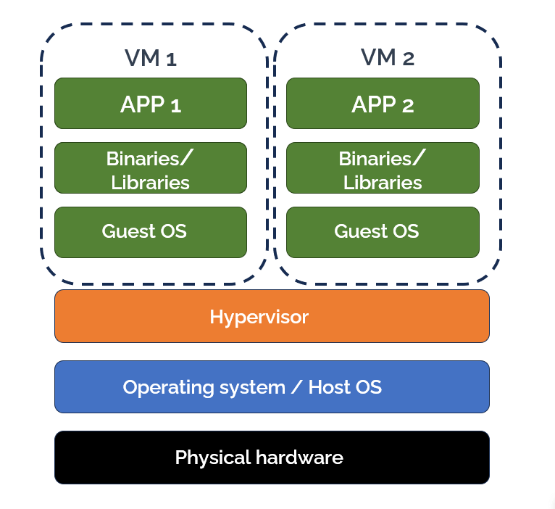
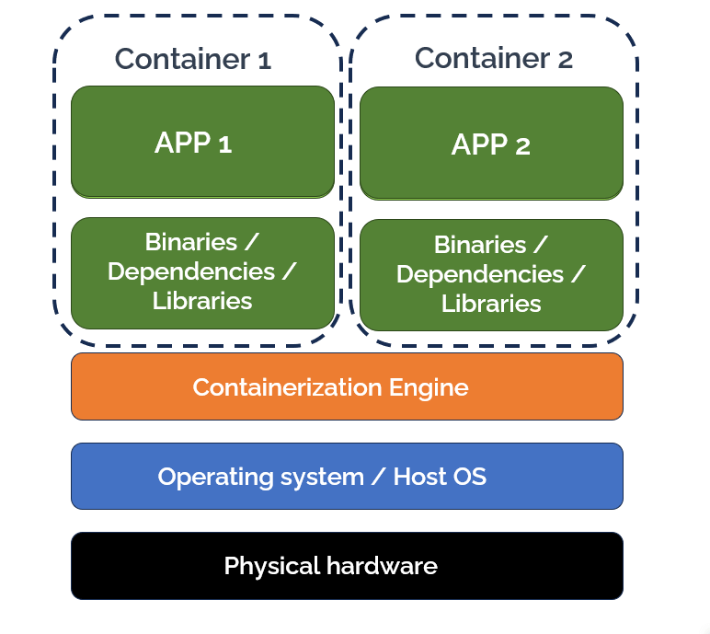
Virtualization vs Containerization

Slide 27
Virtualization vs Containerization
1. Resource Overhead
When comparing containerization vs virtualization in terms of resource overhead, containerization is the clear winner. Because containers share the host system’s operating system, and do not need to run a full operating system, they are significantly more lightweight and consume fewer resources. Virtual machines, on the other hand, each require their own OS, which increases the overhead, especially when many VMs are running on the same host system.
2. Startup Time
In general, containers start up more quickly than VMs, because they don’t have to start up an entire operating system. Virtual machines take much longer to boot up. This means containers are more flexible and can be torn down and restarted whenever needed, supporting immutability, which means that a resource never changes after being deployed.

Slide 28
Virtualization vs Containerization
3. Portability
Both containers and virtual machines offer a high degree of portability. However, containers have a slight edge because they package the application and all of its dependencies together into a single unit, which can be run on any system that supports the container platform. Virtual machines, while also portable, are more dependent on the underlying hardware.
4. Security Isolation
In terms of security isolation, virtual machines have the advantage. Because each VM is completely isolated from the host system and other VMs, a security breach in one VM typically does not affect the others (although it is possible to compromise the hypervisor and take control of all VMs on the device). Containers, while isolated from each other, still share the host system’s OS, so a breach in one container could possibly leak to other containers.

Slide 29
Virtualization vs Containerization
5. Scalability and Management
The lightweight nature and rapid startup time offered by containers make them ideal for scaling applications quickly and efficiently. They also lend themselves well to the microservices architecture, which can simplify the management of complex applications. Virtual machines, while also scalable, are more resource-intensive and take longer to start, making them less suitable for microservices and distributed applications.

Slide 30
Monolithic Architecture
Application Architectures
A monolithic architecture is a single, unified application where all the components and functionalities are tightly integrated into one cohesive unit. It runs as a single process, and all its parts are interdependent.
Characteristics:
Single Codebase: All components, such as the user interface (UI), business logic, and data access layers, are part of one codebase.
Tightly Coupled: Any change to one part of the system may require redeploying the entire application.
Centralized Database: Often relies on a single database for all operations.
Advantages:
Simplicity: Easier to develop and test initially due to its single codebase.
Performance: Can be faster since components communicate directly within the application.
Deployment: Requires only one deployment process for the entire application.
Challenges:
Scalability: Difficult to scale individual components independently.
Maintenance: Becomes cumbersome as the application grows in size and complexity.
Downtime: Any changes require redeploying the whole system, leading to potential downtime.
Example:
A traditional e-commerce application where the catalog, user authentication, order processing, and payment gateway are all part of a single application.

Slide 31
3-Tier Architecture
3-Tier architecture is a layered approach that divides the application into three distinct layers:
Presentation Layer: The user interface that interacts with end-users.
Business Logic Layer: Contains the rules and operations of the application (calculations, etc.).
Data Layer: Handles data storage, retrieval, and management.
Characteristics:
Separation of Concerns: Each layer is responsible for a specific function, making it modular.
Advantages:
Modularity: Easy to maintain and update individual layers without affecting others.
Scalability: Layers can be scaled independently, especially the data and business logic layers.
Flexibility: Supports integration with other systems via APIs or middleware..
Challenges:
Complexity: Slightly more complex than monolithic architectures to design and implement.
Latency: Communication between layers can introduce latency.
Deployment: Requires managing multiple components..
Example:
A banking application where: The presentation layer is a mobile app.
The business logic layer contains rules for transaction validation.
The data layer is a secure database storing user accounts and balances.

Slide 32
Microservices Architecture
Microservices architecture breaks down an application into a collection of small, independent, and loosely coupled services. Each service is designed to handle a specific business capability and can be developed, deployed, and scaled independently.
Characteristics:
Decoupled Services: Each service runs in its own process and communicates via lightweight APIs.
Polyglot Programming: Different services can use different programming languages, databases, or frameworks.
Independent Deployment: Changes to one service don’t require redeploying the entire application.
Advantages:
Scalability: Individual services can be scaled as needed.
Resilience: Failure in one service doesn’t affect the entire system.
Faster Development: Teams can work on services independently, speeding up development cycles.
Challenges:
Complexity: Managing many services can be challenging, especially communication and coordination.
Latency: Services communicate over a network, which may introduce latency.
Monitoring: Requires robust monitoring and logging for troubleshooting.
Example:
A modern e-commerce platform where:
The user service handles authentication and user profiles.
The catalog service manages product listings.
The order service processes orders and payments. Each of these services is an independent microservice, often deployed in containers like Docker.

Slide 33
Deployment Models
A cloud deployment model essentially defines where the infrastructure for your deployment resides and determines who has ownership and control over that infrastructure. It also determines the cloud’s nature and purpose. Types of Cloud Deployment Models
Public Cloud
Private Cloud
Hybrid Cloud
Multi-Cloud

Slide 34
Deployment Models
Public Cloud Model
Public cloud is a commonly adopted cloud model, where the cloud services provider owns the infrastructure and openly provides access to it for the public to consume.
As the service provider owns the hardware and supporting networking infrastructure, it is under the service provider’s full control. The service provider is responsible for the physical security, maintenance, and management of the data center where the infrastructure resides. The underlying infrastructure is, therefore, outside of the customer’s control and also away from the customer’s physical location.
Examples: Microsoft Azure, Amazon AWS, Google Cloud, Oracle Cloud. Advantages of the Public Cloud Model
Low initial capital cost (Move from Capex to Opex)
High Flexibility
High (almost unlimited) scalability
High Reliability
Low maintenance costs
Disadvantages of the Public Cloud Model
Data security concerns for strictly regulated businesses

Slide 35
Deployment Models
Private Cloud Model
A private cloud can be thought of as an environment that is fully owned and managed by a single tenant. This option is usually chosen to alleviate any data security concerns that might exist with the public cloud offering. Any strict cloud governance requirements can also be more easily adhered to, and the private cloud can be more easily customized.
Full control of the hardware can lead to higher performance. A customer will typically run a private cloud within their own building (on-premises) or purchase rack space in a data center in which to host their infrastructure.
However, the responsibility to manage the infrastructure also falls to the customer, creating a need for more staff with wider skills and increasing costs.
Examples: On-premises data centers using OpenStack or VMware. Advantages of the Private Cloud Model
Increased security and control
Dedicated hardware may improve performance
High flexibility
Disadvantages of the Private Cloud Model
High cost
Higher management overhead

Slide 36
Deployment Models
Hybrid Cloud Model
The hybrid model combines both public and private cloud deployment models giving a single cloud infrastructure that is aimed at increasing flexibility and deployment options for the business.
For example, applications with strict governance and data security requirements may be hosted in the business private cloud, whereas applications without these concerns, which need to be scaled on demand, could be hosted in the public cloud.
Examples: Using a private cloud for sensitive data and a public cloud for other operations. Advantages of the Hybrid Cloud
Improved scalability
High control
Highly scalable
High fault tolerance
Cost-effective
Disadvantages of the Hybrid Cloud
Setup challenges
High management overhead

Slide 37
Deployment Models
Multi-Cloud Model
nearly 90% of companies are now considered multi-cloud, meaning they combine cloud services from at least two different cloud service providers, whether public or private. Adopting a multi-cloud approach gives you greater flexibility to choose the solutions that best suit your specific business needs, and also reduces the risk of vendor lock-in.

Slide 38
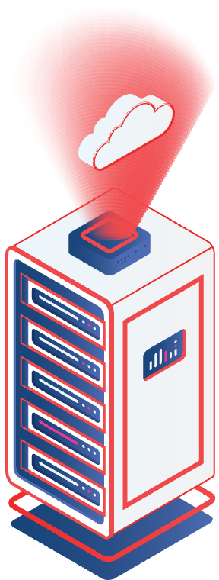
Service Models
Infrastructure as a Service (IaaS)
What It Offers:
Virtualized computing resources like virtual machines (VMs), storage, and networks.
Users control the operating system and applications.
Features:
Full control over the operating system and runtime.
Ideal for businesses needing customizable environments.
Requires technical expertise to manage.
Examples:
AWS EC2 (Elastic Compute Cloud)
Google Compute Engine
Azure Virtual Machines
Use Cases:
Hosting a website or application with custom configurations.
Disaster recovery and backup solutions.

Slide 39
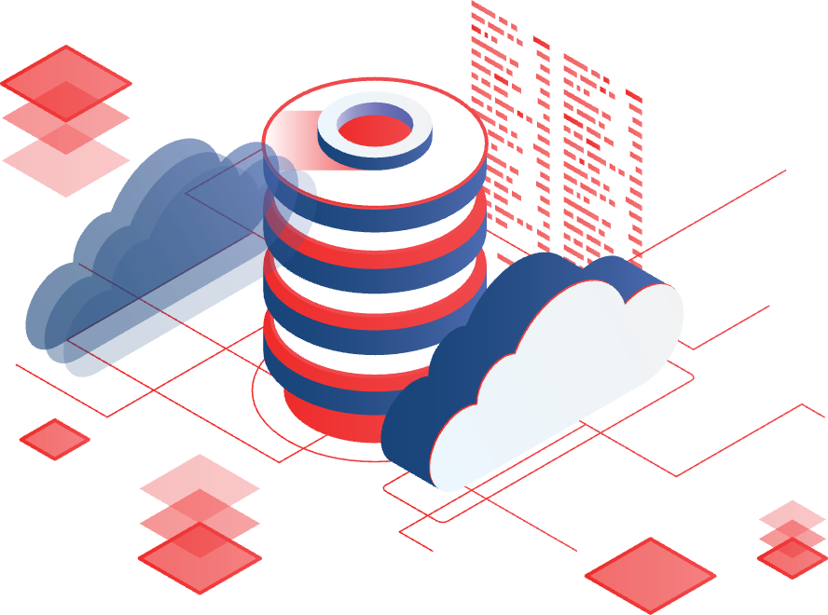
Service Models
Platform as a Service (PaaS)
What It Offers:
A complete development and deployment environment, abstracting infrastructure complexities. Provides tools, libraries, and frameworks for developers..
Features:
Developers focus only on coding and deploying applications. Middleware and runtime are preconfigured.
Lower operational overhead compared to IaaS.
Examples:
AWS Elastic Beanstalk Google App Engine Microsoft Azure App Service.
Use Cases:
Developing mobile apps quickly. Building e-commerce platforms.

Slide 40
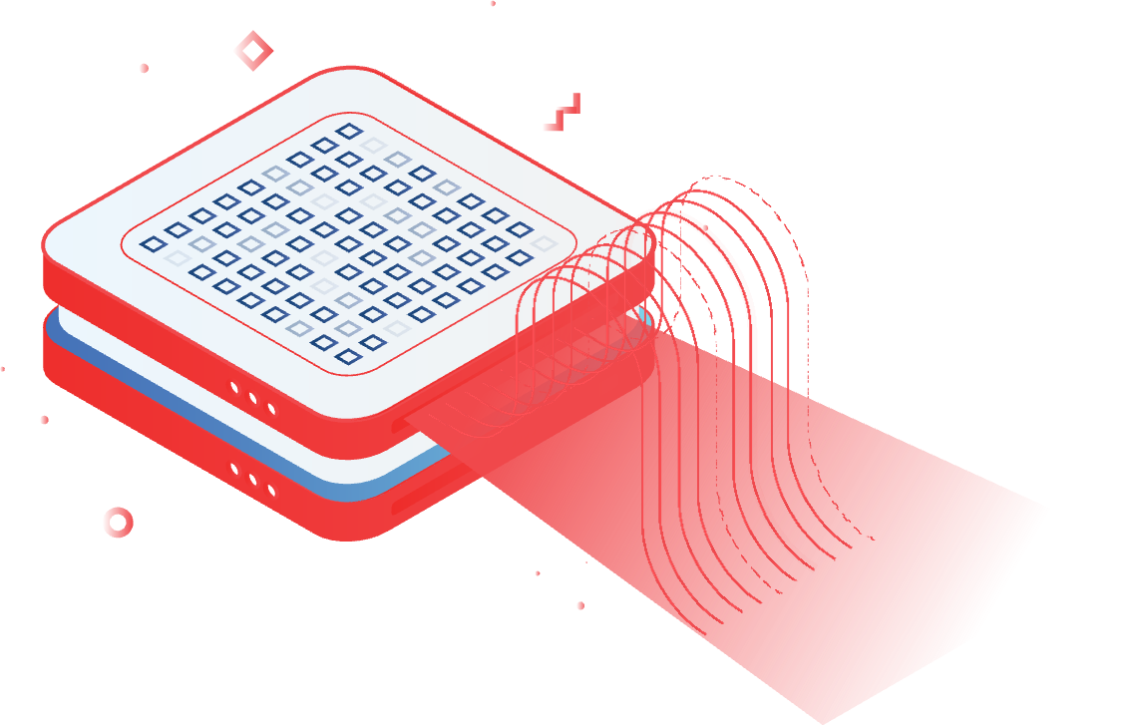
Service Models
Software as a Service (SaaS)
What It Offers:
Ready-to-use software applications accessible over the internet. No installation or management of underlying infrastructure.
Features:
Fully managed by the service provider. Accessible through web browsers or lightweight client software. Subscription-based pricing models.
Examples:
Google Workspace (formerly G Suite): Gmail, Google Docs, Sheets, etc. Microsoft Office 365: Cloud-based Word, Excel, PowerPoint.
Use Cases:
Collaborative work (e.g., Google Docs). Communication (e.g., Zoom, Slack).

Slide 41
Service Models
A simple analogy to help remember the difference between IaaS, PaaS, SaaS, and serverless is to think of the models like eating a cake. You could make your own from scratch (on-premises data center), where you buy all the basic ingredients to make everything like the flour and milk. However, most of us generally don’t have enough time or don’t want to spend so much time and effort to eat a cake. Instead, you might choose from the following options instead: IaaS: Buying pre-packed ingredients like fresh milk and flour made by someone else that you use to cook at home.
PaaS: Order takeout or delivery where your cake is prepared for you and you don’t have to worry about the ingredients or how you’ll bake it, but you have to worry about the final look of the cake in terms of garnishing and customizing the final look,
SaaS: Call ahead to the bakery and order the exact cake you want. They prepare everything ahead of time for you so that all you have to do is show up and eat.

Slide 42
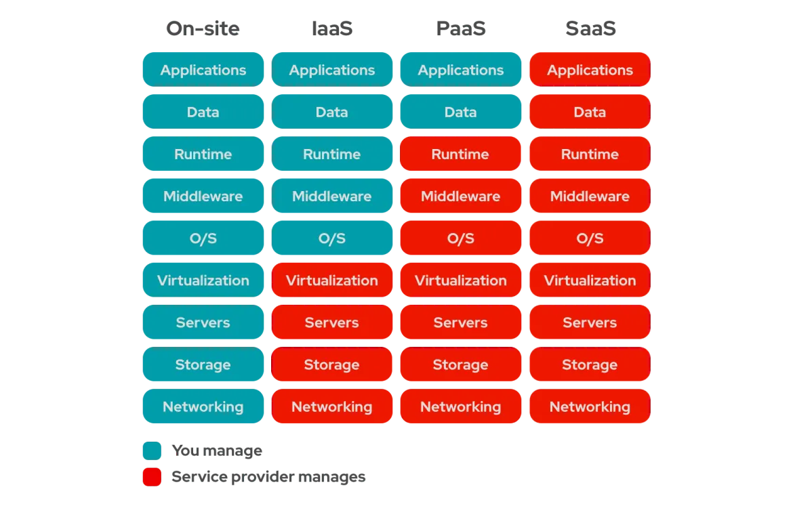
On-premise
IaaS
PaaS
SaaS
You manage
CSP manages

Slide 43
Middleware
Middleware is software that acts as a bridge between different applications, systems, or components. It enables communication, data exchange, and functionality between separate or incompatible systems.
Role of Middleware
Middleware typically sits between the operating system and the application. It provides services such as messaging, authentication, and database access that are not provided by the operating system itself.
Examples of Middleware
Database Middleware:
Connects applications to databases.
Example: JDBC (Java Database Connectivity) for Java applications to interact with databases like MySQL or PostgreSQL.
Message-Oriented Middleware (MOM):
Enables asynchronous communication between distributed systems.
Example: Apache Kafka, RabbitMQ.
API Gateways:
Manage API requests and responses in a scalable and secure manner.
Example: AWS API Gateway.
Web Servers:
Act as middleware between client-side requests (via browsers) and the backend.
Example: Apache HTTP Server, Nginx.

Slide 44
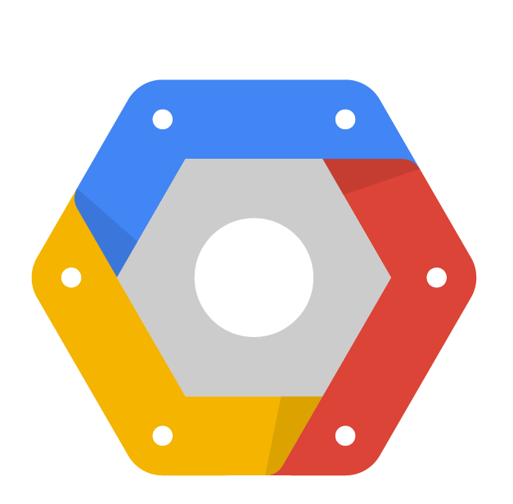
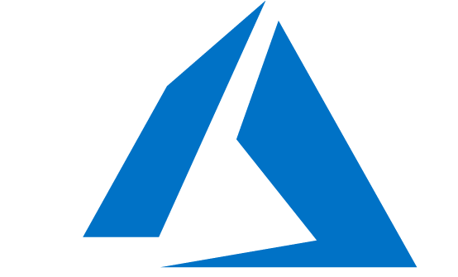

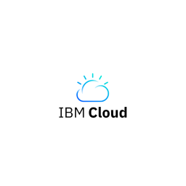
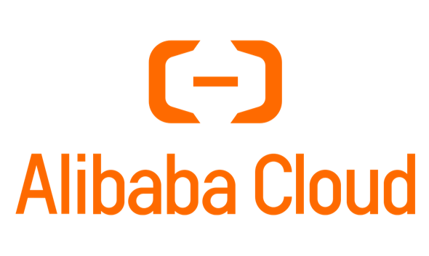
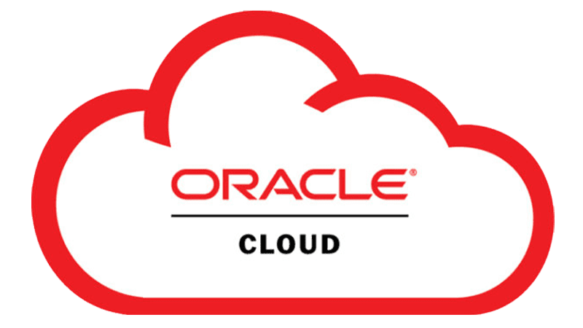
Cloud Service Providers (CSPs)
Microsoft Azure
Google Cloud Platform

Slide 45
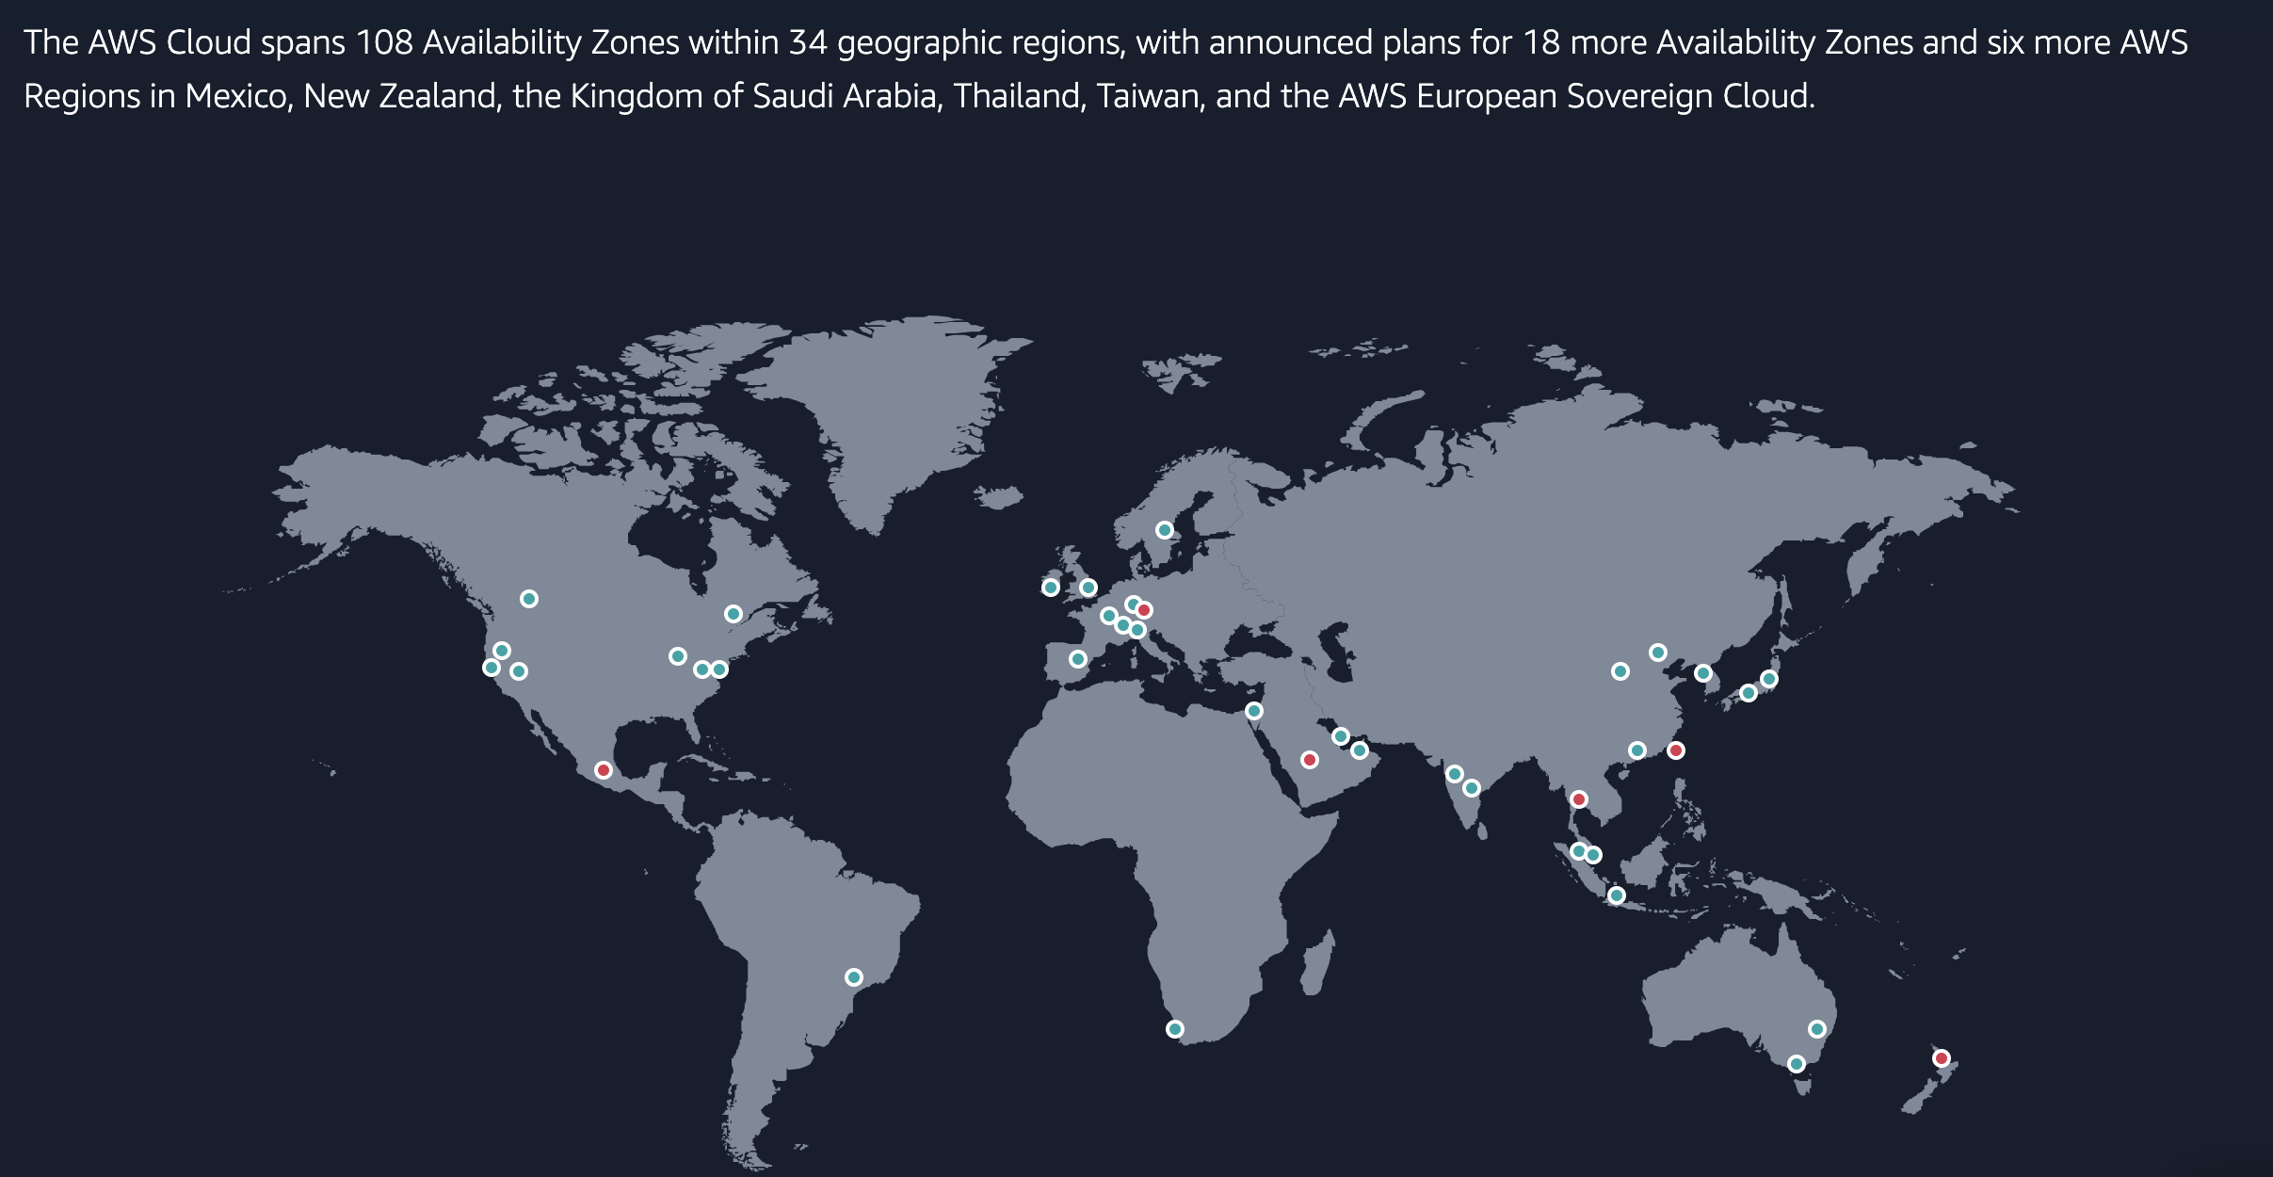

AWS

Slide 46
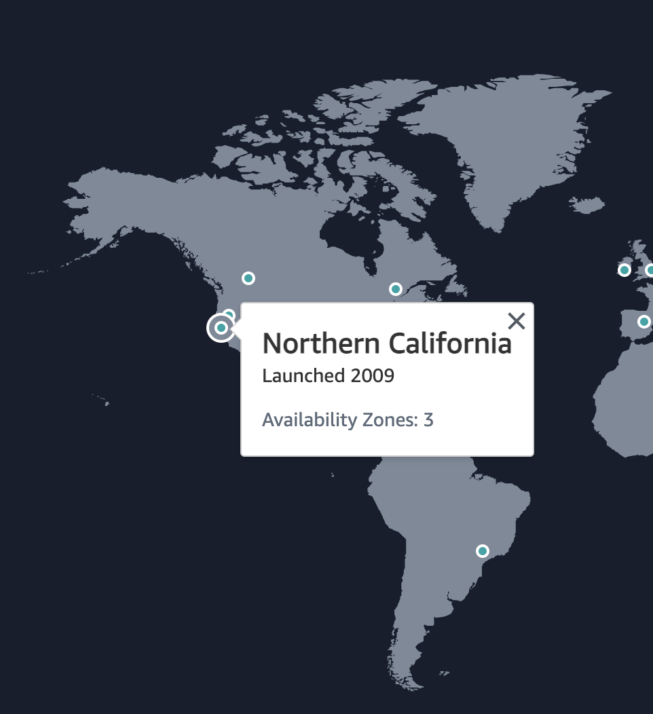
AWS Infrastructure
AWS Regions
A region is a geographically isolated location where AWS has data centers. Each region is independent and consists of multiple Availability Zones.
Why Regions Exist:
Proximity to Customers: Regions allow you to run applications closer to your users, reducing latency.
Compliance: Some regions meet specific legal or regulatory requirements for data residency.
Disaster Recovery: By spreading workloads across regions, businesses can recover faster in case of a region-wide outage.
Examples of Regions:
us-east-1 (North Virginia, USA)
eu-west-1 (Ireland)
ap-southeast-1 (Singapore)

Slide 47
AWS Infrastructure
Availability Zones (AZs)
An Availability Zone is a distinct physical location within a region. Each AZ has its own power, cooling, and networking to ensure independence. Each region has at least 2 AZs
Why Multiple AZs Exist:
High Availability: Distributing workloads across multiple AZs ensures that even if one AZ fails (e.g., due to a natural disaster), others remain operational.
Fault Tolerance: AZs are isolated from failures in other AZs but are connected through low-latency links for high-speed communication.
Key Properties of AZs:
At least two AZs exist in every AWS region.
They are connected using high-speed, fiber-optic networking.
Examples: A region like us-east-1 may have AZs named us-east-1a, us-east-1b, us-east-1c, and so on.

Slide 48
AWS Key concepts
High Availability (HA)
Fault Tolerance (FT)
Disaster Recovery (DR)

Slide 49
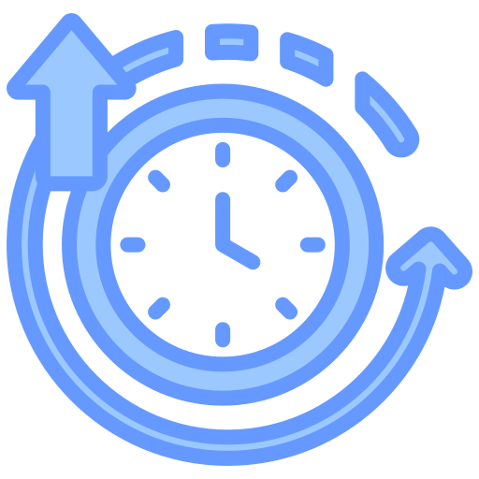
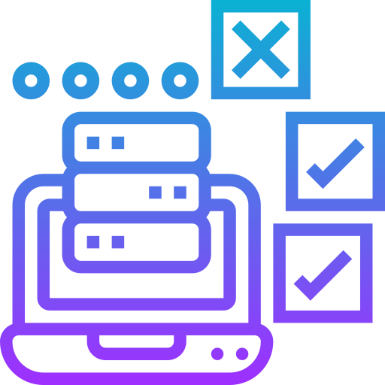
AWS Key concepts
High Availability (HA)
High Availability refers to a system's ability to remain operational and accessible for a very high percentage of time. It aims to minimize downtime, ensuring services are continuously available to users.
Measured as a percentage of uptime (e.g., 99.9% availability translates to ~8.76 hours of downtime annually).
Fault Tolerance (FT)
Disaster Recovery (DR)

Slide 50
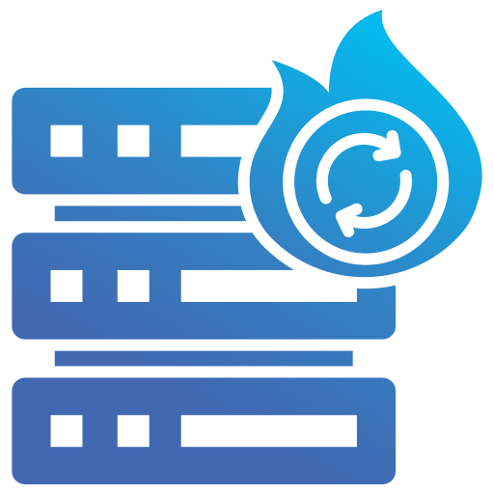
AWS Key concepts
High Availability (HA)
High Availability refers to a system's ability to remain operational and accessible for a very high percentage of time. It aims to minimize downtime, ensuring services are continuously available to users.
Measured as a percentage of uptime (e.g., 99.9% availability translates to ~8.76 hours of downtime annually).
Fault Tolerance (FT)
Fault Tolerance ensures that a system continues to operate without interruption even if one or more components fail. This involves building systems that can withstand failures seamlessly.
Disaster Recovery (DR)

Slide 51
AWS Key concepts
High Availability (HA)
High Availability refers to a system's ability to remain operational and accessible for a very high percentage of time. It aims to minimize downtime, ensuring services are continuously available to users.
Measured as a percentage of uptime (e.g., 99.9% availability translates to ~8.76 hours of downtime annually).
Fault Tolerance (FT)
Fault Tolerance ensures that a system continues to operate without interruption even if one or more components fail. This involves building systems that can withstand failures seamlessly.
Disaster Recovery (DR)
Disaster Recovery refers to the process and infrastructure set up to restore operations after a catastrophic event, such as data center failures, natural disasters, or cybersecurity incidents.

Slide 52

AWS Key Services
Identity and Access Management (IAM)
Purpose: Manage access to AWS services/resources securely.
Users: Individual accounts representing people or apps.
Groups: Collection of users sharing permissions.
Roles: Temporary access for AWS services or federated users.
Policies: JSON documents defining permissions (allow/deny actions).
Best Practices:
Enable MFA for users.
Use least privilege principles.

Slide 53
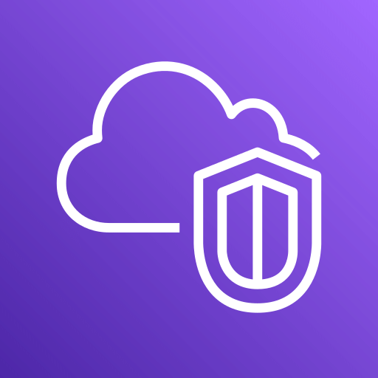
AWS Key Services
Virtual Private Cloud (VPC)
A VPC = (Can’t communicate)A Virtual Network inside AWS
﻿ ﻿A VPC is within 1 account & 1 region
﻿﻿ Private and Isolated unless you decide otherwise
﻿﻿ Two types - Default VPC and Custom VPCs
CIDR Block: Defines the range of IP addresses you can use within the VPC.
Subnets: (Can communicate) Divide your VPC into smaller sections:
Public Subnet: Directly accessible from the internet (e.g., for web servers).
Private Subnet: Hidden from the internet (e.g., for databases).
Internet Gateway: Allows resources in a public subnet to access the internet.
NAT Gateway: Allows resources in a private subnet to access the internet securely.

Slide 54
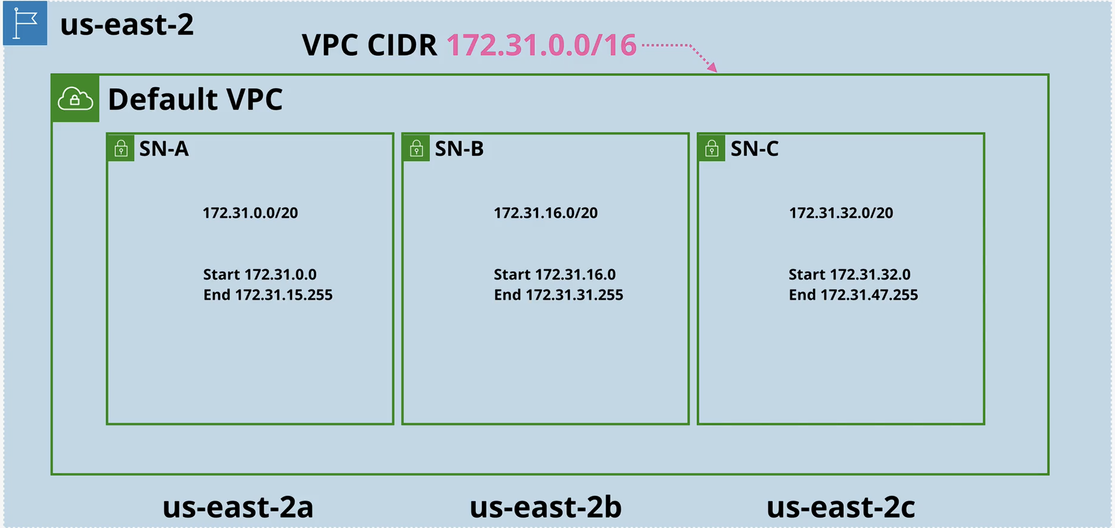
AWS Key Services
Virtual Private Cloud (VPC)

Slide 55
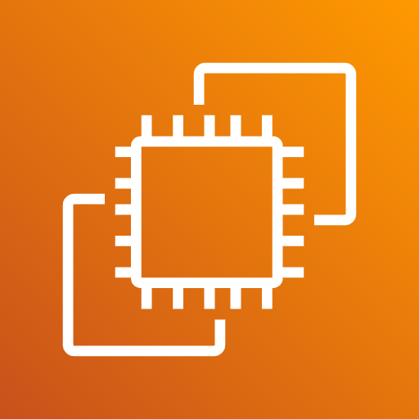
AWS Key Services
Elastic Compute Cloud (EC2)
Purpose: Scalable virtual servers for running applications.
Instances: Virtual machines with configurable CPU, memory, storage, and OS.
Key Features:
Elasticity: Scale up/down based on demand.
Instance Types: Choose from a variety of types.
Pricing Models: On-demand, Reserved.
Storage: Attach Elastic Block Store (EBS)
Networking: Public/Private subnets in VPC.
Assign Elastic IP for static public addresses.
Best Practices:
Use IAM Roles for access control.
Enable security groups for traffic filtering.
Automate configuration with user data.

Slide 56

Day 1 Assignment
Create a PDF explaining key AWS services
Instructions:
Content: Include the following sections:
IAM (Identity and Access Management)
VPC (Virtual Private Cloud)
EC2 (Elastic Compute Cloud)
DynamoDB (DDB)
Lambda
S3 (Simple Storage Service)
Submission:
Save the file as FirstName-LastName-AWS-DayOne.pdf
Upload the file to the Drive—create a folder
named after you to which only you and I have access
Deadline Today 13/12/2024 at 11:00 PM

Slide 57
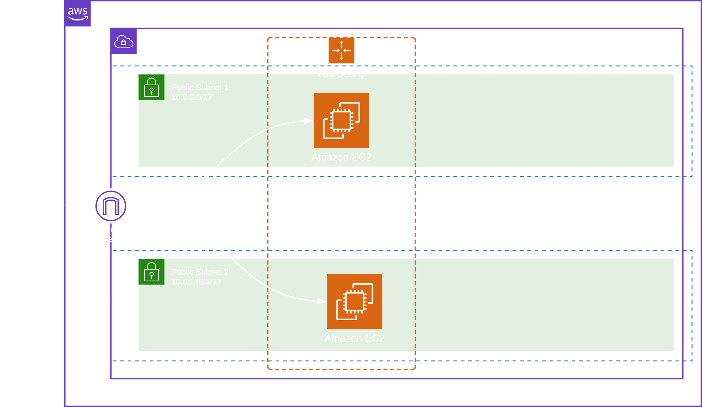
DEMO 1

Slide 58
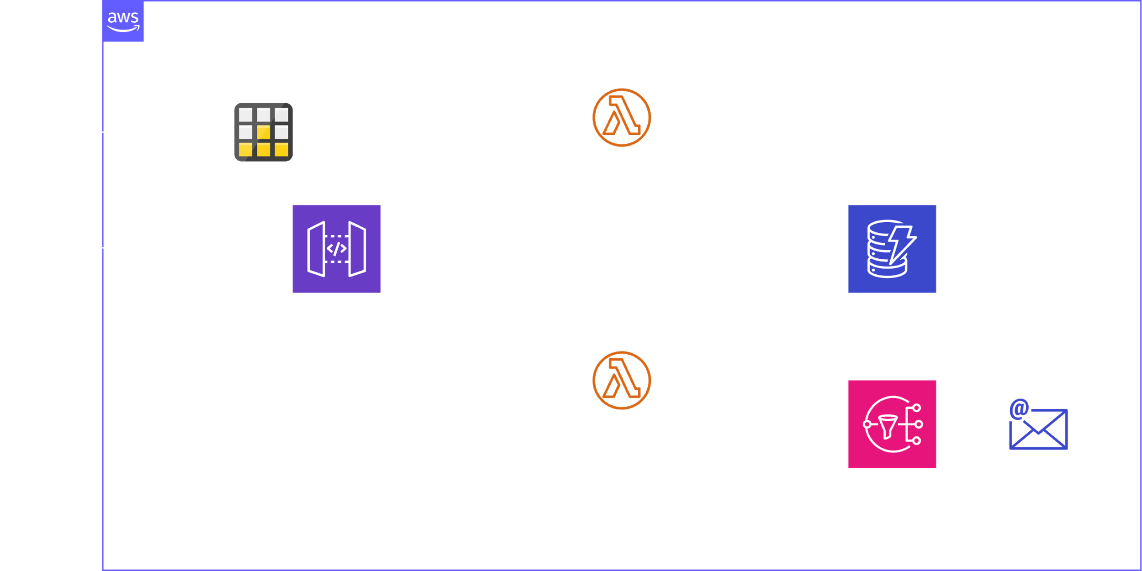
DEMO 2

