Slide 1
Lab1
HSV.
Noise.
Histogram.
Notes:
CMYK
Cyan, Magenta, Yellow, blacK

Slide 2
HSV

Slide 3
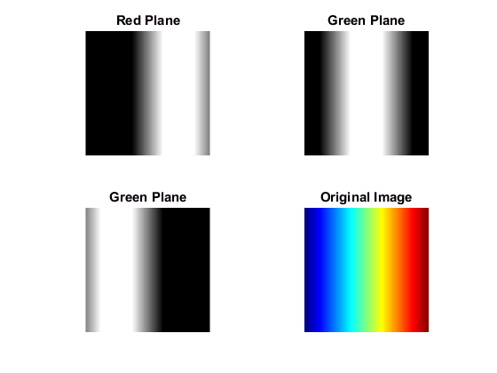
RGB Channels
Blue Plane

Slide 4
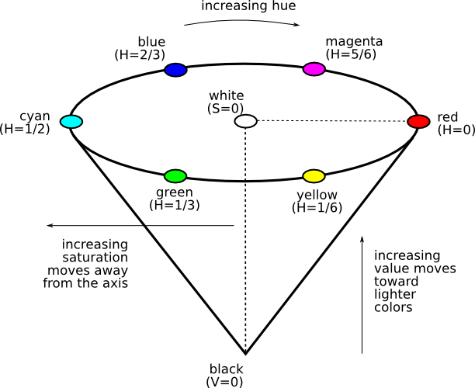
HSV

Slide 5
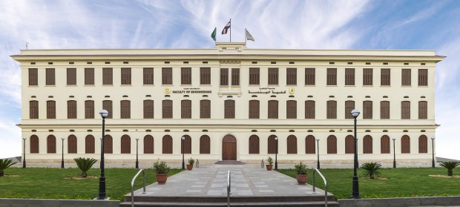
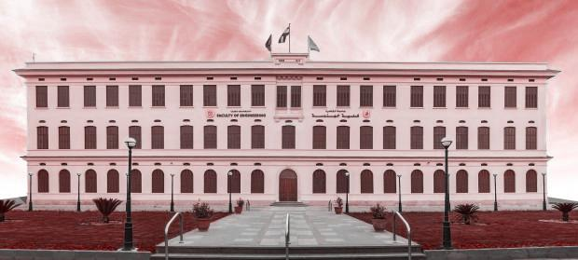
Hue
Notes:
The same Hue value for all pixels

Slide 6
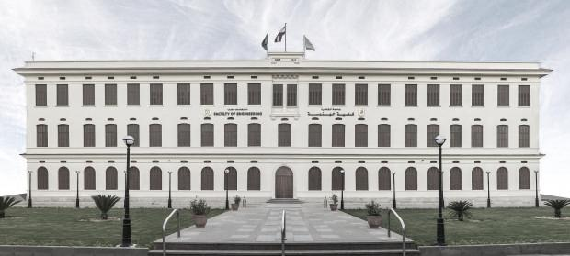
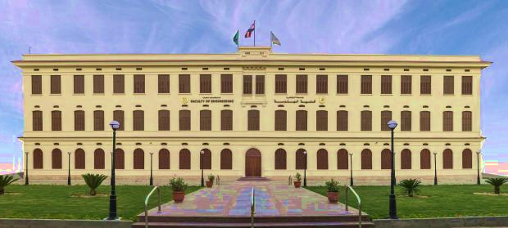
Saturation
Notes:
First image:

Slide 7
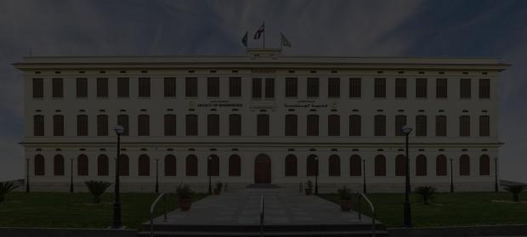
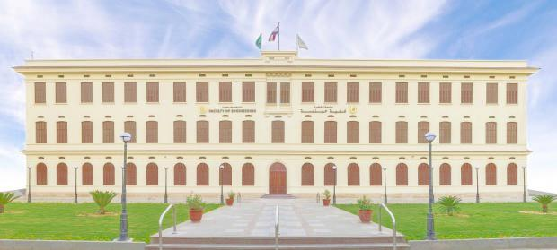
Value
Notes:
First image:

Slide 8
Req:
Show each channel alone.
What is the meaning of the result image?
Notes:
GS

Slide 9
Noise

Slide 10
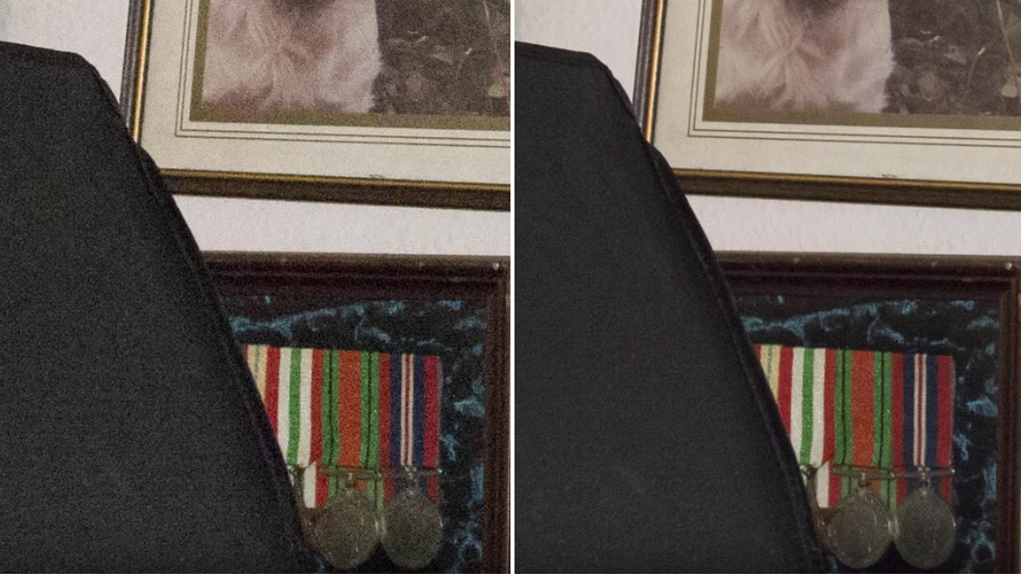
Noise

Slide 11
Req
Salt and pepper noise (ratio of pixels to affect).

Slide 12
Image Processing is different!!
Understand.
Quiz
Discussions.
Ask freely.
Grades is not the point!

