Slide 1

Machine Learning Workshop
With TensorFlow APIs

Slide 2
What is Machine Learning? Computer learning from data, without being explicitly programmed.

Slide 3
Why Machine Learning?
Reduce time programming (spelling corrector)
Customize and scale products (supporting other languages)
Do seemingly unprogrammable tasks (cat vs dog image)

Slide 4
Workshop Structure
Workshop Parts
Part 1: The Basics
Part 2: Optimizations
Content Based on Course: https://developers.google.com/machine-learning

Slide 5
The Basics
Terminology
Linear Regression
Loss

Slide 6
Terminology
Label: is what we're predicting
Feature: is an input variable
Example: is a particular instance of data
Labeled Example: (feature, label)
Unlabeled Example: (feature, ?)
Model: the relationship between features and label

Slide 7
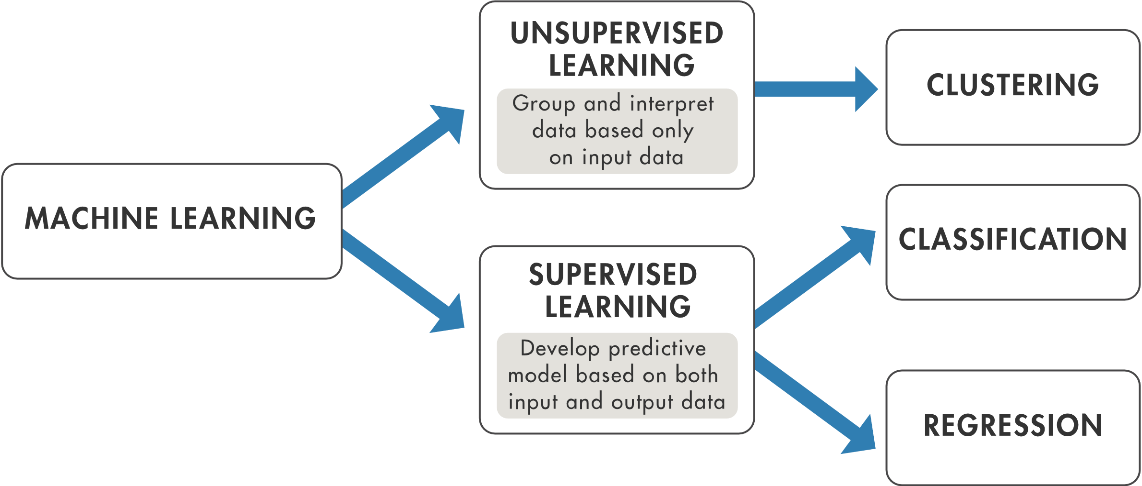
Types of Machine Learning

Slide 8
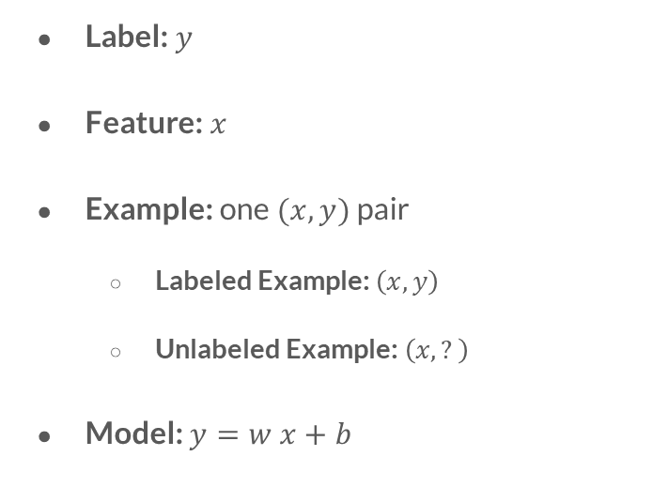
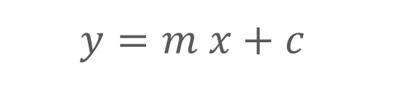
Linear Regression
Label: $y$
Feature: $x$
Example: one $(x, y)$ pair
Labeled Example: $\left(x, y\right)$
Unlabeled Example: $\left(x, ?\right)$
Model: $y=w x+b$
$$y=m x+c$$

Slide 9
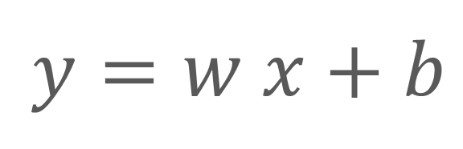
Model Represented in Linear Algebra
Feature
Label
$$y=w x+b$$
Weight
Bias

Slide 10
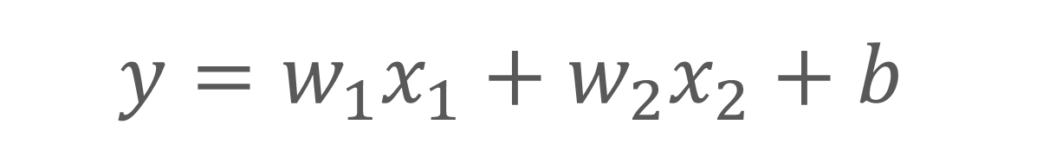
Model with Two Features
$$y=w_{1}x_{1}+w_{2}x_{2}+b$$
First Feature
Second Feature

Slide 11
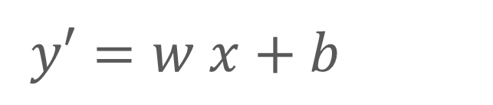
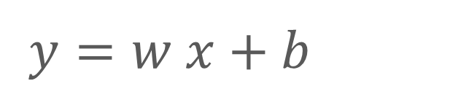
Model Training → Model Inference
$$y=w x+b$$
$$y′=w x+b$$
Actual Label
Predicted Label

Slide 12
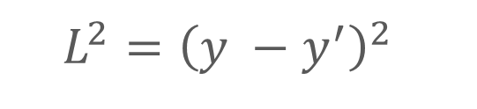
Loss
Squared loss: a popular loss function
The square of the difference between the label and the prediction
(observation - prediction)²
$$L^{2}={\left(y −y^{′}\right)}^{2}$$

Slide 13
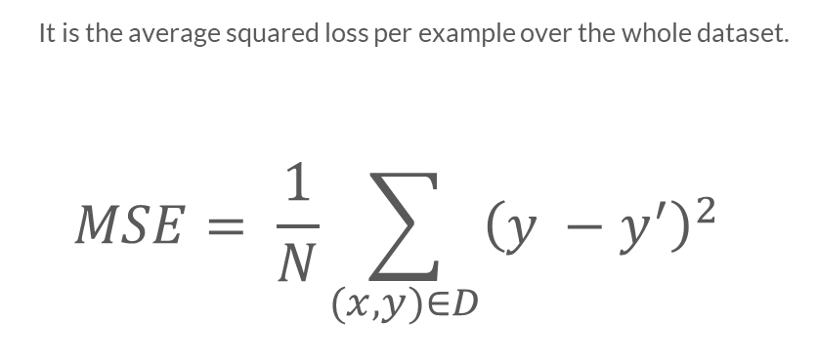
Mean square error (MSE)
It is the average squared loss per example over the whole dataset.
$$MSE= \frac{1}{N}\sum_{(x,y)∈D}{{\left(y −y^{′}\right)}^{2}}$$

Slide 14
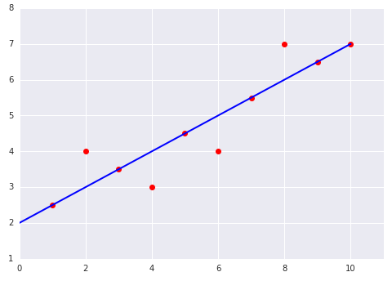
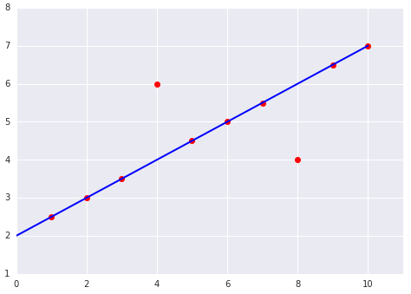
Which one has the higher Mean Squared Error?
(1)
(2)

Slide 15
The Goal
Structure
Train
Predict
Terminology
Linear Regressor
Loss & Error

Slide 16
Let’s Code! Go to: TFlab.ML

Slide 17
Optimization
Iterative Learning
Gradient Descent
Hyperparameters

Slide 18
Iterative Learning
1. Set initial values for weight and bias
2. Compute loss
3. Evaluate
4. Regenerate values for weight and bias
5. Repeat from step 2!
Avoids Processing All Data

Slide 19
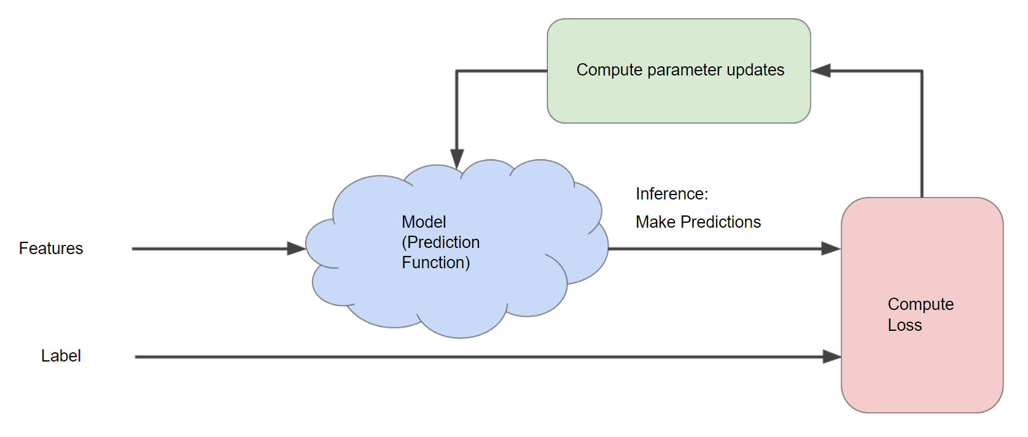
Diagram of an Iterative Approach to Training a Model

Slide 20
Gradient Descent
A vector which has:
Direction: of steepest loss increase
Magnitude: the further the larger
Negative Gradient

Slide 21
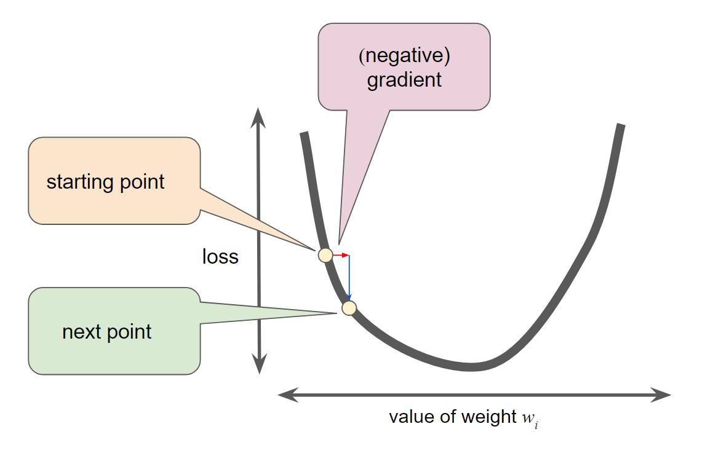
Gradient Step Moves to the Next Point on the Loss Curve

Slide 22
Hyperparameters
Steps: length of iteration
Batch Size: number of examples to train on (each step)
Learning Rate: controls gradient
Knobs of Model Training

Slide 23
Optimize Your Code Go to: TFlab.ML

Slide 24
Thank You! Code & Presentation are available here: https://github.com/OmarEinea/tf

