Slide 1

Machine Learning Workshop
With TensorFlow APIs

Slide 2
Why Machine Learning?
Reduce time programming (spelling corrector)
Customize and scale products (supporting other languages)
Do seemingly unprogrammable tasks (cat vs dog image)

Slide 3
Workshop Structure
Workshop Parts
Part 1: The Basics
Part 2: Optimizations
Content Based on Course: https://developers.google.com/machine-learning

Slide 4
The Basics
Terminology
Linear Regression
Loss

Slide 5
Terminology
Label: is what we're predicting
Feature: is an input variable
Example: is a particular instance of data
Labeled Example: (feature, label)
Unlabeled Example: (feature, ?)
Model: the relationship between features and label

Slide 6
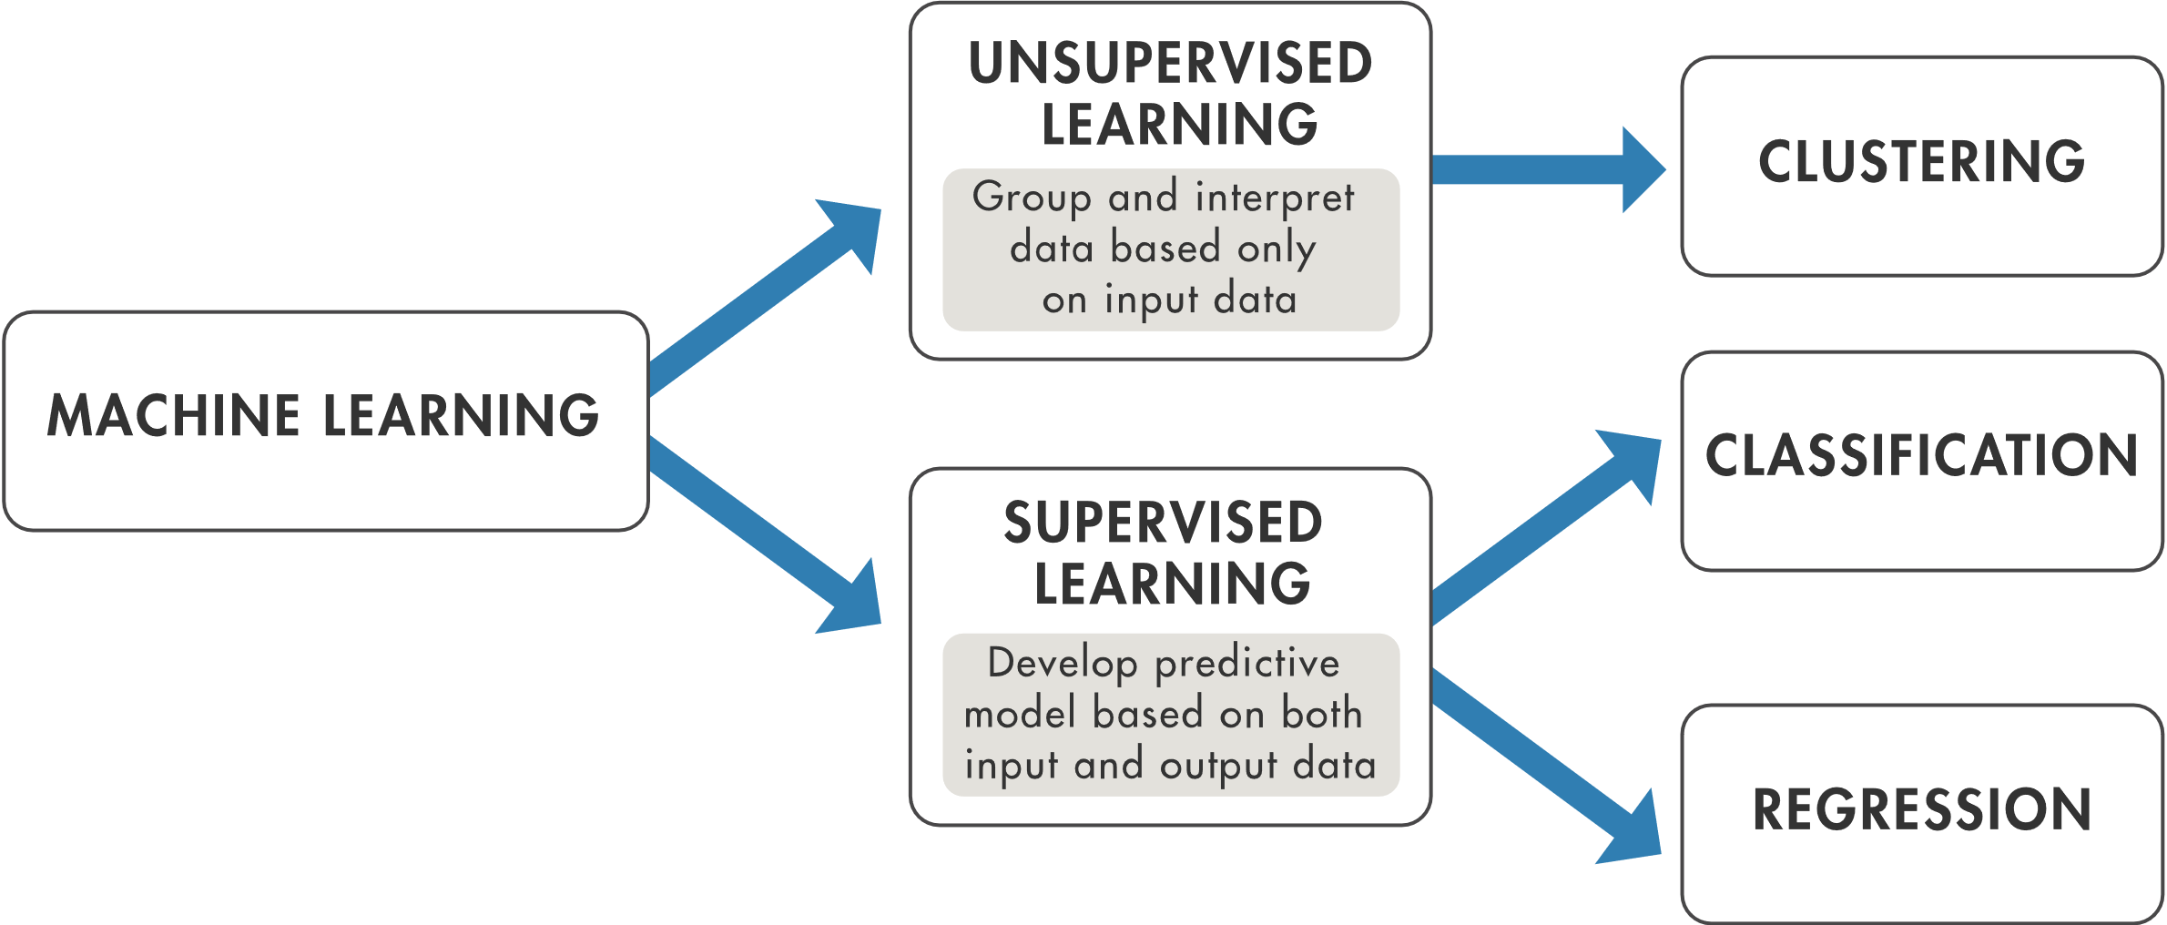
Types of Machine Learning

Slide 7
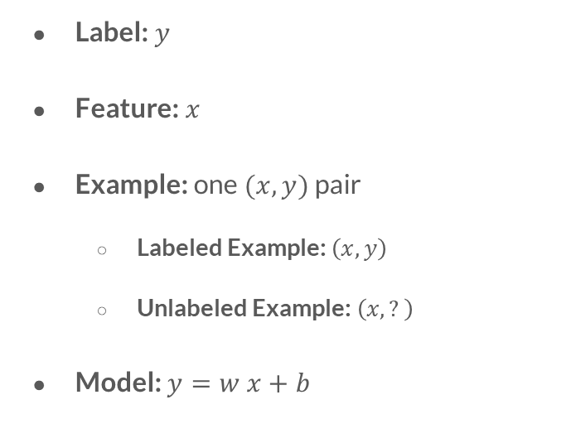
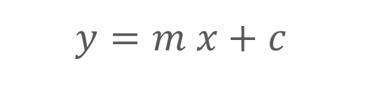
Linear Regression
Label: $y$
Feature: $x$
Example: one $(x, y)$ pair
Labeled Example: $\left(x, y\right)$
Unlabeled Example: $\left(x, ?\right)$
Model: $y=w x+b$
$$y=m x+c$$

Slide 8
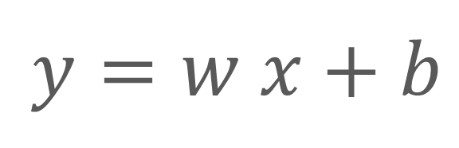
Model Represented in Linear Algebra
Feature
Label
$$y=w x+b$$
Weight
Bias

Slide 9
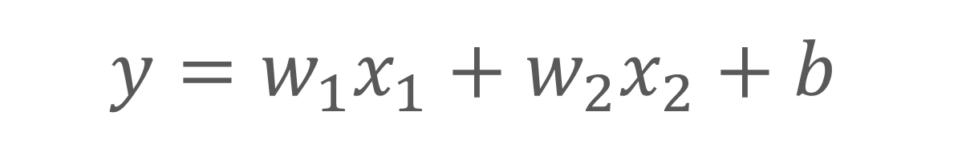
Model with Two Features
$$y=w_{1}x_{1}+w_{2}x_{2}+b$$
First Feature
Second Feature

Slide 10
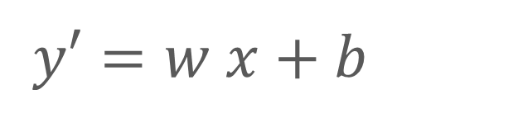
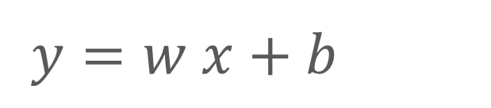
Model Training → Model Inference
$$y=w x+b$$
$$y′=w x+b$$
Actual Label
Predicted Label

Slide 11
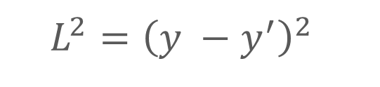
Loss
Squared loss: a popular loss function
The square of the difference between the label and the prediction
(observation - prediction)²
$$L^{2}={\left(y −y^{′}\right)}^{2}$$

Slide 12
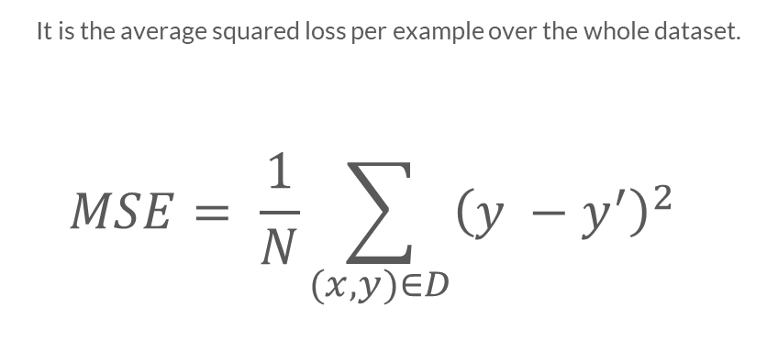
Mean square error (MSE)
It is the average squared loss per example over the whole dataset.
$$MSE= \frac{1}{N}\sum_{(x,y)∈D}{{\left(y −y^{′}\right)}^{2}}$$

Slide 13
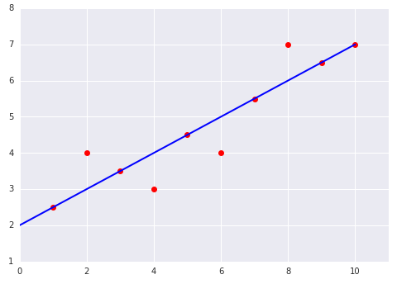
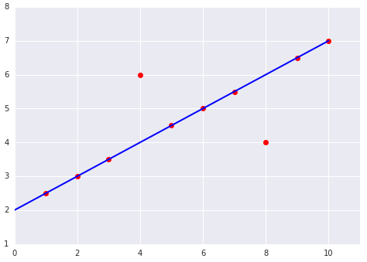
Which one has the higher Mean Squared Error?
(1)
(2)

Slide 14
Let’s Code! Go to: TFlab.ML

Slide 15
Optimization
Iterative Learning
Gradient Descent
Hyperparameters

Slide 16
Iterative Learning
1. Set initial values for weight and bias
2. Compute loss
3. Evaluate
4. Regenerate values for weight and bias
5. Repeat from step 2!
Avoids Processing All Data

Slide 17
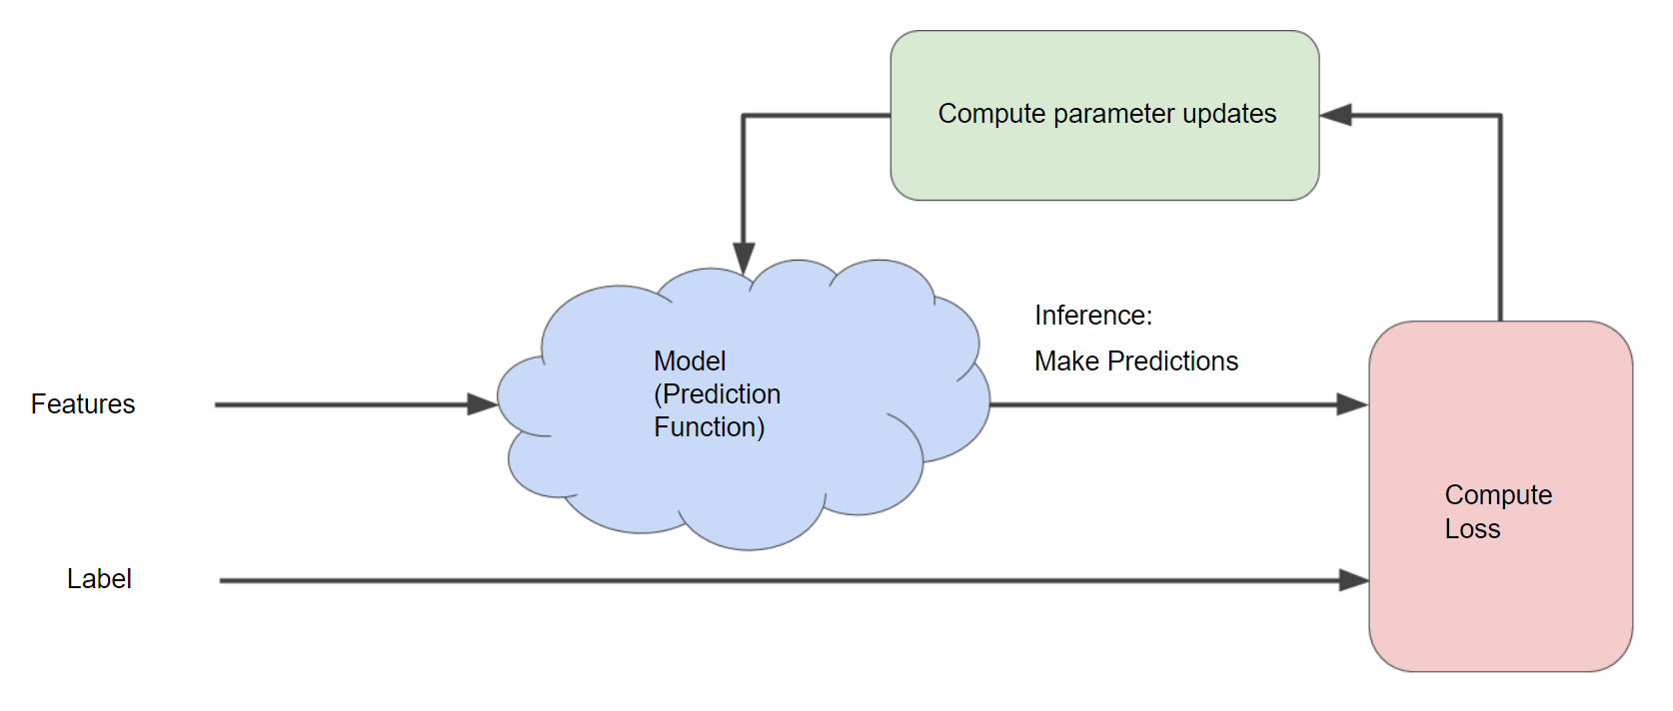
Diagram of an Iterative Approach to Training a Model

Slide 18
Gradient Descent
A vector which has:
Direction: of steepest loss increase
Magnitude: the further the larger
Negative Gradient

Slide 19
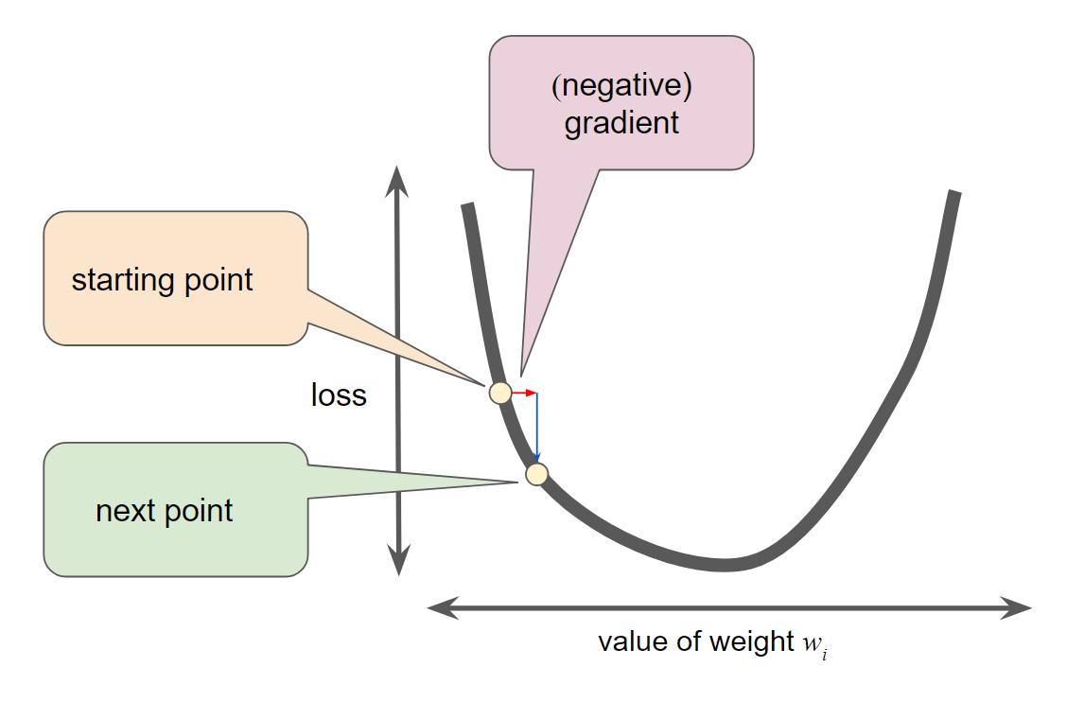
Gradient Step Moves to the Next Point on the Loss Curve

Slide 20
Hyperparameters
Learning Rate: controls gradient
Repeat: number of training cycles
Steps: length of iteration (i++, i+=2)
Batch Size: number of examples to train on (each step)
Knobs of Model Training

Slide 21
Optimize Your Code Go to: TFlab.ML

