Slide 1
Machine Learning
Hassan ElMasry 52-2481
Omar ElZaher 52-1672
Fares Ebiede 52-7897
Karim Essam 52-1434
Bashar Menissy 52-2382

Slide 2
Motivation
The number of unsettled loans over the past few years have been significantly increasing.
Banks and financial instiutions are using ML algorithms to better improve the decision making behind the loan approval decisioning.
This projects main aim is to tackle this problem using different models and decide which model fixes the problem better.

Slide 3
Agenda
1- Dataset
2- Pre cleaning Visulization
3- Data Cleaning
4- After cleaning Visulization
5- Feature Selection
6- K-Means Clustering
7- Hierarichal Clustering
8- Logistic Regression
9- Decision Tree
10- Random Forrest
11- Model Comparison

Slide 4
Dataset
Loan Approval Prediction Dataset
Binary Classification task for the Loan Status Column (Approved or Rejected)
Contains 13 Features and 4269 Instances
Integer Features: loan_id, no_of_dependents, income_annum, loan_amount, loan_term, cibil_score, residential_assets_value, commercial_assets_value, luxury_assets_value, bank_asset_value
Object Features: education, self_employed, loan_status
The Target is the loan status which has 2656 Approvals and 1613 Rejections

Slide 5
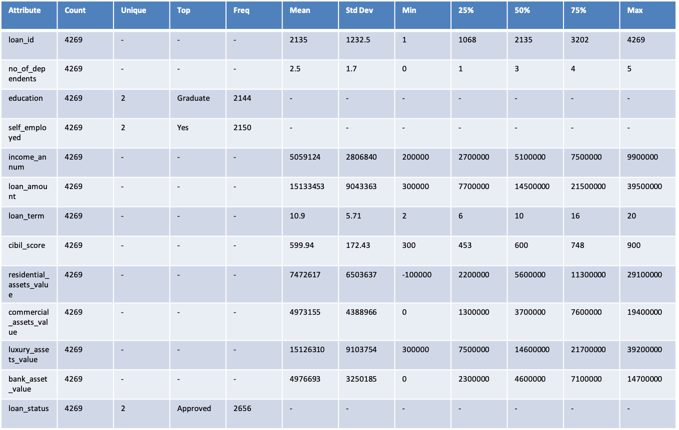
Dataset: Descriptive statistics

Slide 6
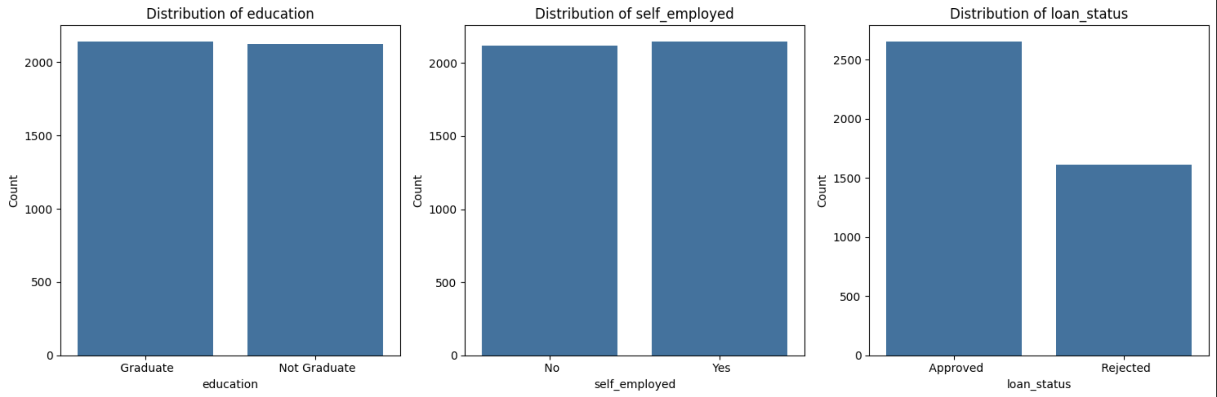
Pre cleaning visulization: categorcal

Slide 7
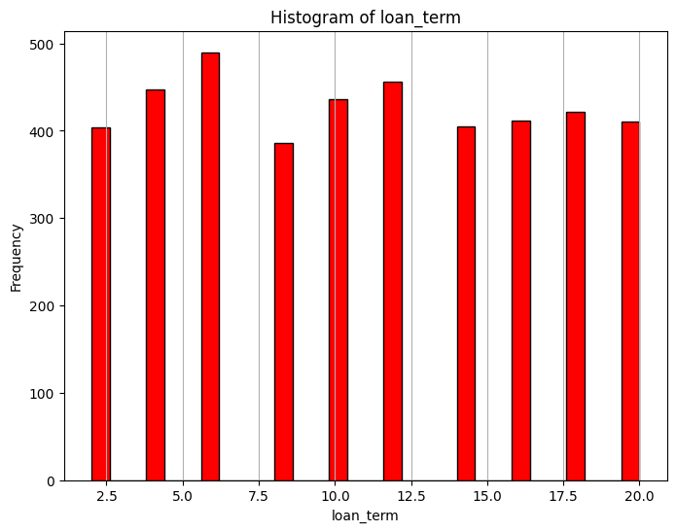
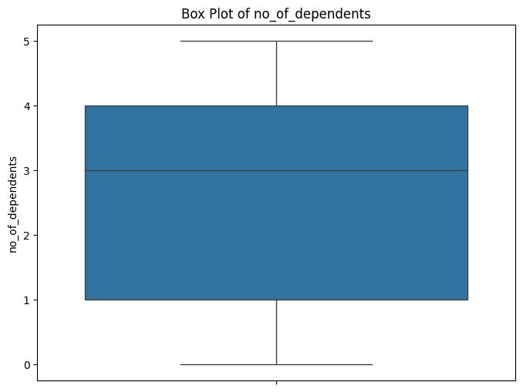
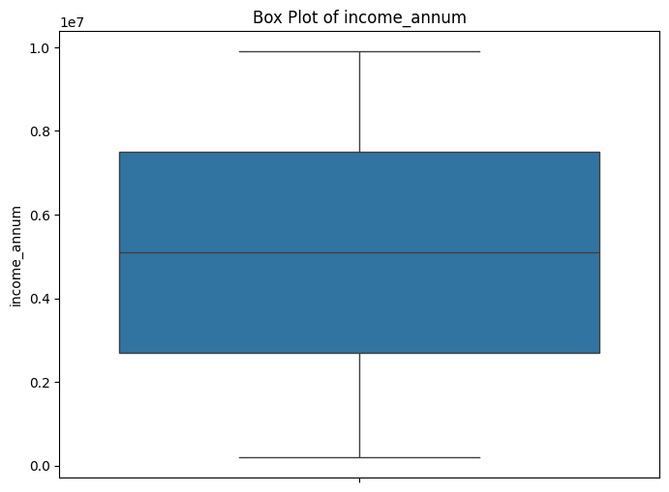
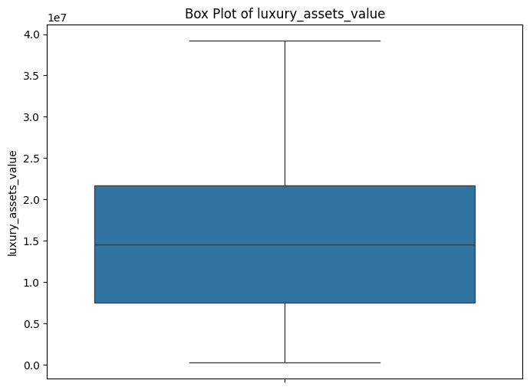
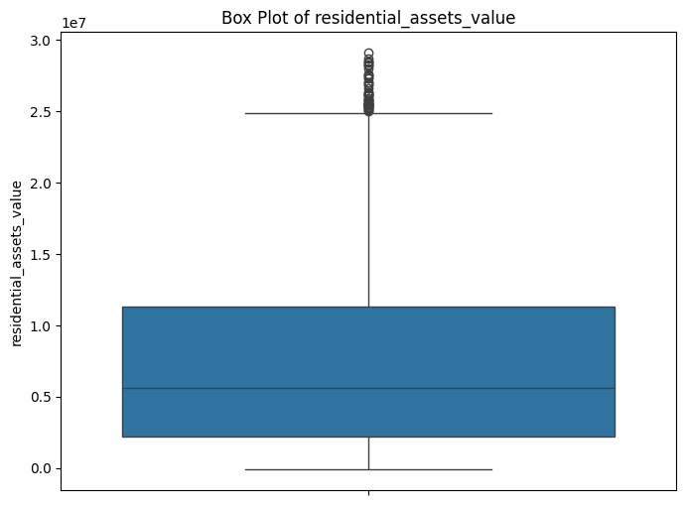
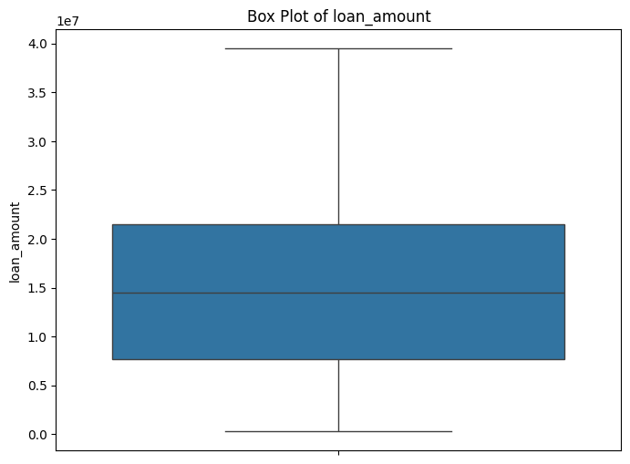
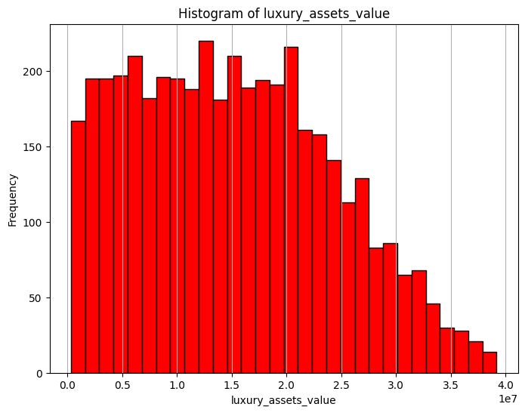
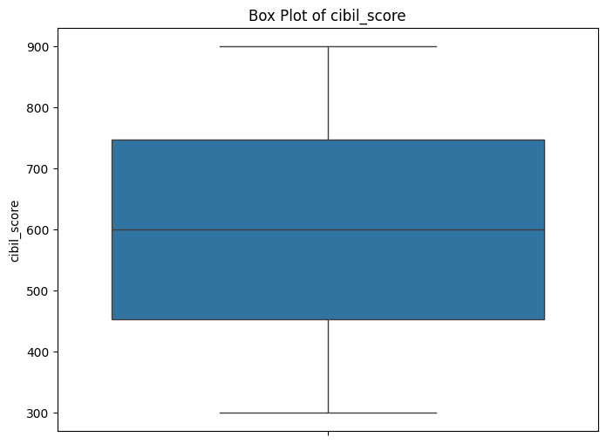
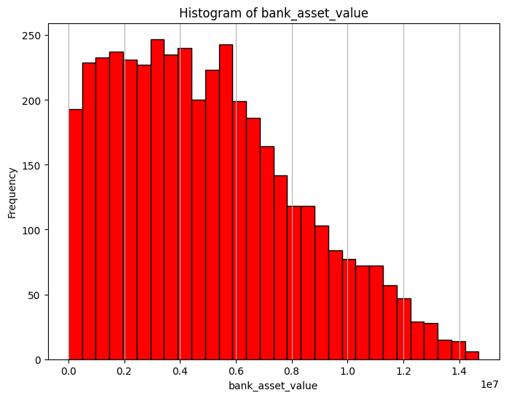
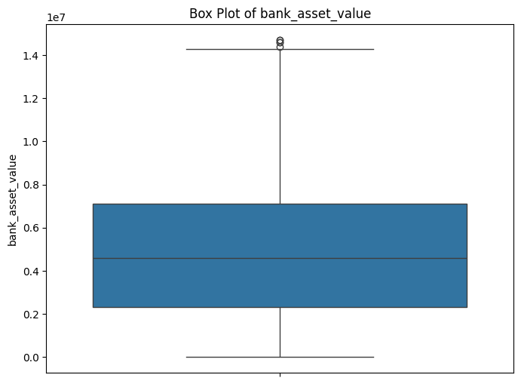
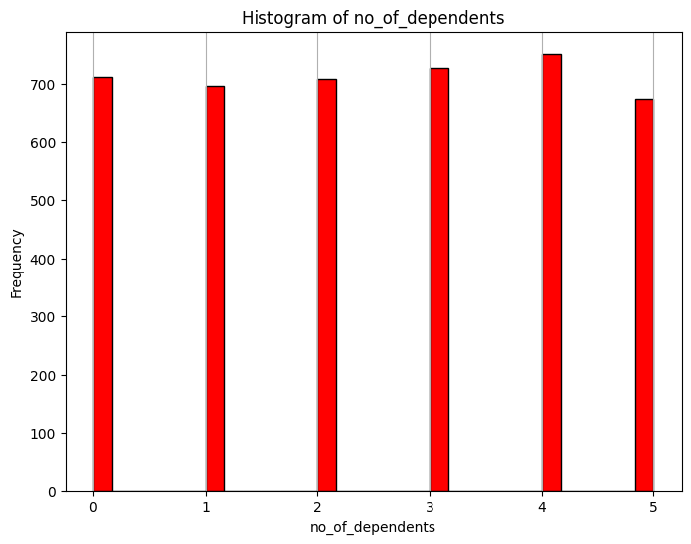
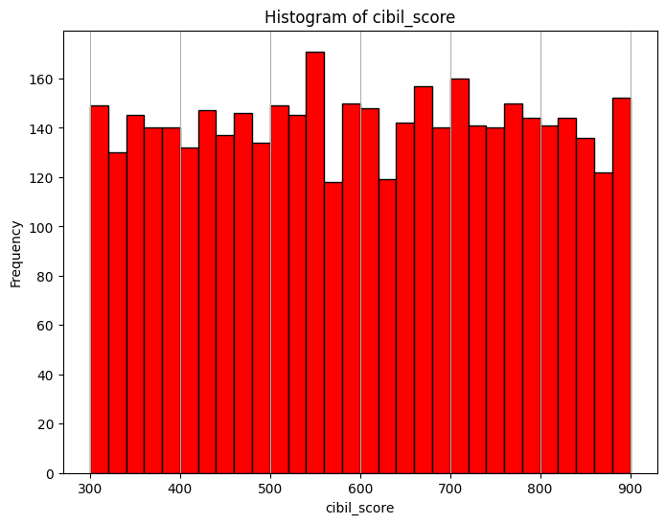
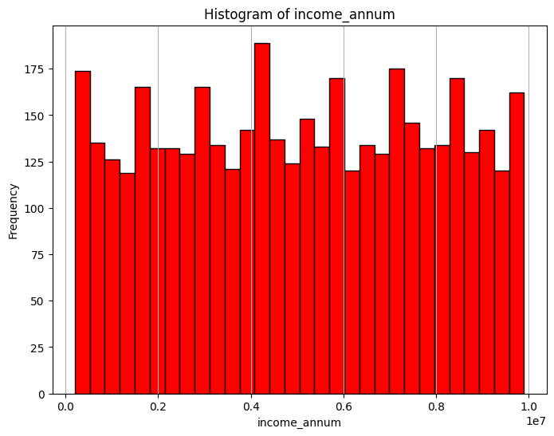
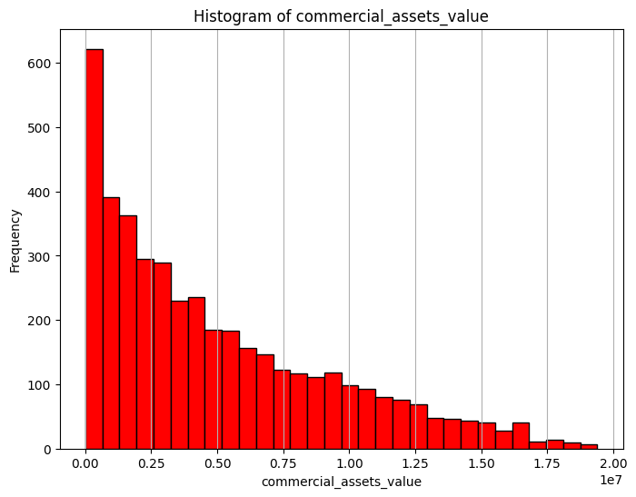
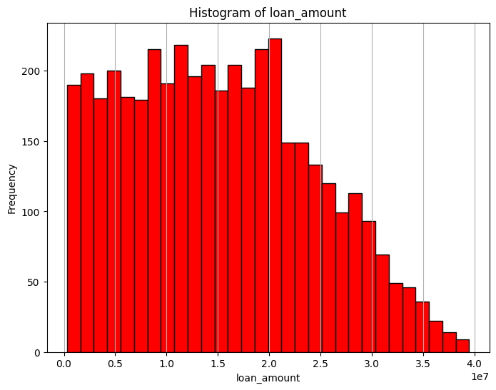
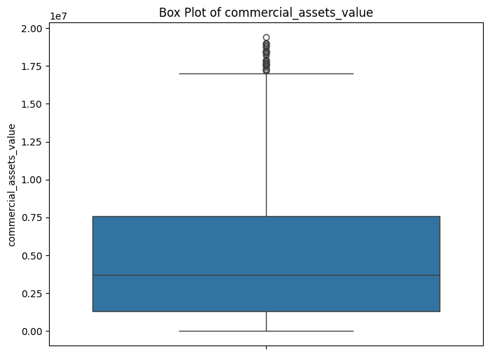
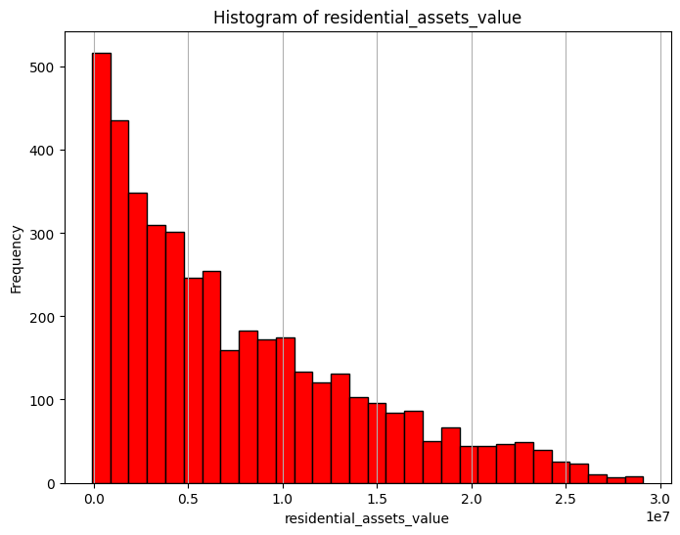
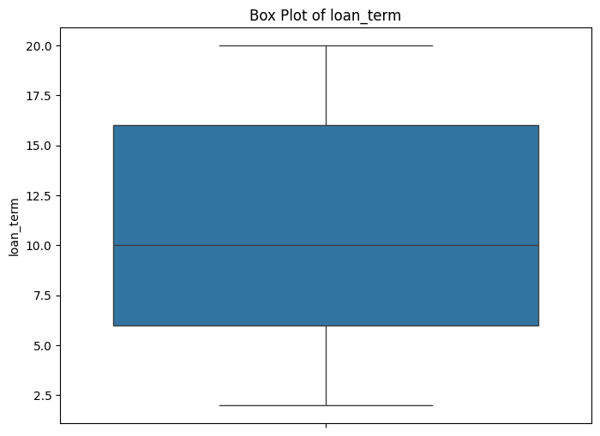
Pre cleaning visulization: numerical

Slide 8
Data cleaning
The Dataset does not contain any Null Values or Duplicate Rows
Outliers were detected using the boundaries Q3 + 1.5*IQR and Q1 – 1.5*IQR then the detected outliers were removed from the dataset leaving 4178 Instances
Residential Asset values and Commercial asset values contained negative value which made no sense hence were updated to a value of 0.
All Numerical Values were normalized using the MinMax Scaler to range of 0 to 1
Loan Status, Education and Self Employed were encoded using the Label encoding

Slide 9
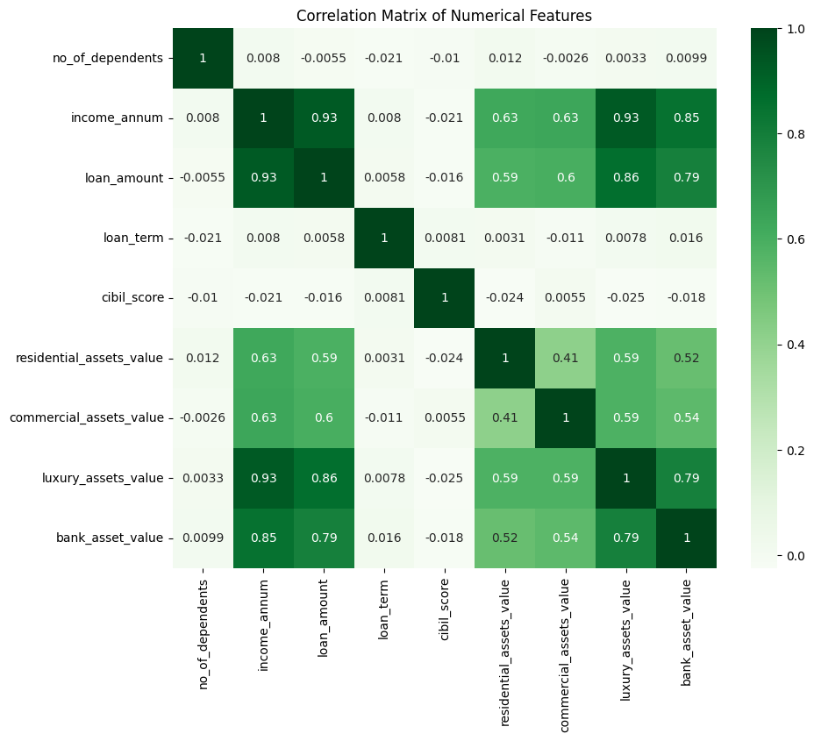
After cleaning Visulization
The 4 features regarding the assets values were highly correlated overall.

Slide 10
Feature selection and pca
The loan id column was dropped as it serves no significance to the models.
The 4 assets features were added together to create a new feature Total assets
The total assets feature was divided by 4 to create a new feature Average Assets value.
The 4 assets feature and the total assets were dropped from the dataset and replaced by the Average assets value.
The PCA was used to select 5 features out of the 9 available features
The data was then split into 20% testing and 80% training with a random state of 42 to insure the same split every time.

Slide 11
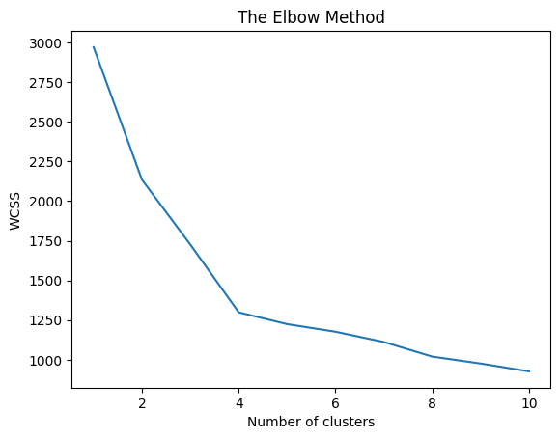
K Means Clustering
The elbow method was used to identify the optimal number of clusters which was 4

Slide 12
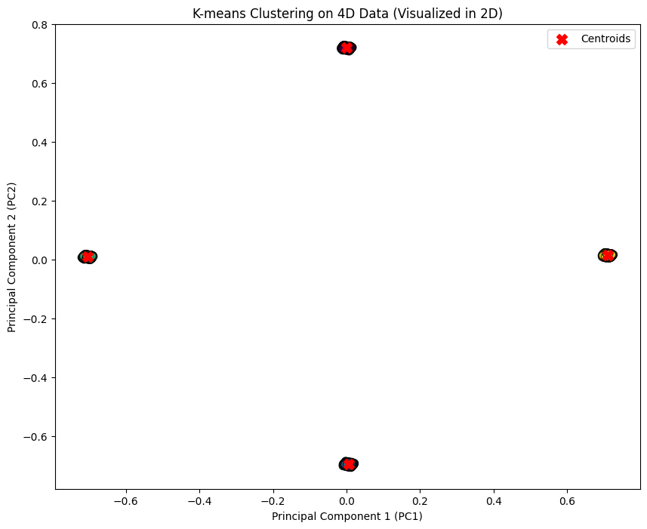
K Means Clustering
The topmost 2 PCA components were used to plot a scatter diagarm to visualize the clusters created and marked with an X. The Model scored an 42.5% on the silhoute scale

Slide 13
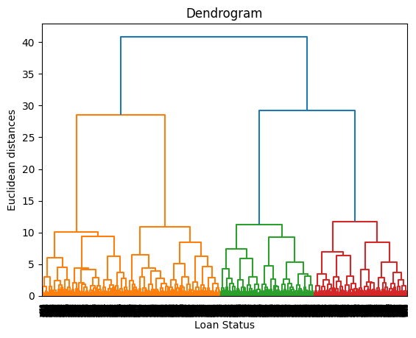
Hierarchal Clustering
A Dendogram was plotted to identify how many clusters should be created by cutting the graph from the middle there are 4 clusters.

Slide 14
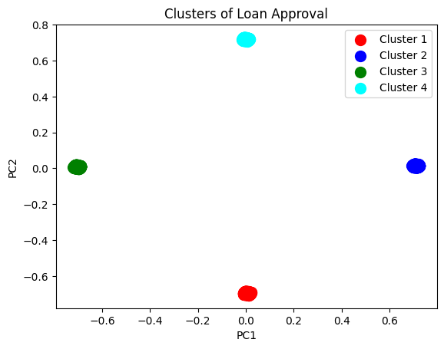
Hierarchal Clustering
The topmost 2 PCA components were used to plot a scatter diagarm to visualize the clusters created. The Model scored an 42.5% on the silhoute scale

Slide 15
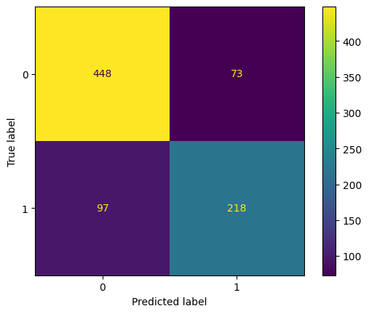
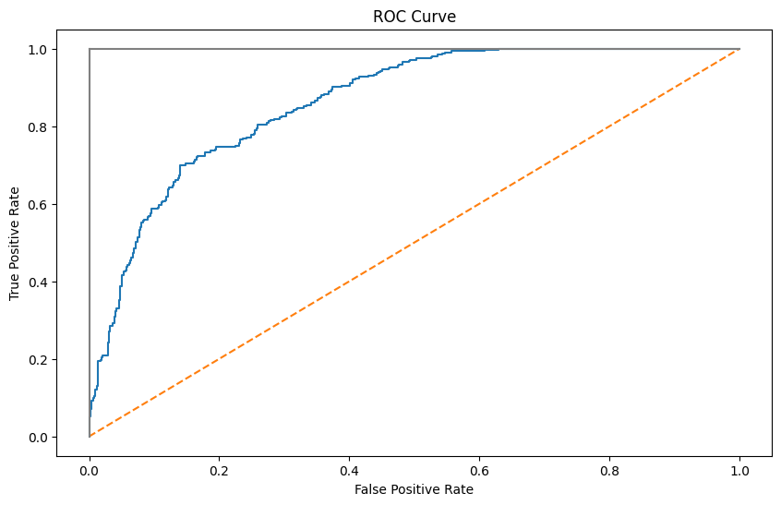
Logistic Regression
The ROC Curve indicates that the model does not overfit and is considered a Good model for evaluation.
The Confusion matrix shows that there are 170 missclassified instances.
Accuracy: 79.66507177033493 % Precision: 74.91408934707904 % Recall: 69.2063492063492 %
F1 score: 71.94719471947195 %

Slide 16

Decision Tree
The Confusion matrix shows that there are 95 missclassified instances.
Accuracy: 88.63636363636364 % Precision: 86.42384105960265 % Recall: 82.85714285714286 %
F1 score: 84.60291734197732 %

Slide 17
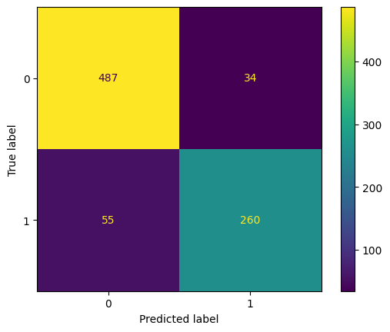
Random Forest
The Number of estimators for the random forest used was 10, the model was tried for 3 and 5 and 7 also but 10 achieved the best results.
The Confusion matrix shows that there are 89 missclassified instances.
Accuracy: 89.35406698564593 % Precision: 88.43537414965986 % Recall: 82.53968253968253 %
F1 score: 85.38587848932676 %

Slide 18
Results
 | Logistic Regression | Decision Tree | Random Forest
Accuracy | 79.7% | 88.6% | 89.4%
Precision | 79.4% | 86.4% | 88.4%
Recall | 62.2% | 82.9% | 82.5%
F1-Score | 71.9% | 84.6% | 85.4%

