Slide 1
Preprocessing
Before building our regression models, we need to make sure that the dataset is clean and ready-to-use.
Preprocessing :
Analyze the samples and check if there are null values or not.
How can you deal with the missing values ??
Feature Scaling
Encode the text features to numerical values (i.e “Club”, “Nationality”)
Feature understanding and Selection: (Next Lab)
Determine the best model that fit your data. How ?

Slide 2
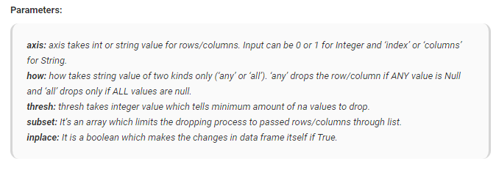
Preprocessing – Missing Values
To know which columns have missing values: DataFrame.isna().sum()
To remove them: DataFrame.dropna(axis=0, how=‘any’, thresh=None, subset=None, inplace=False)

Slide 3
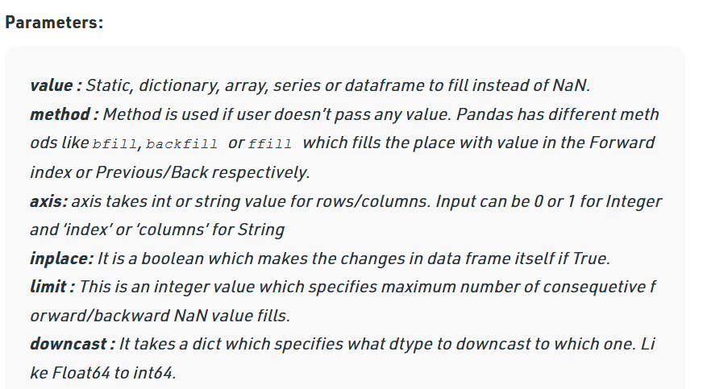
Preprocessing – Missing Values
Another method to deal with missing values is to fill the NaN values in column with a value such as the mean, median or mode of the column
We can choose which method to use to fill a column based on the nature of the column (numerical, categorical,..etc)
To fill the missing values: DataFrame.fillna(value=None, method=None, axis=None, inplace=False, limit=None, downcast=None)

Slide 4
Preprocessing - Feature Scaling
Feature Scaling is a technique to standardize the independent features present in the data in a fixed range. It is performed during the data pre-processing to handle highly varying magnitudes or values or units.
If feature scaling is not done, then a machine learning algorithm tends to weigh greater values, higher and consider smaller values as the lower values, regardless of the unit of the values.
Example: If an algorithm is not using feature scaling method then it can consider the value 3000 meter to be greater than 5 km but that’s actually not true and in this case, the algorithm will give wrong predictions. So, we use Feature Scaling to bring all values to same magnitudes and thus, tackle this issue.

Slide 5


Preprocessing - Feature Scaling
Techniques to perform Feature Scaling :-
Min-Max Normalization: This technique re-scales a feature or observation value with distribution value between 0 and 1.
Standardization: It is a very effective technique which re-scales a feature value so that it has distribution with 0 mean value and variance equals to 1.

Slide 6
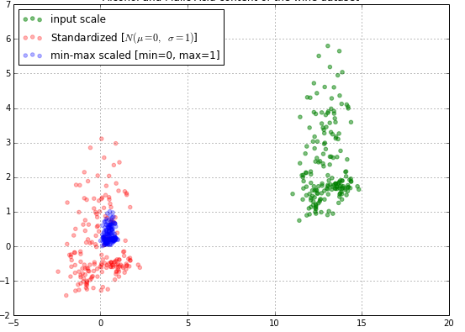
Preprocessing - Feature Scaling

Slide 7
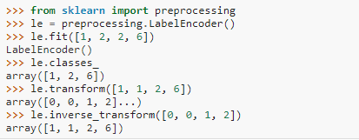
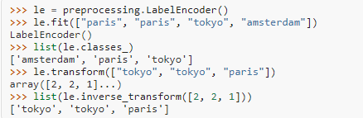
Preprocessing - Encoding
LabdelEncoder : can be used to normalize labels.
It can also be used to transform non-numerical labels to numerical labels.

Slide 8
Testing Tips and Common Mistakes
Split data to train and test before preprocessing
Missing data
Don’t fill the data with values from the test-set (ex: mean-mod) instead use only the values used while training
Feature scaling
Don’t learn scaling variables from test-set instead use the variables from training-set
Feature encoding
Don’t learn encoding values from test-set instead use values from training set
Handle the missing values

Slide 9
Feature Selection
Data Correlation: Is a way to understand the relationship between multiple variables and attributes in your dataset. Using Correlation, you can get some insights such as:
One or multiple attributes depend on another attribute or a cause for another attribute.
One or multiple attributes are associated with other attributes.
Why is correlation useful?
Correlation can help in predicting one attribute from another (Great way to impute missing values).
Correlation can (sometimes) indicate the presence of a causal relationship.
Correlation is used as a basic quantity for many modelling techniques

Slide 10
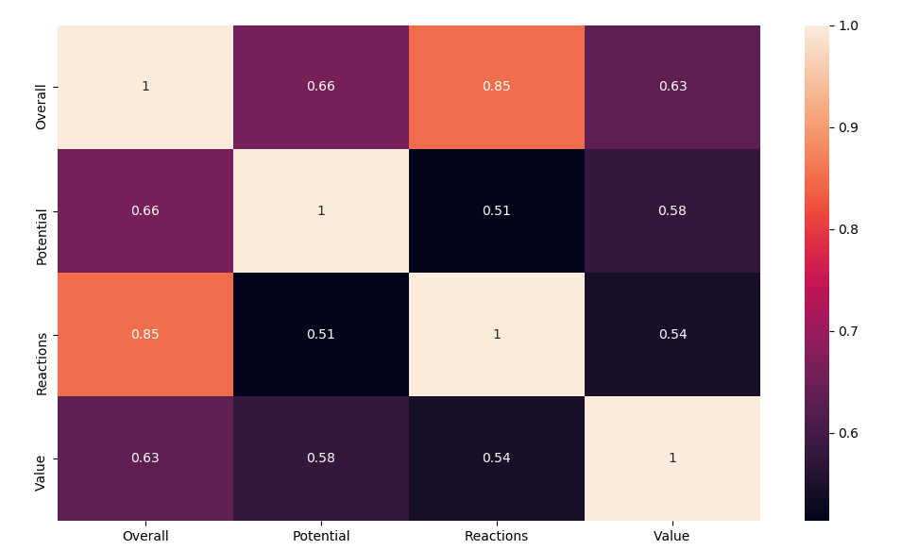
Feature Selection
Positive Correlation: means that if feature A increases then feature B also increases or if feature A decreases then feature B also decreases.
Negative Correlation: means that if feature A increases then feature B decreases and vice versa.
No Correlation: No relationship between those two attributes.
In python, dataframe.corr() computes the correlation of the columns and returns the correlation matrix.

Slide 11
Feature Selection
There are four main types of feature selection methods:
A. Filter methods
B. Wrapper methods
C. Embedded methods such as Lasso Regularization
D. Hybrid methods
Filter Methods:
Filter Methods Examples:
Chi-squared test, information gain, and correlation coefficient scores.

Slide 12
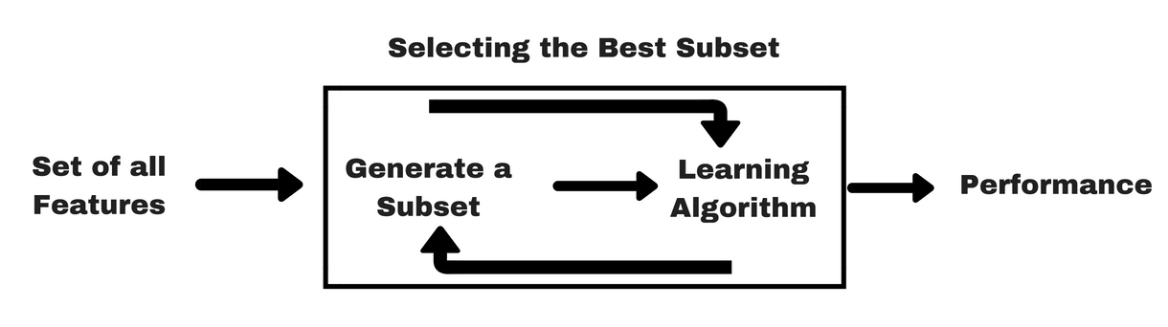
Feature Selection
Wrapper Methods:
Wrapper Methods Examples: forward feature selection, backward feature elimination, recursive feature elimination, etc

Slide 13
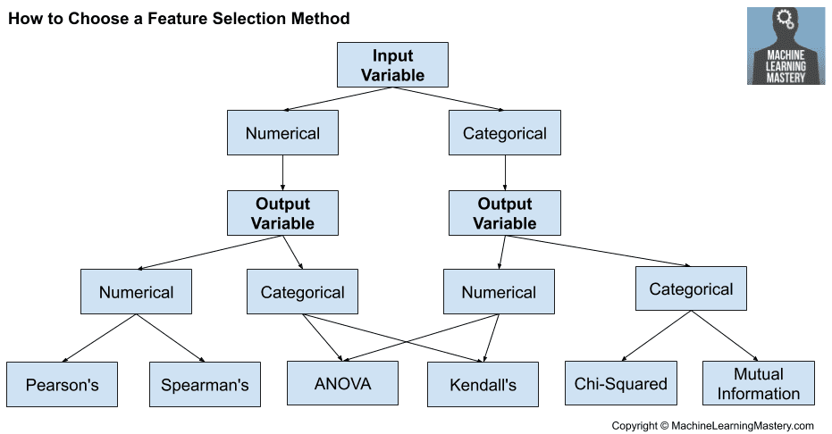
How to choose feature selection Method

