Slide 1
SkillBridge
Project-Idea-to-Learning-Path Platform
Academic Project Report | JEE, Spring Security, Big Data

Slide 2
Agenda
Problem & objectives
Solution architecture
Backend & security
Recommendation engine
Frontend experience
Big Data pipeline
Results & validation
Roadmap
SkillBridge | Academic Project Report

Slide 3
Problem & Opportunity
Learner pain points
SkillBridge response
Project ideas are concrete, skill paths are not
Course discovery is noisy and unstructured
Lack of explainable recommendations
Turn project text into skills
Ranked, explainable recommendations
Progress + analytics in one platform
SkillBridge | Platform Overview

Slide 4
Three-Application Architecture
Frontend
Backend
Big Data
React + TypeScript
Protected routes
Dashboard UX
API client
Spring Boot 4
REST APIs
Recommendation engine
Security filters
Docker lab
Sqoop + Flume
Hive + MapReduce
HBase outputs
SkillBridge | Core Modules

Slide 5
Backend Architecture
Layered design
Key modules
Controllers → Services → Repositories
DTO validation
Transactions
Central error handling
Auth & security
Catalog management
Recommendations
Admin analytics
SkillBridge | Platform Overview

Slide 6
Spring Security Highlights
Authentication
Authorization
Hardening
JWT tokens
BCrypt hashing
Google/GitHub OAuth
Role-based access
Method security
Owner checks
Strict CORS
HSTS + headers
Brute-force protection
SkillBridge | Core Modules

Slide 7
Recommendation Engine
Explainable algorithm
Score breakdown
Text normalization
Skill detection
Category rules
Score components
Title match (30)
Skill match (40)
Category match (20)
Popularity bonus (10)
SkillBridge | Platform Overview

Slide 8
Core Domain Model
User & Roles
Learning entities
Catalog
USER / ADMIN
OAuth identity
Security context
Projects
Detected skills
Recommendations
Courses
Providers
Categories
Skills
SkillBridge | Core Modules

Slide 9
Frontend Experience
Primary routes
Admin suite
Dashboard
Projects
Courses
Saved & Progress
Overview analytics
Users management
Catalog CRUD
Big Data status
SkillBridge | Platform Overview

Slide 10
Big Data Laboratory
Batch pipeline
Streaming pipeline
Catalog build
Postgres mirror
Sqoop → HDFS
Hive queries
events.log
Flume ingestion
HDFS raw zone
Analytics refresh
SkillBridge | Platform Overview

Slide 11
End-to-End Pipeline (System View)
Web Application Flow
Idea Input
Skill Detection
Catalog Search
Recommendation
Event Logging
Analytics
Big Data Flow
Catalog Build
Supabase Sync
Sqoop Import
Hive Queries
MapReduce
HBase Serving
Outputs: explainable recommendations, dashboards, and analytics
SkillBridge | Full Pipeline

Slide 12
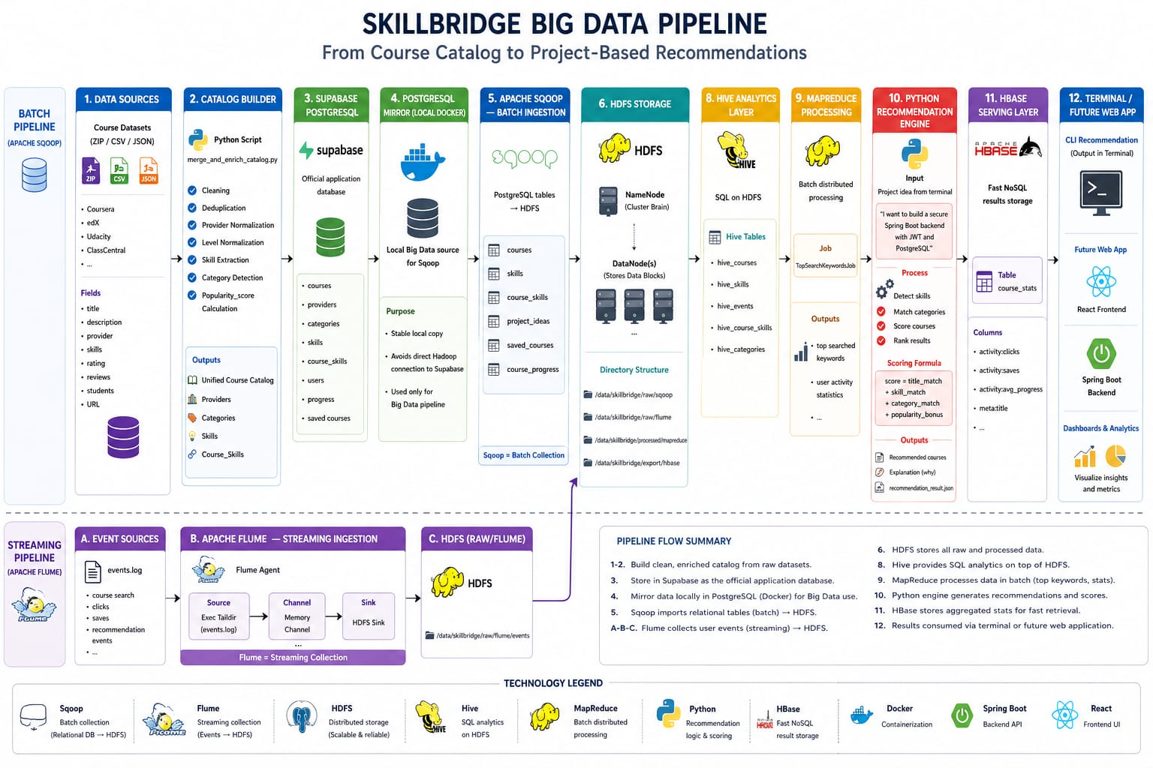
Pipeline Diagram (Reference)
Provided pipeline visual for the Big Data flow.

Slide 13
Catalog Building
Inputs
Outputs
CSV/JSON datasets
Provider normalization
Skill extraction
Unified courses
Categories/providers
Popularity score
Supabase sync
SkillBridge | Platform Overview

Slide 14
Analytics Outputs
Hive
MapReduce
HBase
Course counts
Top providers
Skill distribution
Top search keywords
User intent signals
course_stats
Fast lookup
Admin dashboards
SkillBridge | Core Modules

Slide 15
Admin Dashboards
Transactional metrics
Big Data metrics
Users
Projects
Recommendations
Saved courses
Top categories
Top skills
Pipeline status
Data freshness
SkillBridge | Platform Overview

Slide 16
Testing & Validation
Automated
Manual
Big Data
Security tests
Recommendation tests
Context load
Login lockout
Admin access
Project workflow
Sqoop imports
Hive queries
HBase load
SkillBridge | Core Modules

Slide 17
Runbook (Demo Commands)
Backend
Frontend + Big Data
mvn spring-boot:run
JWT auth ready
API at :8080
npm run dev
docker compose up
Run pipeline scripts
SkillBridge | Platform Overview

Slide 18
Current Limitations
Product
Engineering
Rule-based recommendations
Manual Hadoop execution
Screenshots pending
OAuth setup required
Docker services dependency
No auto refresh
SkillBridge | Platform Overview

Slide 19
Future Improvements
Intelligence
Platform
Semantic embeddings
Feedback loop
Smarter ranking
Scheduled refresh
Deployment automation
Richer analytics
SkillBridge | Platform Overview

Slide 20
Thank you
Questions & discussion

