Slide 1
CSE411 major task Power window control system using Tiva C running FreeRTOS
Presented to :
dr: sherif hammad
Eng : hesham salah
Eng : mohamed tarek
Presented by : TEAM 17
19P9349 Mazen Ahmed Ellaboudy 19P7372 Ahmed Adel Saleh 19P5760 Mohamed Ahmed Badr 19P3218 Mohamed khaled abd elaziz 19P1060 Omar Mahrous Eltoutongy

Slide 2
Team ROLES
Ahmed Adel Saleh (Driver & Passenger Tasks)
Mazen Ahmed Ellaboudy (Interrupts + Tasks)
Mohamed Ahmed Badr (Queue Receive Task)
Mohamed Khaled Abdelaziz (Driver & Passenger Tasks)
Omar Mahrous Eltotoungy (Circuit Topology + Lock Task)

Slide 3
Project scope
- Implementation of front passenger door window with both passenger and driver control panels (2 pushbuttons for each panel).
- Implementation of 2 limit switches to limit the window motor from top and bottom limits of the window.
- Obstacle detection implementation is done using a push button to indicate jamming.
- Lock Mode is implemented using switch button.

Slide 4
Manual open/close function
One touch auto open/close function
System basic features
Window lock function
Jam protection function

Slide 5
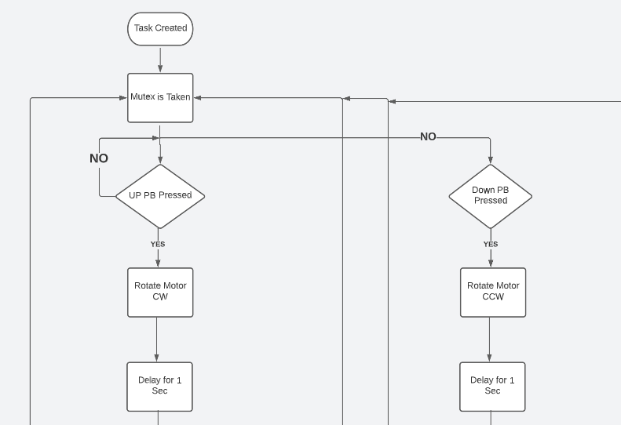
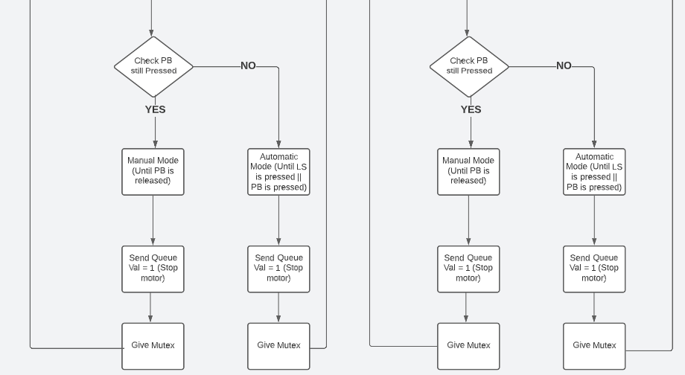
Flow charts
Passenger Task (Priority 1)

Slide 6
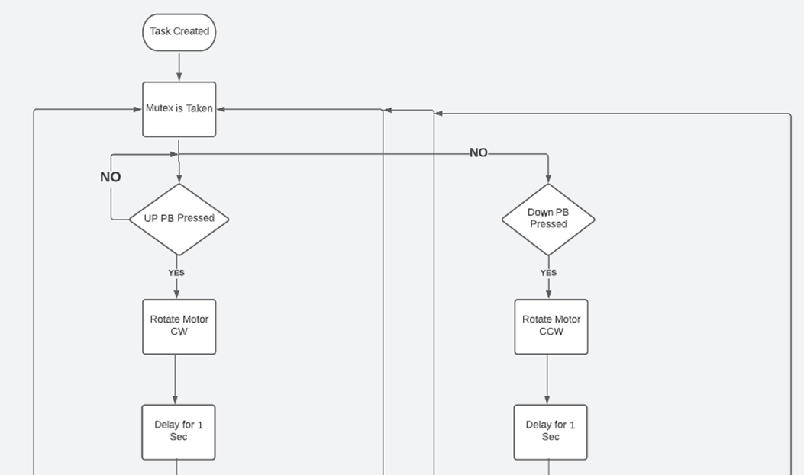
Driver Task (Priority 1 OR 2)

Slide 7
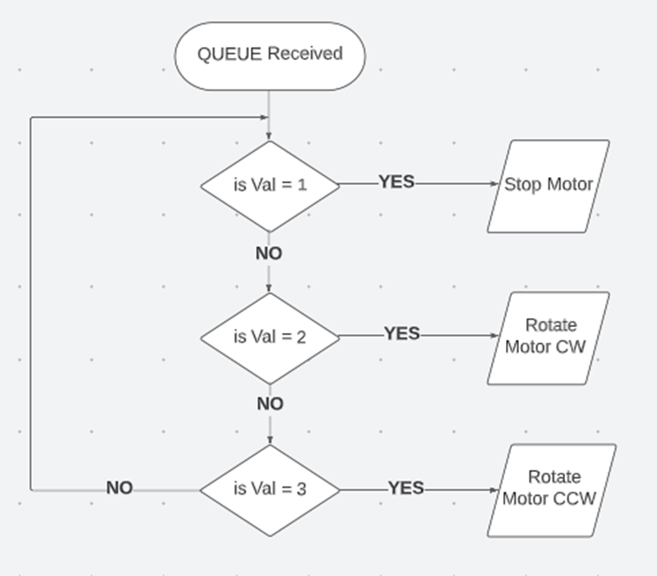
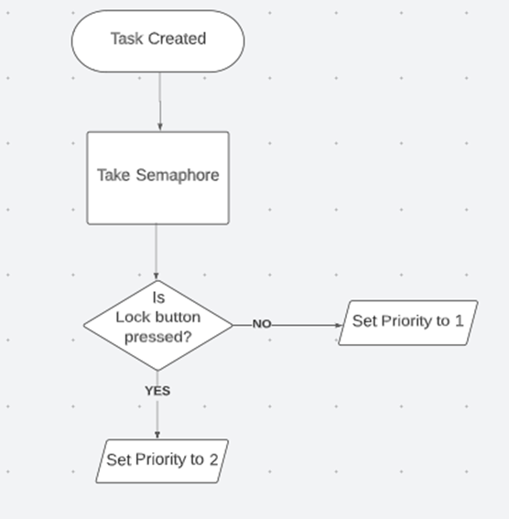
Queue Task (Priority 3) LOCK Task (Priority 4)

Slide 8
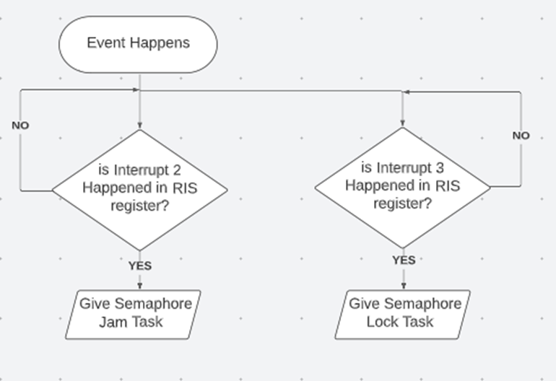
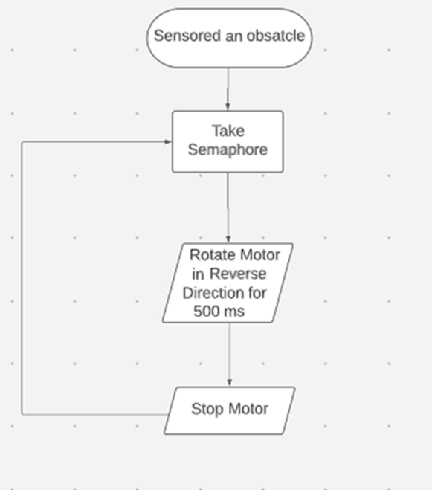
ISR JAM Task (Priority 5)

Slide 9
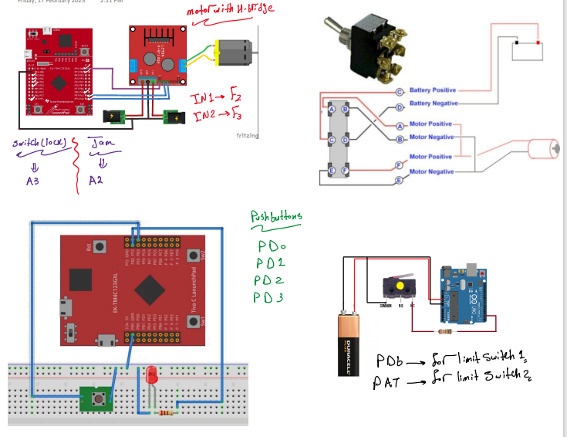
Electrical circuit

Slide 10
Corner Cases
CASE 1: ( Driver & Passenger Press Simultaneously)
In this case, our system responds by giving control to which ever button was pressed first. For example, if driver pressed UP first and the passenger pressed DOWN after, the motor will rotate UPWARDS.
CASE 2: (Activating Lock while Passenger PB is pressed)
Since the lock button uses interrupt when triggered, the lock will disable the passenger control panel immediately and will stop the motor.

Slide 11
Corner Cases
CASE 3: ( Pressing PB again while automatic is activated)
If the motor is in automatic mode, then the driver or passenger pressed the button again, the motor will exit automatic mode and execute whichever task is sent to it. It can be automatic again in the other direction, or manual mode in either direction.
CASE 4: (Using PB during Jam Protection Process)
The jam protection task has the highest priority in our system. Any other activity is blocked until the task is done executing.

