Slide 1



Supplier Chain Quality
DEPI Graduation Project

Slide 2


Team
Begad Mahmoud Kandeel
Omar Essam Saber

Slide 3
AGENDA
01.
02.
03.
Introduction to Data
Technical Report
Analytical Report
04.
05.
Take aways
Executive Summary
06.
Next Step

Slide 4
Introduction
This project centers around a comprehensive analysis of supplier quality and the effects of manufacturing downtime on overall production efficiency. The dataset captures detailed information about the quality of materials supplied by various vendors, and we aim to accomplish two main goals:
1. Identify the Best and Worst Vendors: We want to rank vendors based on the quality of materials they supply, distinguishing those that consistently deliver high-quality products from those that contribute to defects or quality issues.
2. Assess Plant Efficiency in Defect Detection and Downtime Reduction: We aim to identify which manufacturing plants have the best systems in place for detecting defects early and rejecting faulty materials before they impact production. This helps reduce downtime caused by defective materials, as well as overall operational inefficiencies.
Downtime can occur for various reasons, such as during machine setup, equipment maintenance, or when there are shortages of supplies or manpower. It represents a significant production cost, as the factory is unable to operate at full capacity. Defects, in this context, refer to any material imperfections or errors that disrupt the production process, leading to delays or rework.
By analyzing this data, we seek to uncover trends and actionable insights that will help improve both supplier selection and plant efficiency, ultimately leading to higher production quality and reduced operational losses

Slide 5
Objective
Supplier Performance Evaluation: To identify the best and worst-performing suppliers based on the quality of materials they provide. This evaluation will allow us to make informed decisions regarding supplier selection and retention, ensuring that only high-quality materials are sourced to maintain production standards.
Plant Efficiency in Defect Detection: To determine which manufacturing plants are most effective at identifying and rejecting defective materials, thereby minimizing downtime. By pinpointing plants with strong defect detection processes, we can enhance overall production efficiency and reduce disruptions caused by poor-quality materials.

Slide 6
Key findings
Supplier Performance Variability: The analysis revealed significant differences in quality among suppliers, with some consistently delivering high-quality materials and others frequently supplying defective items. These variations directly correlate with downtime.
Plant Detection Efficiency: Some plants were much more effective at identifying and rejecting defective materials early in the process, minimizing downtime. Conversely, plants with lower defect detection rates experienced higher levels of downtime due to increased repair and rework requirements.
Correlation Between Supplier Quality and Downtime: Plants receiving materials from lower-quality suppliers tended to experience more frequent and prolonged downtime, highlighting supplier quality’s critical role in overall production efficiency.

Slide 7
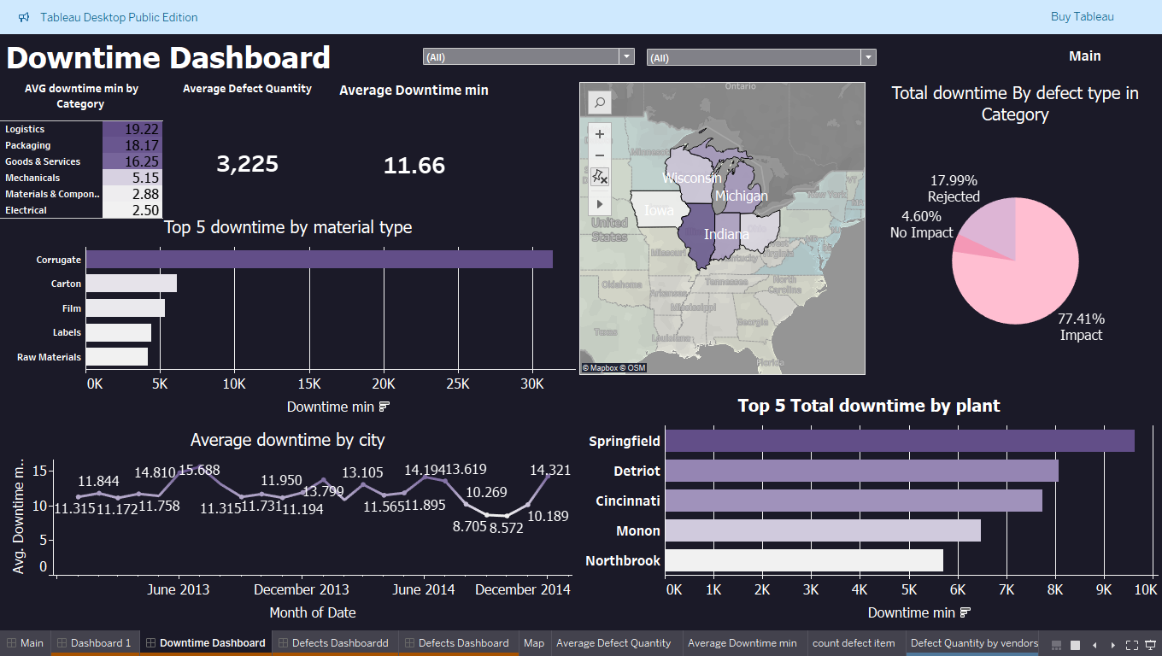
Dashboards

Slide 8
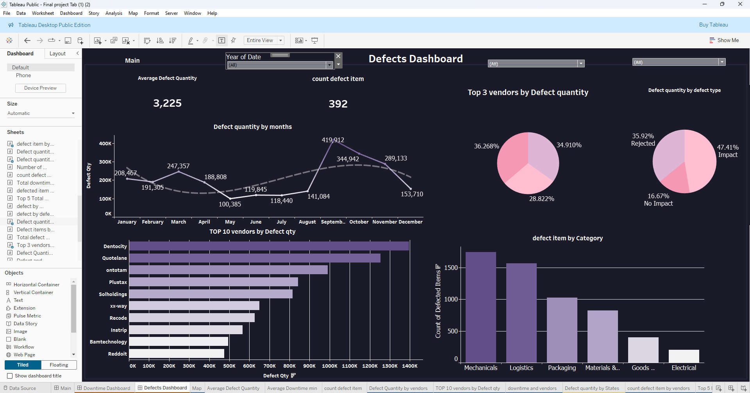
Dashboards

Slide 9
Technical Report

Slide 10
01.
Cleaning Part

Slide 11
Duplicates in Defects
Bad Seams was duplicated 5 times
Excessive Grease -Scrap attached - Wrinkles /Scratches/Scuffing: were duplicated 2 times.
Foreign objects found
Warped: were duplicated 3 times

Slide 12
Duplicates in Vendors
RoundPhase & Quotefix: were duplicated 2 times

Slide 13
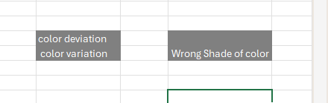

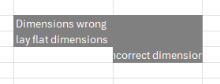
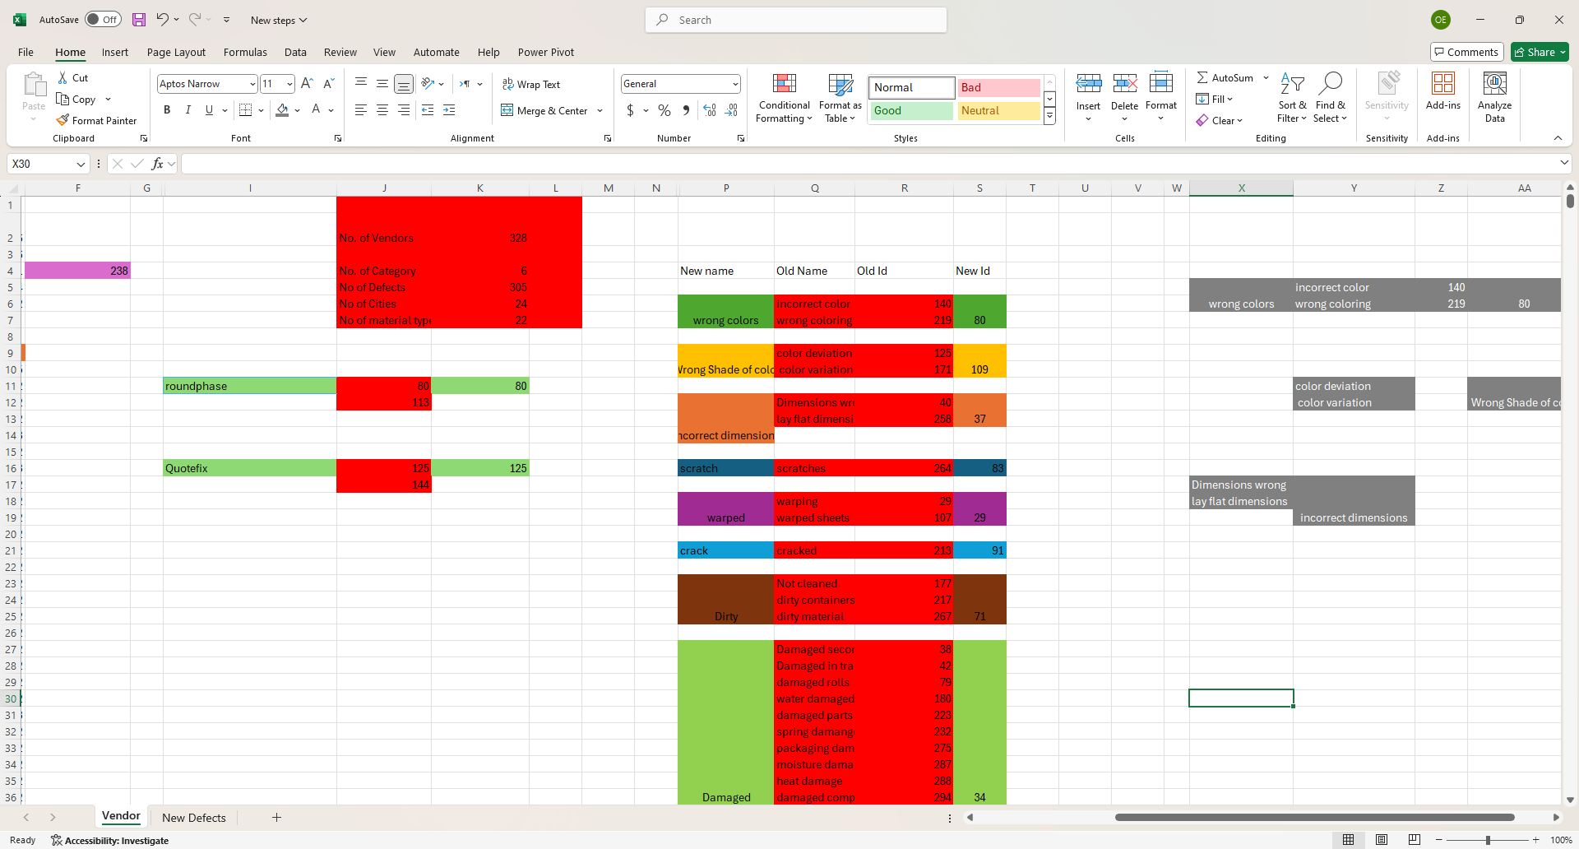
Wrong Defect type

Slide 14
02.
Data Modeling

Slide 15
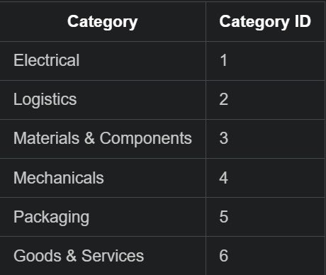
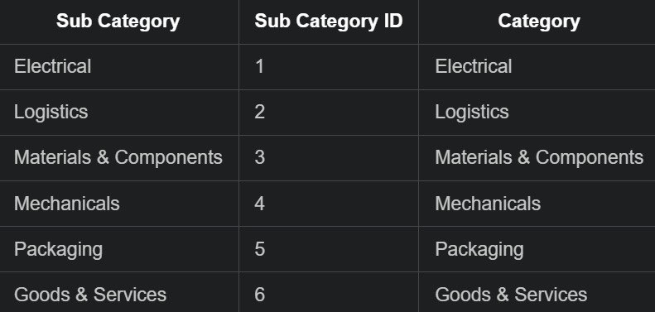
Category Table

Slide 16
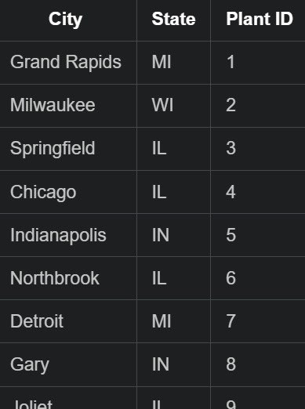
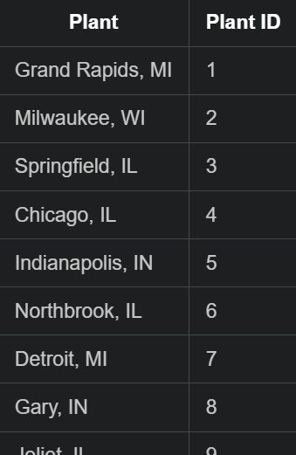
Plant Table

Slide 17

State Table

Slide 18
Analytical Report

Slide 19


Downtime Analysis
We Have around 18.5 million defective items, resulting in an outage of a total of 67,110 minutes. Although some materials have fewer damaged pieces they can create delays, resulting in increased downtime.

Slide 20
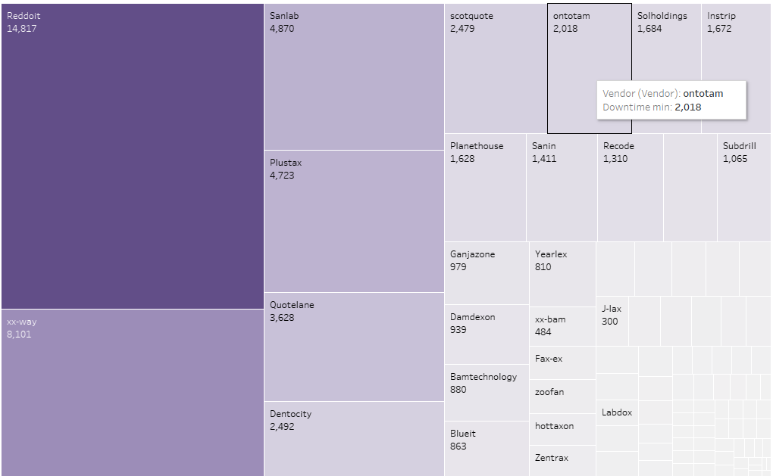
The top 10 vendors are represented by the 10 blocks on the left side of the Treemap. We can also notice that they represent more than 50% of total downtime.

Slide 21
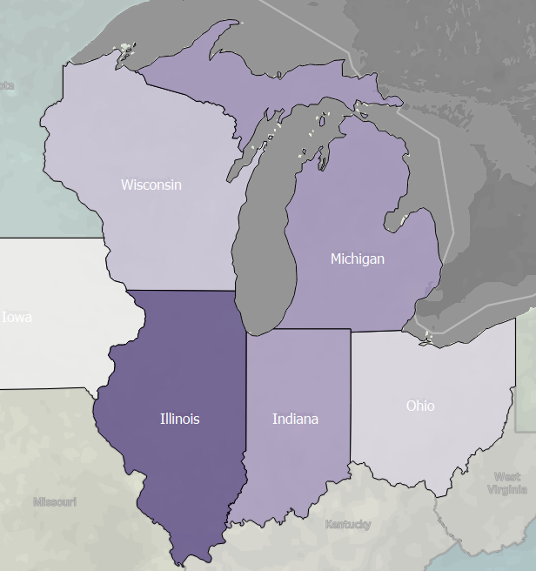
Does States affect?
South States has large number of Defects than north States

Slide 22
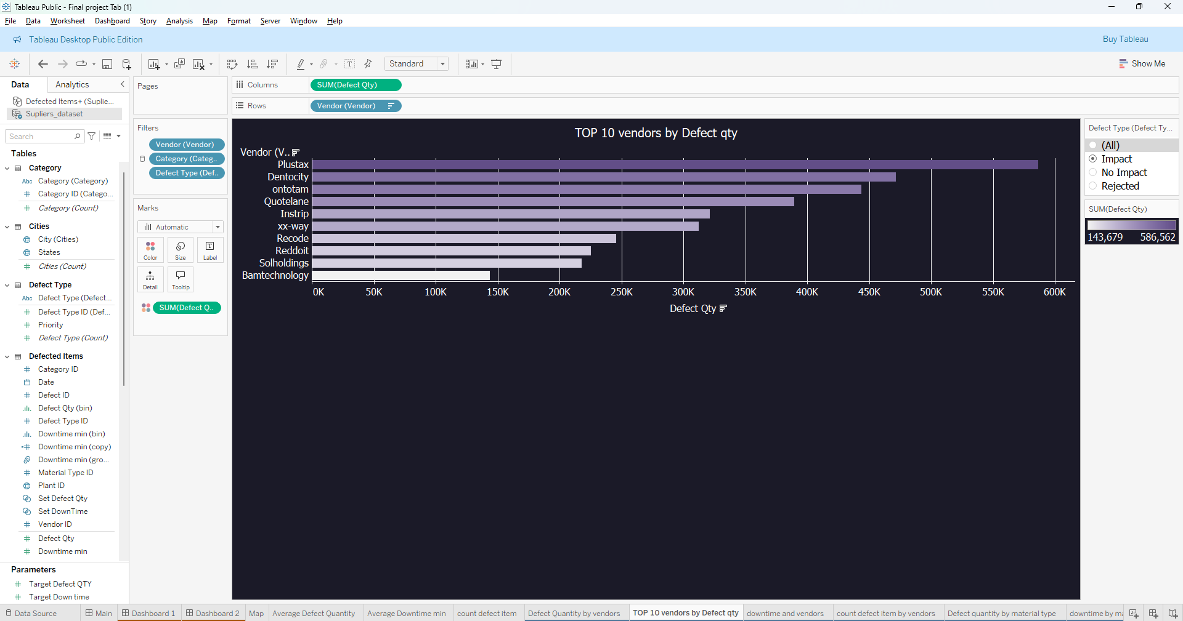
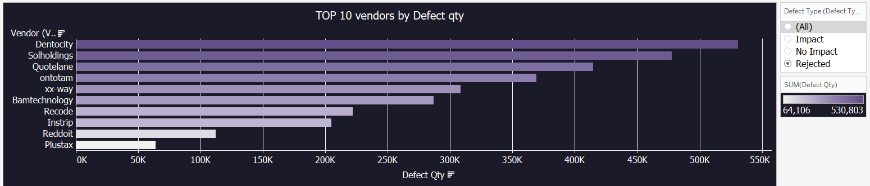
How Vendors affect Quantity?
Plustax has the highest number of defects that have impacted the customer.
Dentorcity has the highest number of defects that the customer rejected. Therefore, not all vendors are bad because the type of defect impacts the quantity.

Slide 23
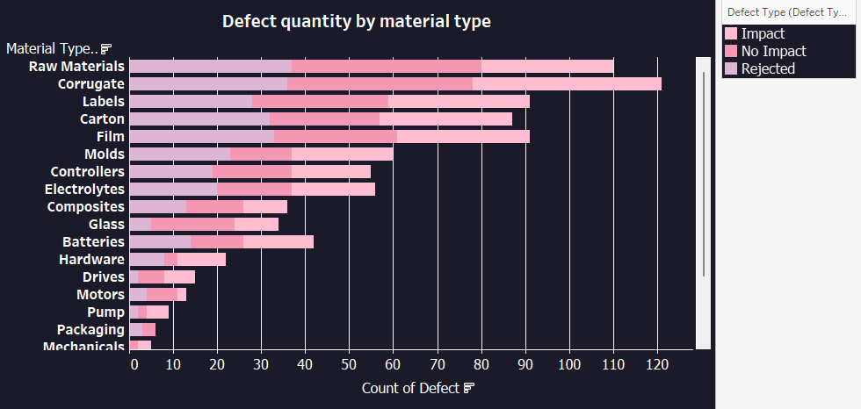
Which material type is best managed?
It should be noted that while the Raw materials material category has a large number of overall flaws, the majority of those defects are either rejected or have no impact.
So, we need to confirm if, despite the high defect count, this material type does not cause considerable downtime

Slide 24
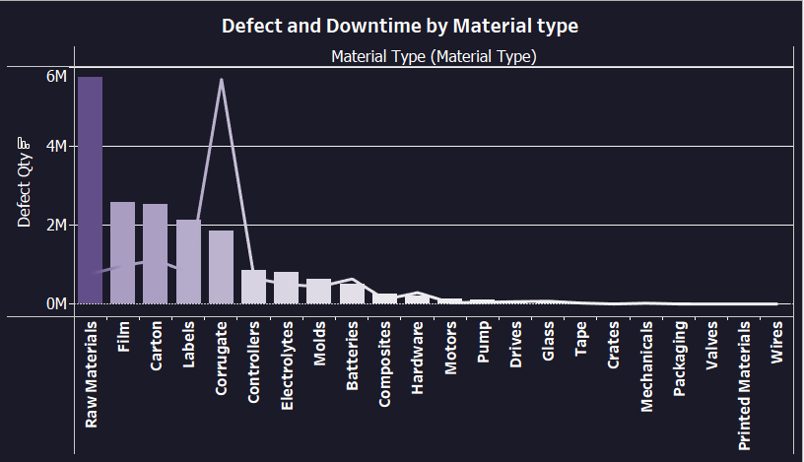
look at the Total Defect Qty, Total Downtime Minutes by Material Type tile:
Raw materials appear to be well managed; although they have more defects, they have lower total downtime minutes.

Slide 25
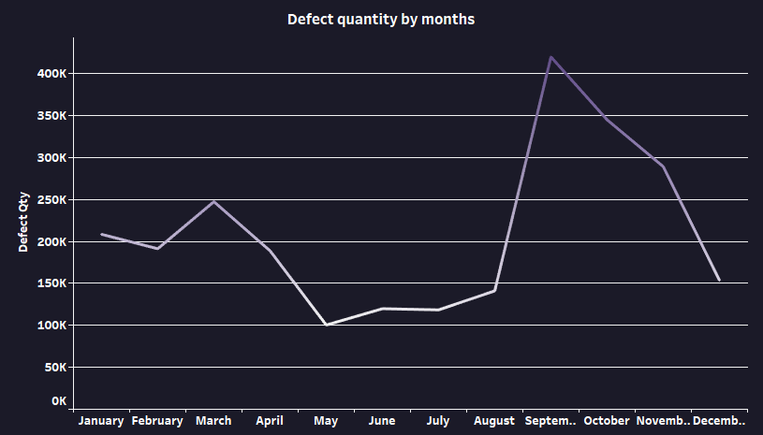
Which month has highest defect quantity?
Starting in August, we observed a sharp rise in defect quantity, which continued to escalate rapidly until it reached its peak in September. This upward trend indicates a significant issue that requires immediate attention.

Slide 26
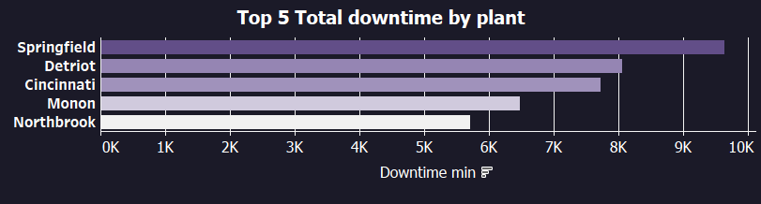
Which Plants has the highest downtime minutes?
As indicated in the chart, Springfield leads as the plant with the highest total downtime, recording 9,637 minutes. Detroit follows in second place with 8,066 minutes, while Cincinnati ranks third with 7,732 minutes of downtime.

Slide 27
Takeaways

Slide 28
The issue at hand is that raw materials consistently exhibit the highest defect rate among all material types, which could be severely impacting the overall quality and efficiency of production. This high defect rate not only leads to increased waste, rework, and production delays but also adds to operational costs and could harm the reputation of the company if defective products reach customers. Furthermore, relying on raw materials with such a high defect frequency can affect downstream processes, leading to inefficiencies and increased workloads for quality control teams.
Recommendation: Implementing a multi-faceted approach is critical. Begin by tightening quality control protocols for incoming raw materials, including more rigorous inspections, sampling, and testing before materials are used in production. Strengthen supplier partnerships through detailed feedback and performance evaluations, encouraging suppliers to adhere to higher quality standards. Consider sourcing from multiple suppliers to reduce dependency on any single vendor that may consistently underperform. Additionally, introduce advanced tracking and analytics to identify specific defect trends, which will enable targeted interventions and continuous improvement. Training staff on material handling and establishing clearer communication channels with suppliers could further help minimize defects at the source.

Slide 29
The issue is that states in the southern region, particularly Illinois, are consistently reporting the highest defect quantities. This trend suggests that regional factors such as supplier quality, transportation, storage conditions, or even environmental influences may be contributing to the problem. High defect rates in these areas not only disrupt production but also drive-up operational costs, slow down delivery timelines, and increase the risk of defective products reaching customers. If left unaddressed, these localized issues could harm the overall performance of the company and negatively impact customer satisfaction.
Recommendation: Consider implementing stricter quality control measures in these areas, such as increased inspections, enhanced staff training, and improved storage conditions to prevent material degradation. Additionally, work closely with regional suppliers to address quality issues and introduce preventive measures that align with standards in other regions with lower defect rates. Regular audits and performance reviews for both suppliers and local facilities can ensure long-term improvements.

Slide 30
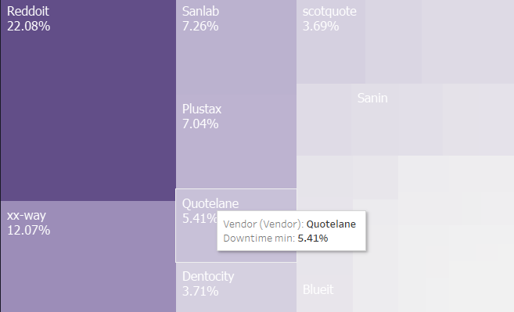
Another critical issue to address is that the top six vendors (specially Reddoit) are responsible for over 50% of the total downtime minutes, as highlighted in the tree chart. This suggests a significant vendor-related problem that is directly affecting production efficiency and operational performance.
Recommendation: Initiate a detailed vendor performance review, focusing on the top six vendors with the highest downtime contributions. Collaborate with these vendors to identify the root causes of delays, whether related to supply chain inefficiencies, quality issues, or logistical challenges. Establish clear performance improvement plans with measurable KPIs for each vendor, including stricter delivery schedules, better quality controls, and faster response times for issue resolution. Additionally, consider diversifying the supplier base to reduce dependency on underperforming vendors and mitigate the risk of future downtime. Regular vendor audits and performance reviews should be implemented to ensure sustained improvements.

Slide 31
In terms of defects causing the most downtime, "Bad Seams" ranks first, accounting for a total of 9,978 downtime minutes. Following that, Misc (Miscellaneous) defects come in second with 3,065 downtime minutes. The difference between these two categories is substantial, with "Bad Seams" contributing nearly three times as much downtime, which is a significant concern.
Recommendation: Immediate action should be taken to address the high downtime caused by bad seams. Start by conducting a root cause analysis to identify the factors contributing to this issue, such as equipment malfunction, operator error, or material inconsistencies. Once the root causes are identified, implement corrective measures, such as improving machine calibration, providing additional training for operators, or upgrading equipment where necessary. Additionally, establish more frequent quality checks during production to catch seam defects earlier, preventing prolonged downtime. For the "Miscellaneous" category, further investigation is needed to break down the causes and address them individually. Continuous monitoring and data analysis should be employed to track progress and ensure that these improvements lead to reduced downtime

Slide 32
As mentioned before, there has been a significant and rapid increase in defect quantities starting from August, reaching a peak in September. This trend highlights a critical issue that requires immediate attention.
Recommendation: Conduct a thorough investigation to identify any changes in processes, materials, or external factors that may have caused the increase in defects. Address the root causes by adjusting production processes, enhancing quality control, and providing additional employee training. Implement ongoing monitoring to ensure defect levels are stabilized and prevent future surges.

Slide 33
According to the chart, Springfield has the highest total downtime, recording 9,637 minutes. This substantial amount of downtime indicates a critical issue that needs to be addressed promptly.
Recommendation: To tackle the high downtime in Springfield, a thorough analysis should be conducted to identify the root causes. This analysis could include evaluating equipment performance, reviewing maintenance schedules, and assessing operational processes. Once the causes are identified, targeted improvements can be implemented, such as enhancing preventive maintenance, optimizing workflows, and providing additional staff training. Additionally, establishing a real-time monitoring system for downtime causes will help facilitate quicker responses and reduce future occurrences.

Slide 34
July 2013 stands out as the month with the highest average downtime, recorded at 15.688 minutes/month, when compared to the two-year period of 2013 and 2014. This significant downtime indicates potential underlying issues that may need to be addressed.
Recommendation: A detailed investigation should be conducted to identify the factors contributing to this high average downtime in July 2013. Analyzing operational data from that month may reveal patterns related to equipment failures, staffing shortages, or other disruptions. Based on these insights, corrective measures can be implemented, such as improving maintenance schedules, optimizing resource allocation, and enhancing training programs. Regular monitoring and evaluation of downtime metrics can also help prevent similar issues in the future.

Slide 35
Executive Summary
This project aims to analyze supplier data to identify trends, optimize procurement strategies, and enhance decision-making. The primary objective is to uncover insights that can help the organization improve supplier management, streamline operations, and reduce costs.
The analysis begins by exploring key characteristics of the data, including supplier performance, product categories, and order volumes. Using descriptive statistics and visualizations, the data was examined to uncover patterns and anomalies. The findings revealed several significant trends, including areas where supplier reliability could be improved and opportunities to negotiate better pricing terms with certain suppliers.
Based on these insights, recommendations were formulated to enhance supplier selection criteria and optimize order frequency. The report also identifies limitations in data availability and suggests areas for further research, including collecting additional data on supplier lead times and quality metrics.
In conclusion, this analysis provides a foundation for improving supplier management strategies, with the potential to enhance overall operational efficiency and cost savings.

Slide 36
Next Step
To build on these findings, the next steps involve gathering additional data on supplier quality and lead times to refine the analysis further. Implementing a performance monitoring system will allow for continuous assessment of supplier performance. Additionally, conducting a follow-up analysis with these new data points will provide more granular insights, enabling the organization to strengthen its supplier relationships and improve procurement efficiency.

Slide 37

we would like to extend our heartfelt gratitude to Eng. Yasser A. Rahman for being an exceptional instructor. Your passion for teaching has made a tremendous impact on our learning journey. Your dedication and enthusiasm have truly inspired us, and we are grateful for the knowledge and skills you've shared. Thank you for being a great mentor and guiding us with such commitment and expertise.
Thank you!

Slide 38
Thank you!

