Slide 1
Weather AUS
Prepared by Omar Essam

Slide 2
Data preview
This dataset comprises about 10 years of daily weather observations from numerous locations across Australia.
shape: 145460 rows × 23 columns
Temperature metrics: MinTemp, MaxTemp
Humidity: Humidity9am / Humidity3pm
Pressure: Pressure9am / Pressure3pm
Wind attributes: WindGustDir, WindGustSpeed, WindSpeed9am/3pm
Target: RainTomorrow (Yes/No)

Slide 3
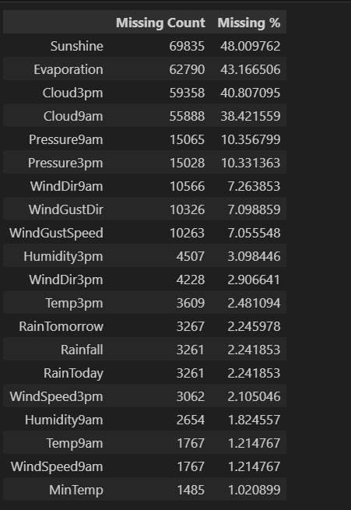
Data preview
Missing values:
Types of data:
16 float type:
MinTemp-MaxTemp-Rainfall-Evaporation-Sunshine-WindGustSpeed
WindSpeed9am-WindSpeed3pm-Humidity9am-Humidity3pm
Pressure9am-Pressure3pm-Cloud9am-Cloud3pm-Temp9am-Temp3pm
7 objects:
Date-Location-WindGustDir-WindDir9am
WindDir3pm-RainToday-RainTomorrow
The number of duplicates are 0

Slide 4
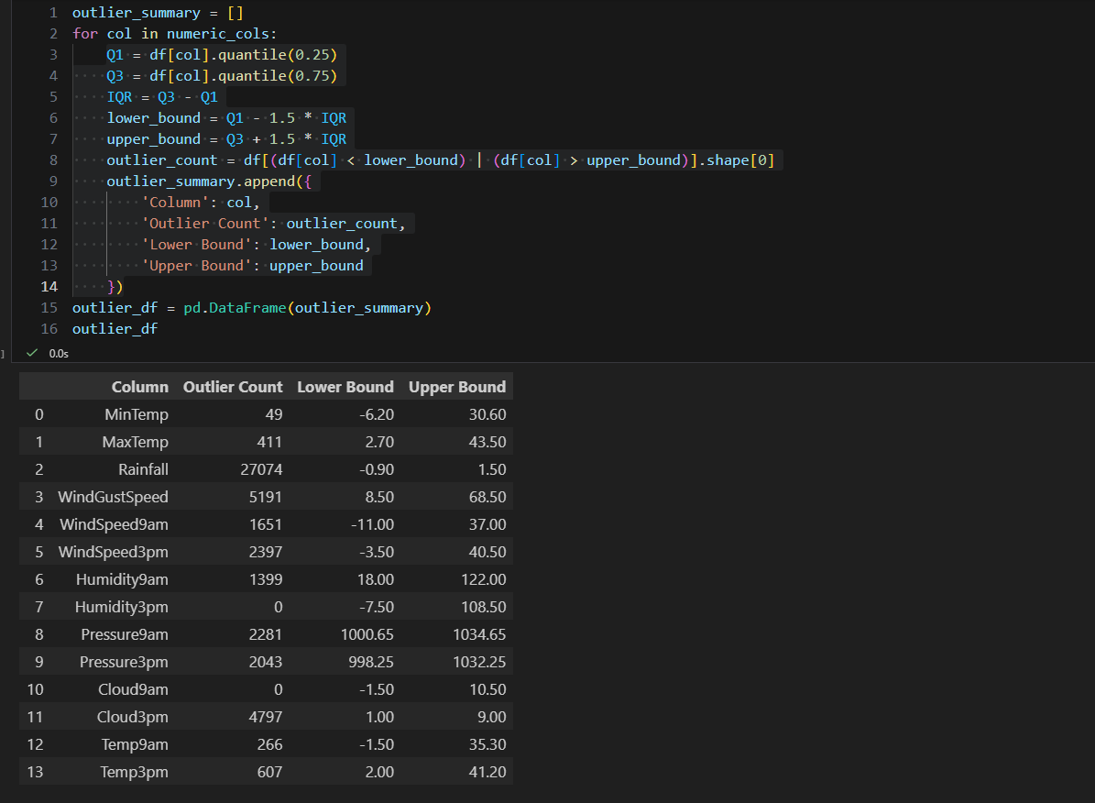
Data preview
outliers:

Slide 5
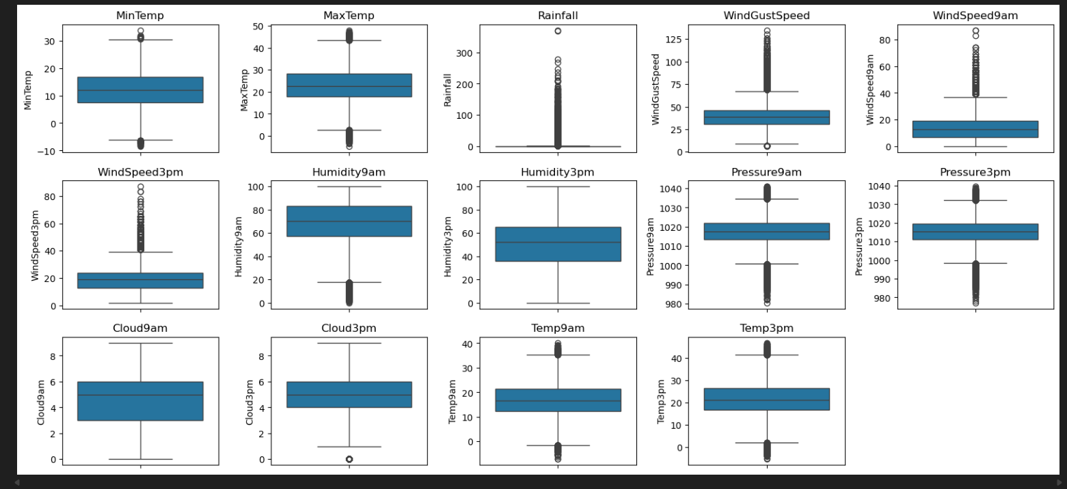
Data preview
outliers:

Slide 6
Data Cleaning
Handling data types
Converted Date to datetime format.
Converted object/text columns into categorical types for efficiency and clarity.
Missing values strategy
You used a smart two-level approach:
Drop rows where columns had very low missing values (<5%).
'MinTemp', 'MaxTemp', 'Rainfall',
'WindDir3pm', 'WindSpeed9am', 'WindSpeed3pm',
'Humidity3pm', 'Humidity9am',
'Temp9am', 'Temp3pm',
'RainToday', 'RainTomorrow'
Drop entire columns that were mostly missing (>40%), such as:
  Evaporation
  Sunshine

Slide 7
Data Cleaning
3.Impute missing numeric features using median for columns like:
  WindGustSpeed
  Pressure9am
  Pressure3pm
  Cloud9am
  Cloud3pm
4. impute categorical features using mode:
  WindGustDir
  WindDir9am

Slide 8
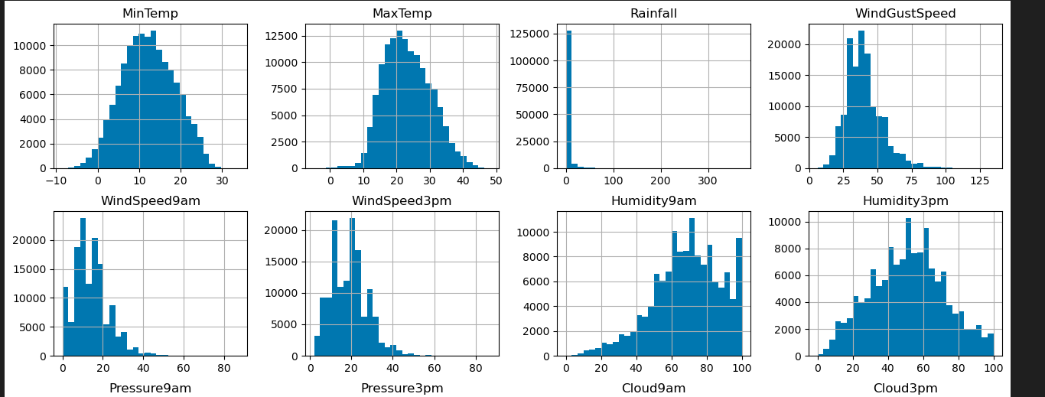
Data Distribution

Slide 9
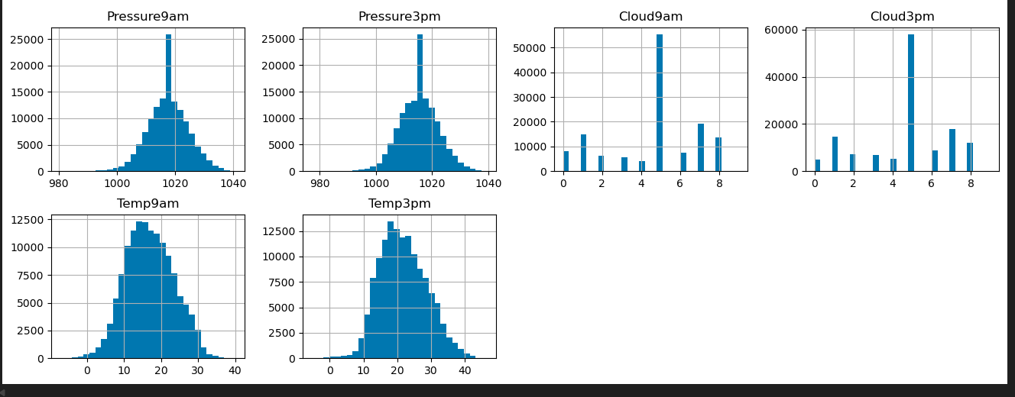
Data Distribution

Slide 10
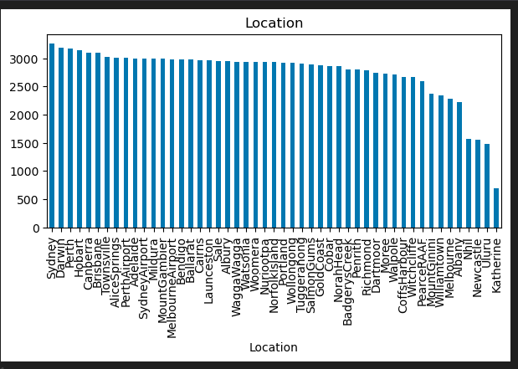
Location Distribution
Sydney is the most raining location

Slide 11
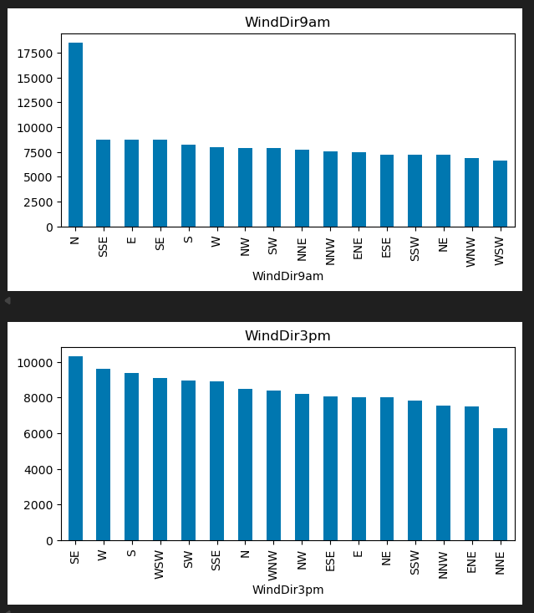
The diff between wind dir at 9am & 3pm

Slide 12
Feature Engineering
Seasonal & time-based features
Extracted Year, Month, Day, DayOfYear
Created a Season feature (Summer, Autumn, Winter, Spring)
Weather-derived features
TempDiff = MaxTemp – MinTemp
PressureDrop = Pressure9am – Pressure3pm
HumidityDiff = Humidity3pm – Humidity9am
WindSpeedChange = WindSpeed3pm – WindSpeed9am
IsWindyDay = 1 if WindGustSpeed > 60 else 0

Slide 13
Analysis

Slide 14
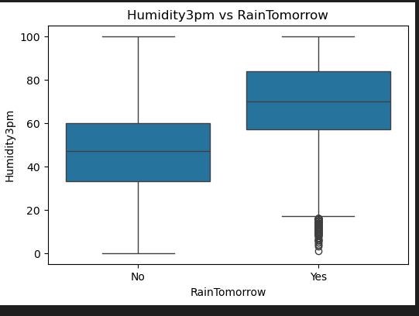
RainTomorrow vs Humidity3pm:
Humidity at 3pm is significantly higher on days when it rains tomorrow
Humidity3pm is the most powerful predictor of rain in the WeatherAUS dataset.
How do humidity levels at 3pm compare between rainy and non-rainy days?

Slide 15
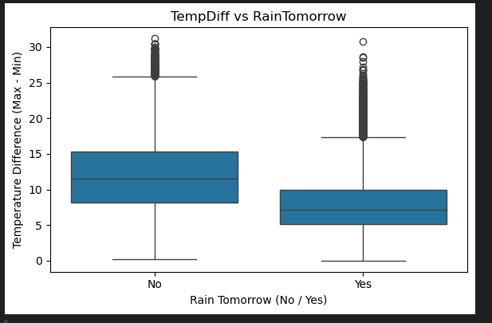
RainTomorrow vs TempDiff
Large temperature swings within the day correlate with a higher chance of rain tomorrow
How does temperature difference (TempDiff) relate to rainfall probability?

Slide 16
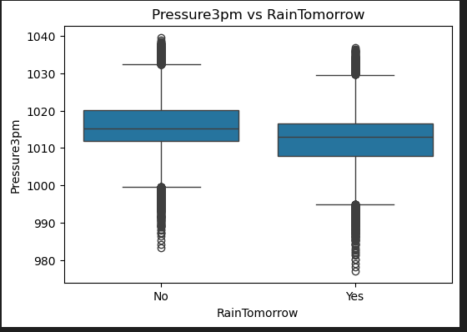
RainTomorrow vs Pressure 3pm
lower on rainy days

Slide 17
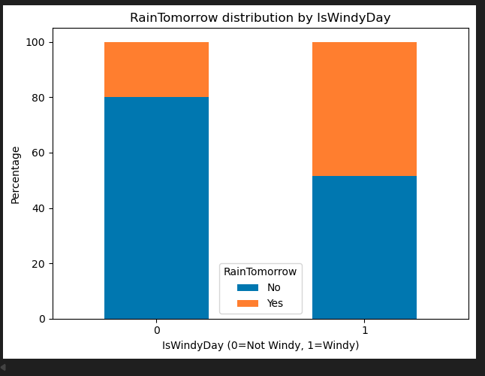
RainTomorrow vs IsWindyDay
Windy days are more likely to be followed by rainfall
Is a high wind gust (>60 km/h) a strong indicator of next-day rain?

Slide 18
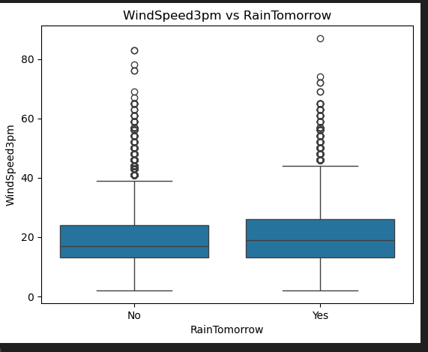
RainTomorrow vs IsWindyDay
Windy days are more likely to be followed by rainfall.
Is WindSpeed3pm higher on days before rain?

Slide 19
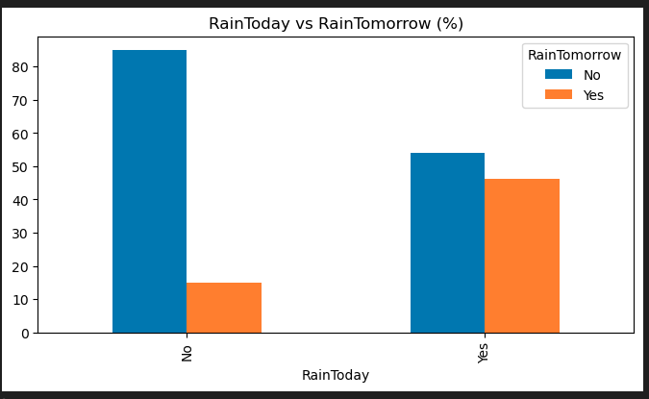
RainToday is a strong temporal predictor for RainTomorrow.
RainTomorrow vs RainToday

Slide 20
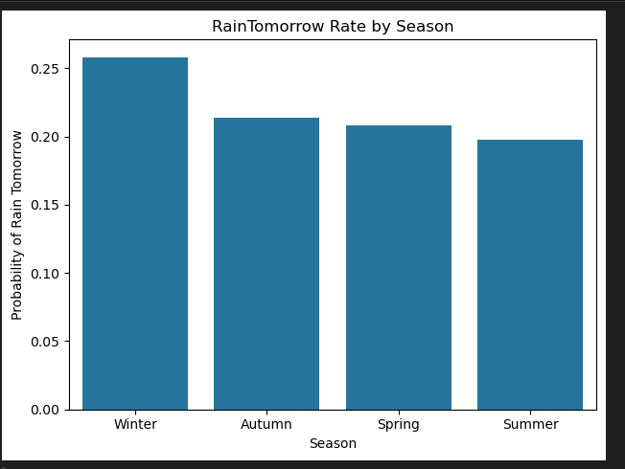
Winter → highest rain probability
Autumn → second highest
Spring → moderate
Summer → lowest rain probability
RainTomorrow vs Season

Slide 21
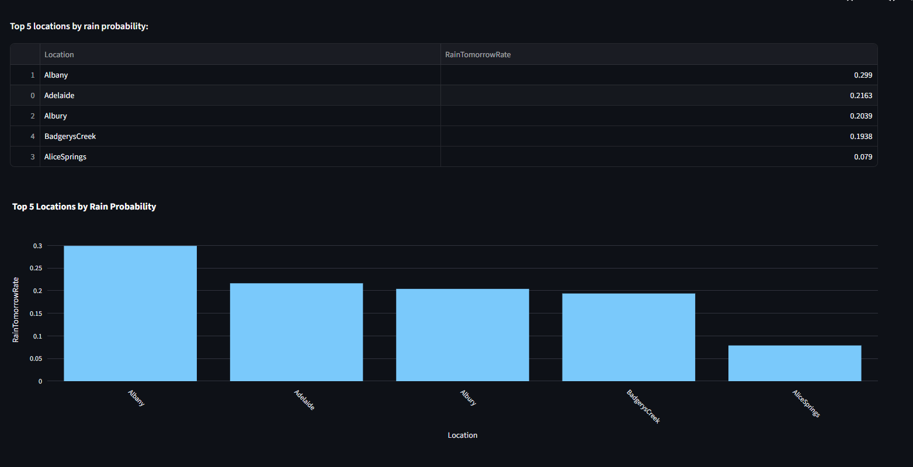
RainTomorrow vs Location

Slide 22
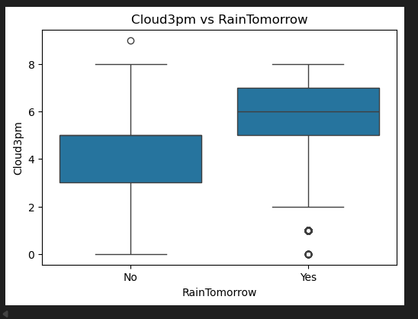
RainTomorrow vs Cloud3pm
Cloud cover in the afternoon is a strong signal of ongoing atmospheric instability.

Slide 23
Summary
Raw shape: 145460 rows × 23 columns
After cleaning: 134590 rows × 31 columns
Removed Sunshine & Evaporation cols
Added new cols : Year - Month- Day - DayOfYear - season - tempdiff - preassure drop - humidty diff - windsoeedchange - iswindyday

Slide 24
ML

Slide 25
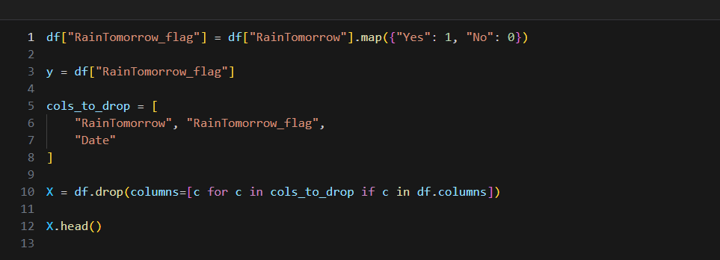
Target
Converted raintomorrow into 1 & 0

Slide 26
Target
Converted raintomorrow into 1 & 0
Splitting target and features

Slide 27
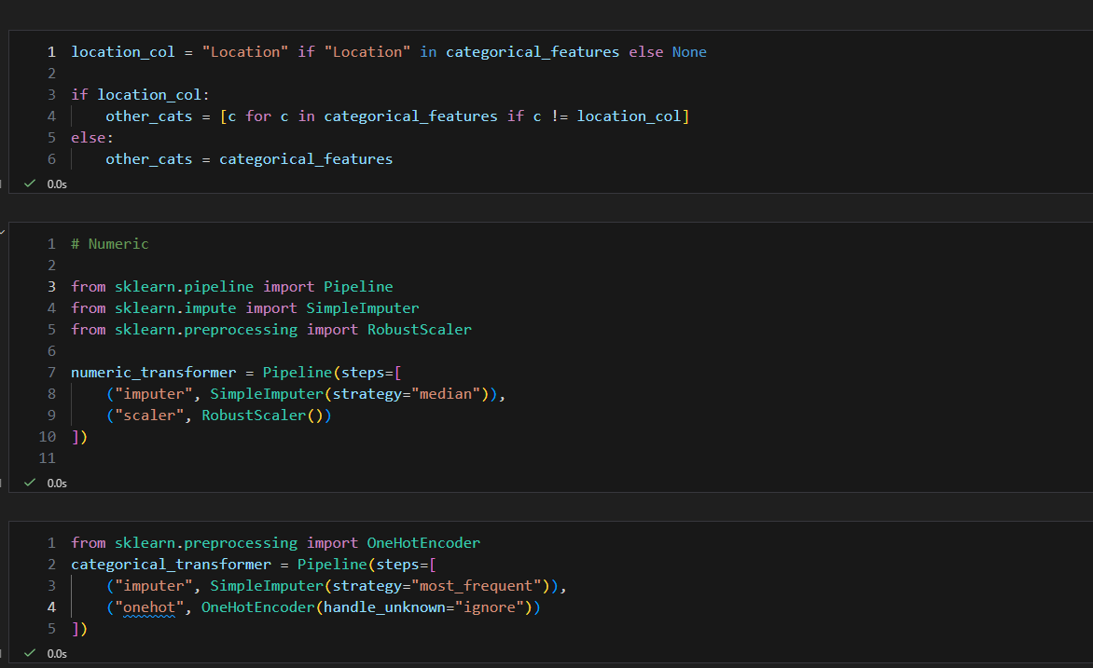
Fill missing values

Slide 28
Fill missing values
1) Selecting Location for Target Encoding
Used target encoder because i have 49 value so it was better than one hot encoder. One hot encoder will create a 49 cols
2) Numeric Transformer – Pipeline for Numerical Features
Handles missing values using the median and scales numerical data with RobustScaler to reduce the impact of outliers.
3) Categorical Transformer – Pipeline for Categorical Features
Fills missing categorical values with the most frequent category and converts text-based columns into numerical format using OneHotEncoding.

Slide 29
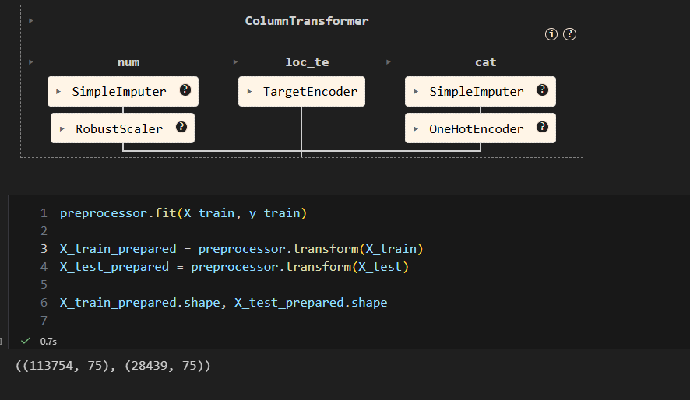
Final preparing

