Slide 1
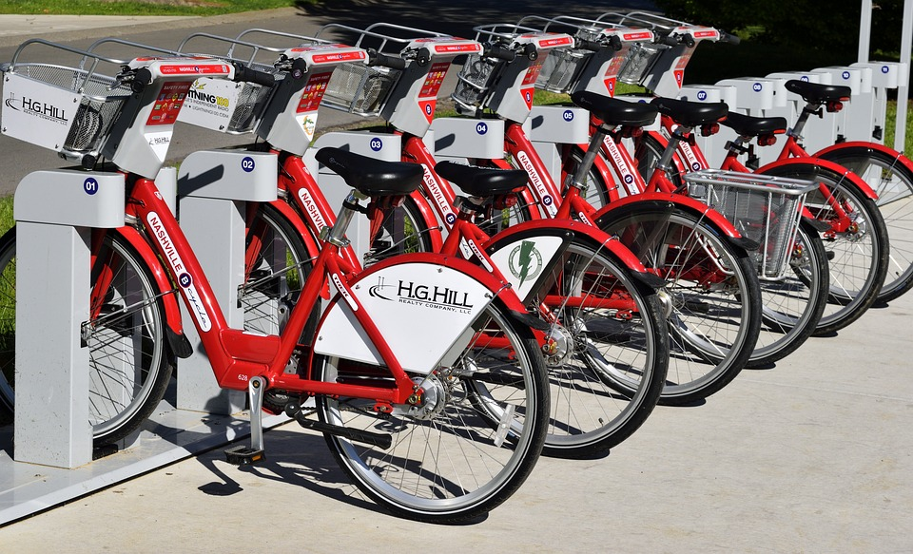
CASE STUDY:
CYCLISTIC
(GOOGLE DATA ANALYTICS CAPSTONE)
BY OMAR FAROOQ PATEL

Slide 2
WHO AM I?
I am someone who is interested in the data and how they effect ones decision, action and strategy. I would like to gain and apply the knowledge and skill at my dispense and to practice them as in the job market and practical manner.

Slide 3
Context of this case:
You are a junior data analyst working on the marketing analyst team at Cyclistic, a bike-share company in Chicago. The director of marketing believes the company’s future success depends on maximizing the number of annual memberships. Therefore, your team wants to understand how casual riders and annual members use Cyclistic bikes differently. From these insights, your team will design a new marketing strategy to convert casual riders into annual members. But first, Cyclistic executives must approve your recommendations, so they must be backed up with compelling data insights and professional data visualizations.

Slide 4
Context of this case:
In 2016, Cyclistic launched a successful bike-share offering. Since then, the program has grown to a fleet of 5,824 bicycles that are geo tracked and locked into a network of 692 stations across Chicago. The bikes can be unlocked from one station and returned to any other station in the system anytime
Until now, Cyclistic’s marketing strategy relied on building general awareness and appealing to broad consumer segments. One approach that helped make these things possible was the flexibility of its pricing plans: single-ride passes, full-day passes, and annual memberships. Customers who purchase single-ride or full-day passes are referred to as casual riders. Customers who purchase annual memberships are Cyclistic members.
Cyclistic’s finance analysts have concluded that annual members are much more profitable than casual riders
The director of marketing and your manager. has set a clear goal: Design marketing strategies aimed at converting casual riders into annual members

Slide 5
Ask phase
Three questions will guide the future marketing program:
How do annual members and casual riders use Cyclistic bikes differently?
Why would casual riders buy annual memberships?
How can Cyclistic use digital media to influence casual riders to become members?
Moreno(The director of marketing and your manager) has assigned you the first question to answer: How do annual members and casual riders use Cyclistic bikes differently?

Slide 6
What is the Objective?
To Convert the Casual Riders into Annual Membership holders:-
See how Casual Members are different from Annual Members.

Slide 7
About the CYCLISTIC
Single Rider
$3.40/Trip
One trip up to 30 minutes
Day Pass
$15/Trip
Unlimited 3 hours in 24 hours period
Annual Membership
$9*/month
Unlimited 45-min rides
* $108/year Annual Sum
Best Value
See Details
See Details
Join Now

Slide 8
Prepare Phase
Find the data and its sources
Check the reliability and biasness of the sources
Sort and filter the data
The data includes the usage of bikes as a casual and annual member and the details associated with it from January 2024 to May 2024.
The data includes the following columns:-

Slide 9
Process Phase
Check the null and error within the data provided.
Clean the data to the best possible extent.
Organize the data in the form so that it is easy to be used by tools in next steps
Document the cleaning process.

Slide 10
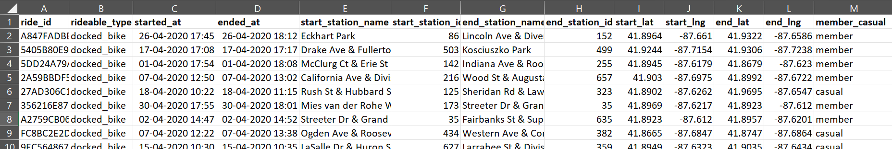

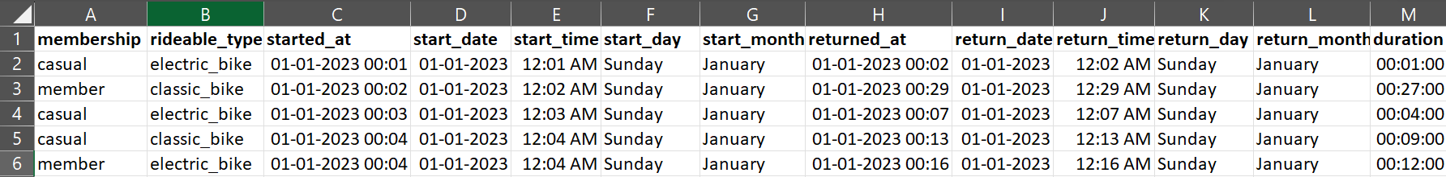
After remove and cleaning the data we organize it into the following columns:-

Slide 11
Analyze Phase
Aggregated your data so its usable and accessible.
Organize and format your data.
Perform calculations.
Identify trend and relations.

Slide 12
After Processing and Analyzing the data I come to conclusion as shown in the above table where we have added all the figures of Casual Member and Annual Members across different months.
1) The Annual Member are almost 3-4 times the Casual Members as they are responsible for major profits.
2) I see that the most number of users are in the month of June-August irrespective of type of Membership.
3) Considering the context we know that it is the Summer Season.
Concluding, We should advertise the casual members the benefits of annual member in the months before the summer season.

Slide 13
Share Phase
Determine the best possible tool that can be used for sharing visuals
Create effective visuals
Present your findings
Ensure your work is accessible

Slide 14
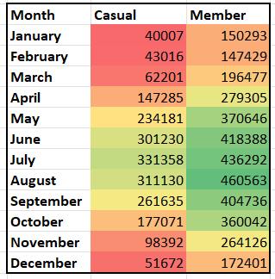
Casual vs Member

Slide 15
Membership on Monthly-Wise

Slide 16
Variation of Casual vs Member

Slide 17
Month-Wise Casual vs Member

Slide 18
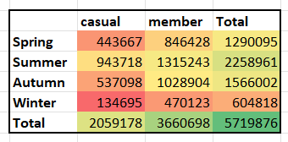
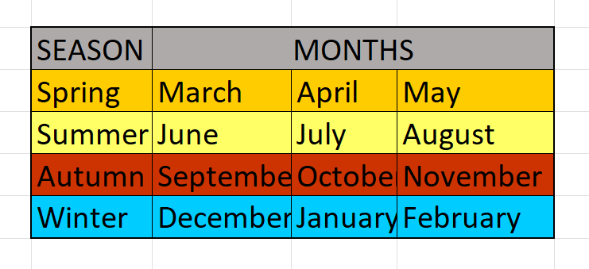
Season Wise Membership

Slide 19
Season Variation

Slide 20
Day-Wise Casual vs Member

Slide 21
Insights
MEMBER
CASUAL
Annual riders are more profitable.
Advertise casual rider the benefits of Annual Member
Before the surge months
(Summer Month).
Casual Riders are less Profitable.
Annual Members ride more summer season.
Casual riders
Ride more in summer season.
Renew the Annual membership
Plan.
Annual Member ride more in working days.
Casual Riders take rides more on weekends.

Slide 22
The Difference Between Casual rider and Annual Member is
The Casual Riders are usually the ones who use the rides most at the week ends which means the are using it for recreational purposes.
The Annual Members are one who use the rides most on the working days that indicates they may be majoring using the rides as working professional.
As the temperature is very low in winter and high in summer which results in decreases and increases the usage of rides respectively.

Slide 23
Suggestions:
Annual membership should be renewed in the terms of “duration of the hours in 24 hour period” and offer other benefits
The new Annual Membership should be advertised to Casual rider before the summer season and before weekends

Slide 24
Act
Create your portfolio and Add your case study.
Links
Linkedin: LinkedIn ID
Githube: OmarFarooq-dotcom

Slide 25
Thank You

