Slide 1
DATA ANALYSIS OF COVID-19

Slide 2
Questions:
What are the total number of Confirmed Cases in different nations?
What are the total number of Recovered Cases in different nations?
What are the total number of Confirmed Cases in India?
What are the total number of Recovered Cases in India?
Can we Forecast Trend-Line for COVID-19?
Can we Group Indian states and find COVID-19 Hits?
Find the Highest Death rate in International level
Find the Least Death rates
Can we find the variation in COVID-19 Cases around the world
Can we forecast the sheet for future and reference

Slide 3
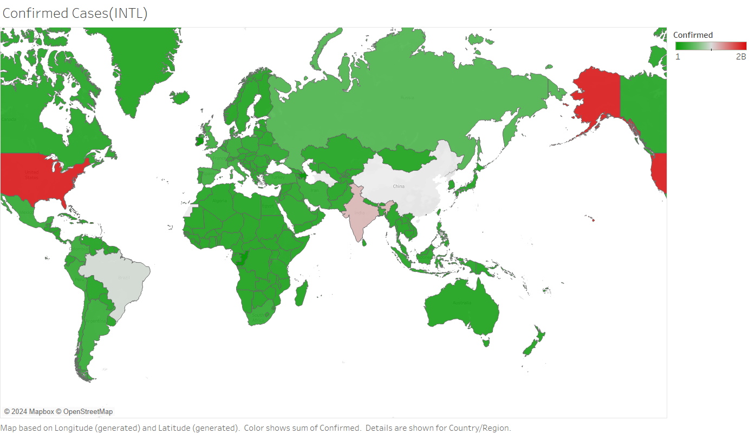
1)
What are the total number of
Confirmed Cases
In
different nations
?

Slide 4
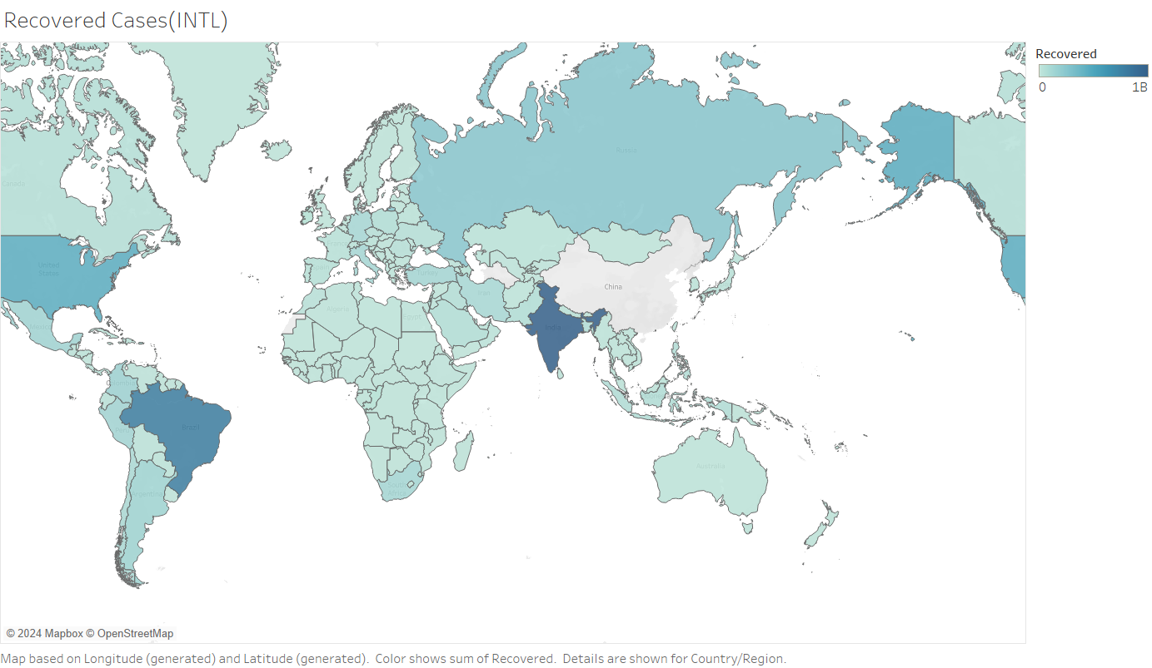
2)
What are the total number of Recovered Cases
in
different nations
?

Slide 5
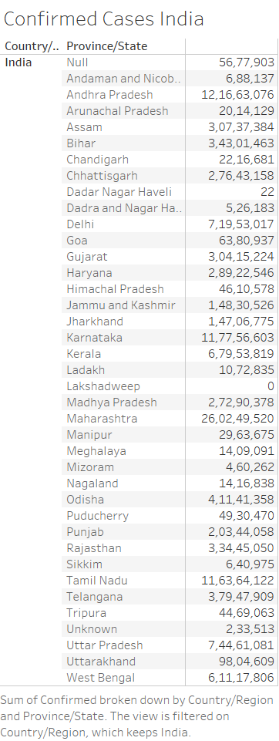
3) What are the total number
Of Confirmed Cases in India?

Slide 6
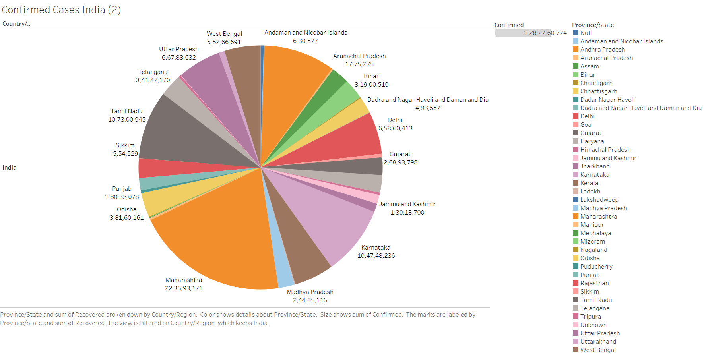
3) What are the total number Of Confirmed Cases in India? (In PIE CHART)

Slide 7
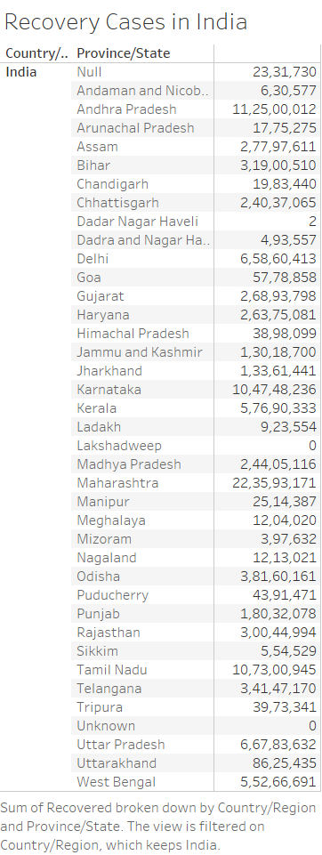
4) What are the total number of Recovered Cases in India?

Slide 8
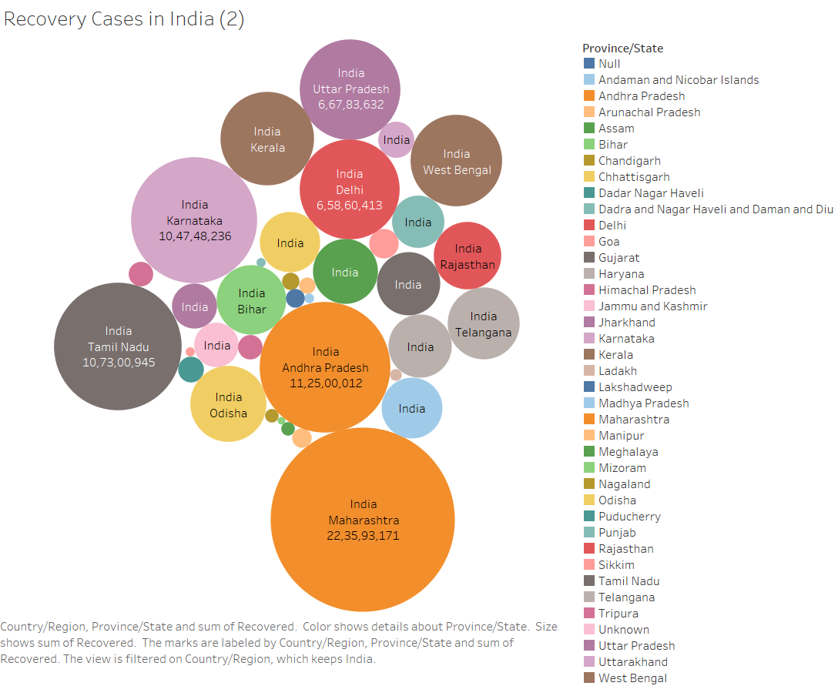
“State Wise”

Slide 9
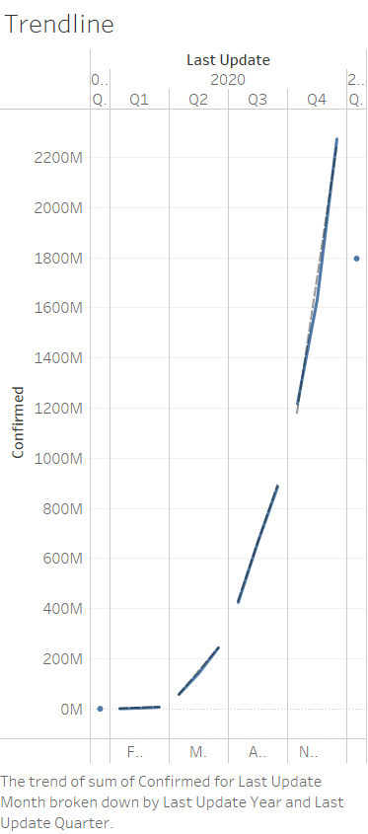
5)Can we Forecast Trend-Line for COVID-19?

Slide 10
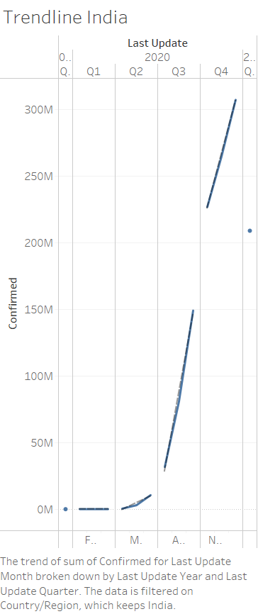
5)Can we Forecast Trend-Line in India for COVID-19?

Slide 11
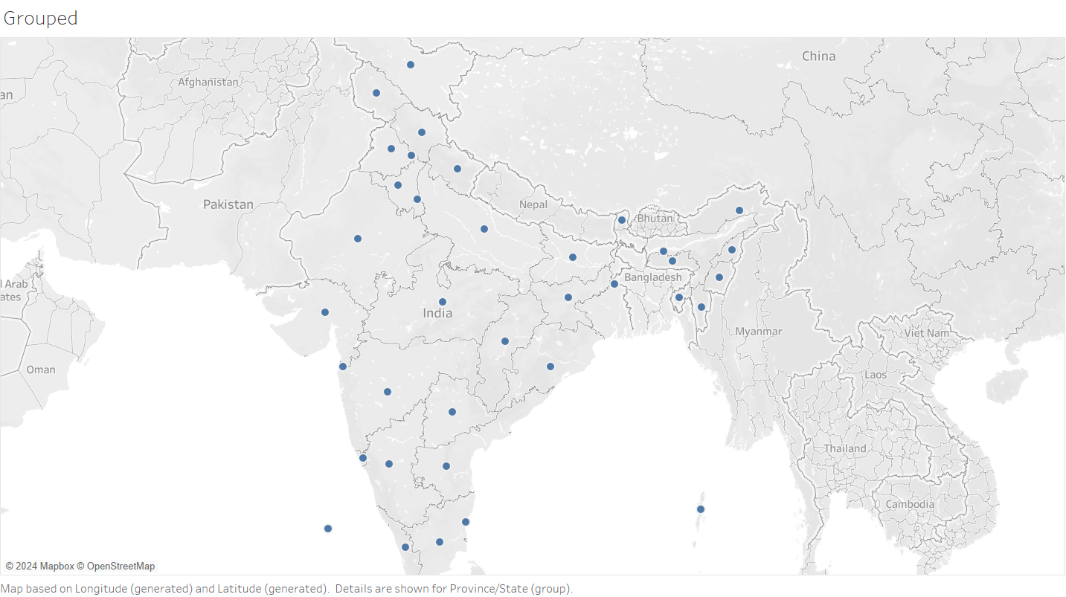
6)Can we Group Indian states and find COVID-19 Hits?

Slide 12
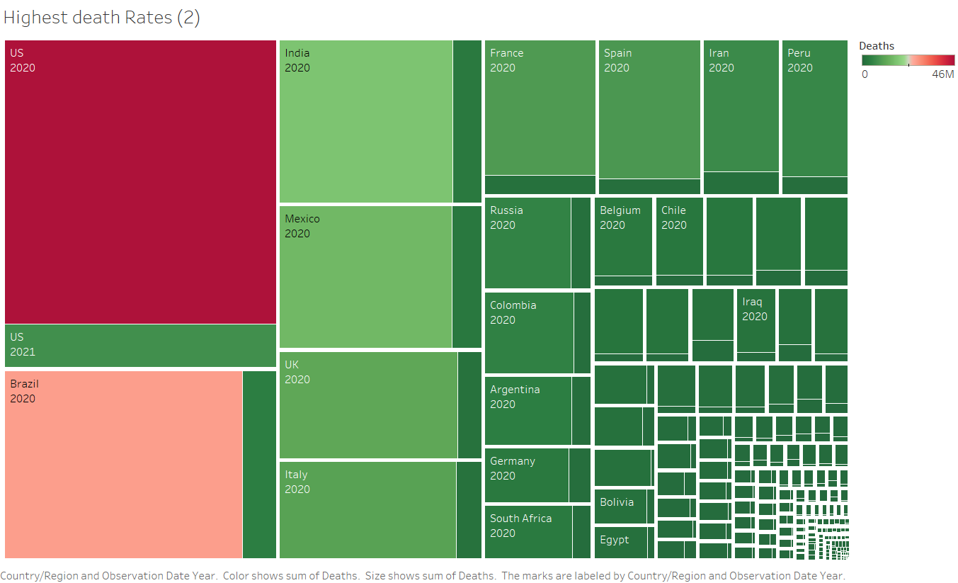
8)Find the Highest Death rate in International level

Slide 13
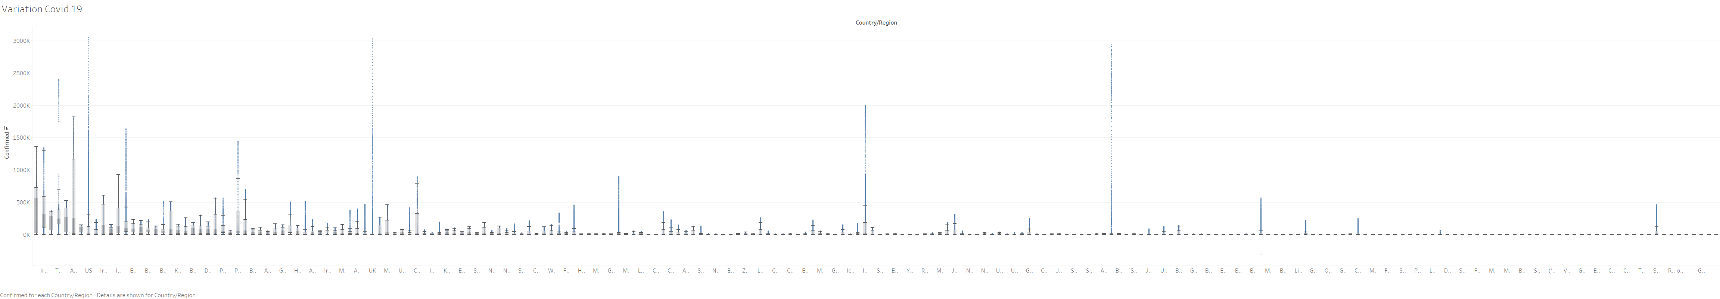
8)Can we find the variation in COVID-19 Cases around the world

Slide 14
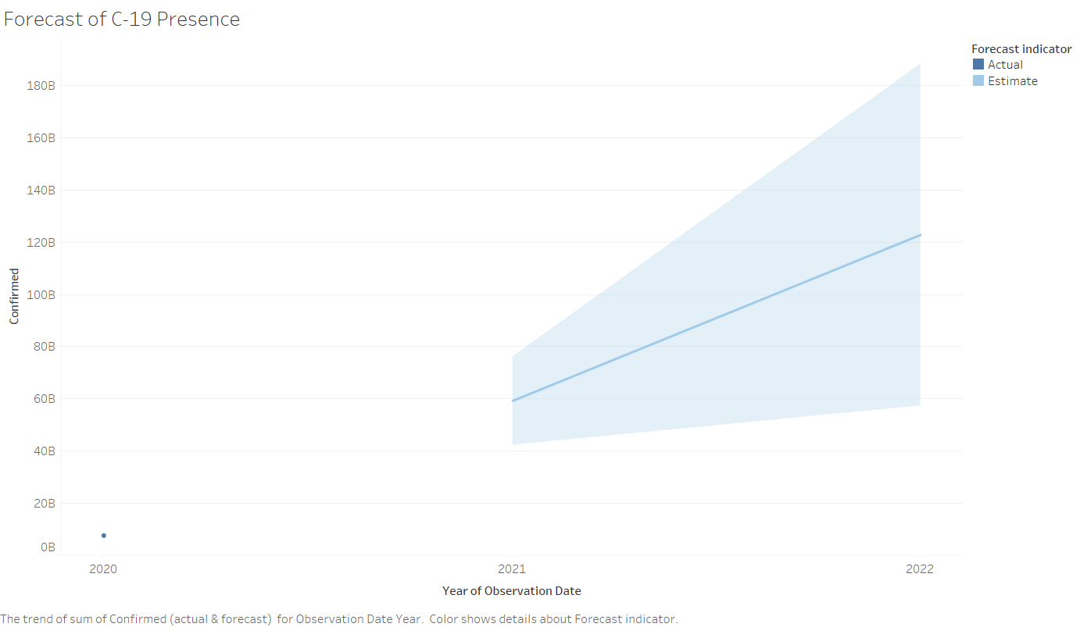
9)Can we forecast the sheet for future and reference

Slide 15
Dashboard of international
figures:
Confirmed Cases
Recovered Cases
Highest Death Cases
Variation of COVID-19
Trendline
Link to International Dashboard

Slide 16
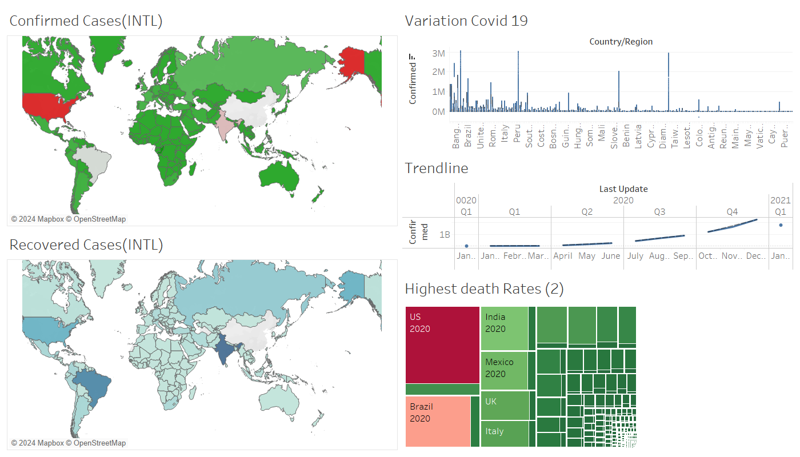

Slide 17
Dashboard of Indian figures:
Confirmed Cases in India
Recovered Cases in India
Grouped States of India
Forecast of COVID-19
Trendline in India
Link to Indian DashBoard

Slide 18
