Slide 1
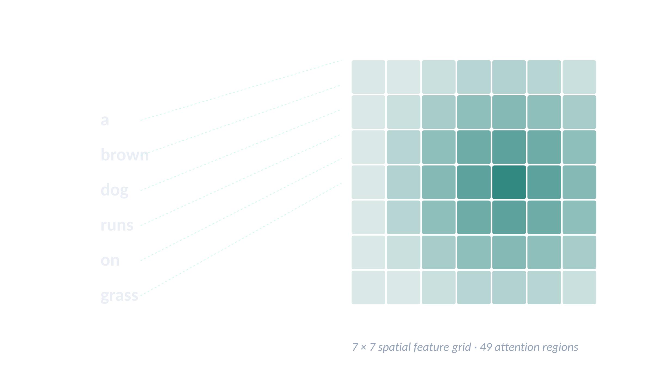
FINAL PROJECT · ITI AI-PRO
Image Captioning
with Visual Attention
From Show-and-Tell baseline to Show-Attend-and-Tell — built, debugged, evaluated, deployed.
0.2403
FINAL TEST BLEU-4
1,091 images · beam search k=5
Omar Gamal ElKady
ITI · AI-Pro Track · Final Project Defense

Slide 2
AGENDA
What we'll cover today
A 25-slide walkthrough from problem statement to deployed service
1–4
Problem & dataset
5–7
Preprocessing
Image captioning, Flickr8k, image-level splits
Tokenizer, vocabulary, image transforms
8–10
Baseline model
11–14
Attention upgrade
Show-and-Tell · the bottleneck
Bahdanau math, decoder loop, why each piece exists
15
Engineering war story
16–17
Inference & evaluation
The identity-copy bug
Greedy, beam search, BLEU/METEOR/CIDEr
18–21
Explainability
22–25
Error analysis & wrap-up
Qualitative grid · attention maps · GradCAM
Failure modes · conclusion
Image Captioning · ITI AI-Pro · Final Project Defense
1 / 25

Slide 3

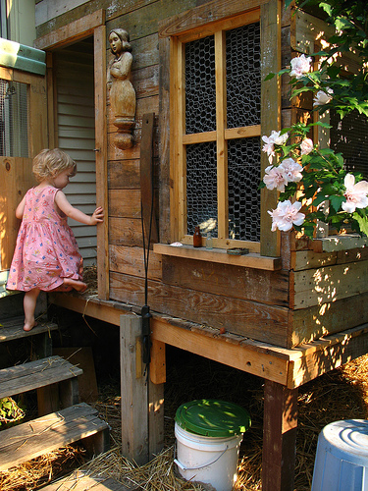


01 · MOTIVATION
What is image captioning, and why is it hard?
An image goes in. A natural-language sentence comes out.
The task
EXAMPLE FROM FLICKR8K
Given an arbitrary image, generate a fluent description of what it shows. Inputs are pixels; outputs are sequences of words.
5 human-written captions:
A child in a pink dress is climbing up a set of stairs in an entry way.
A girl going into a wooden building.
A little girl climbing into a wooden playhouse.
A little girl climbing the stairs to her playhouse.
A little girl in a pink dress going into a wooden cabin.
Why it is hard
Two modalities. Pixels and words live in different spaces — the model must bridge them.
Open-ended output. Many valid captions per image; no single right answer.
Sequential generation. Each word depends on prior words AND on what part of the image is relevant right now.
1000268201_693b08cb0e.jpg
BLEU compares against ALL 5 references
Five different annotators say the same scene five different ways. A correct prediction doesn't need to match any single one — just have enough word/n-gram overlap with the set.
Image Captioning · ITI AI-Pro · Final Project Defense
2 / 25

Slide 4
02 · OVERVIEW
Project at a glance
8,091
40,455
2,557
0.2403
Flickr8k images
image-caption pairs
vocabulary size
Final BLEU-4 (test)
Built across 7 phases
1
2
3
4
5
6
7
Setup
EDA & data
Baseline
Attention
Inference
Error analysis
Deploy
uv env, CUDA, Kaggle
split, vocab, pickles
Show-and-Tell · 0.18
Show-Attend-Tell · 0.22
beam search · 0.24
failure taxonomy
FastAPI + Gradio + Docker
End-to-end: data preprocessing, two model variants, hyperparameter search, full evaluation suite, error analysis, production-ready service.
Image Captioning · ITI AI-Pro · Final Project Defense
3 / 25

Slide 5
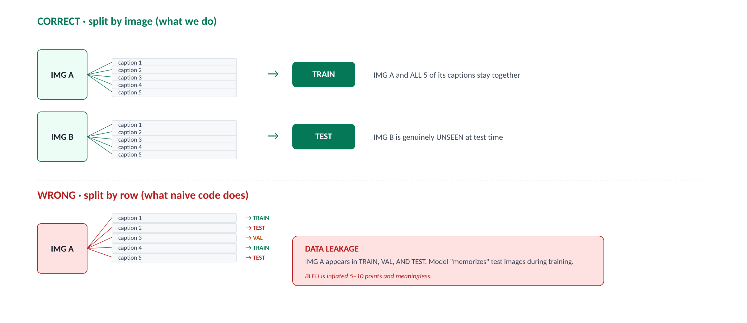
03 · DATASET
Flickr8k — small, careful, image-level split
8,091 photos · 5 captions each · 40,455 rows · split at the image level (not the row level)
6,000
TRAIN images
1,000
VAL images
1,091
TEST images
VERIFIED
assert (train ∩ val == ∅) and (train ∩ test == ∅) and (val ∩ test == ∅)
Image Captioning · ITI AI-Pro · Final Project Defense
4 / 25

Slide 6
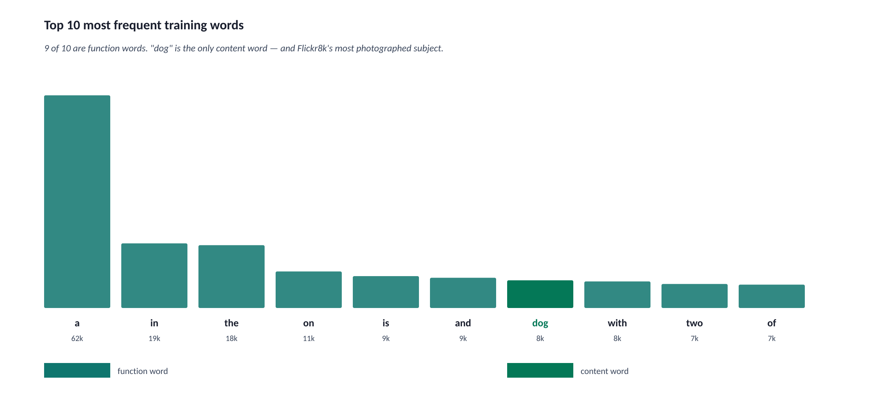
04 · VOCABULARY
The Zipf curve — and why we threshold at frequency 5
Captions are dominated by function words. Rare words can't be learned from a handful of examples.
Three vocabulary decisions
freq_threshold = 5
Words with <5 occurrences across training collapse to <unk>. Below 5 there's no signal to learn from.
vocab size = 2,557
From 7,469 unique training words. Output Linear(512 → 2,557) stays at ~1.3M params — fits the data.
98.7% / 96.4% / 96.1%
Coverage on train / val / test. The 2-3% gap is real <unk> from new words. Good sign.
Plus four special tokens with FIXED indices
0
<pad>
1
<start>
2
<end>
3
<unk>
ignore_index in CrossEntropy
always 1st input at inference
stop signal for generation
unknown / out-of-vocab
Image Captioning · ITI AI-Pro · Final Project Defense
5 / 25

Slide 7
05 · IMAGE PIPELINE
Two transform pipelines — training vs evaluation
Why we preserve aspect ratio · why we normalize · why we randomize only at training
TRAINING
EVALUATION
1. Resize(256) — shorter side to 256, aspect ratio preserved
2. RandomCrop(224) — pick a random 224×224 window each epoch
3. RandomHorizontalFlip(p=0.5) — free 2× data
4. ColorJitter(brightness=0.2, contrast=0.2) — lighting robust
5. ToTensor() — (H,W,3) uint8 → (3,H,W) float [0,1]
6. Normalize(ImageNet mean/std) — match ResNet's distribution
1. Resize((224, 224)) — direct resize to model input size
2. ToTensor()
3. Normalize(ImageNet mean/std)
No randomness at eval — the same image must always produce the same prediction.
Why preserve aspect ratio?
Why normalize?
Why color jitter only B/C?
ResNet learned object proportions on ImageNet. Squashing a 400×500 image to 224×224 distorts shapes — the dachshund stops looking like a dachshund.
ResNet was trained on N(ImageNet mean, std) inputs. Skipping normalization costs ~0.08 BLEU-4 silently.
Brightness and contrast preserve semantics. Jittering hue/saturation would turn 'red dog' into 'blue dog' — invalidating the caption.
Image Captioning · ITI AI-Pro · Final Project Defense
6 / 25

Slide 8

06 · BASELINE
Show and Tell — image as 'token zero'
ResNet50 → 256-dim summary → LSTM. The simplest end-to-end captioner that works.
ARCHITECTURE (Phase 3)
Image as token 0
ENCODER
The 256-dim image feature is concatenated to the embedding sequence — the LSTM sees [image, <start>, a, dog, ...] as one homogeneous stream of vectors.
ResNet50 (frozen) → Linear(2048→256) → BatchNorm → 256-dim vector
DECODER
Frozen ResNet
embedding = nn.Embedding(2557, 256)
inputs = [image, <start>, w₁, w₂, ...]
lstm = nn.LSTM(input=256, hidden=512)
dropout = nn.Dropout(0.5)
fc = Linear(512, 2557) # vocab logits
23.5M ImageNet-pretrained params stay fixed. Only ~525K projection params + ~3.4M decoder params train. Fits 6K images.
Teacher forcing
At training, LSTM receives ground-truth previous words. PyTorch's fused kernel runs all timesteps in ONE call. Fast.
RESULT val BLEU-4 = 0.1772 at epoch 14 · 17 min training on 6 GB GPU · template captions, generic outputs
Image Captioning · ITI AI-Pro · Final Project Defense
7 / 25

Slide 9
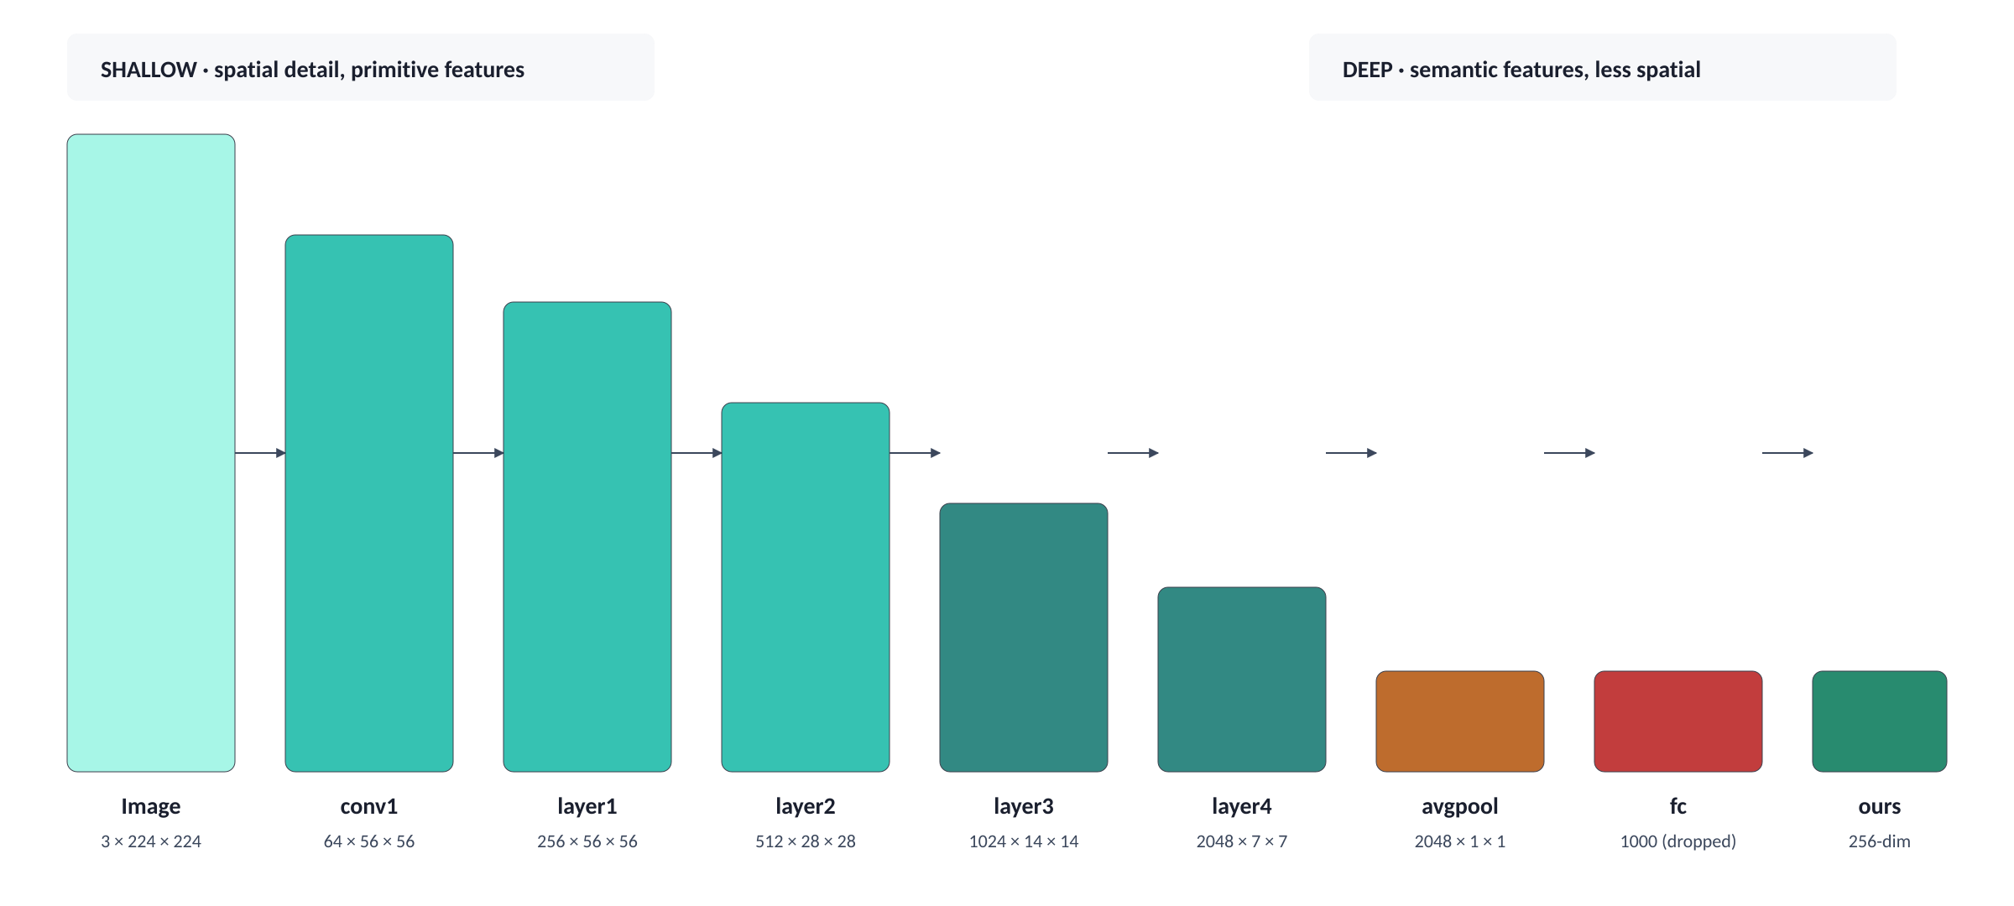
07 · ENCODER DEEP-DIVE
How an image becomes a feature vector
ResNet50 progressively trades spatial detail for semantic depth. We tap into different layers depending on the model.
Baseline tap · [:-1]
Attention tap · [:-2]
Drop only fc. Keep avgpool. Get one 2048-dim summary → project to 256.
Drop fc AND avgpool. Keep the (2048, 7, 7) spatial grid → 49 location vectors.
Image Captioning · ITI AI-Pro · Final Project Defense
8 / 25

Slide 10
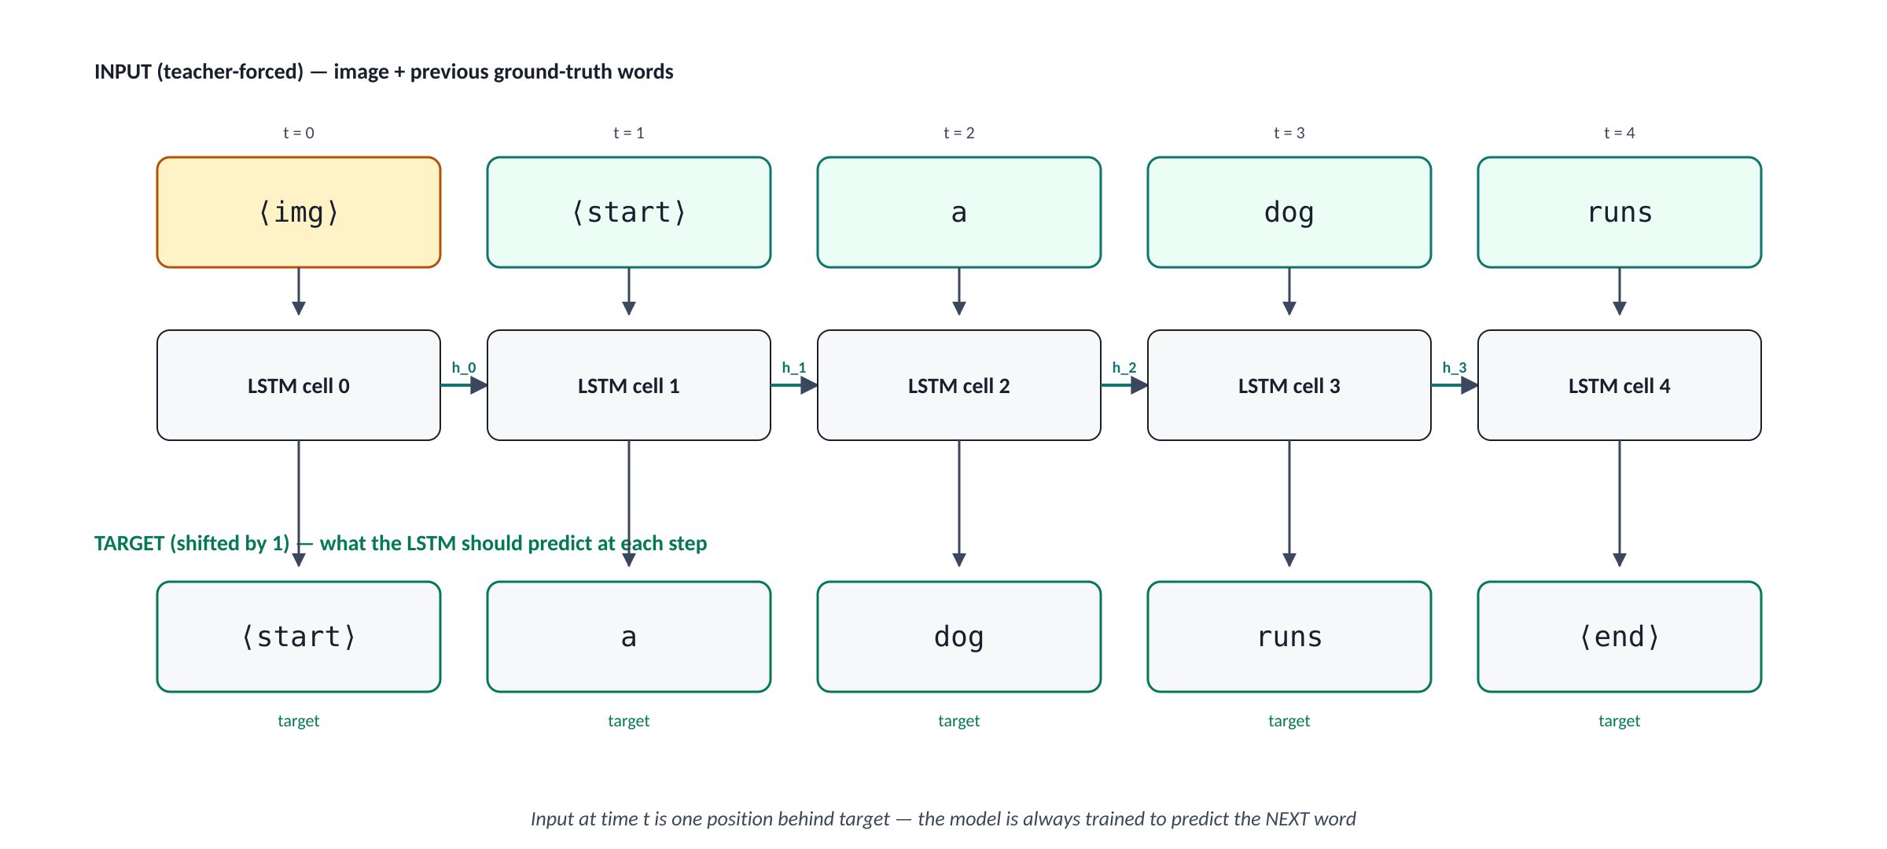
08 · TEACHER FORCING
How the LSTM is actually trained
Inputs and targets are shifted by one position — that's what makes the model learn to predict the NEXT word.
Why it's fast
All inputs are known up front (they're the ground-truth caption). PyTorch's fused LSTM kernel runs all T timesteps in one CUDA call. ~4× faster.
Image Captioning · ITI AI-Pro · Final Project Defense
9 / 25

Slide 11
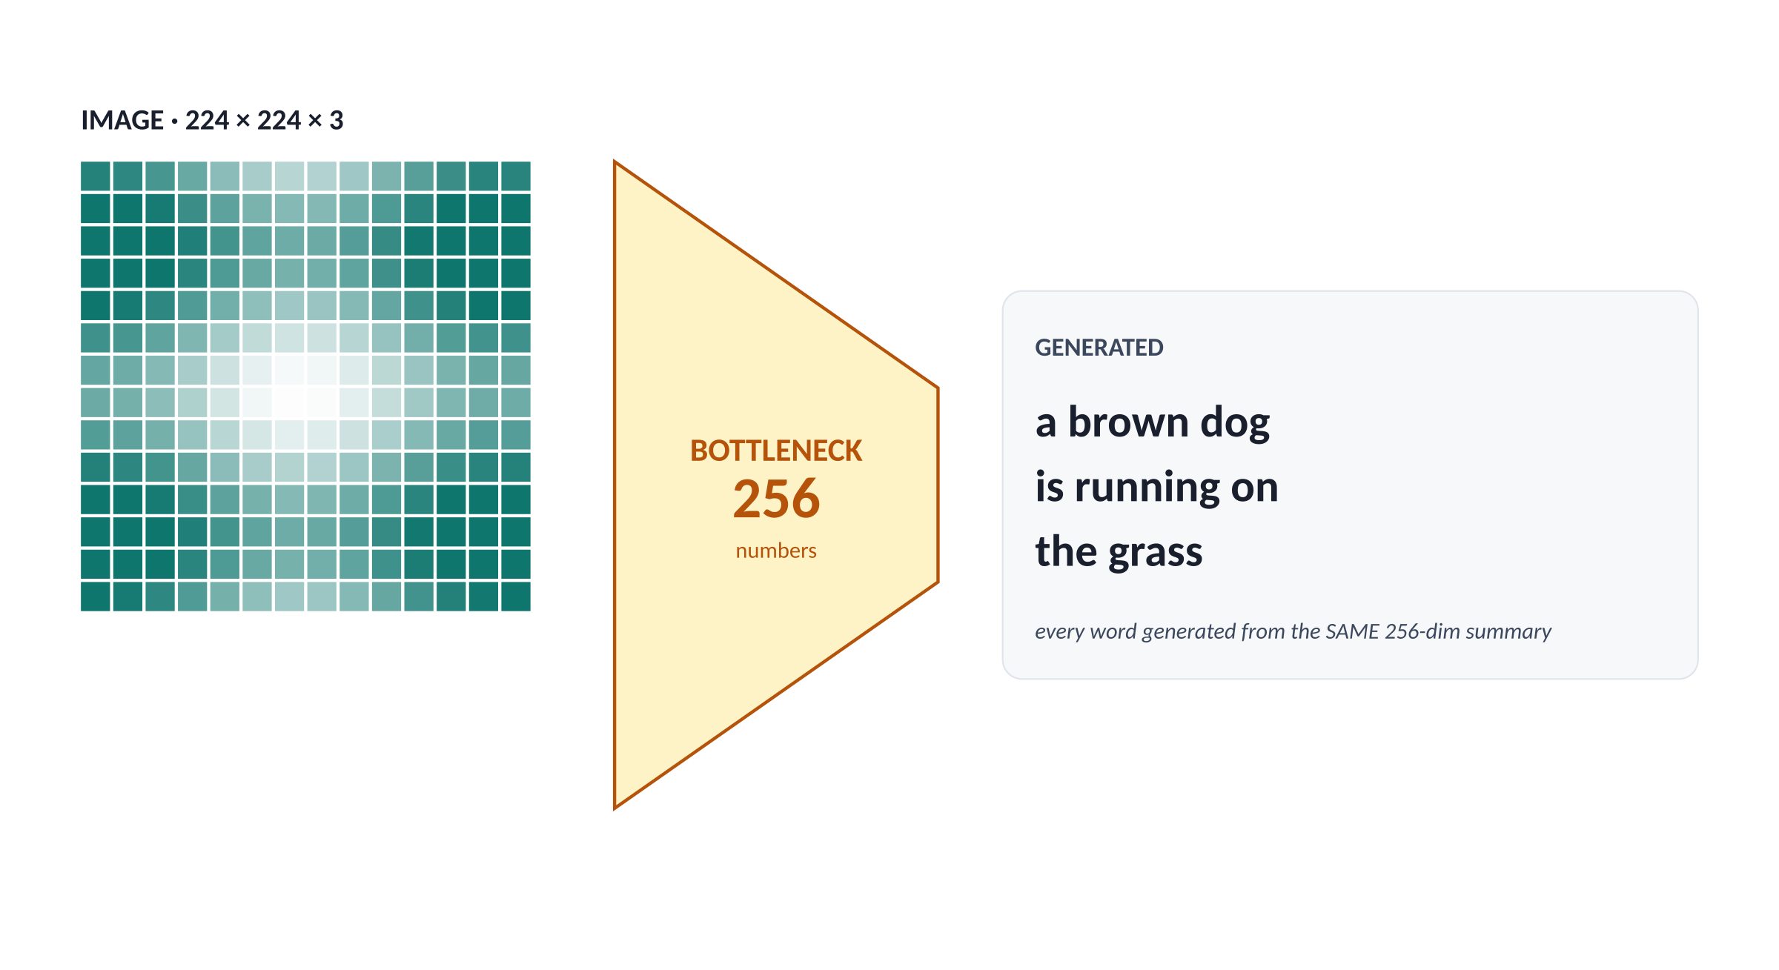

09 · BOTTLENECK
Why one summary vector isn't enough
224×224 pixels compressed to 256 numbers. Every word generated from the same summary.
Three observable failures
Template lock-in
Same skeleton recycled: "a [person] in a [color] [shirt] is [verb] on a [surface]".
Vocabulary collapse
Only 400 of 2,557 known words actually used at inference (15.6%).
Weak attribute grounding
Right object, wrong color. Right scene, wrong action. Summary loses fine details.
THE FIX → keep the spatial grid · let the decoder query different regions per word → ATTENTION
Image Captioning · ITI AI-Pro · Final Project Defense
10 / 25

Slide 12
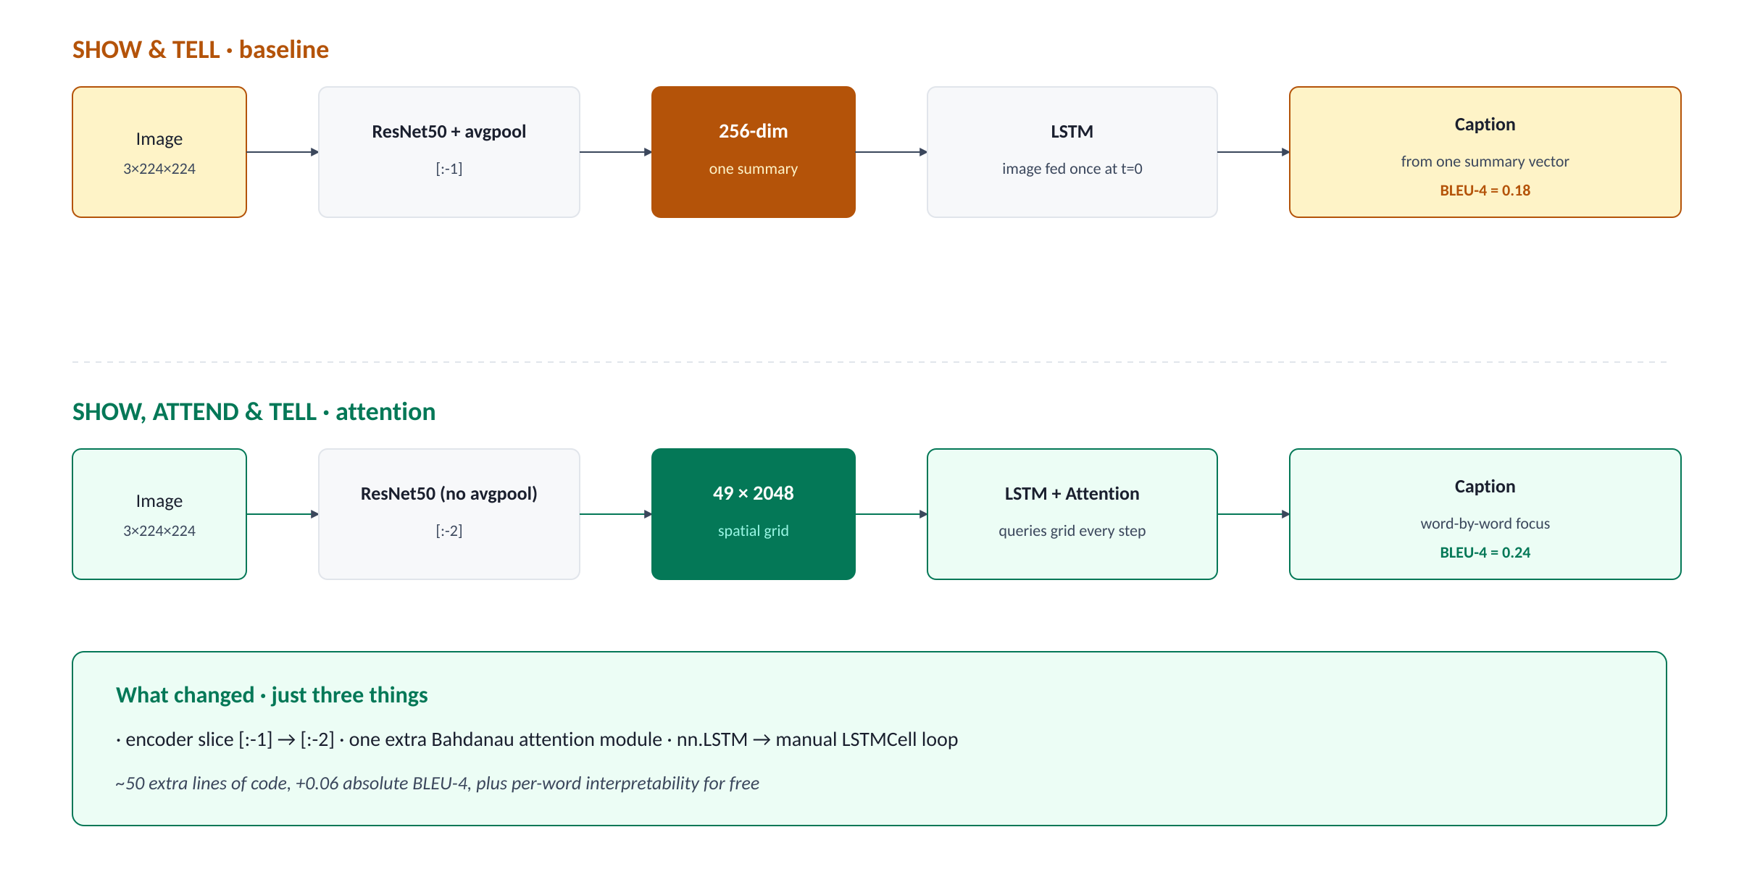
10 · ATTENTION OVERVIEW
Show, Attend and Tell — what changed
The architecture-level diff between the baseline and the attention model.
Image Captioning · ITI AI-Pro · Final Project Defense
11 / 25

Slide 13
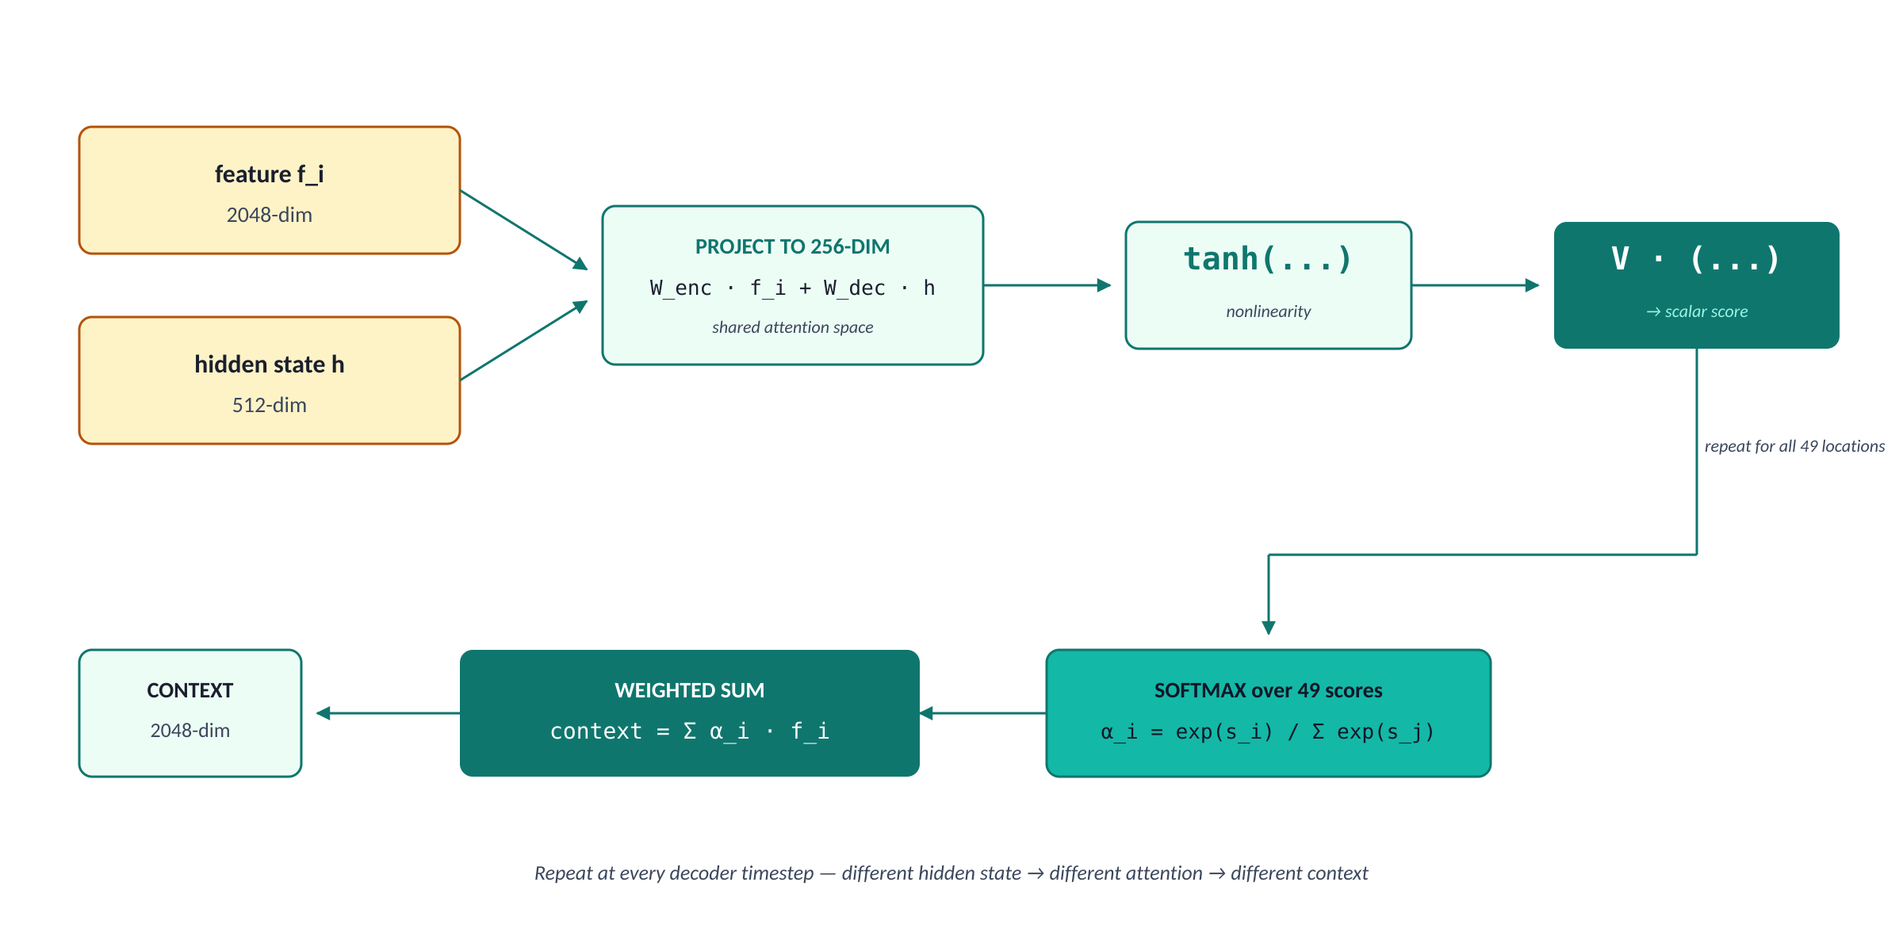
11 · ATTENTION MECHANICS
Bahdanau attention — the score, softmax, blend
Three steps that turn the decoder's question into a custom image summary for the next word.
Image Captioning · ITI AI-Pro · Final Project Defense
12 / 25

Slide 14

12 · ATTENTION INTUITION
Why each piece of the formula exists
Q, K, V — the universal pattern behind every modern attention mechanism.
Attention as content-based lookup
Why each piece exists
QUERY decoder hidden state — what am I looking for right now?
KEYS the 49 spatial features — what's available to look at?
VALUES the same 49 features — what do I retrieve?
Why W_enc and W_dec?
Features are 2048-dim, hidden is 512-dim — different sizes can't be added. Both project into a shared 256-dim attention space.
Why tanh?
Without a nonlinearity the score collapses to a linear function. Tanh is bounded and zero-centered — ideal for similarity scores that can be positive or negative.
Why V?
We need ONE scalar per location to feed softmax. V collapses the 256-dim attention vector into a single learned-weighted score.
Library analogy. Walk into a library with a question (query). Each book's spine has labels (keys). Contents are the values. Score each spine, weight, blend.
Why softmax?
Turns 49 arbitrary scores into 49 weights summing to 1 — a proper probability distribution over locations.
Image Captioning · ITI AI-Pro · Final Project Defense
13 / 25

Slide 15



13 · DECODER LOOP
One timestep of the attention decoder
Five operations per generated word: score, blend, concat, step, project.
STEP 1
STEP 2
STEP 3
STEP 4
STEP 5
Score & softmax
Context vector
Concatenate
LSTMCell step
FC → vocab logits
49 alphas summing to 1
Σ α_i · f_i — 2048-dim blend
[emb(word_t); context_t] = 2304-dim
produces new (h_t, c_t)
Linear(512 → 2,557)
Three implementation notes
LSTMCell instead of nn.LSTM
Initial state from features
Save the alphas
We need to inject attention between every step, so we can't use the fused kernel. Manual Python loop, slower per step but flexible.
h_0 = tanh(init_h(features.mean(dim=1))). The mean of 49 features seeds the hidden state instead of zeros.
We store all 49-dim alphas across timesteps for the doubly-stochastic regularizer and for visualization (the per-word heatmaps).
Image Captioning · ITI AI-Pro · Final Project Defense
14 / 25

Slide 16
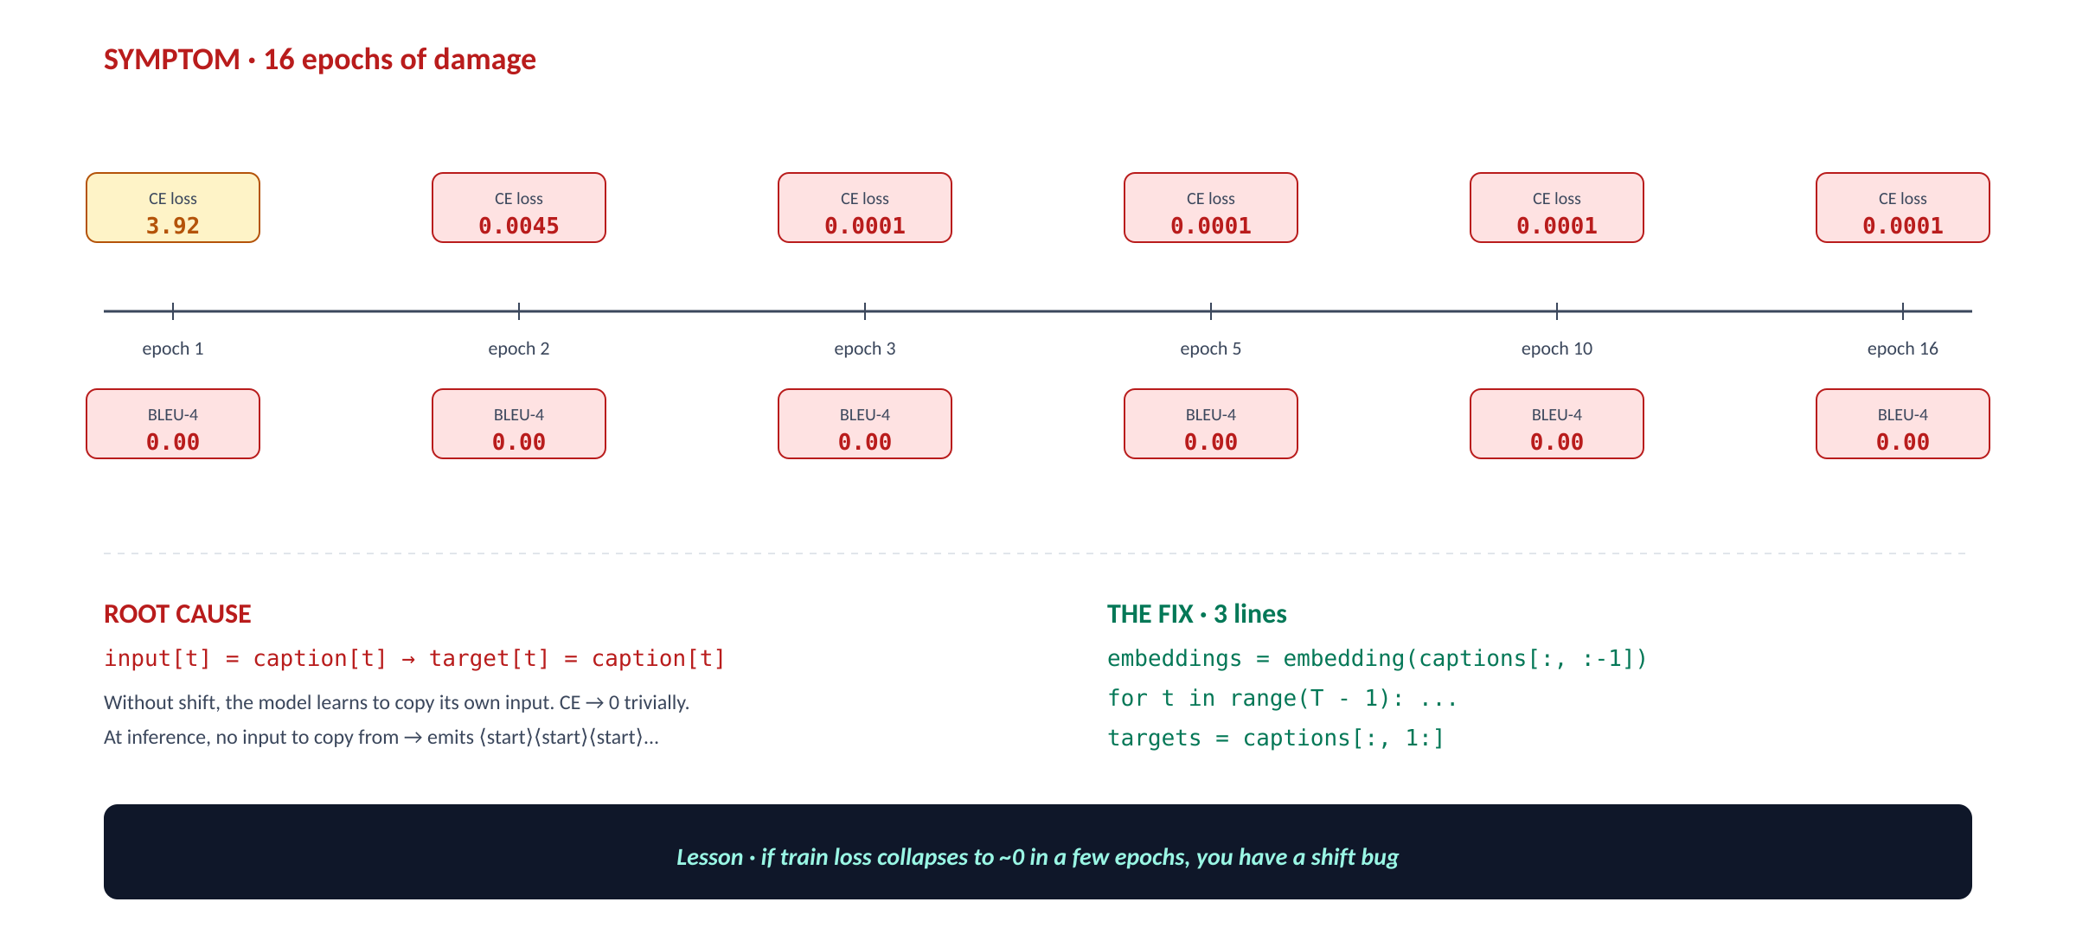
14 · ENGINEERING WAR STORY
The identity-copy bug
Train loss collapsed to 0.0001 in 3 epochs. BLEU stayed at 0.00 for 16 epochs. Here's why.
Image Captioning · ITI AI-Pro · Final Project Defense
15 / 25

Slide 17
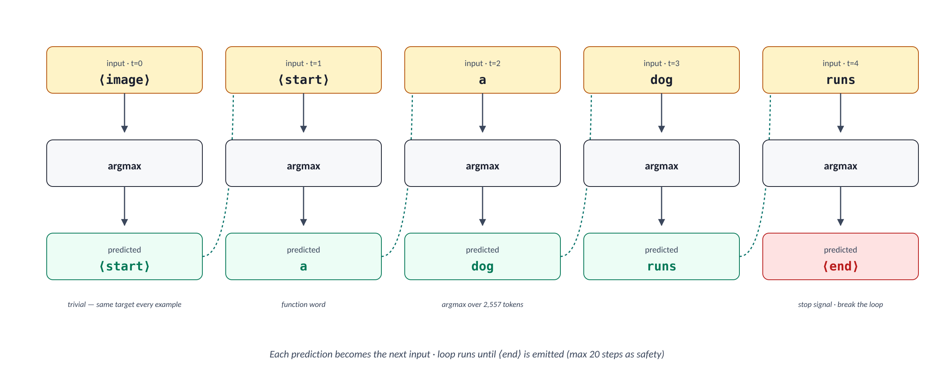
15 · INFERENCE · GREEDY
Greedy decoding — argmax at every step
Fast, simple, locally myopic. Each prediction becomes the next input.
Pro · Fast
Con · Locally myopic
Con · Exposure bias
One forward path. No branching. ~5 sec for 200 val images.
Commits to highest-prob first word. Misses globally better sequences hidden behind low-prob first words.
Trained with ground-truth previous words. At inference must continue from its own (possibly wrong) predictions.
Image Captioning · ITI AI-Pro · Final Project Defense
16 / 25

Slide 18
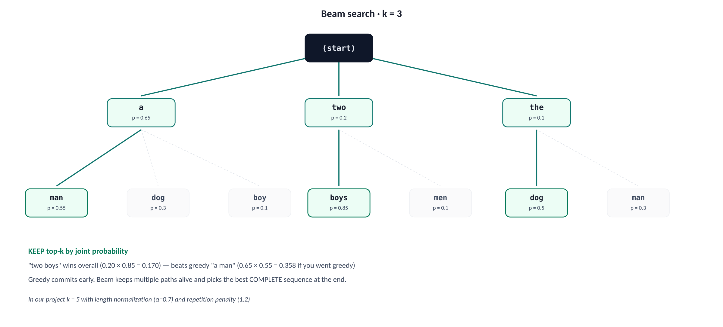
16 · INFERENCE · BEAM SEARCH
Beam search — keep top-k candidates alive
Slower but smarter. Picks the best COMPLETE sequence at the end, not just the best next word.
GREEDY
0.2073
BLEU-4 on full test
BEAM K=5
0.2403
BLEU-4 on full test
+0.033
absolute lift, free
same model, smarter decoding
Image Captioning · ITI AI-Pro · Final Project Defense
17 / 25

Slide 19

17 · RESULTS
Final numbers across the project
BLEU-4 grew from 0.18 (baseline) to 0.21 (+ attention) to 0.24 (+ beam search) — +36% relative.
Metric | Baseline (Show & Tell) | + Attention (greedy) | + Beam (k=5) FINAL
BLEU-1 | 0.586 | 0.626 | 0.6488
BLEU-2 | 0.394 | 0.434 | 0.4714
BLEU-3 | 0.265 | 0.302 | 0.3378
BLEU-4 (headline) | 0.177 | 0.207 | 0.2403
METEOR | — | — | 0.4270
CIDEr | — | — | 0.6004
ROUGE-L | — | — | 0.4795
+36% relative BLEU-4 lift baseline → final · attention contributes ~17%, beam search adds another ~16% on top
Image Captioning · ITI AI-Pro · Final Project Defense
18 / 25

Slide 20
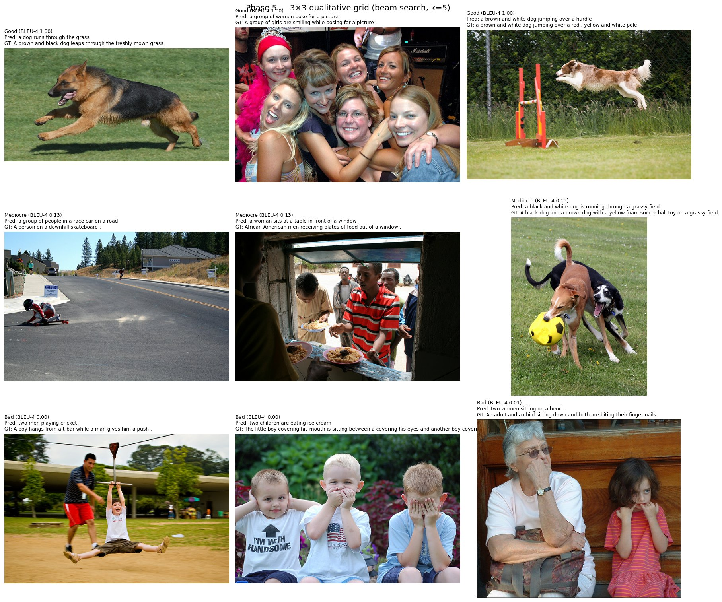
18 · QUALITATIVE RESULTS
What the model actually produces — Good, Mediocre, Bad
9 random test images sampled across the BLEU-4 range. Beam search k=5.
OBSERVATION the model is reliable on dogs and groups · struggles with action verbs and rare scenes (skateboarding, fencing, t-bar)
Image Captioning · ITI AI-Pro · Final Project Defense
19 / 25

Slide 21
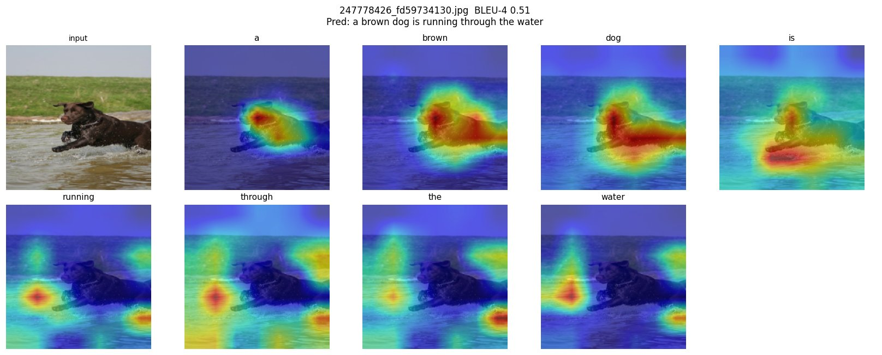
19 · EXPLAINABILITY · ATTENTION
Per-word attention — when it works
Real output from our model · BLEU-4 = 0.51 · prediction matches reality.
'brown' & 'dog'
'running'
'water'
attention concentrates tightly on the dog's body — color and object grounding work together
lights up on the splashing water around the legs — verb is grounded in motion cues
spreads to the river surface below the dog — scene-level attribute correctly localized
PRED: "a brown dog is running through the water" · BLEU-4 = 0.51
Image Captioning · ITI AI-Pro · Final Project Defense
20 / 25

Slide 22
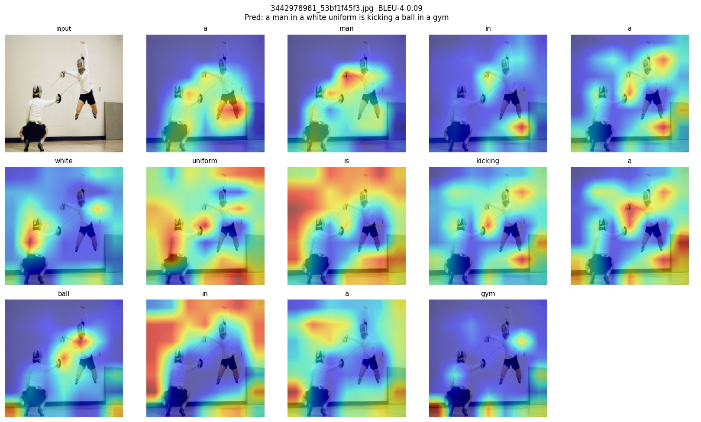
20 · EXPLAINABILITY · WHEN ATTENTION FAILS
Right region · wrong words — the limits of pure attention
Same architecture, different image. Attention is fine but the decoder hallucinates.
DIAGNOSIS
Image truth
Two fencers in white uniforms, one mid-jump, sabres extended.
Model says
"a man in a white uniform is kicking a ball in a gym"
What attention got right
It DID look at the fencers. The maps for 'man' and 'white uniform' focus on the jumping figure correctly.
What went wrong
Decoder defaulted to a TRAINING-CORPUS template. 'White uniform + gym + jumping' = sports → 'kicking a ball'. The model has never seen fencing.
PRED: "a man in a white uniform is kicking a ball in a gym" · BLEU-4 = 0.09 (template lock-in)
Image Captioning · ITI AI-Pro · Final Project Defense
21 / 25

Slide 23
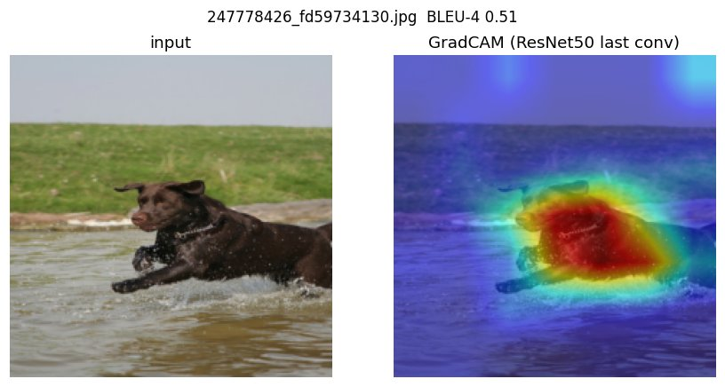
21 · ATTENTION vs GRADCAM
Two interpretability methods on the SAME image
Attention queries the spatial grid per-word · GradCAM finds salient regions for the encoder, post-hoc.
GRADCAM (encoder, post-hoc)
ATTENTION (decoder, per-word)
One heatmap per image · shows where the encoder's last conv layer fires hardest.
9 heatmaps · one per generated word · shows what the decoder queried at each step.
Source: gradient of mean(features) w.r.t. layer4
Granularity: one heatmap per image
Cost: one extra backward pass
Source: the alphas tensor in the decoder
Granularity: one heatmap per generated word
Cost: free — already computed
Image Captioning · ITI AI-Pro · Final Project Defense
22 / 25

Slide 24
22 · ERROR ANALYSIS
Where the model fails — six recurring patterns
Corpus BLEU is optimistic. Per-image median is much lower. Half the predictions miss badly.
1
Missing object
2
Wrong attribute
3
Wrong relationship
Caption omits a salient object in the scene.
Right object, wrong color/size — 'red' vs 'blue' shirt.
Right objects, wrong action — 'dog chasing' vs 'dog beside'.
4
Generic caption
5
Hallucination
6
Repetition
Template slot-filling: 'a man is standing on a beach'.
Object that's not in the image at all (rare but visible).
Same word/bigram repeated — 'dog dog' or 'on the on the'.
Vocabulary collapse
Per-image BLEU is bimodal
400 of 2,557 words actually used (15.6%)
median 0.128 vs corpus 0.24
'safe-word bias' — the model converges on a vocabulary subset and stays there.
43% of predictions score below BLEU-4 = 0.1 — corpus number is optimistic.
Image Captioning · ITI AI-Pro · Final Project Defense
23 / 25

Slide 25


23 · WHAT I LEARNED
Conclusion
Architecture
Engineering
Methodology
Show-Attend-and-Tell cleanly beats Show-and-Tell. Attention isn't just a BLEU lift — it's interpretability.
The identity-copy bug is the lesson · if loss collapses to zero, you have a shift bug. Always inspect input/target alignment.
Save-on-best vs save-on-last. Image-level splits. Same tokenizer everywhere. These small disciplines determine whether your numbers are real.
Final · BLEU-4 0.2403 · METEOR 0.4270 · CIDEr 0.6004 · ROUGE-L 0.4795
Thank you · questions welcome.

