Slide 1
A Solution to Improve Helmet Detection Across Any Construction Site
Presented by: Omar Geasa
Supervision: Dr. Elhossieny

Slide 2
Agenda
Intrdouction
Model Architecture
Problem Statemtent
Results
Future Work

Slide 3
Introduction
Automated detection of Personal Protective Equipment (PPE) has become increasingly important for maintaining safety in construction and industrial environments. Modern computer vision models such as YOLO offer fast and reliable detection, making them suitable for real-time monitoring through surveillance systems.
To build effective PPE detection models, datasets must be prepared in a consistent and model-compatible format. This includes converting annotation formats, structuring image and label directories, and ensuring clean training/validation splits. Proper dataset preparation is the foundation for achieving accurate and stable model performance.

Slide 4
Problem Statement
Most available PPE datasets use XML annotations, which are not directly compatible with YOLO’s required input format. This creates a barrier for researchers and developers who want to train YOLO-based models efficiently.
Furthermore, existing datasets often contain inconsistencies in class naming, annotation structure, and folder organization. Without transforming and standardizing these datasets, model training becomes unreliable, and evaluation results become inaccurate, limiting the real-world applicability of PPE detection systems.

Slide 5
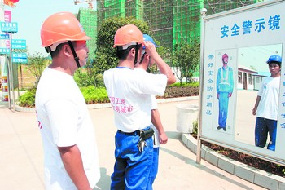
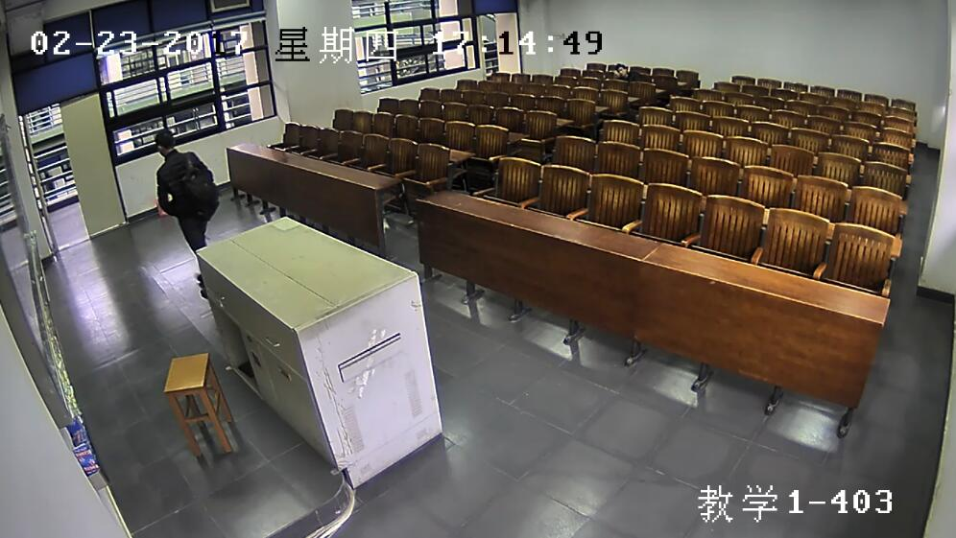
Dataset overview

Slide 6
Model Architecture
Preprocessing Conversion
XML to YOLO TXT
Normalize bbox
Create train/val split
Generate Data .yml
Raw VOC dataset
Images + XML Labels
YOLO Ready Dataset
Train/images, Train/label
Val/images, Val/label
Model Evaluation
mAP50
mAP50-95
Precision
Accuracy
YOLO Training
Best.pt model weights

Slide 7
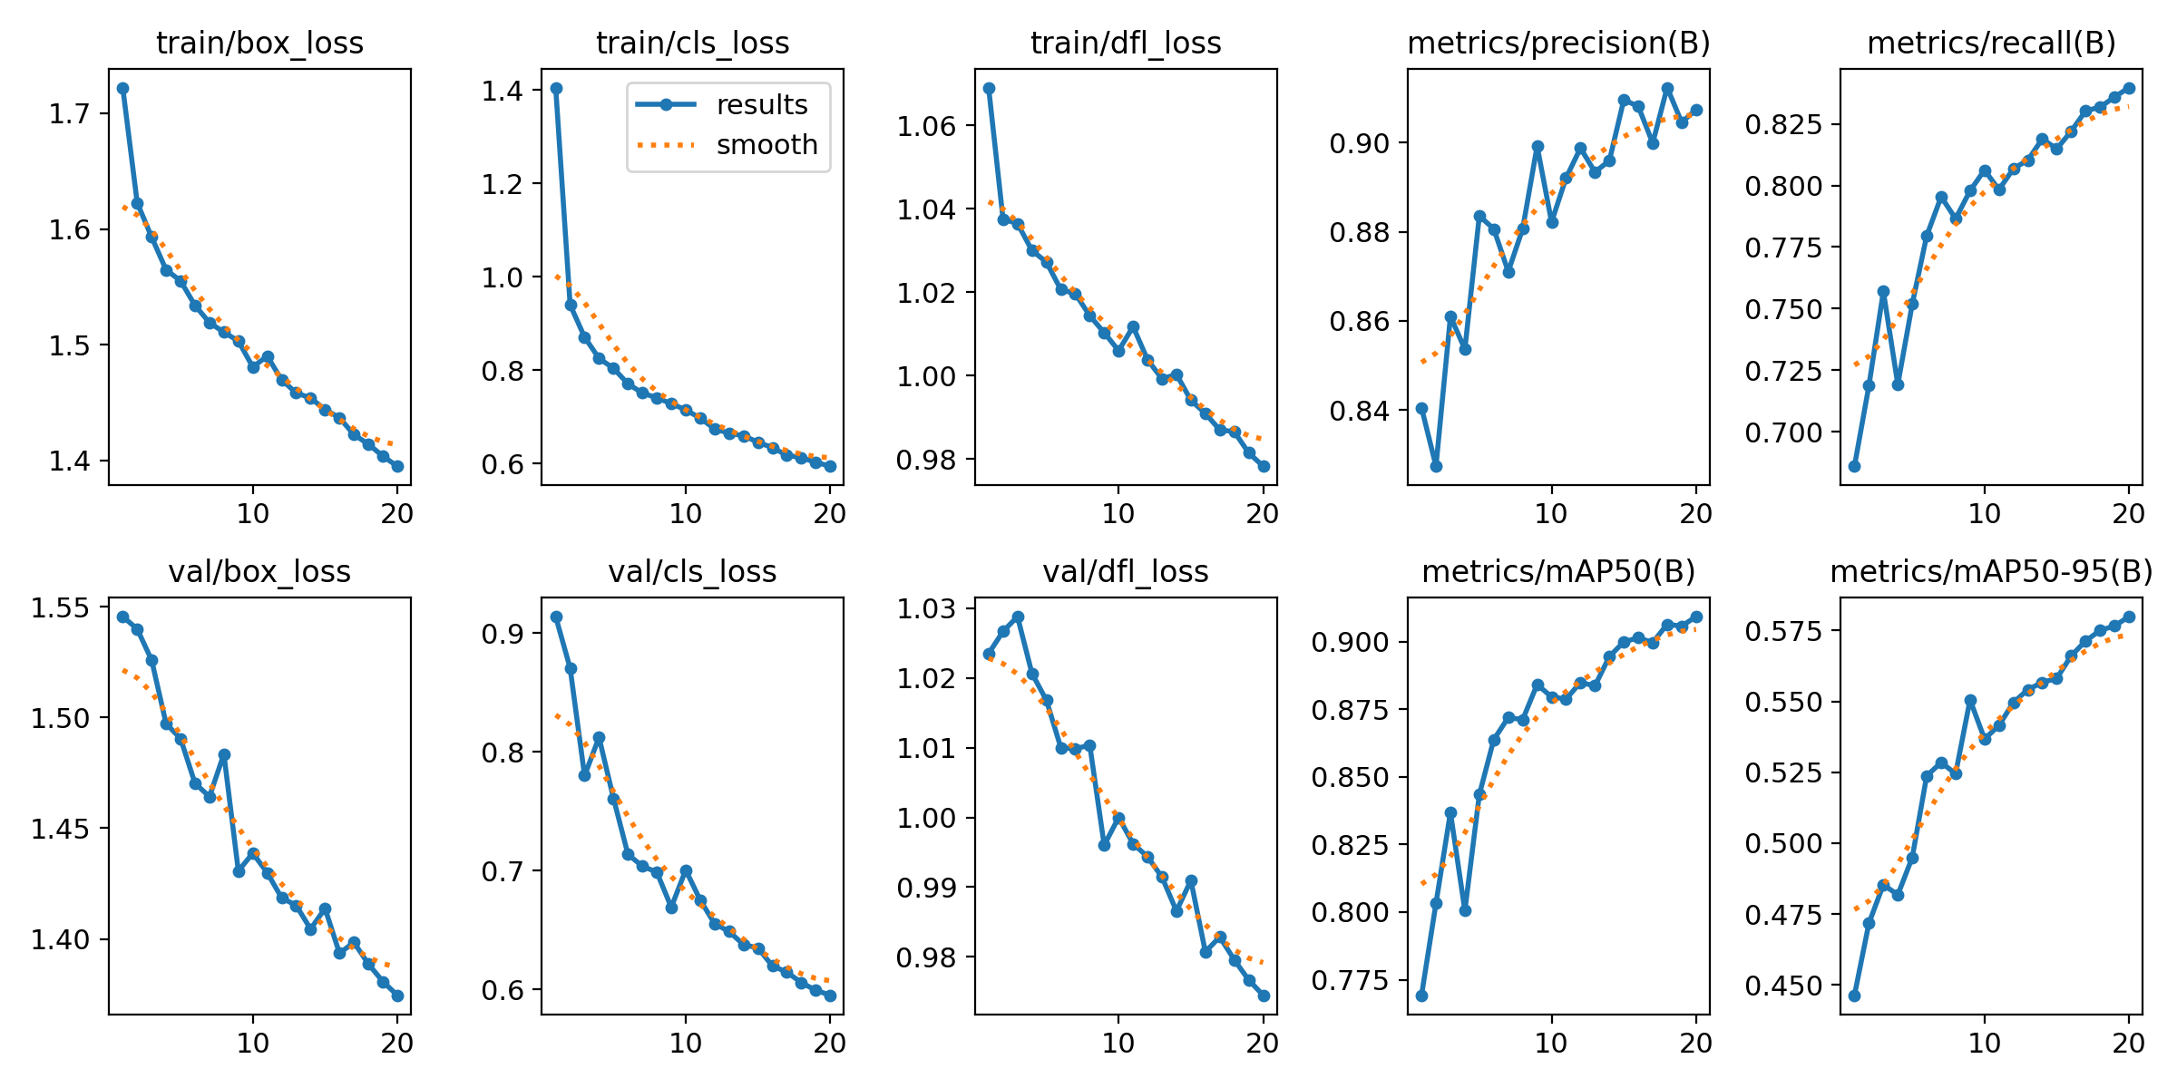
Results

Slide 8
Results
Metric | Final Value | Trend | Interpretation for Paper
metrics/mAP50(B) | ~0.92 | Steady Increase | Excellent localization accuracy when 50% overlap is required. This is your primary "Accuracy" benchmark.
metrics/recall(B) | ~0.85 | Strong Increase | The model successfully identified ~85% of all ground-truth objects (helmets/heads) in the validation set.
metrics/mAP50-95(B) | ~0.47 | Steady Increase | Lower value indicates that the model struggles slightly with precise bounding box placement (high IoU requirement).
val/box_loss | Strong Decrease | Smooth Decrease | The model is getting better at predicting box coordinates. Validation loss tracking training loss means no severe overfitting occurred.

Slide 9
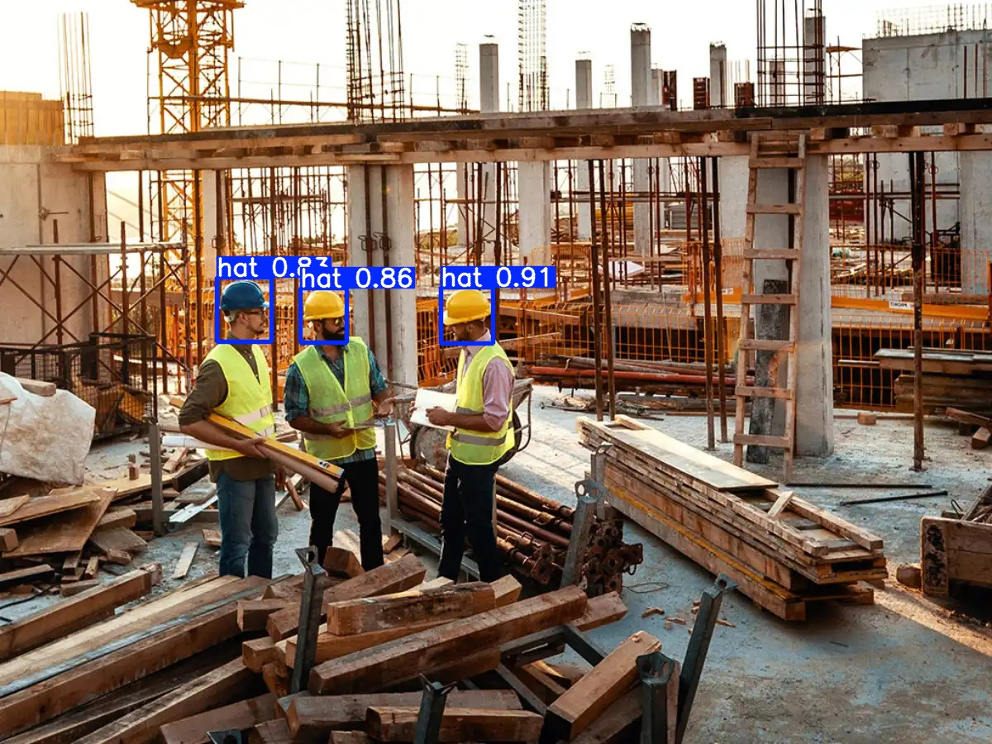
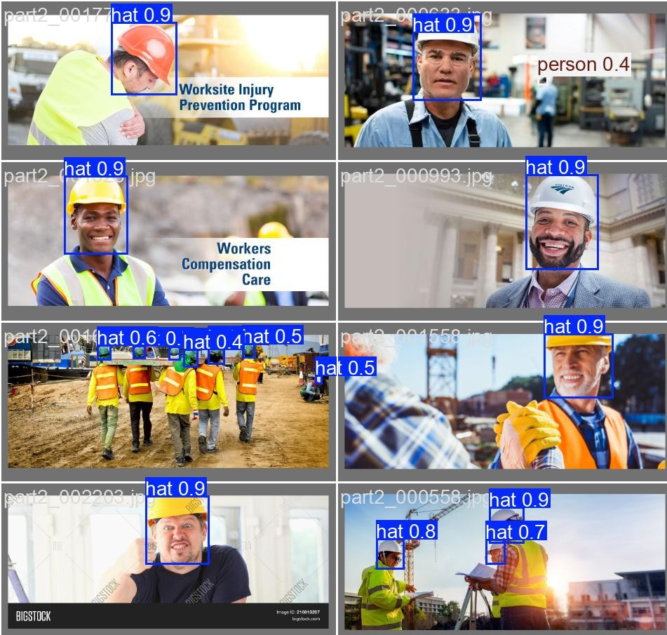
Results

Slide 10
Future Work
We will try to use another labeled dataset which wasn’t seen by the model in the training phase and evaluate the model performance
Try to implement the algorithm in real time as in surveillance systems to monitor any violations to the safety procedure on-site.

Slide 11





Thank You!

