Slide 1
Customers Like You
Omar Gomaa
Individual project - Data Engineer and ML Engineer
Notes:
Introduce myself
This is my individual project: I handled both Data engineer and ML engineer roles
The goal → take real retail transaction data, build customer-product representation, and test whether dimensionality reduction could support personalized recommendations.

Slide 2
From transactions to a sparse matrix
1,067,371
Raw invoice lines
802,558
After cleaning
684,043
Training rows
Customer x product matrix, built from training rows only
5,474 x 4,529
customers x products
98.32%
sparse
417,700
non-zero cells
72,876
held-out unseen-product rows
Removed: cancelled invoices, non-positive quantities and prices, rows with no Customer ID, and non-product charge codes
The last two months are the test period; for each customer I held out only products they had never bought before
Notes:
1.06 million invoice lines →802k valid rows after cleaning of which 684k used for training
For cleaning, I removed cancelled invoices, non-positive quantities, non-positive prices, rows with missing customer IDs, and stock codes that represented charges rather than actual products.
I used time based split, last 2 months were treated as the test period 85.2 – 14.8 split
Within the test period, I only evaluated products that a customer had not purchased before. That way, the model is being tested on genuinely new purchases rather than getting credit for recommending something already present in that customer’s history
Customer by product matrix was built with 5474 customers and 4529 products., it was 98.32% sparse: meaning almost all customer-product combinations were zero because each customer bought only a small fraction of the full catalog

Slide 3
Truncated SVD
The matrix is 98.3% empty. PCA centers the columns, which reduces sparsity.
Truncated SVD works directly on sparse input and returns customer and product factors in one fit.
k = 100
components chosen
0.4961
relative error
What compression buys
189.15 MB dense > 7.63 MB latent factors
The sparse CSR matrix is 4.80 MB, so the win is a compact latent representation for fast scoring, not raw storage against CSR.
Notes:
Since the customer product matrix was 98.32% sparse, I used Truncated SVD because it can work with sparse Data without centering it first
SVD was applied using scikit learn truncatedsvd on the training customer product matrix. The model compresses the original thousands of product dimensions into a smaller set of latent components representing purchasing patterns
I tested (k=10, 20, 50, 100 and 200)
Reconstruction error decreased as k increased, but with diminishing returns, so I selected k=100, where the error was 0.4961
The dense version of the matrix would be 189 MB → the 100 component latent factor was 7.63 MB
For recommendations, I normalized the product-factor vectors and used cosine similarity to generate personalized recommendations

Slide 4
Personalization beats best sellers
Real, but a modest margin - and measured on a deliberately strong baseline
+3.3
percentage points
1.56 s
nightly job
Fair Comparison
Both scored on the same 1,927 eligible customers
Baseline recommends the 10 best sellers each customer has not already bought
Measured only on held-out purchases the model never saw
397 hits vs 333 hits
Hit Rate@10 is the share of customers whose next purchase appears in our top ten suggestions.
Notes:
The main evaluation metric was HitRate@10. it measures the % of customers where at least one actual held out purchase appeared in the top 10 recommendations.
Truncated SVD model achieved 20.60%, compared with 17.28% for best seller baseline. An improvement of 3.3%
I made the comparison fair by evaluating both methods on the same 1927 customers, the baseline also excluded products the customers had purchased before
Resulted in 397 hits on svd, vs 333 baseline
The recommendation scoring job took 1.56 seconds

Slide 5
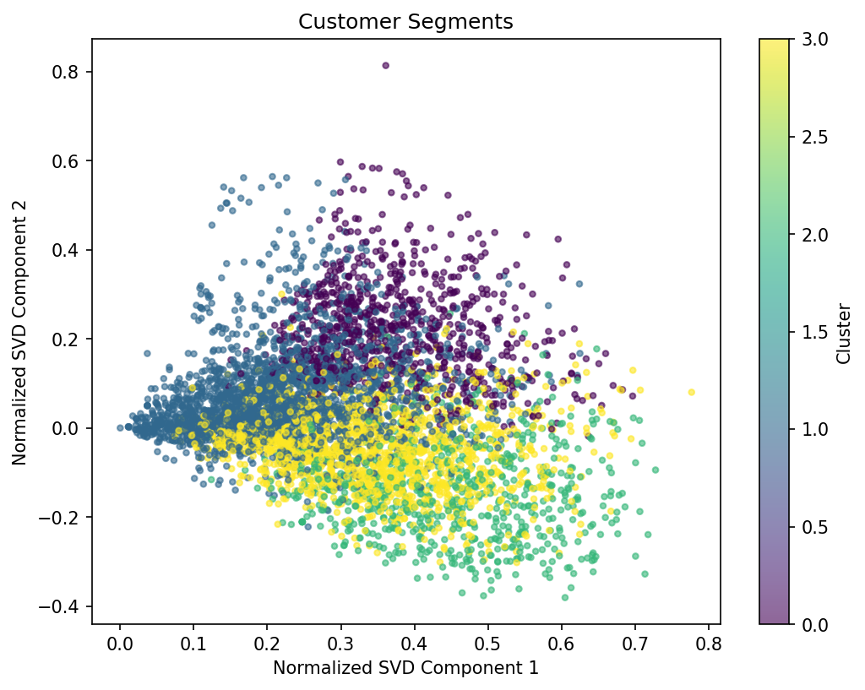
PCA vs SVD
Measure | PCA | SVD
Hit Rate@10 | 20.13% | 20.60%
Fit time | 0.48 s | 1.01 s
Peak memory | 17.92 MB | 17.70 MB
Stored factors | 7.63 MB | 7.63 MB
Quality at k=100 | 74.81% var. | 0.4961 err.
4 segments
2,375
Home &
Utility
1,575
Novelty &
Party
831
Decorative
Homeware
693
Bags &
Storage
Near-identical accuracy. SVD was chosen because it fits sparse data natively, not because it scored dramatically higher.
Component 1 means the same thing in both: overall purchasing activity.
Cluster numbers are arbitrary, so each segment is named from its top product, not its cluster number.
Customers projected on two SVD components, clustered into four groups and named from their top products. No customer IDs appear in the figure.
Notes:
PCA vs SVD had almost identical recommendation accuracy
The part I want to focus on here is the customer map. Each point represents one customer, and the plot shows them projected onto the first two SVD components
The colors represent the four customer segments: Home and Utility, Novelty and Party, Decorative Homeware, and Bags and Storage.
The clustering itself was performed using the normalized SVD customer representation. These two components are just the 2D view of those groups.
named each group based on the products most associated with that cluster, because the numerical KMeans labels themselves are arbitrary
groups overlap rather than forming perfectly separated islands, which makes sense because customer purchasing behavior isn’t divided into completely distinct categories.

Slide 6
Recommendation
Recommend
Truncated SVD recommender on product pages
Refresh the factors on the existing nightly schedule
Track Hit Rate@10 against the best-seller baseline every run
Risks
New customers with little or no history
Rare products carry weaker, noisier factors
Behaviour drifts, so today's +3.3 points can decay
Next
Choose k on hit rate, not reconstruction error alone
Compare against other recommender families
Re-check segment stability as data grows
Notes:
Recommend using the Truncated SVD recommender.
refresh the latent factors on a nightly schedule and continue tracking Hit Rate at 10 against the best-seller baseline, so I can see whether personalization continues to provide an advantage over time.
The main risks are new customers with little or no purchase history, rare products that have weaker factors, and changes in customer behavior over time
If I continued the project, the biggest change I would make would be how I choose k I tested several values of k but I mainly compared them using reconstruction error. Next time, I would also compare Hit Rate at 10 across those values so recommendation performance has a more direct role in selecting the final number of components
I would also compare SVD against other recommender approaches and re-check whether the customer segments remain stable as more data is collected.

Slide 7
Thank you

