Slide 1

NORTHWIND ANALYTICS
From SQL Server to Visual Insight
A 16-question deep dive into the Northwind database — pairing every real SQL Server result with its Python visualization.
Eng. Omar Ibrahim
Data Analytics Case Study
SQL SERVER • PYTHON • PANDAS • MATPLOTLIB / SEABORN

Slide 2
HOW THIS PROJECT WORKS
From Raw Data to Visual Story
Every slide in this deck shows the full trail: the T-SQL query, its real output straight from SQL Server Management Studio, and the Python chart built from that same result.
01
02
03
Query
Verify
Visualize
→
→
SQL Server
SSMS Output
Python + Seaborn
Data is queried directly from the Northwind database using T-SQL — joins, GROUP BY, and aggregate functions shape each question.
Each query's raw result grid is captured straight from SQL Server Management Studio as proof of the real output.
pandas loads the same result into a DataFrame; matplotlib/seaborn renders it as a chart chosen to fit its story.

Slide 3
AGENDA
16 Questions, One Database
1
1. Product Distribution by Category
2
2. Average Price by Category
3
3. Supplier Footprint by Country
4
4. Customer Base by Country
5
5. Employee Distribution by City
6
6. Low Stock Alert
7
7. Top Suppliers by Product Range
8
8. Total Inventory Value by Category
9
9. Territories per Employee
10
10. Top 10 Cities by Customers
11
11. Most Common Contact Titles
12
12. Avg & Max Price per Supplier
13
13. Territories by Region
14
14. Premium Products (Above Category Avg.)
15
15. Suppliers With More Than 2 Products
16
16. Customer Distribution by Region

Slide 4
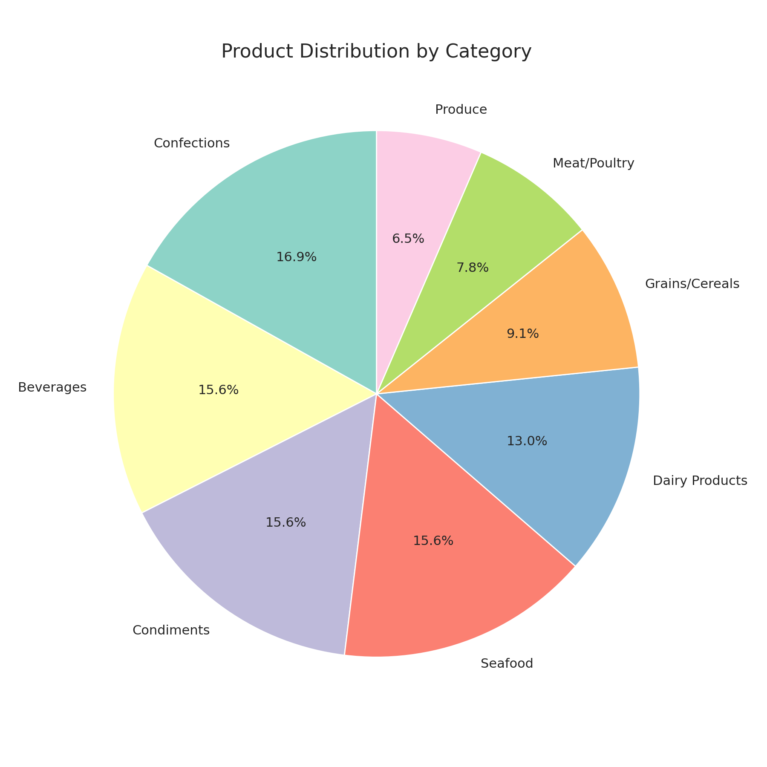
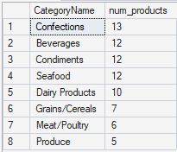
QUERY 01
Product Distribution by Category
SQL QUERY
SQL SERVER OUTPUT
SELECT
c.CategoryName,
COUNT(p.ProductID)
AS num_products
FROM Categories c
JOIN Products p
ON p.CategoryID =
c.CategoryID
GROUP BY c.CategoryName
ORDER BY num_products DESC;
Live result grid — SSMS
Confections leads the catalog with 13 products.
Beverages, Condiments, and Seafood are tied at 12 each.
Produce is the smallest category with just 5 products.

Slide 5
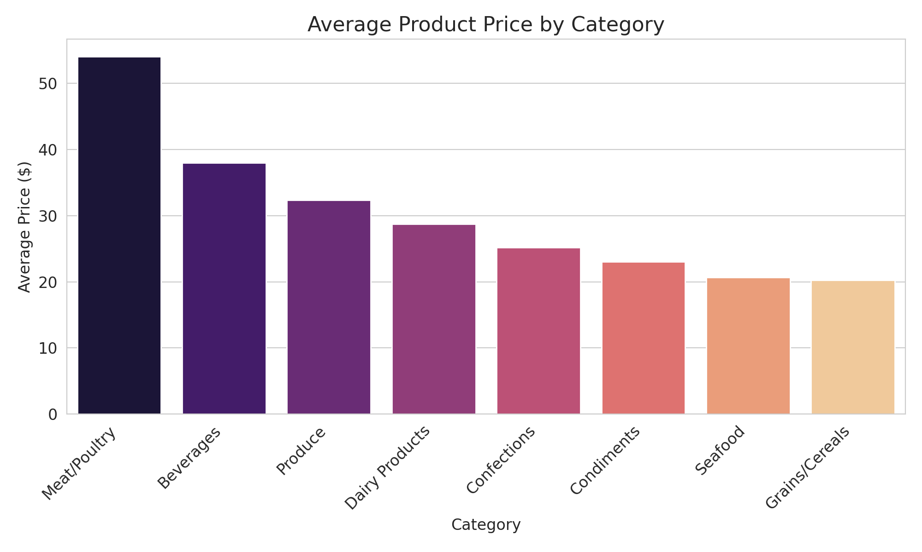
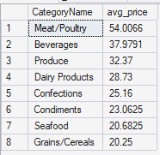
QUERY 02
Average Price by Category
SQL QUERY
SQL SERVER OUTPUT
SELECT
c.CategoryName,
AVG(p.UnitPrice)
AS avg_price
FROM Categories c
JOIN Products p
ON p.CategoryID =
c.CategoryID
GROUP BY c.CategoryName
ORDER BY avg_price DESC;
Live result grid — SSMS
Meat/Poultry is priciest at $54.01 on average, despite having the fewest products.
Beverages ($37.98) and Produce ($32.37) round out the premium tier.
Grains/Cereals is the most affordable category at $20.25.

Slide 6
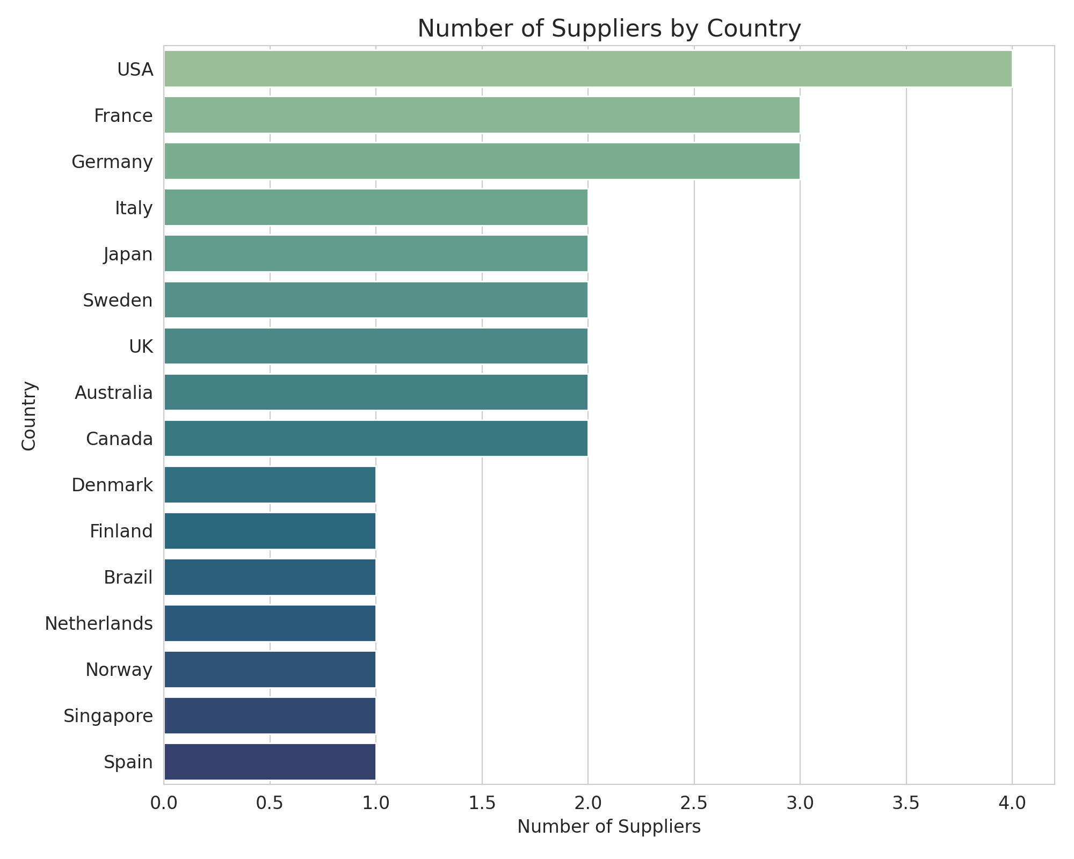
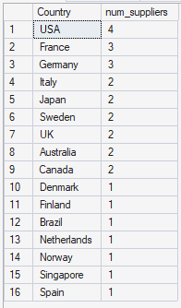
QUERY 03
Supplier Footprint by Country
SQL QUERY
SQL SERVER OUTPUT
SELECT
Country,
COUNT(SupplierID)
AS num_suppliers
FROM Suppliers
GROUP BY Country
ORDER BY num_suppliers DESC;
Live result grid — SSMS
Suppliers are sourced from 16 different countries.
The USA leads with 4 suppliers, followed by France and Germany with 3 each.
Nine countries contribute exactly one supplier.

Slide 7
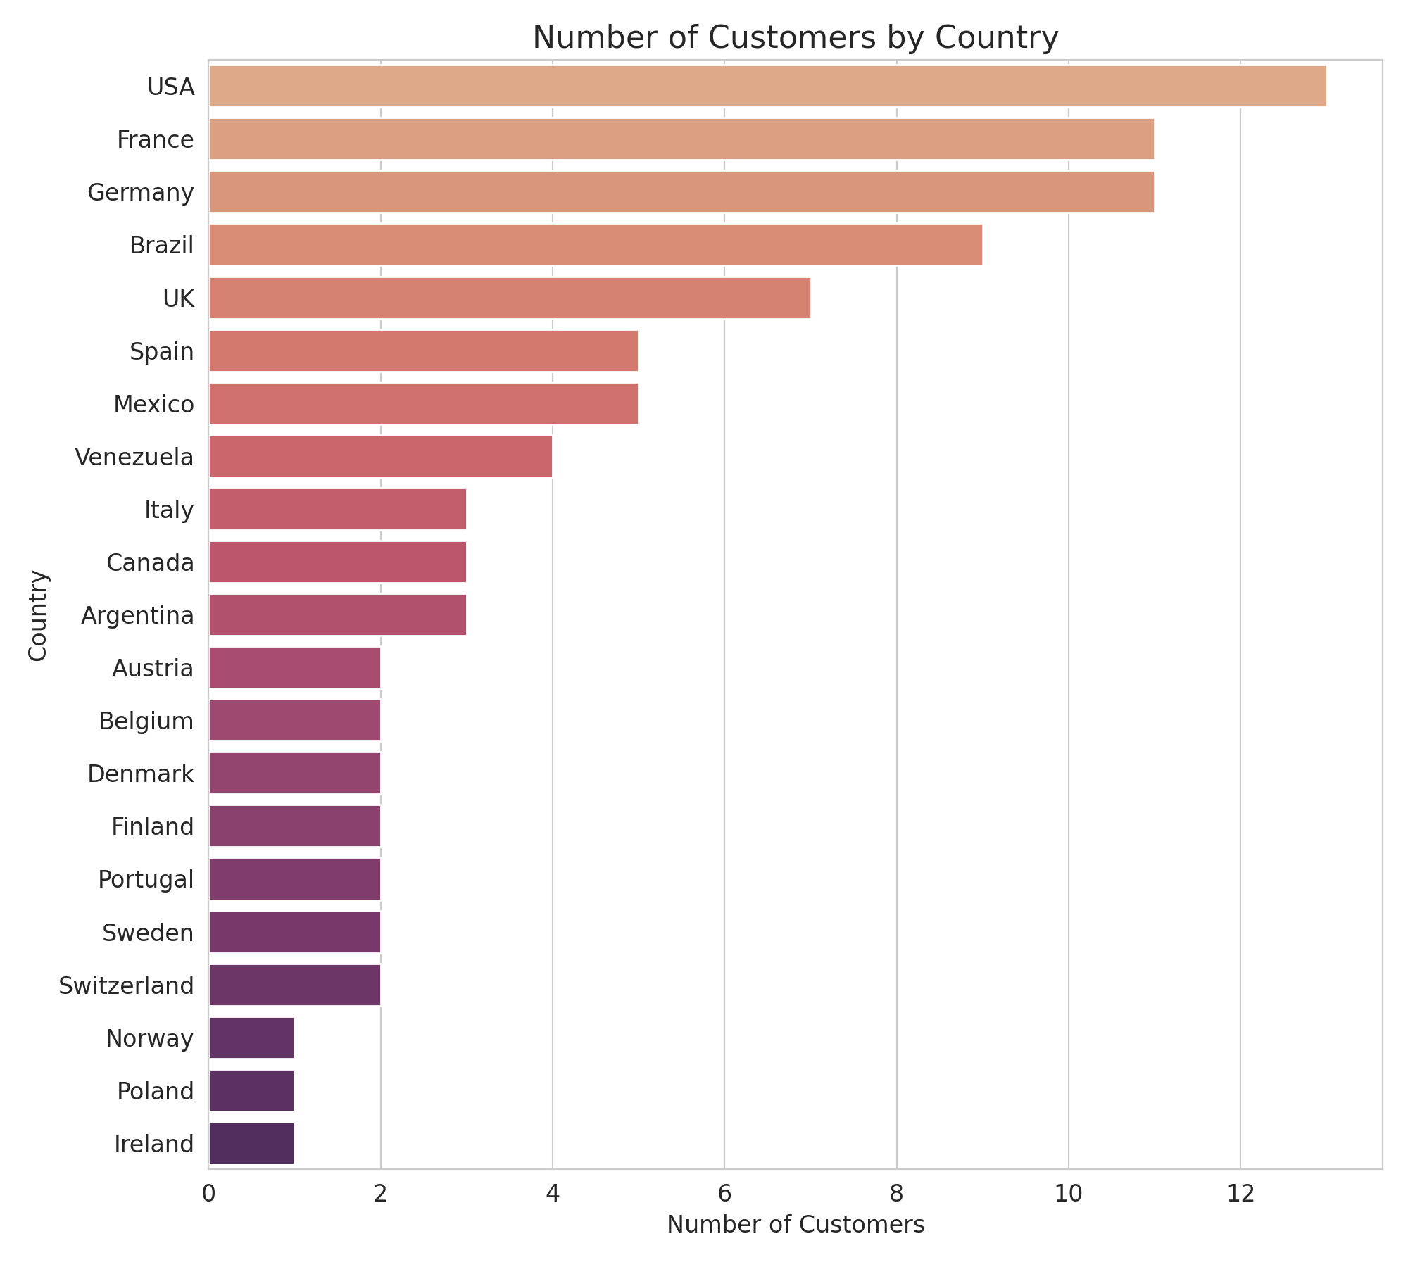
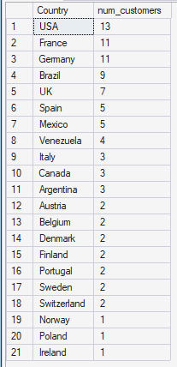
QUERY 04
Customer Base by Country
SQL QUERY
SQL SERVER OUTPUT
SELECT
Country,
COUNT(CustomerID)
AS num_customers
FROM Customers
GROUP BY Country
ORDER BY num_customers DESC;
Live result grid — SSMS
USA (13), France (11), and Germany (11) form the core customer base.
Brazil (9) is the strongest market outside Europe/North America.
Remaining markets are long-tail, mostly 1-5 customers each.

Slide 8
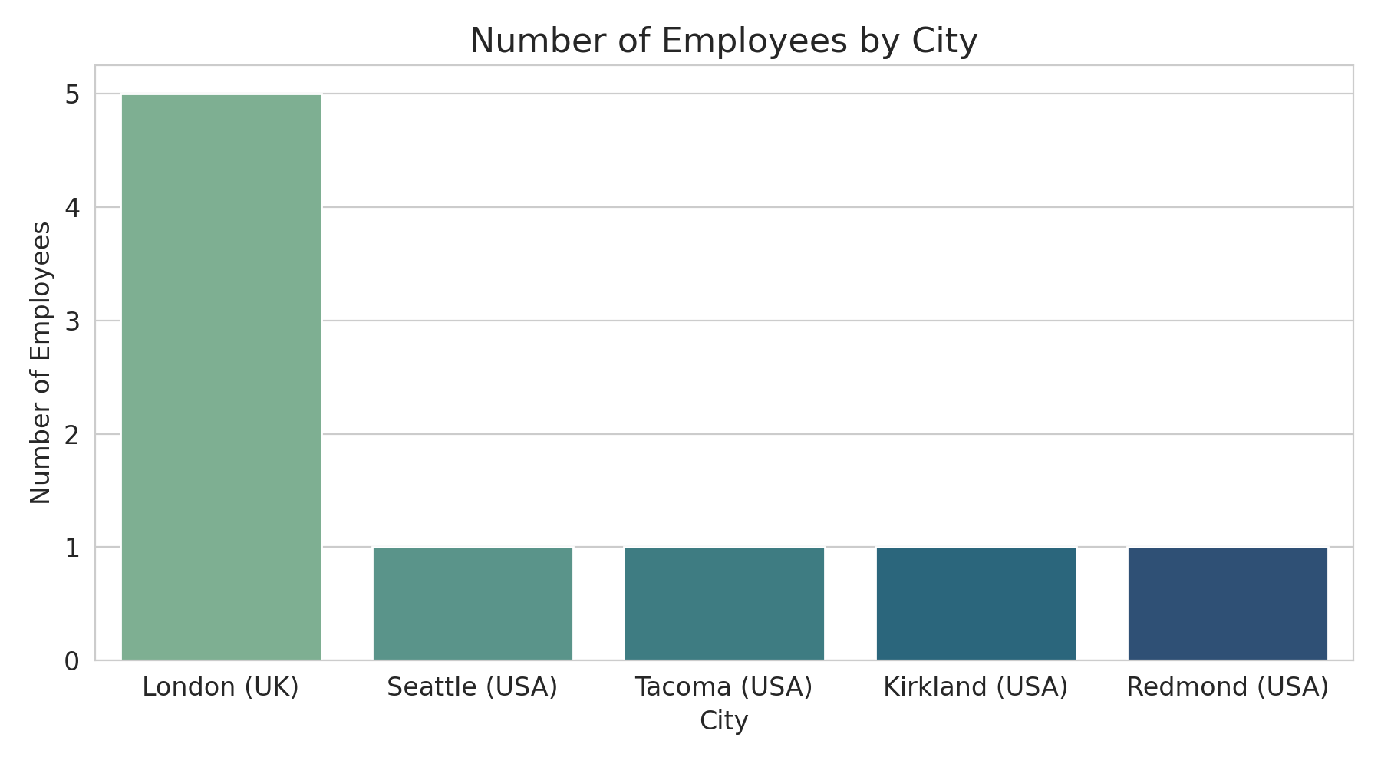
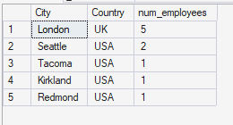
QUERY 05
Employee Distribution by City
SQL QUERY
SQL SERVER OUTPUT
SELECT
City,
Country,
COUNT(EmployeeID)
AS num_employees
FROM Employees
GROUP BY City, Country
ORDER BY num_employees DESC;
Live result grid — SSMS
London is the clear operational hub with 5 employees.
Four U.S. offices each run lean with a single employee.
Staffing is heavily centralized in one location.

Slide 9
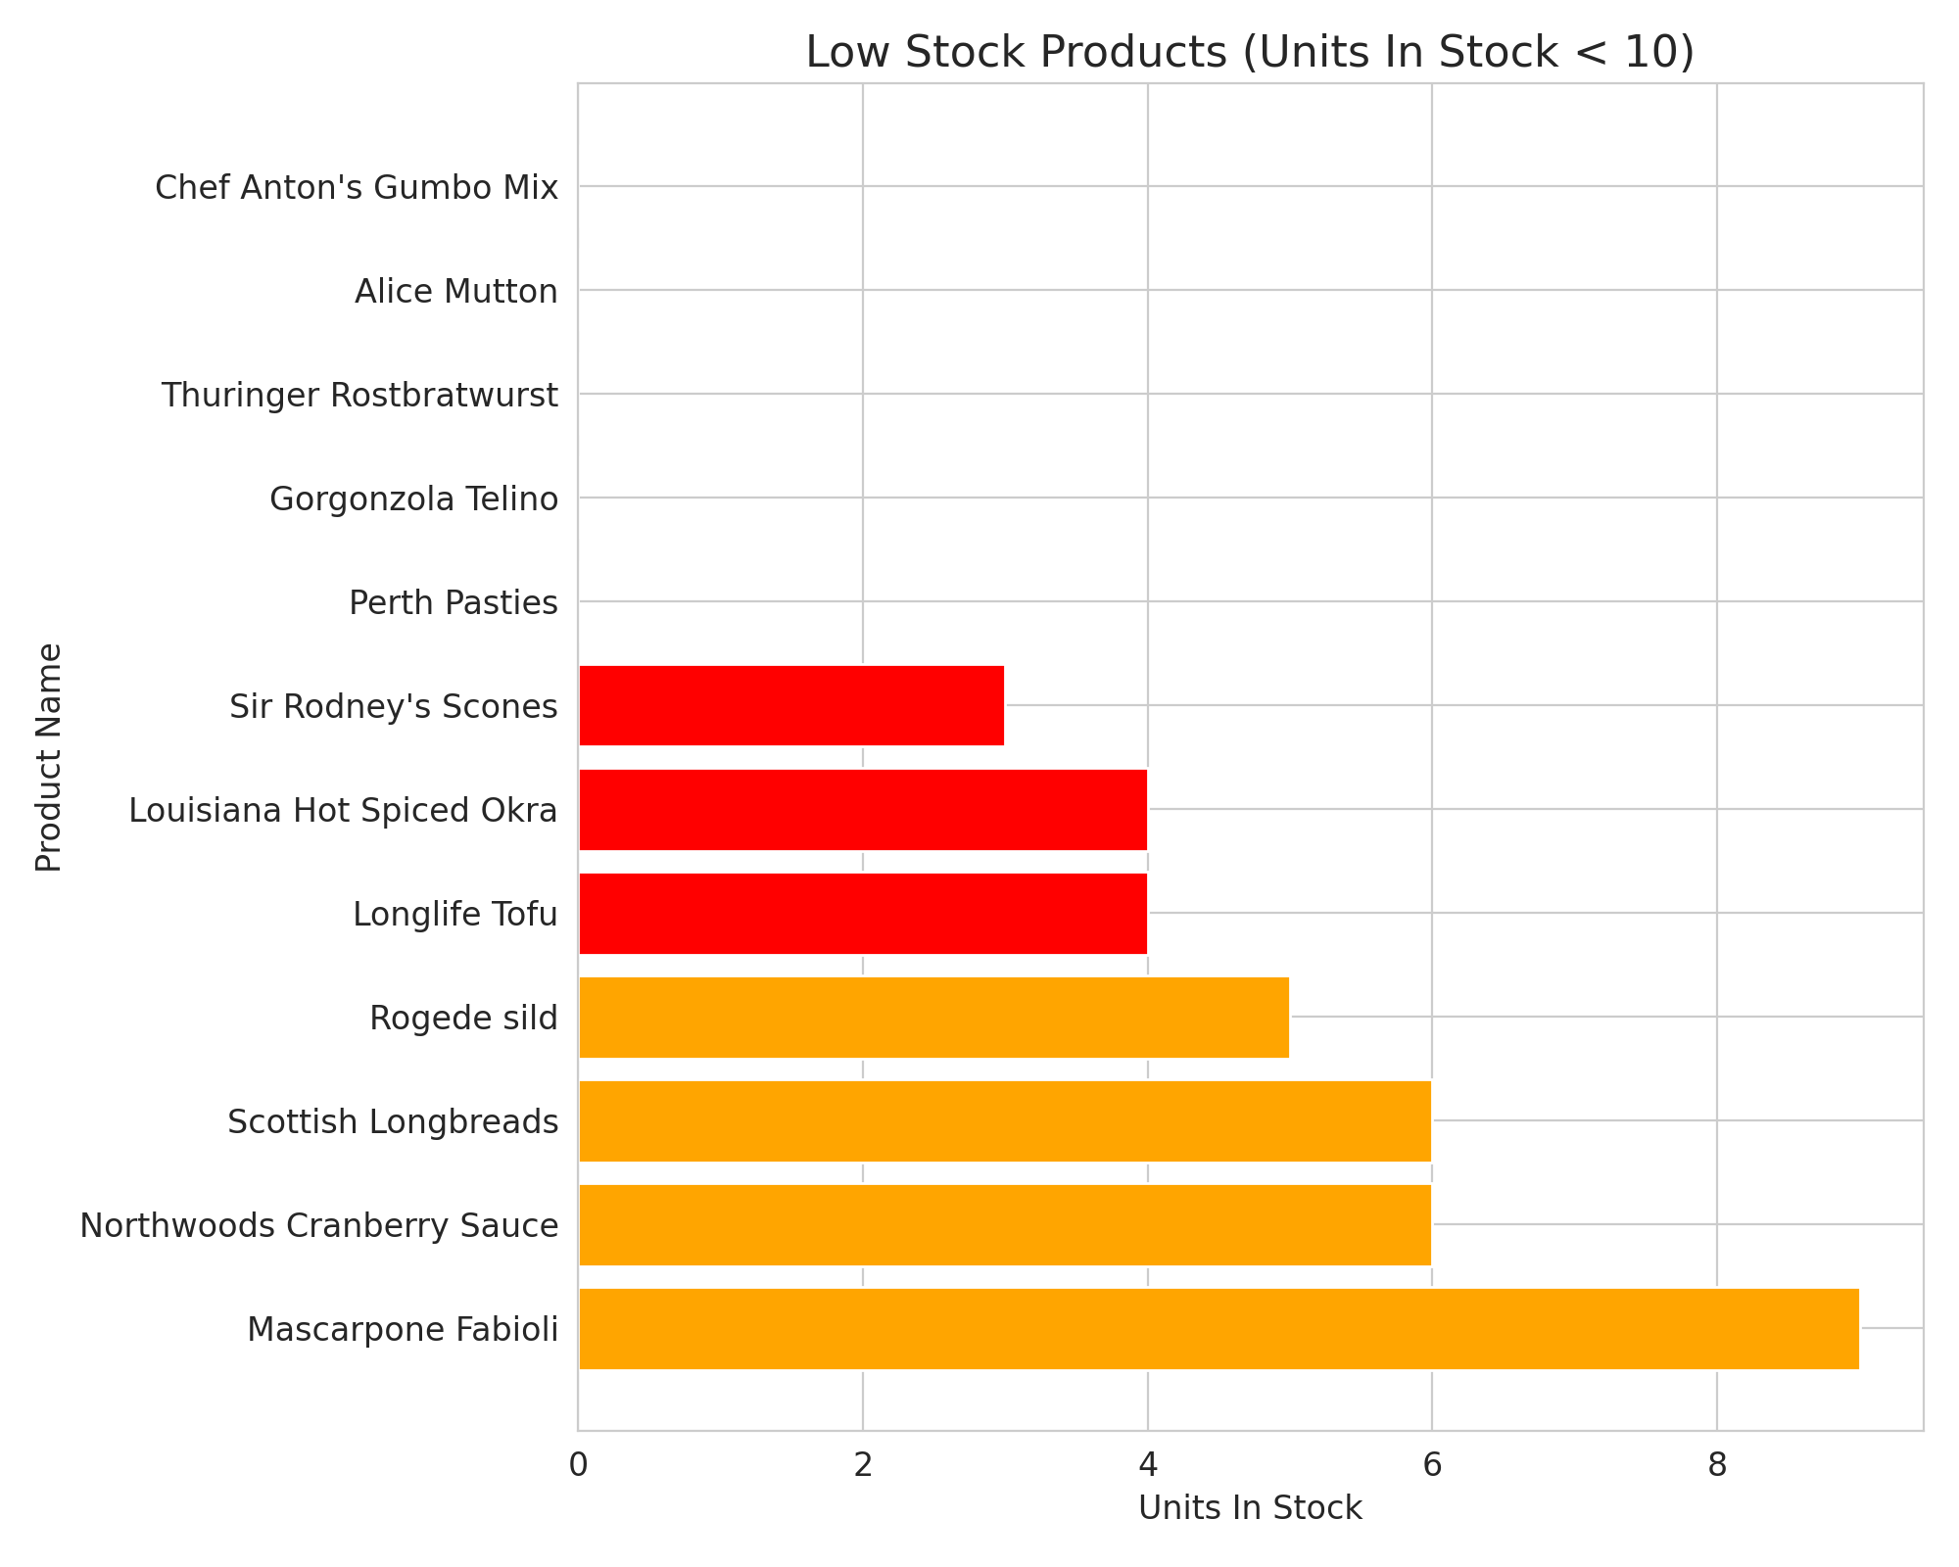
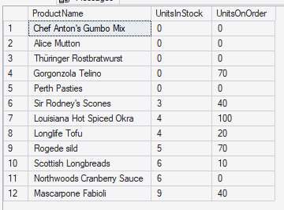
QUERY 06
Low Stock Alert
SQL QUERY
SQL SERVER OUTPUT
SELECT
ProductName,
UnitsInStock,
UnitsOnOrder
FROM Products
WHERE UnitsInStock < 10
ORDER BY UnitsInStock ASC;
Live result grid — SSMS
5 products are completely out of stock.
Only Gorgonzola Telino has replenishment on order (70 units).
12 products sit under the 10-unit threshold.

Slide 10
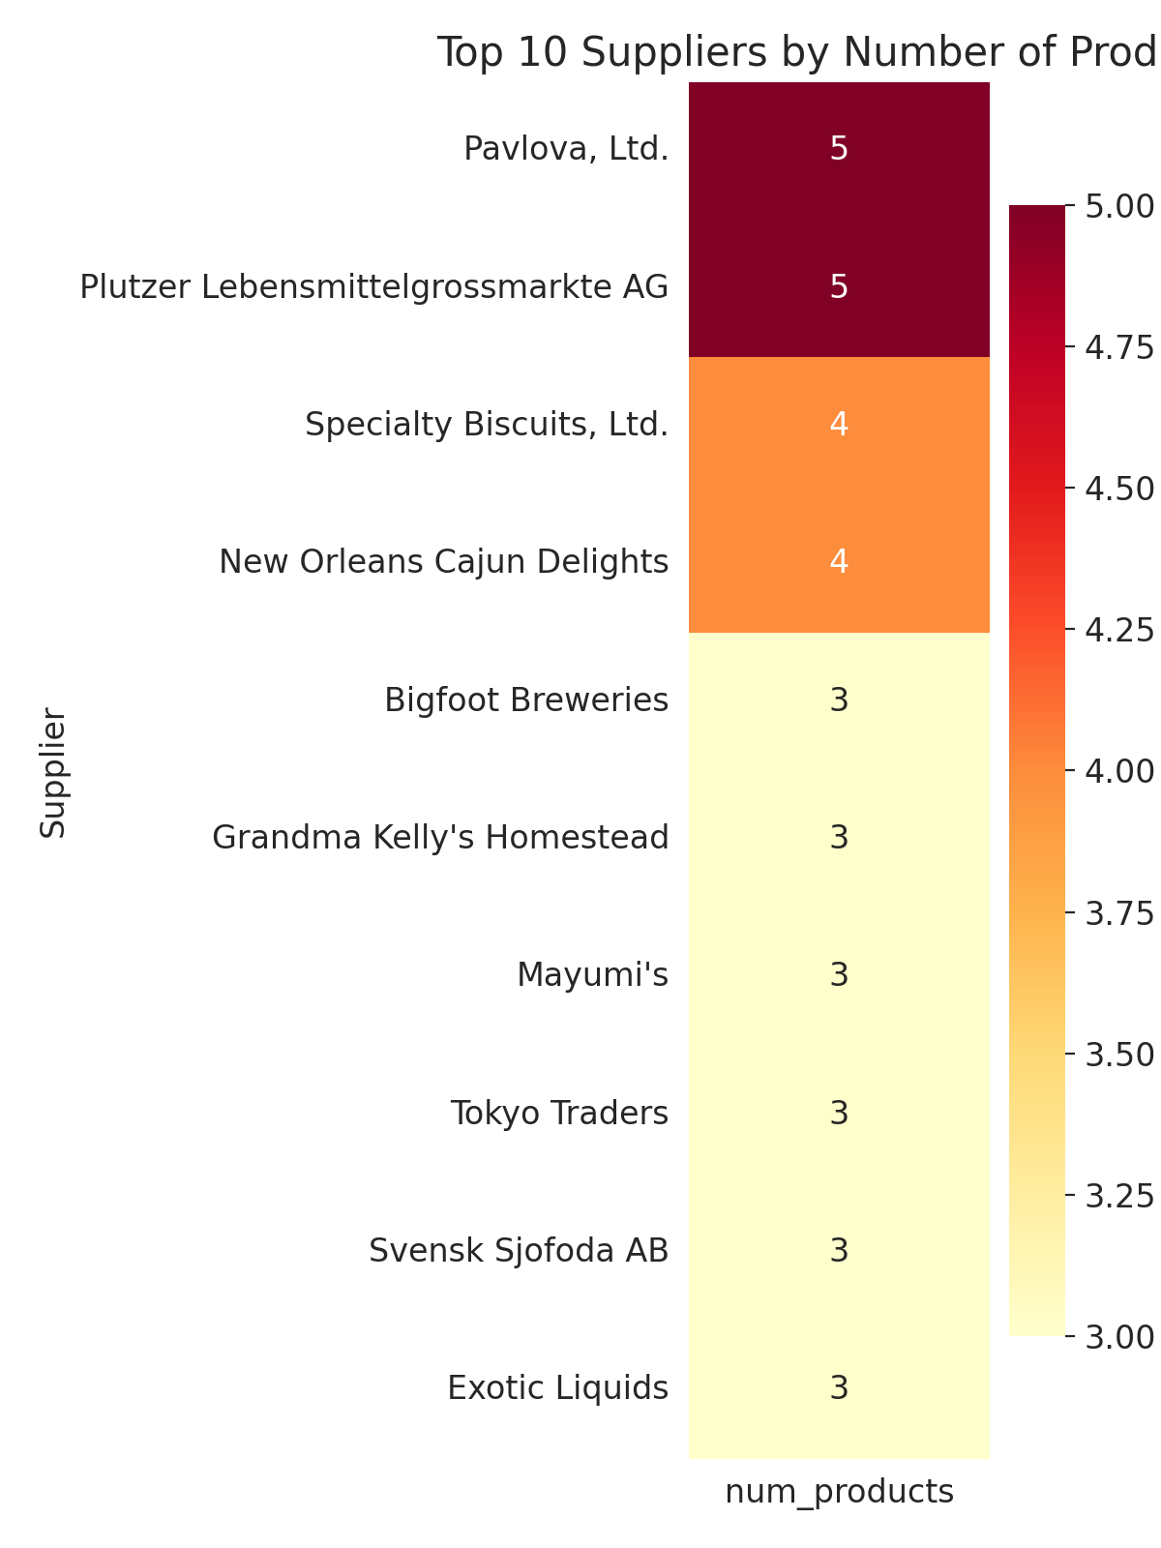
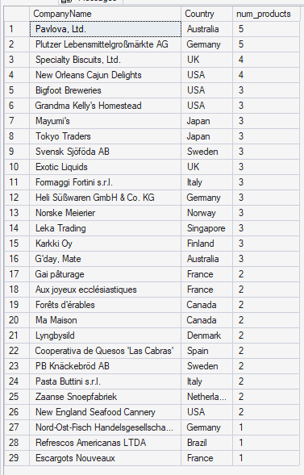
QUERY 07
Top Suppliers by Product Range
SQL QUERY
SQL SERVER OUTPUT
SELECT
s.CompanyName,
s.Country,
COUNT(p.ProductID)
AS num_products
FROM Suppliers s
JOIN Products p
ON p.SupplierID =
s.SupplierID
GROUP BY s.CompanyName,
s.Country
ORDER BY num_products DESC;
Live result grid — SSMS
Pavlova, Ltd. and Plutzer Lebensmittelgroßmärkte AG lead with 5 products each.
Most top suppliers cluster around 3-4 products.
The supplier base is diversified — no single point of dependency.

Slide 11
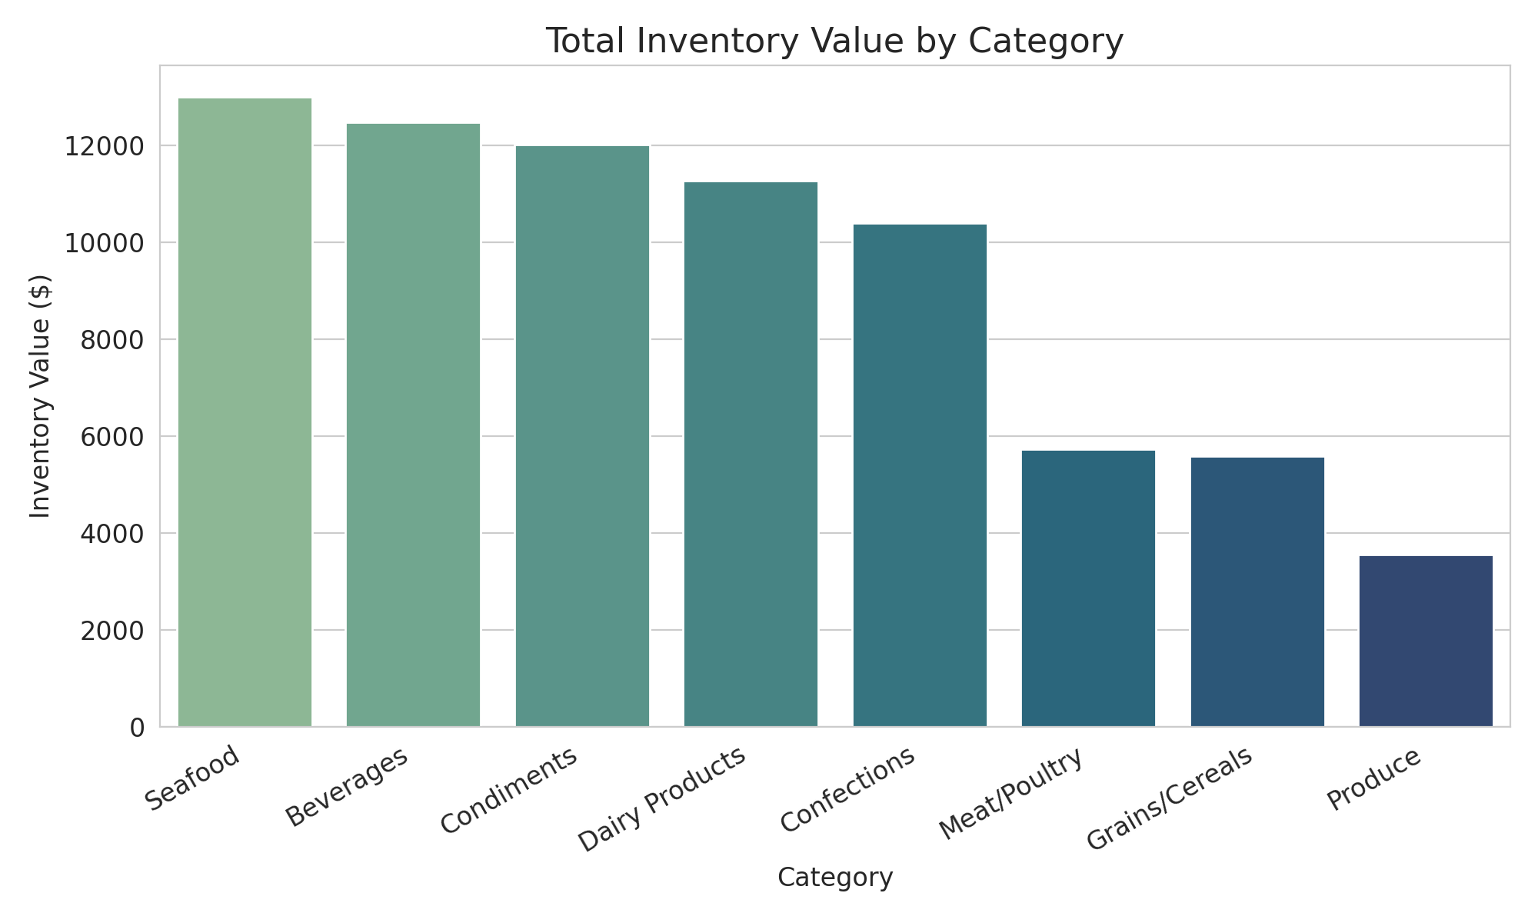
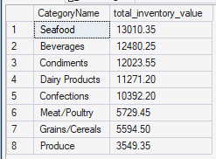
QUERY 08
Total Inventory Value by Category
SQL QUERY
SQL SERVER OUTPUT
SELECT c.CategoryName,
SUM(p.UnitsInStock *
p.UnitPrice)
AS total_inventory_value
FROM Categories c
JOIN Products p
ON p.CategoryID =
c.CategoryID
GROUP BY c.CategoryName
ORDER BY total_inventory_value DESC;
Live result grid — SSMS
Seafood holds the highest inventory value at $13,010.35.
Beverages and Condiments follow closely, both above $12,000.
Produce carries the lowest tied-up value at just $3,549.35.

Slide 12
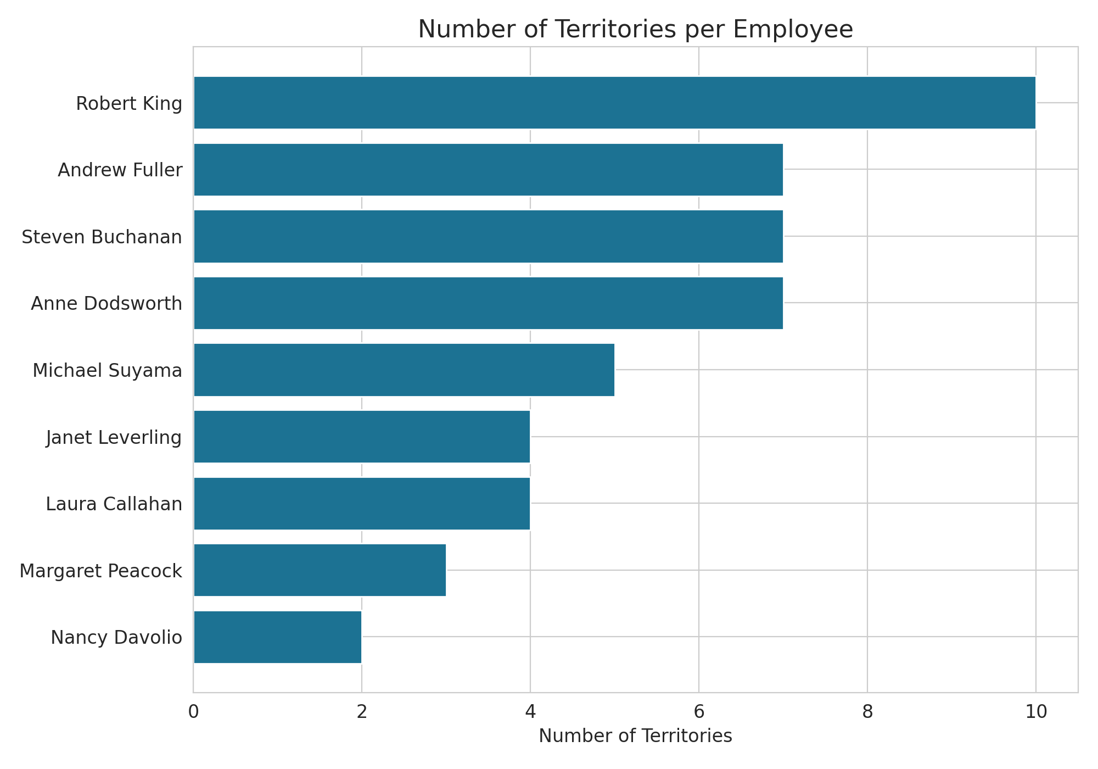
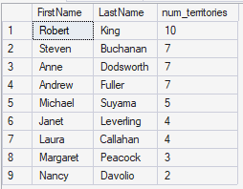
QUERY 09
Territories per Employee
SQL QUERY
SQL SERVER OUTPUT
SELECT e.FirstName,
e.LastName,
COUNT(et.TerritoryID)
AS num_territories
FROM Employees e
JOIN EmployeeTerritories et
ON et.EmployeeID =
e.EmployeeID
GROUP BY e.FirstName,
e.LastName
ORDER BY num_territories DESC;
Live result grid — SSMS
Robert King covers the most territories, with 10 assigned.
Steven Buchanan, Anne Dodsworth, and Andrew Fuller each cover 7.
Nancy Davolio has the lightest load, with only 2 territories.

Slide 13
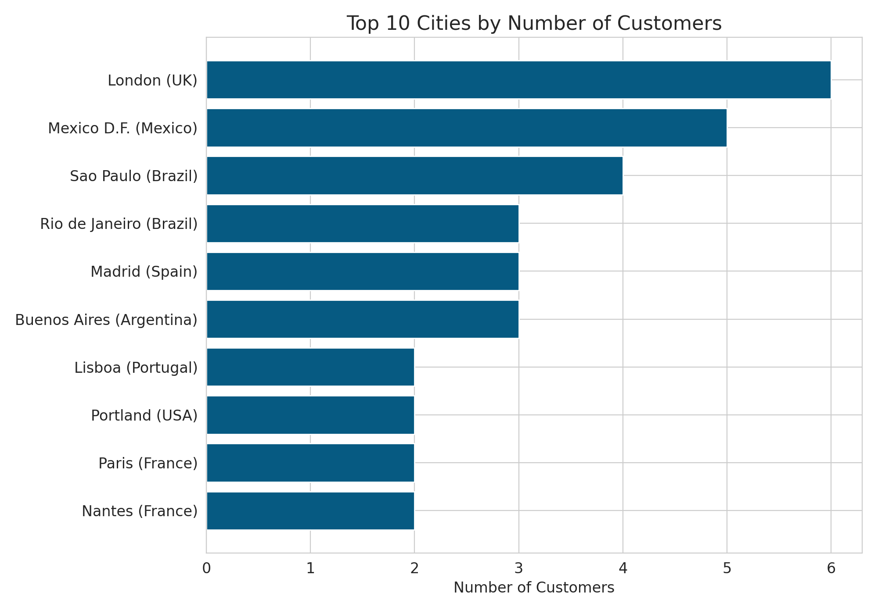
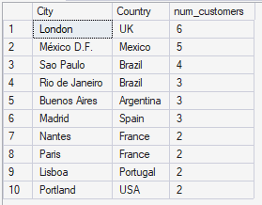
QUERY 10
Top 10 Cities by Customers
SQL QUERY
SQL SERVER OUTPUT
SELECT TOP 10
City, Country,
COUNT(CustomerID)
AS num_customers
FROM Customers
GROUP BY City, Country
ORDER BY num_customers DESC;
Live result grid — SSMS
London tops the list with 6 customers.
Mexico City follows with 5, ahead of Sao Paulo's 4.
Six cities are tied at 2-3 customers, spanning Latin America and Europe.

Slide 14
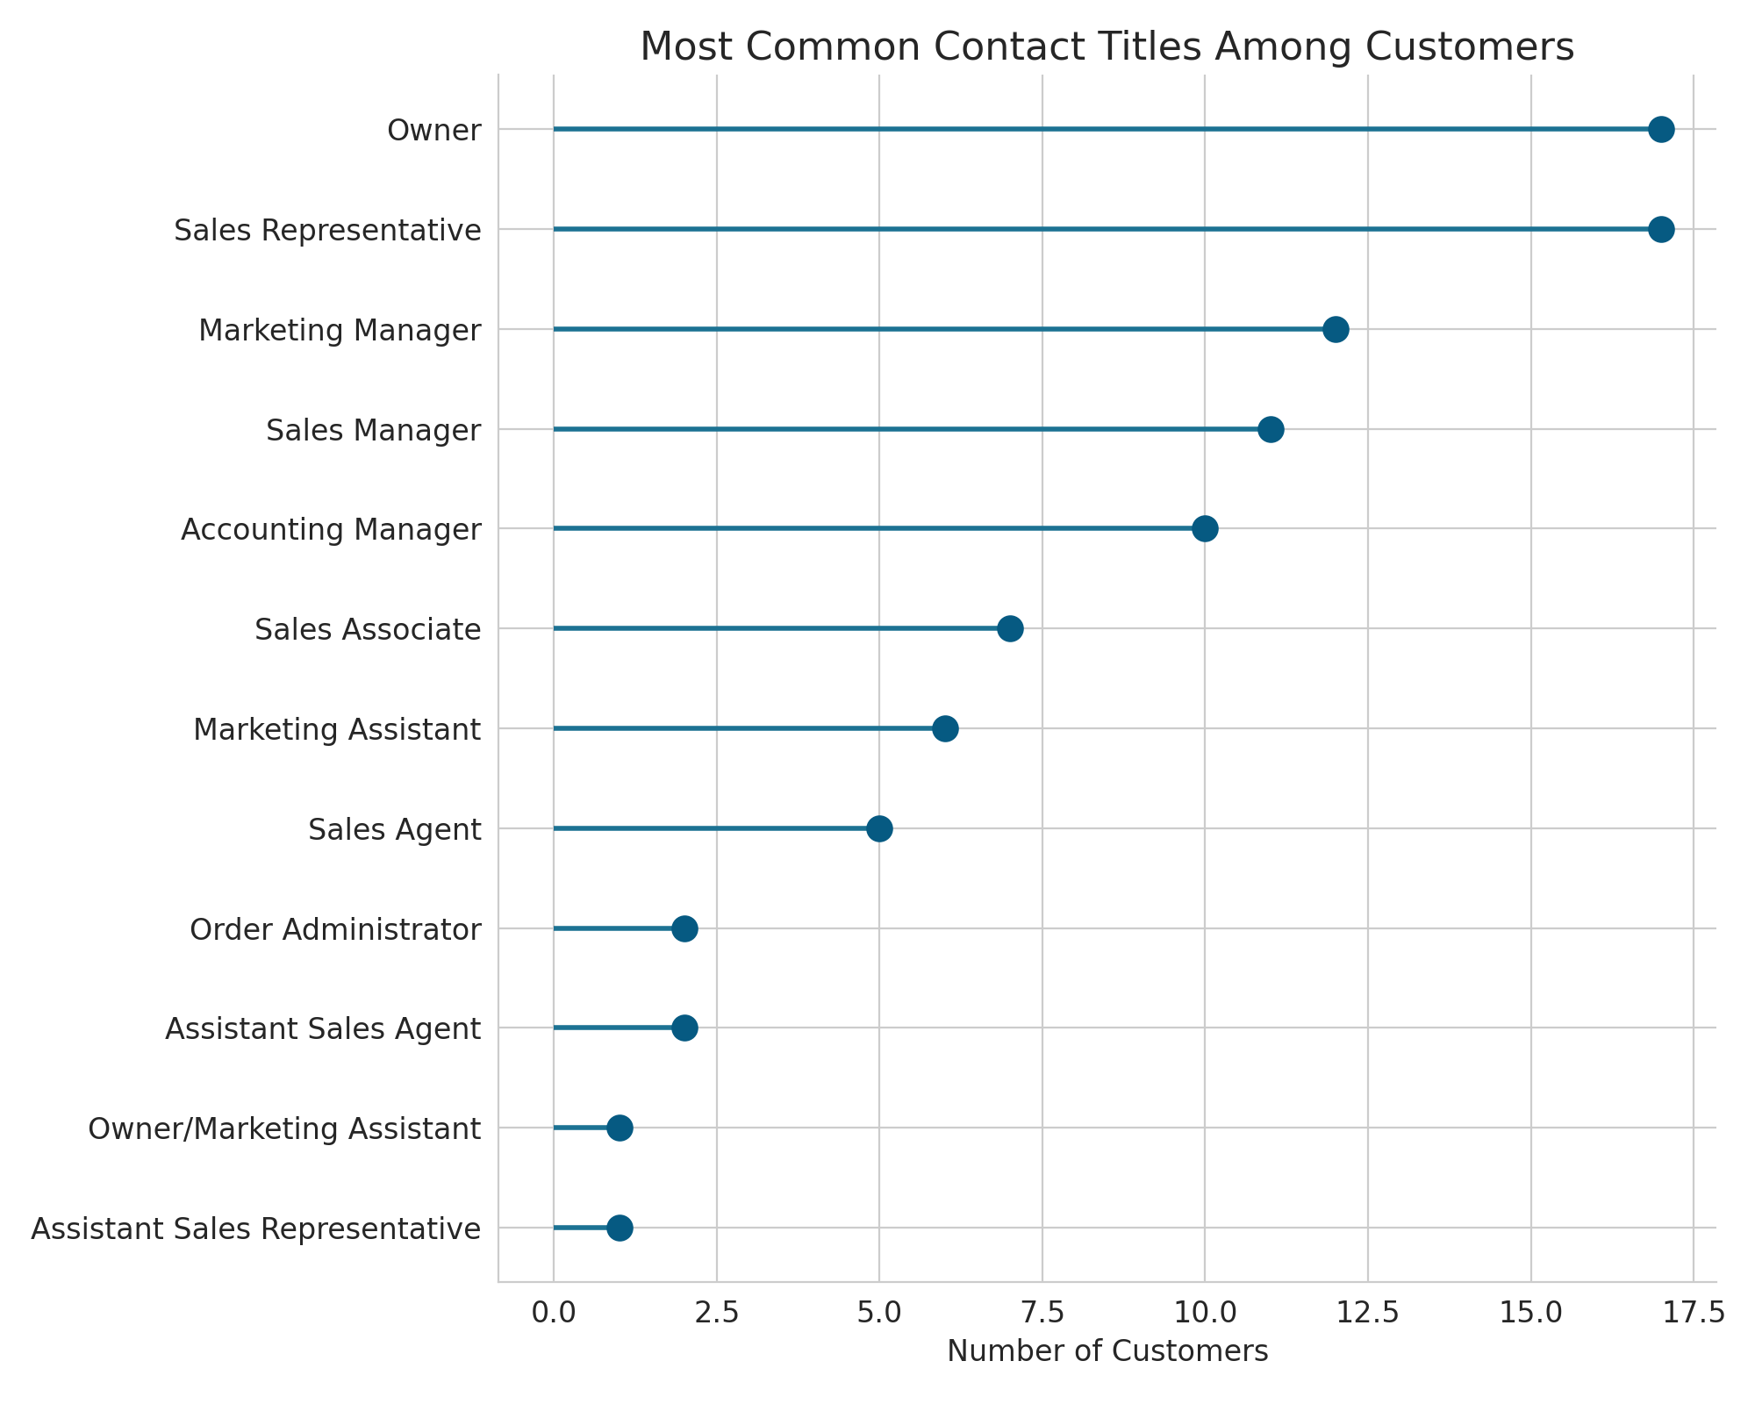
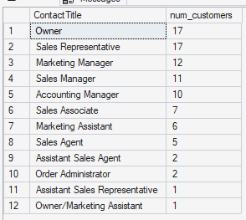
QUERY 11
Most Common Contact Titles
SQL QUERY
SQL SERVER OUTPUT
SELECT ContactTitle,
COUNT(CustomerID)
AS num_customers
FROM Customers
WHERE ContactTitle
IS NOT NULL
GROUP BY ContactTitle
ORDER BY num_customers DESC;
Live result grid — SSMS
"Owner" and "Sales Representative" are tied as the most common titles, 17 each.
Marketing Manager (12) and Sales Manager (11) are the next most frequent.
Several niche titles, like Owner/Marketing Assistant, appear only once.

Slide 15
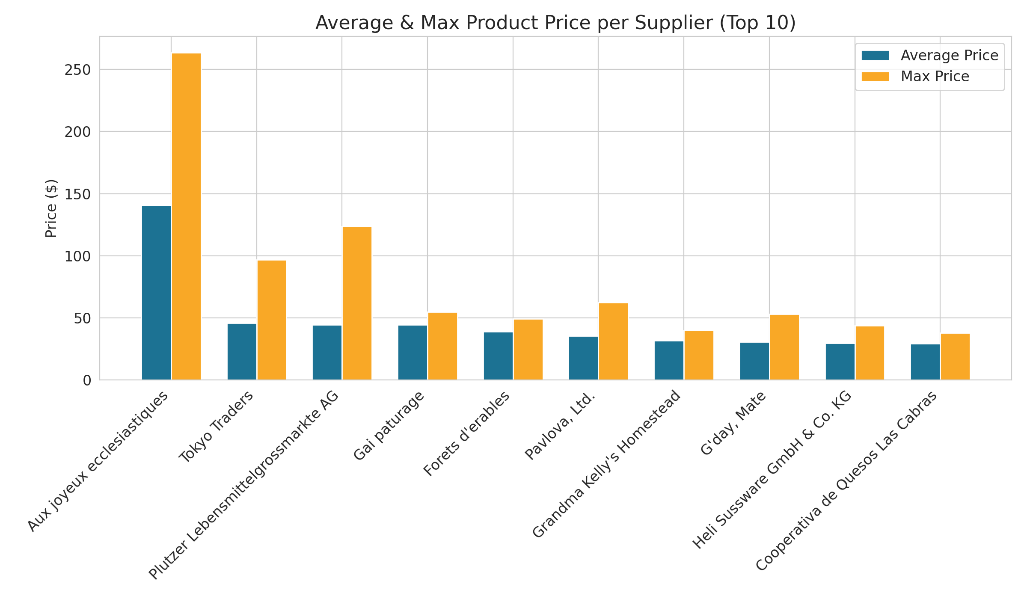
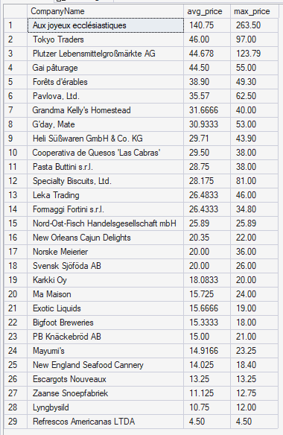
QUERY 12
Avg & Max Price per Supplier
SQL QUERY
SQL SERVER OUTPUT
SELECT s.CompanyName,
AVG(p.UnitPrice)
AS avg_price,
MAX(p.UnitPrice)
AS max_price
FROM Suppliers s
JOIN Products p
ON p.SupplierID =
s.SupplierID
GROUP BY s.CompanyName
ORDER BY avg_price DESC;
Live result grid — SSMS
Aux joyeux ecclésiastiques has by far the highest average price, at $140.75.
Its Côte de Blaye also sets the ceiling — $263.50, the highest price in the catalog.
The remaining top-10 suppliers average between $28 and $46.

Slide 16
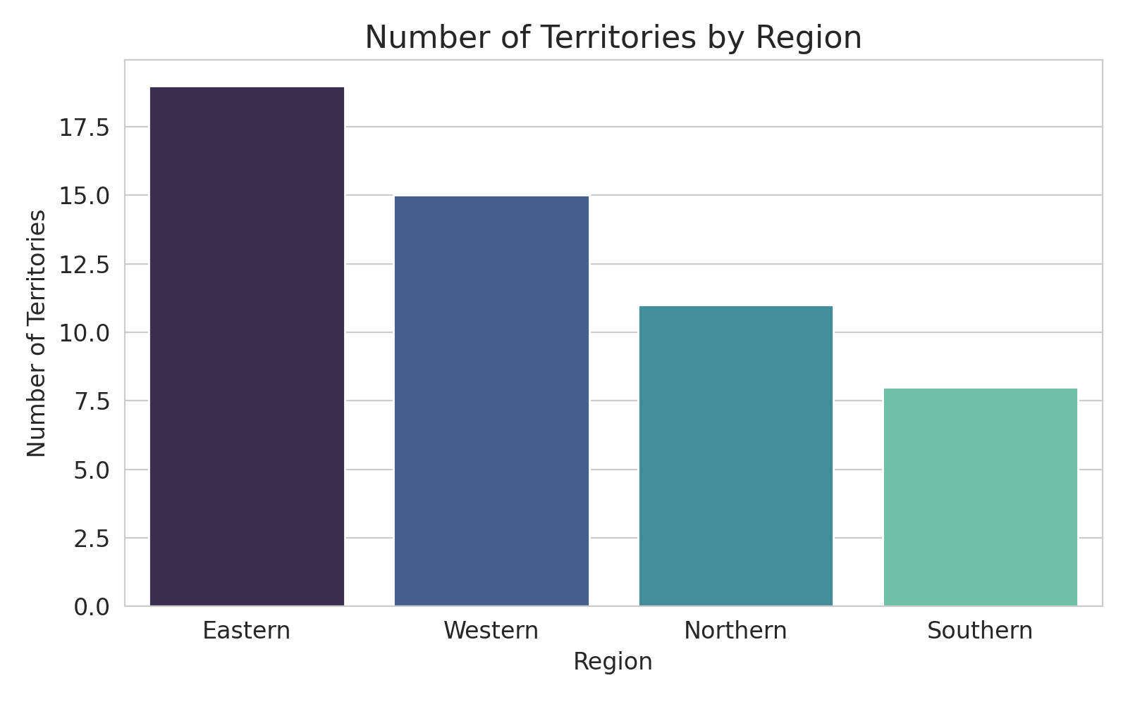
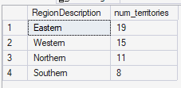
QUERY 13
Territories by Region
SQL QUERY
SQL SERVER OUTPUT
SELECT r.RegionDescription,
COUNT(t.TerritoryID)
AS num_territories
FROM Region r
JOIN Territories t
ON t.RegionID =
r.RegionID
GROUP BY r.RegionDescription
ORDER BY num_territories DESC;
Live result grid — SSMS
The Eastern region covers the most territories, with 19.
Western (15) and Northern (11) follow behind.
Southern is the smallest region, with 8 territories.

Slide 17
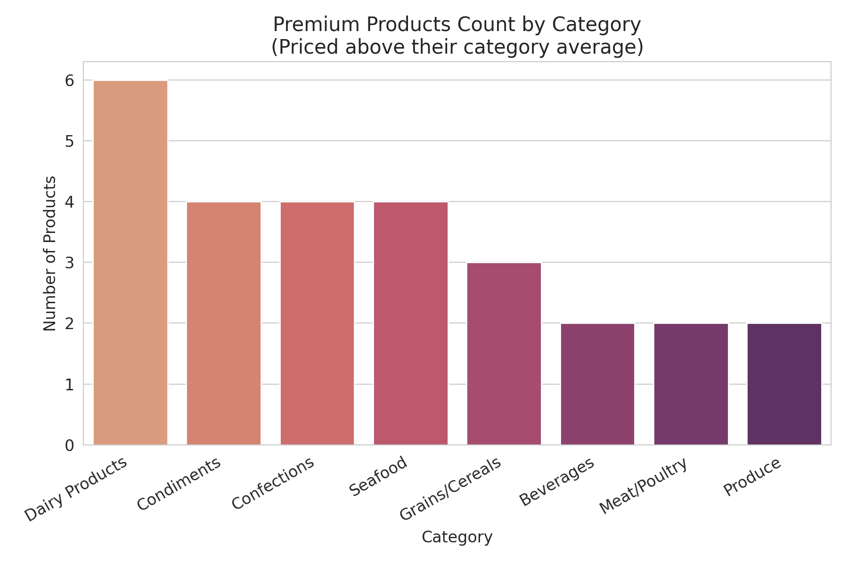
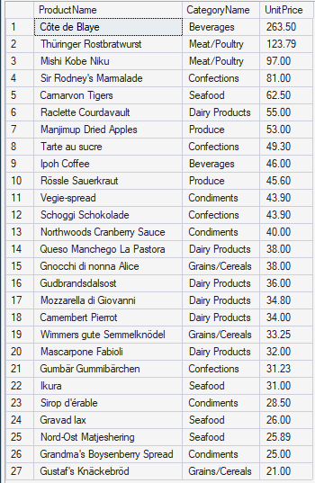
QUERY 14
Premium Products (Above Category Avg.)
SQL QUERY
SQL SERVER OUTPUT
SELECT p.ProductName,
c.CategoryName,
p.UnitPrice
FROM Products p
JOIN Categories c
ON c.CategoryID =
p.CategoryID
WHERE p.UnitPrice >
(SELECT AVG(p2.UnitPrice)
FROM Products p2
WHERE p2.CategoryID =
p.CategoryID)
ORDER BY p.UnitPrice DESC;
Live result grid — SSMS
27 products are priced above their category's average.
Côte de Blaye ($263.50) and Thüringer Rostbratwurst ($123.79) top the list.
Most premium products still fall between $15 and $50.

Slide 18
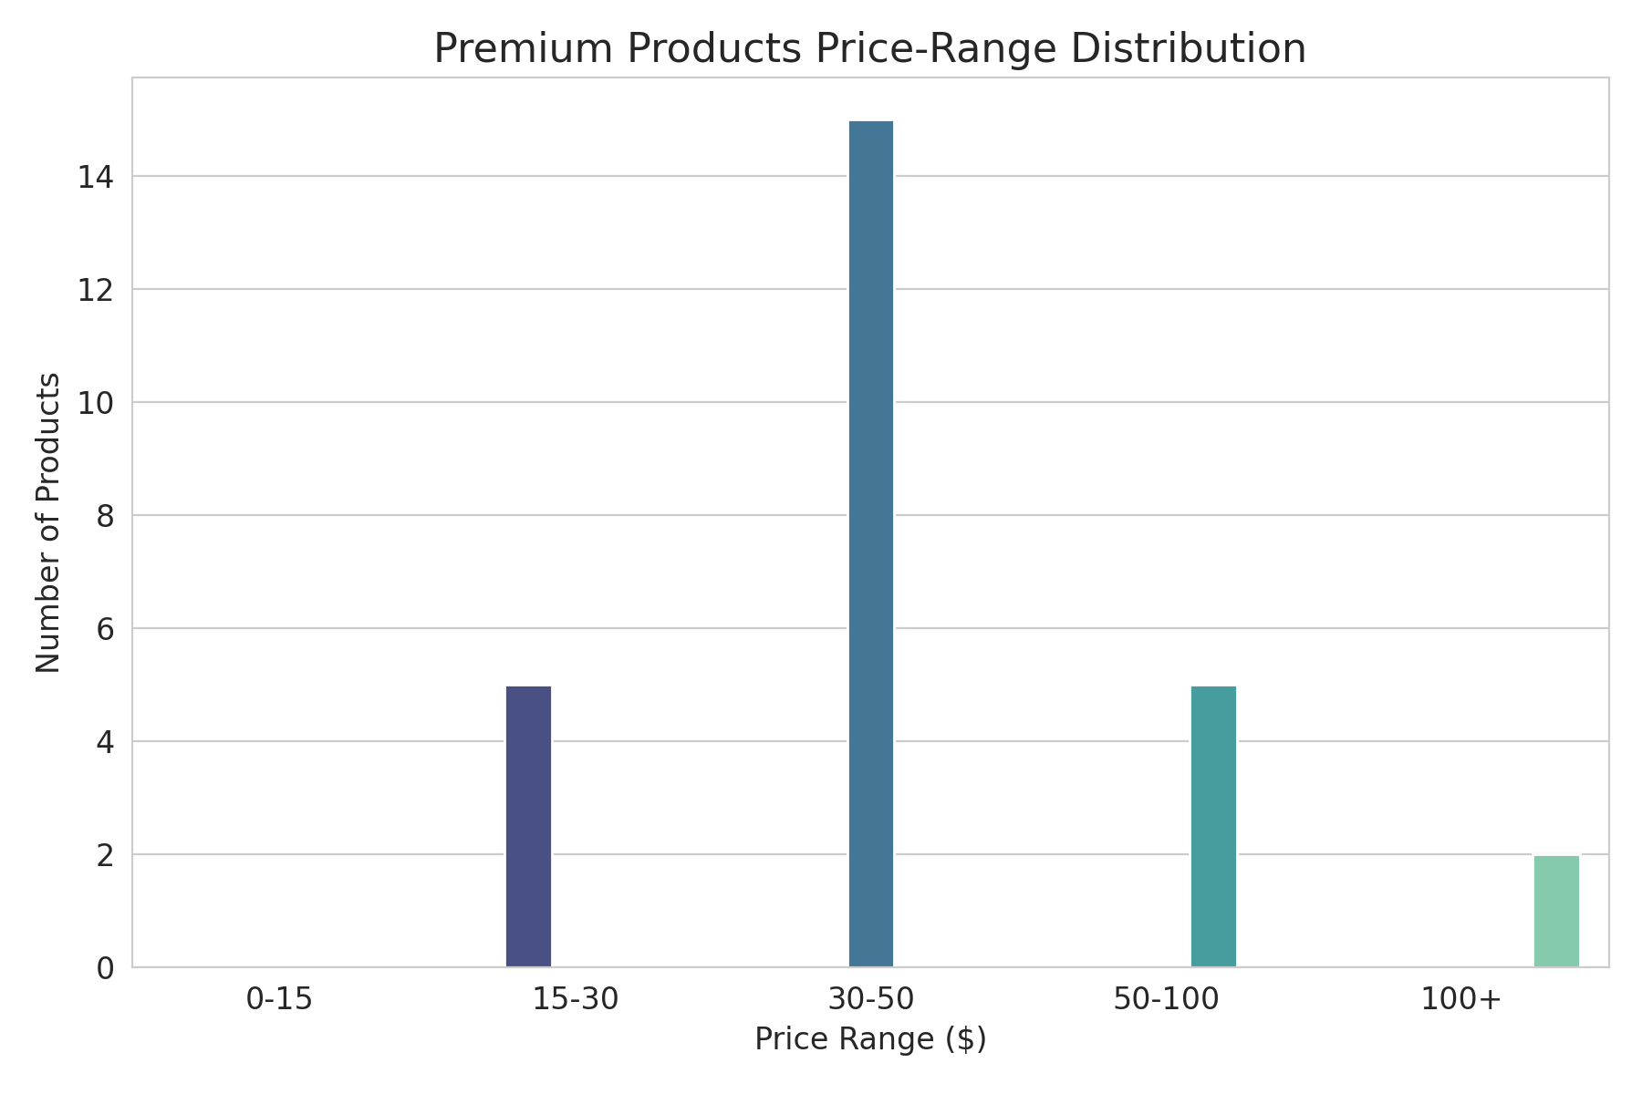
QUERY 14 · PRICE VIEW
Premium Products (Above Category Avg.) — Price Range View
SQL QUERY
SQL SERVER OUTPUT
SELECT p.ProductName,
c.CategoryName,
p.UnitPrice
FROM Products p
JOIN Categories c
ON c.CategoryID =
p.CategoryID
WHERE p.UnitPrice >
(SELECT AVG(p2.UnitPrice)
FROM Products p2
WHERE p2.CategoryID =
p.CategoryID)
ORDER BY p.UnitPrice DESC;
Live result grid — SSMS
Most premium products cluster in the $15-$50 range.
Only a handful cross the $100 mark.
Pricing above average is common, but rarely extreme.

Slide 19
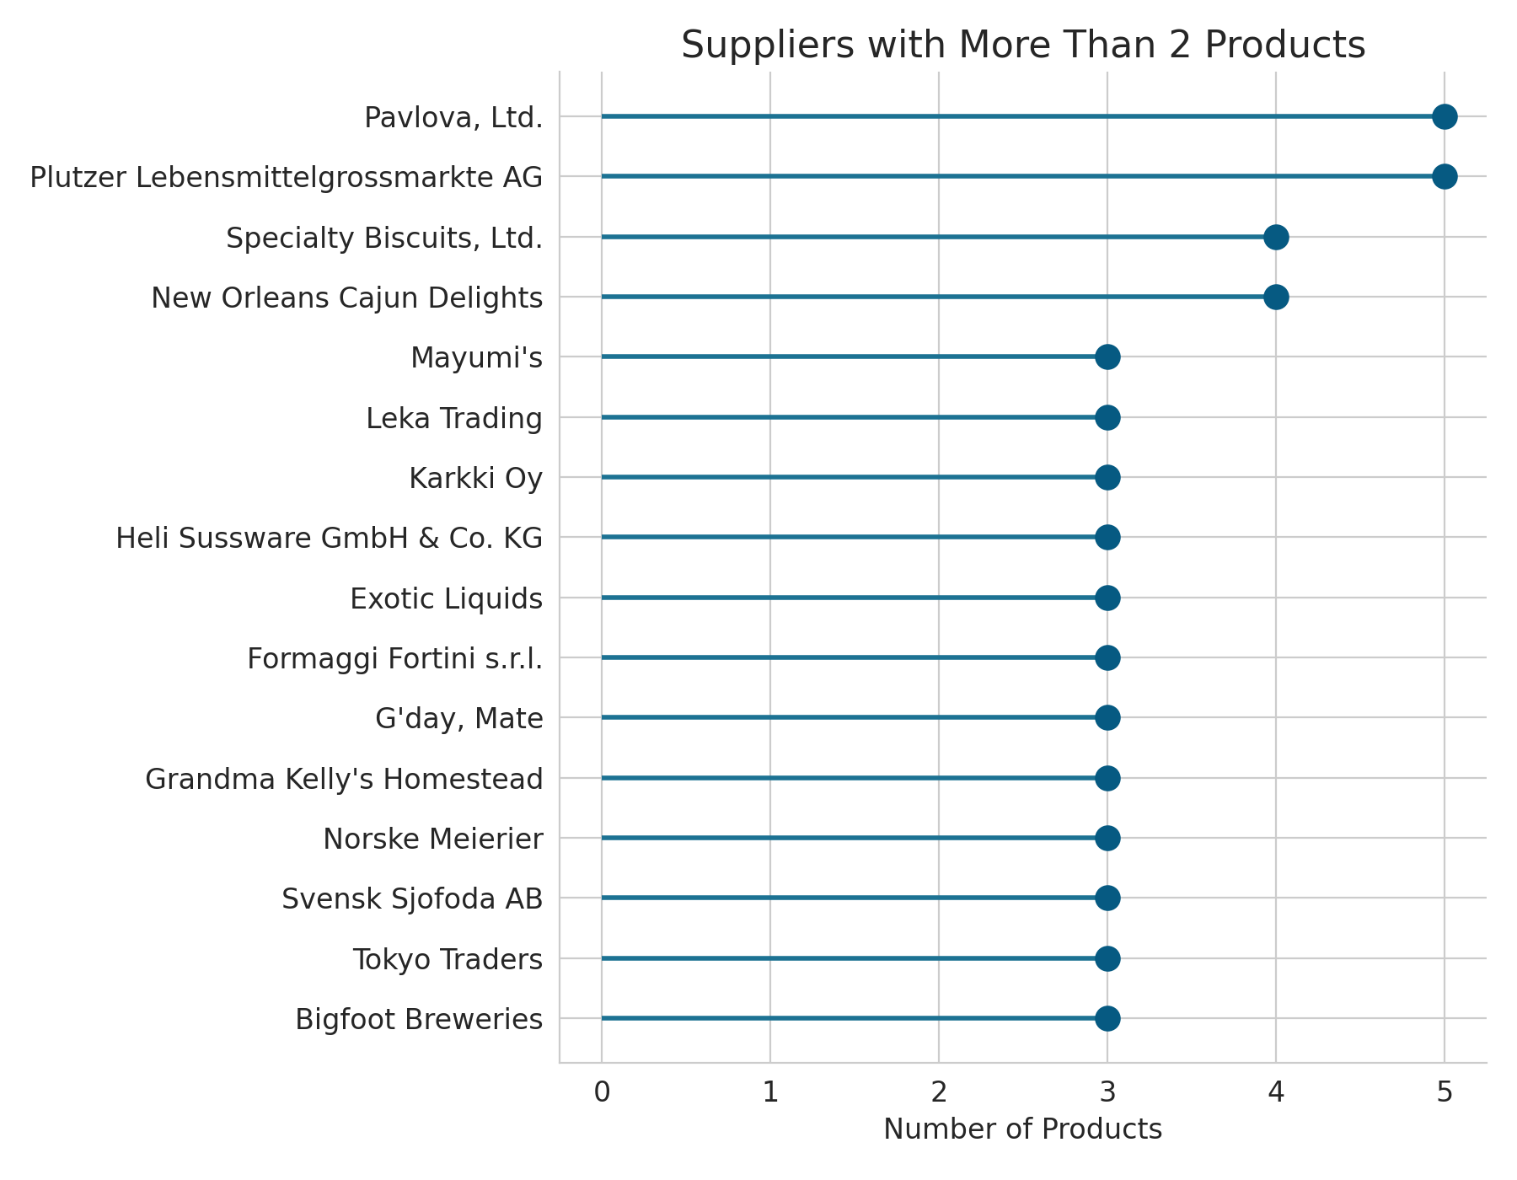
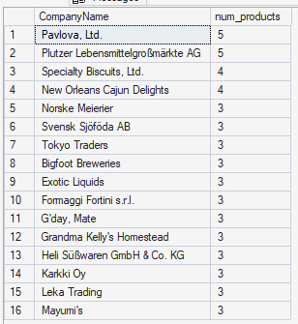
QUERY 15
Suppliers With More Than 2 Products
SQL QUERY
SQL SERVER OUTPUT
SELECT s.CompanyName,
COUNT(p.ProductID)
AS num_products
FROM Suppliers s
JOIN Products p
ON p.SupplierID =
s.SupplierID
GROUP BY s.CompanyName
HAVING COUNT(p.ProductID) > 2
ORDER BY num_products DESC;
Live result grid — SSMS
16 suppliers offer more than two products.
Pavlova, Ltd. and Plutzer Lebensmittelgroßmärkte AG lead with 5 each.
Eight suppliers are tied at exactly 3 products.

Slide 20
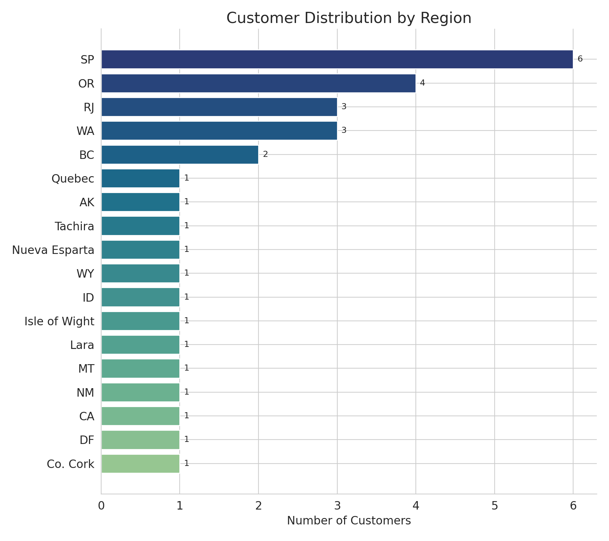
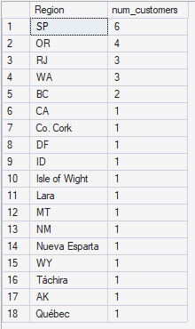
QUERY 16
Customer Distribution by Region
SQL QUERY
SQL SERVER OUTPUT
SELECT Region,
COUNT(CustomerID)
AS num_customers
FROM Customers
WHERE Region
IS NOT NULL
GROUP BY Region
ORDER BY num_customers DESC;
Live result grid — SSMS
São Paulo (SP) leads with 6 customers.
Oregon (OR) follows with 4, then Rio de Janeiro and Washington with 3 each.
The remaining 14 regions each contribute a single customer.

Slide 21
TAKEAWAYS
What the Data Tells Us
A broad, diversified product catalog across 8 categories, from Confections to Produce.
Meat/Poultry and Beverages command premium pricing; Grains/Cereals is the value tier.
A genuinely global footprint — 16 supplier countries and 21 customer countries.
Operations are centralized in London, with lean satellite offices across the U.S.
12 products need urgent restocking, and 27 are priced above their category average — two concrete, actionable findings.
Built with SQL Server + Python (pandas, matplotlib, seaborn) — every result verified against live SQL Server output

