Slide 1

AI-POWERED WEB APPLICATION FOR TEACHERS TO EVALUATE ANSWER SHEETS
Project: Java and Web Development
(DLBCSPJWD01)
Name: Omar Ismail
Matriculation: 92017626
Professor: Christian Remfert
Date: 21.08.2025

Slide 2




AI-Powered Web Application for Teachers to Evaluate Answer Sheets
Problem Statement
Teachers spend a lot of time
manually checking answer sheets.
Subjective answers and different handwritings make checking inconsistent.
Managing hundreds of answer sheets within strict deadlines increases pressure on teachers and reduces the time available for quality teaching.
There is a strong need for an automated system that can quickly and accurately evaluate answers, easing the burden on educators.

Slide 3
AI-Powered Web Application for Teachers to Evaluate Answer Sheets
AIM & CONCEPT
Aim
Develop an AI-powered web application to support teachers in evaluating answer sheets efficiently.
Reduce the time and effort spent on manual checking while ensuring consistency and accuracy.
Target groups are teachers and organizations.
Scope
Focus exclusively on objective-type answer checking like Multiple choice questions , True/False, and short Answer Type.
Provide teachers with instant evaluation results and options for manual review.
Provide them with dashboard where they can see past results.
Future Extension (Bachelor Thesis)
Expand the system to handle subjective-type answers using NLP and advanced AI models.
Address challenges like handwriting recognition and fairness in evaluation.

Slide 4






AI-Powered Web Application for Teachers to Evaluate Answer Sheets
KEY FEATURES
Upload scanned Answer Sheets(PDF or Images)
AI checks Objective Questions automatically.
Teachers can upload the PDF of the book or answer key so that AI can cross reference answers
Integrity check, which is teachers can check doubtful evaluations manually.
HTML, CSS, JavaScript for front-end for responsive and dynamic interactions.
Python with flask for backend and MongoDB for storing results and User-Data.

Slide 5



AI-Powered Web Application for Teachers to Evaluate Answer Sheets
Technical Components
FRONTEND
HTML/CSS for layout and styling
JavaScript for Dynamic Interactions with Backend
BACKEND
Python Flask Server
REST API to handle uploads, AI evaluation, and data retrieval
Tesseract OCR/Qwen2-VL-7B for scanning sheets
Pre-trained AI models for objective answer evaluation.
DATABASE
MongoDB to store results, user data, and logs

Slide 6
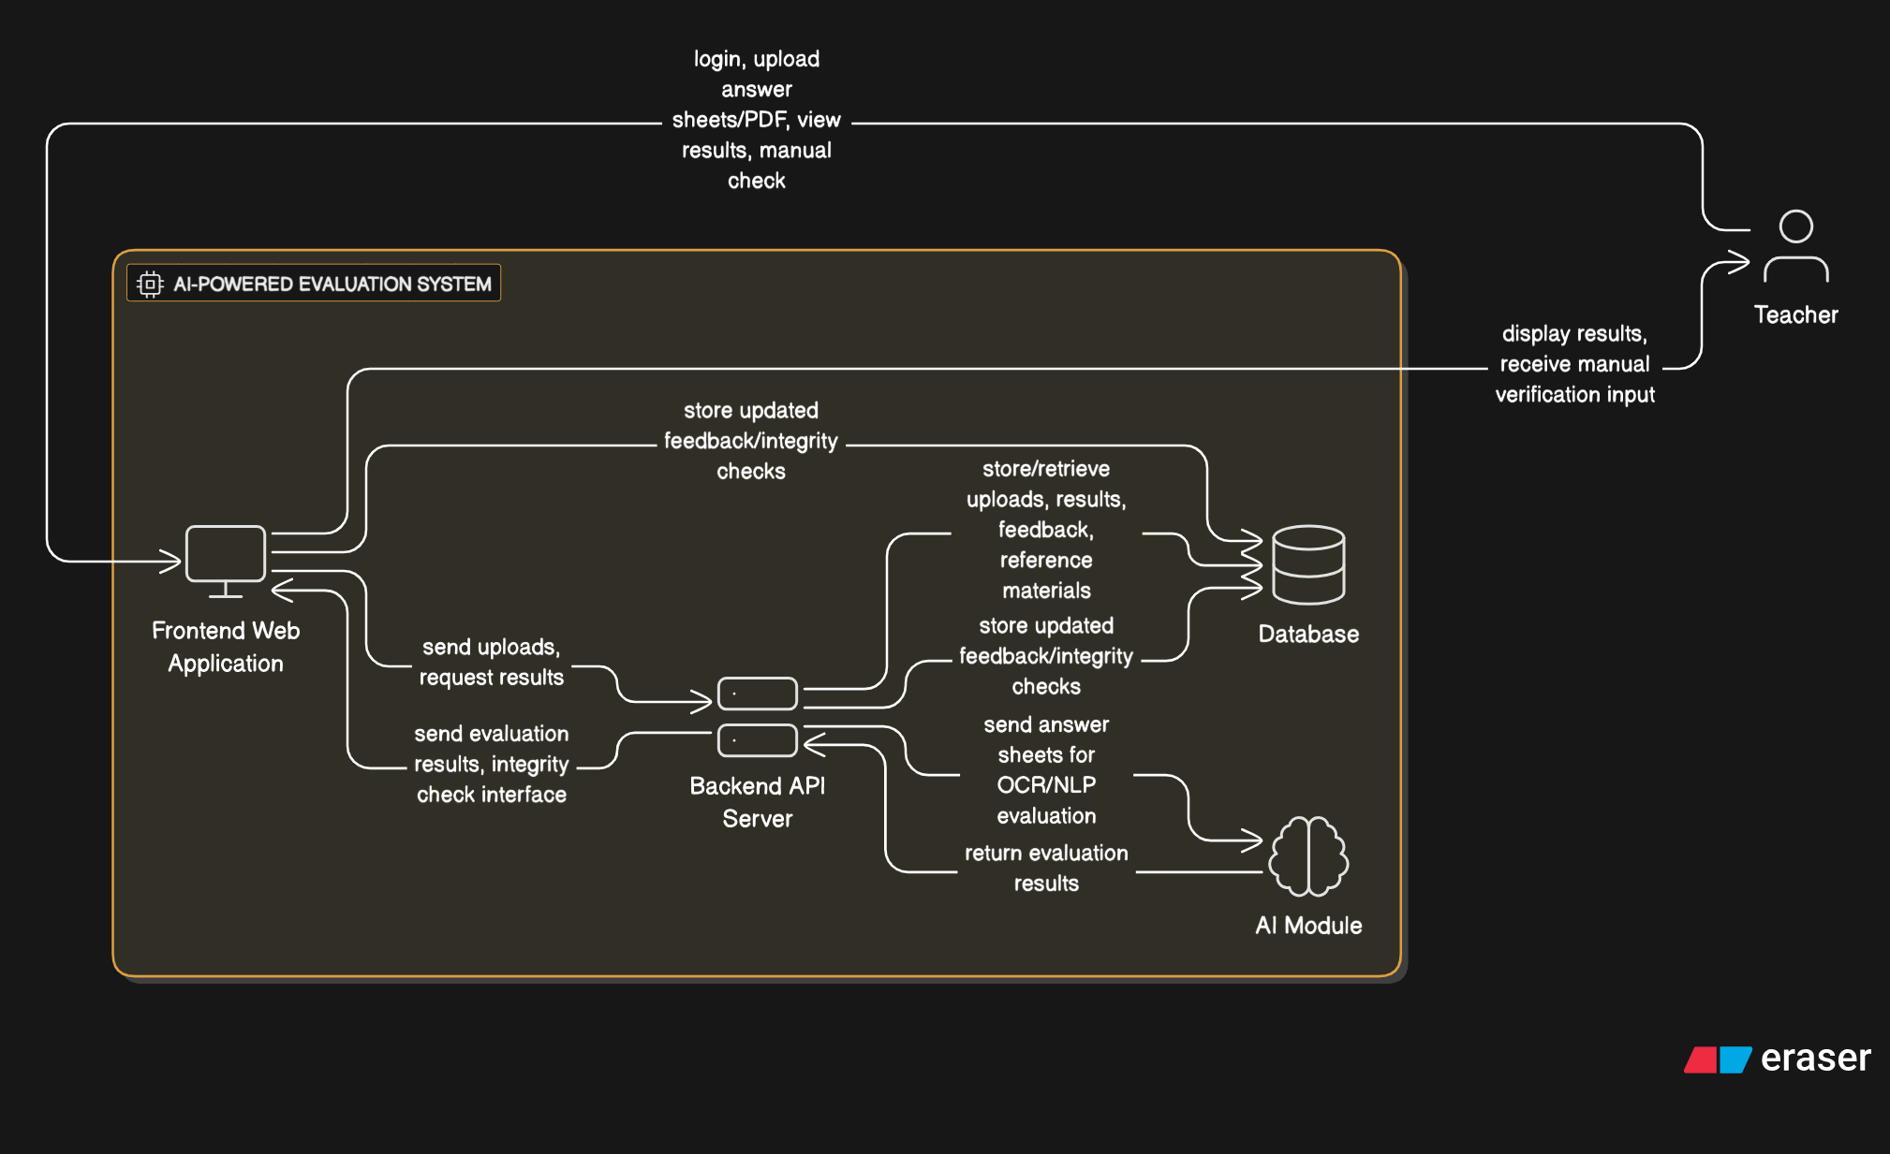
AI-Powered Web Application for Teachers to Evaluate Answer Sheets
Workflow Diagram Made using Eraser

