Slide 1

Lung Cancer Detection Model Using Convolution Neural Networks
Students' work: Omar Ahmed , Muhammad Harara, Mahmoud Abu Aisha , Isa Abu Salmiya

Slide 2
Thanks and gifts :

Slide 3
Table Content :
1) Research Problem
2) Objectives
3) Previous Studies
4) Proposed Model
5) Evaluation
6) Future Work

Slide 4
Research Problem :
In general there are medical errors in detecting the lung cancer, and there is also a low of accuracy where the possibility of obtaining correct results for the presence or absence of lung cancer is not the required ratio, and also it was noted that Previous models need time in processing images to get the result .

Slide 5
Objectives :
1) Identify the problems in the current cancer detection models.
2) To build a model based on CNN using to detect lung cancer.
3) To evaluate the proposed model using chest CT scan images Dataset.

Slide 6
Dataset :
Chest CT-Scan Images Dataset
3,439 images with the extension .png
Images type x-ray
images classified as normal people: 821
images classified as cancer patients: 2618

Slide 7
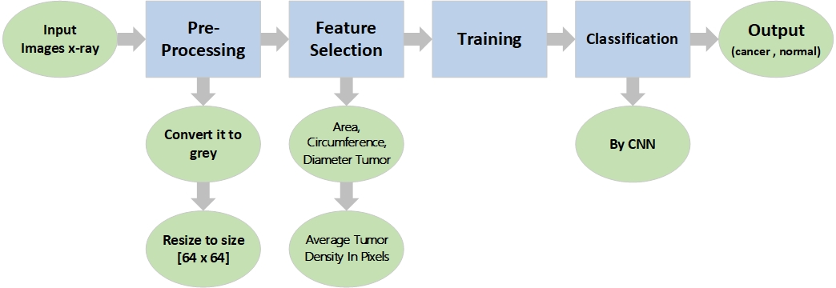
Proposed Model :

Slide 8
Evaluation:
Accuracy | Algorithm | ID
74.43 % | Deep Learning Approach | [1]
60.1 % | Subtraction method between two serial mass chest radiographs is proposed. | [2]
84 % | Deep Learning | [3]
95 % | (Deep Learning) using deep learning-based surface-enhanced Raman spectroscopy (SERS) of the exosomes. | [4]
60 % | Artificial Neural Network (ANN) | [5]
92.61 % | Artificial Neural Network | [6]
84.6 % | support vector machine (SVM) | [7]
85 % | Lung cancer detection using biomarkers | [8]
95 % | ANN | [9]
98 % | LCD – CNN Model | [10]

Slide 10
Future Work :
1) Discover whether cancer is benign or malignant .
2) Support images in any extension .
3) 3D photo support .
4) Color photo support .
5) Locating the cancer in the lung .
6) Embedded system with a website .

