Slide 1


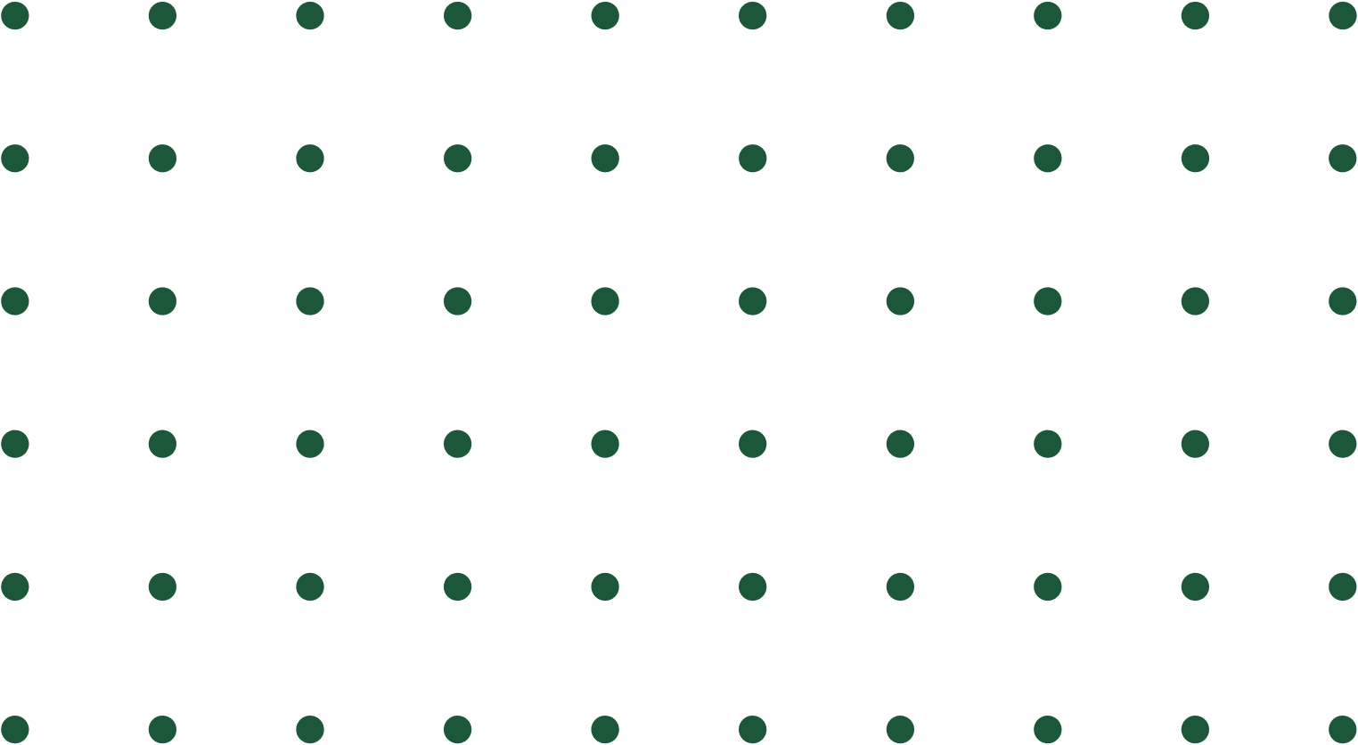
HEART ATTACK PREDICTION WITH ECG
USING TRANSFER LEARNING

Slide 2


Team members
Omar Mohamed ELsayed Mekkia
Rafik Mohammed
Mohamed Mohamed Mekkia
Ali Monir Sakr
Abdelrahman Medhat
Yousef Ahmed

Slide 3


AGENDA
1
Introduction
4
Dataset & ResNet-50
2
What is the ECG report?
5
Model Processing
6
6
3
Transfer learning?
6
Model Testing

Slide 4
OVERVIEW
Today, we will talk about how deep learning, especially CNNs and transfer learning with ResNet50, can predict heart conditions using ECG data, Heart Attack is a major global issue, and early detection is key, Doctors use ECGs to monitor heart activity, but analyzing them can be time-consuming, and subtle signs may be missed, AI helps improve the speed and accuracy of ECG analysis. CNNs, known for recognizing patterns, can be trained to spot key features in ECG images. Using transfer learning with ResNet50, we fine-tuned a model to classify heart conditions, In this presentation, I’ll share our approach and discuss how AI could transform heart attack diagnosis.

Slide 5
INTRODUCTION
What ‘s Heart Attack?
A heart attack occurs when blood flow to part of the heart muscle is blocked, leading to cell damage. Common symptoms include chest pain, shortness of breath, and cold sweats. Treatment may involve medications to dissolve clots or procedures like angioplasty or bypass surgery.

Slide 6
What is the ECG report?
An ECG report is a medical record that displays the heart’s electrical activity as waveforms, showing the overall rhythm and function of the heart. It helps doctors identify any irregularities or abnormalities in the heartbeat, such as arrhythmias or signs of a heart attack. ECG reports are commonly used to monitor heart health and assist in diagnosing heart conditions.
Manager
Marketing
Business Head
Manager

Slide 7
Benefits of using AI in ECG analysis
1
Speed
4
Continuous Learning
2
Consistency
5
Improve Human Analysis
3
Pattern Recognition

Slide 8
why we used transfer learning?
With limited data, training a model from scratch can be challenging. Transfer learning leverages pre-trained models, enabling us to fine-tune on specific tasks, which improves performance and reduces training time. This approach helps utilize learned features from large datasets, making it ideal for medical image classification, especially when data is scarce.
Manager
Marketing
Business Head
Manager

Slide 9
DATASET
The dataset has 4 classes:
normal heart beats
abnormal heart beats
experiencing a heart attack
had a heart attack
Each class has approximately 200-250 images for training.
Manager
Marketing
Manager
Dataset link:
https://data.mendeley.com/datasets/gwbz3fsgp8/2

Slide 10
ResNet-50
ResNet50 is a deep Convolutional Neural Network (CNN) with 50 layers.
It solves the problem of "vanishing gradients" in very deep networks.
Introduced the concept of Residual Learning.
Widely used in image classification tasks.

Slide 11
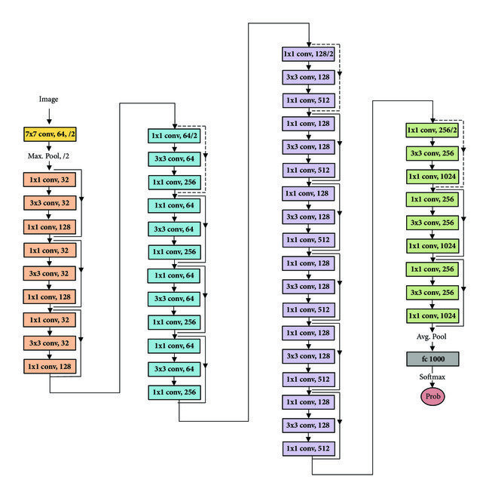
ResNet-50
Total Convolutional Layers3*3: 33
Total Convolutional Layers1*1: 17
Total Max Pooling Layers: 1
Total Average Pooling Layers: 1
Fully Connected Layers: 1 with 1000 neurons
takes an image of size 224x224

Slide 12
Model Processing: dataset preparation
CSV file: is created and mapped each ECG image to its corresponding label.
Data Transformations: Resize images to 224x224 and normalize using ImageNet statistics.
Data Splitting: Split the dataset into training (80%) and validation (20%) sets.
Manager
Marketing
Business Head

Slide 13
Model Processing: Model Setup
Pre-trained Model: pre-trained ResNet50 model was loaded for transfer learning.
Freezing Layers: Freeze layers are up to layer 4 to retain learned features, allowing fine-tuning only for layer 4 and beyond.
Marketing
Business Head
Output Layer: Using Softmax as an activation function for output probabilities
Manager

Slide 14
Model Processing: Training
Loss and Optimizer:
Used CrossEntropyLoss for multi-class classification.
Adam optimizer for updating model weights.
The model trained for 6 epochs with 98% accuracy (Cuda configuration powered by INVIDIA was used.
Marketing
Business Head
Early Stopping was used to save the best weights of the model and prevent overfitting.
Manager

Slide 15
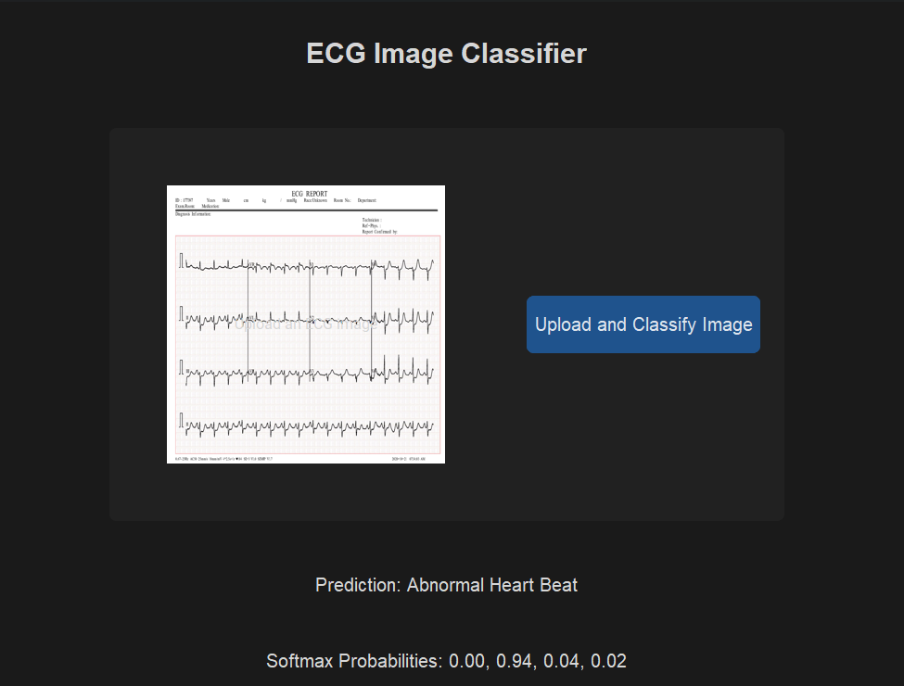
Model
Testing
The model seems to work very efficient
knowing that the values of the softmax are in order
(normal, abnormal , having a heart attack, had a heart attack).

Slide 16
project github link
https://github.com/OmarMakkeyah/Heart_Attack_prediction

Slide 17
Thank you

