Slide 1
Introduction to Git
A simple guide to version control

Slide 2
What does “Git” refer to?
Linus Torvalds – The Creator of Linux and Git
Linus referred to Git as “the stupid content tracker” while he was working on it. Eventually he settled on the name “Git”.

Slide 3
What does “Git” refer to?
*British slang: In British English, “git” is a mildly offensive term meaning a stupid, unpleasant, or contemptible person.
*A random three-letter combination that is pronounceable, and not used by any Unix command
*Global Information Tracker

Slide 4
What is Git?
• Distributed version control system
• Tracks changes in source code
• Enables collaboration and backup
• bla bla bla

Slide 5
Who uses Git?
• Developers of course
• Haven’t you done before:
Final.docx The_actual_final_of_all.docx
The_finalist_of_all_finals.docx
Etc…

Slide 6
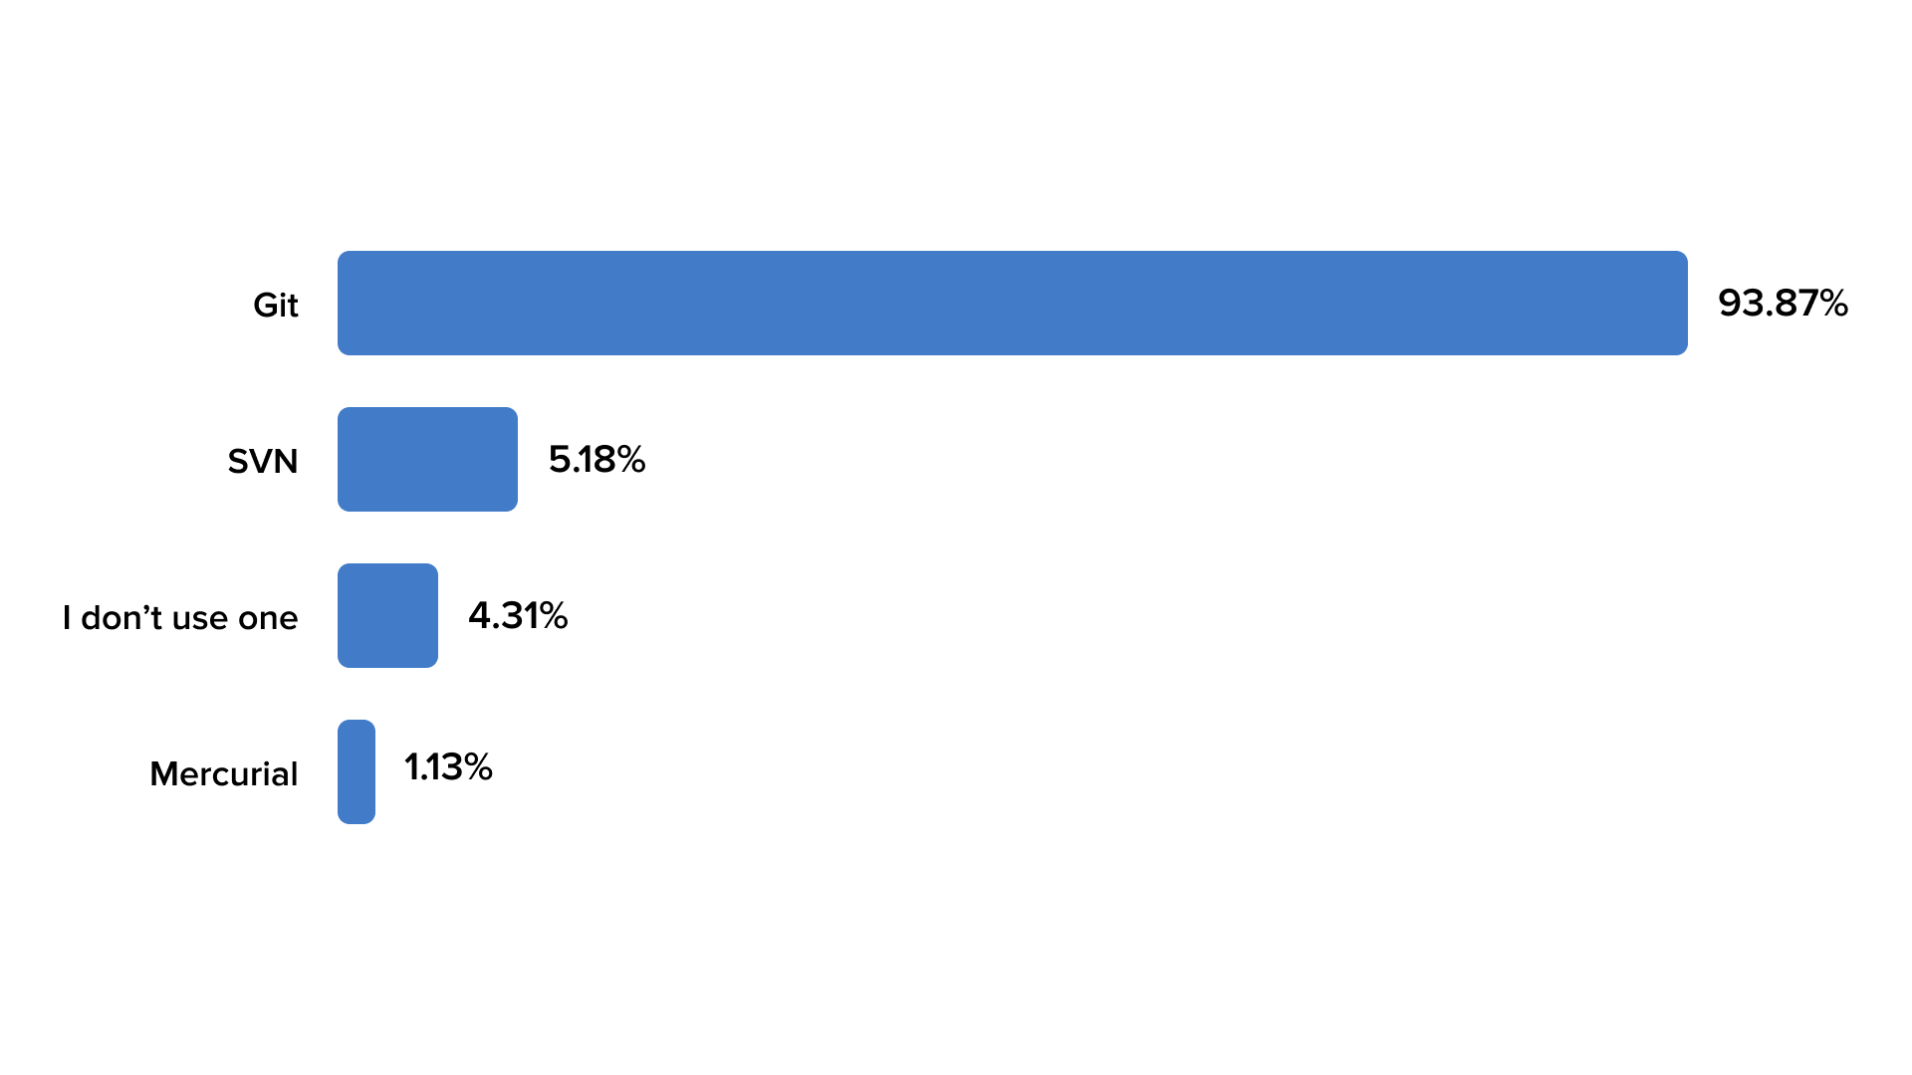
Why Git?

Slide 7
How does Git really work?
Git Commits:
A commit in a git repository records a snapshot of all the
(tracked) files in your directory. It's like a giant copy and paste,
but even better!

Slide 8
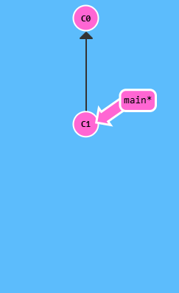
How does Git really work?
git commit

Slide 9
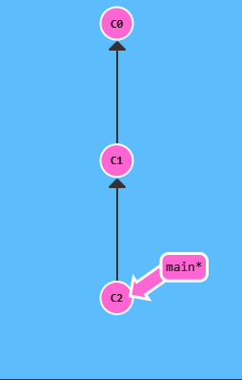
How does Git really work?

Slide 10
How does Git really work?
Git Branches
Branches in Git are incredibly lightweight as well. They are simply pointers to a specific commit -- nothing more. This is why many Git enthusiasts Follow the principle : “Branch early, and branch often”
Because there is no storage / memory overhead with making many branches, it's easier to logically divide up your work than have big beefy branches.
When we start mixing branches and commits, we will see how these two features combine. For now though, just remember that a branch essentially says "I want to include the work of this commit and all parent commits."

Slide 11
How does Git really work?
git branch newImage

Slide 12
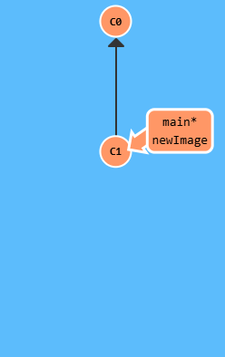
How does Git really work?
git commit

Slide 13
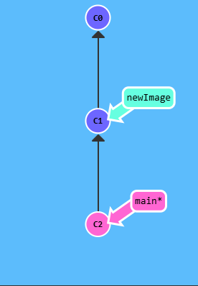
How does Git really work?

Slide 14
How does Git really work?
git branch newImage
git commit

Slide 15
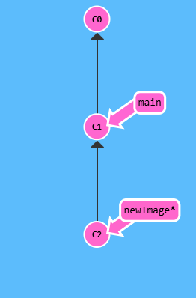
How does Git really work?

Slide 16
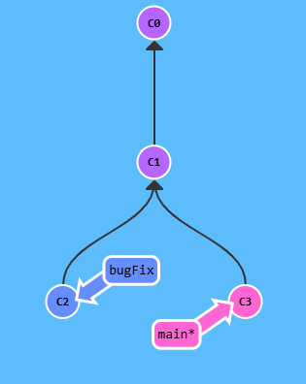
How does Git really work?
git merge bugFix

Slide 17
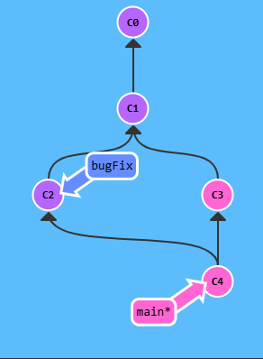
How does Git really work?

Slide 18
How does Git really work?
git checkout bugFix
git merge main

Slide 19
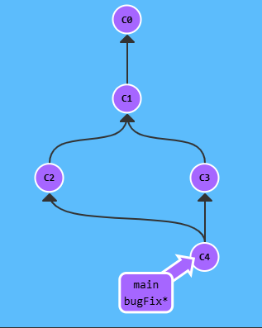
How does Git really work?

Slide 20
Git Remotes: Github?
Remote repositories aren't actually that complicated.
They are actually just copies of your repository on another computer.
That being said, remote repositories have a bunch of great properties:
- First and foremost, remotes serve as a great backup!
- More importantly, remotes make coding social!

Slide 21
Why Use Git?
• Collaborate with team members
• Track and revert changes
• Create branches to work on features
• Ensure backup and history

Slide 22
Basic Git Workflow
1. Modify files in Working Directory
2. Stage changes with `git add`
3. Commit changes with `git commit`
4. Push to remote repository with `git push`

Slide 23
Common Git Commands
`git init` - Initialize a Git repository
`git status` - Check status of changes
`git add <file>` - Stage a file
`git commit -m "message"` - Save changes
`git push` - Upload to remote repository
`git pull` - Get latest changes

Slide 24
Branching and Merging
• `git branch` - Create a new branch
• `git checkout` - Switch to a branch
• `git merge` - Combine branches
• Helps isolate work and collaborate

Slide 25
Example Workflow
1. `git clone` - Copy repository
2. `git checkout -b feature` - Create branch
3. `git add .` and `git commit` - Save work
4. `git push origin feature` - Push changes
5. Create Pull Request on GitHub

Slide 26
Best Practices
• Write clear commit messages
• Commit small, logical changes
• Pull before pushing
• Use `.gitignore` for sensitive files

Slide 27
Thank You!
Recommendation: https://learngitbranching.js.org
Happy Coding with Git!
You can find this presentation on my Github: https://github.com/OmarMoamarFostok/git-presentation.git

