Slide 1
EMBEDDED SYSTEMS PROJECT
Chrome Dinosaur Game
on ATmega32
Bare-Metal Programming & Custom Driver Development
Presented by
Team 1
Notes:
Good day everyone. Today I'm presenting our project: a complete recreation of the famous Chrome Dinosaur game, built from scratch on an ATmega32 microcontroller using bare-metal C, with no operating system or external game engine involved.

Slide 2
Project Objective
Why we built more than just a game
Full Embedded System Design
Design a complete, self-contained embedded system built entirely from first principles.
Drivers Written From Scratch
Implement every microcontroller driver in-house, with no vendor libraries or HAL shortcuts.
Custom LCD Graphics
Apply custom-character (CGRAM) techniques to render game graphics on a simple character LCD.
Chrome Dinosaur Game on ATmega32 | Team 1
2
Notes:
Our core objective was never just to program a game — it was a hands-on application of embedded systems engineering. We wrote the microcontroller drivers completely from scratch to control the LCD, read inputs, generate audio signals, and manage timing precisely enough to animate graphics smoothly.

Slide 3
Layered Software Architecture
A clean separation between application logic and hardware access
APPLICATION LAYER
Dino Game Logic — main.c
HAL — HARDWARE ABSTRACTION
LCD Driver
MCAL — MICROCONTROLLER ABSTRACTION
DIO Driver
HARDWARE
ATmega32
Chrome Dinosaur Game on ATmega32 | Team 1
3
Notes:
The codebase follows a layered architecture to keep it organized and reusable. The MCAL layer programs the DIO registers for direct hardware control. Above it, the HAL layer contains the LCD driver. At the top, the Application layer holds the game logic and physics.

Slide 4
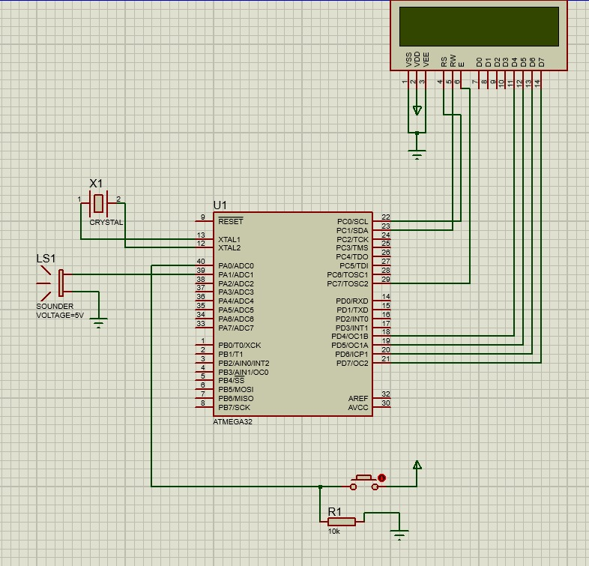
Hardware Interfacing
Actual Proteus schematic — 16x2 LCD wired to the ATmega32 in 4-bit mode
1
PC2–PC5 reserved for JTAG
3
These pins default to the JTAG interface on the ATmega32, so they were kept clear of the LCD bus to avoid data conflicts.
2
Enable re-routed to PC7
Instead of editing the fuse bits, the LCD Enable line was moved to PC7/TOSC2 in software — giving a fully stable display.
1
2
3
PD4–PD7 → LCD D4–D7
The 4-bit data bus runs on Port D, halving the pin count needed compared to 8-bit mode.
4
Push-button + 10kΩ pulldown
4
Debounced button input used to trigger the dinosaur's jump.
Proteus Simulation — Circuit Schematic
Chrome Dinosaur Game on ATmega32 | Team 1
4
Notes:
For the hardware design, we used a 16x2 LCD. To save microcontroller pins, the display runs in 4-bit mode. One engineering challenge we faced: Port C pins PC2 to PC5 are reserved by default for the JTAG interface on the ATmega32. To avoid any data conflict without modifying the fuse bits, we engineered the connection in software and moved the Enable pin to PC7, which gave the display complete stability.

Slide 5
Game Logic Flow
A non-blocking super-loop driven by a millisecond timer
START
Initialize Hardware
(DIO, LCD, Load Custom Characters)
Read Button State
No
Button
Pressed?
Yes
Keep on Ground
Trigger Jump Timer
No, loop back
Update Obstacle Position & Score
Collision
Detected?
Yes
Game Over & Reset
Chrome Dinosaur Game on ATmega32 | Team 1
5
Notes:
The game runs on an infinite super-loop with a millisecond timer, avoiding blocking delay functions that would freeze the processor. Each cycle the MCU reads the button, updates the obstacle coordinates, and checks for a collision by comparing the dinosaur's coordinates against the obstacle's.

Slide 6
Custom Characters (CGRAM)
Drawing sprites pixel-by-pixel inside the LCD's character memory
u8 DINO_STAND_PART_1[8] = { 0b00000, 0b00000, 0b00010, 0b00010, 0b00011, 0b00011, 0b00001, 0b00001 }; LCD_voidDrawPattern(0, DINO_STAND_PART_1);
5 x 8 Pixel Grid — CGRAM Cell
Two body segments and two alternating leg positions create the running animation; matching sets define the cactus and the bird.
Chrome Dinosaur Game on ATmega32 | Team 1
6
Notes:
A character LCD cannot display images directly, so we used its internal CGRAM to create custom 5x8-pixel characters. The dinosaur was split into two body parts, with two separate leg positions to create a running animation, alongside custom sprites for the cactus and the bird.

Slide 7
Source Code — LCD Driver
LCD_PROGRAM.c — sending commands to the display over a 4-bit bus
static void LCD_voidSendEnablePulse(void)
{
MDIO_voidSetPinValue(LCD_CONTROL_PORT, LCD_E_PIN, DIO_HIGH);
_delay_ms(2);
MDIO_voidSetPinValue(LCD_CONTROL_PORT, LCD_E_PIN, DIO_LOW);
}
void LCD_voidWriteCommand(u8 Copy_u8Command)
{
MDIO_voidSetPinValue(LCD_CONTROL_PORT, LCD_RS_PIN, DIO_LOW);
MDIO_voidSetPinValue(LCD_CONTROL_PORT, LCD_RW_PIN, DIO_LOW);
LCD_voidWriteHalfPort(Copy_u8Command >> 4); // High nibble
LCD_voidSendEnablePulse();
LCD_voidWriteHalfPort(Copy_u8Command); // Low nibble
LCD_voidSendEnablePulse();
}
Chrome Dinosaur Game on ATmega32 | Team 1
7

Slide 8
Source Code — Jump & Collision
DINO_PROGRAM.c — non-blocking jump trigger and hitbox check inside the main loop
if (button_state == BUTTON_PRESSED &&
prev_button_state == DIO_LOW &&
jump_flag == 0)
{
jump_flag = 1;
jump_start_time = current_millis;
jump_duration = obstacle_period * 6; // scales with speed
is_buzzer_on = 1;
buzzer_stop_time = current_millis + 30;
}
if (obstacle_row == LINE_2 &&
(obstacle_col == hitbox_col1 ||
obstacle_col == hitbox_col2))
{
is_collision = 1; // cactus hit on the ground row
}
Chrome Dinosaur Game on ATmega32 | Team 1
8

Slide 9
Game Physics & Dynamics
Two simple rules that make the game feel alive
Acceleration
Dynamic Jump
As the score increases, the time interval between obstacle movements is programmatically reduced — the game speed ramps up continuously.
The jump timer is not fixed: airtime scales with the current obstacle speed, so the dinosaur always clears the cactus without getting stuck mid-air.
Score → Speed
Chrome Dinosaur Game on ATmega32 | Team 1
9
Notes:
To add real challenge, we applied an acceleration principle: as the score increases, the interval between obstacle movements shrinks. For realistic physics, we also made the jump timer dynamic — the dinosaur stays airborne for a duration proportional to the obstacle's speed, ensuring it clears the cactus every time.

Slide 10
Live Demo
Proteus simulation — ATmega32 running the full game loop
SCORE 01452
Chrome Dinosaur Game on ATmega32 | Team 1
10
Notes:
Here is a live simulation of the project. As you can see, the acceleration works smoothly, button response is instant thanks to fast polling, and a collision triggers a clean reset of the counters to start a new round.

Slide 11
Thank You
Questions & Answers
Team 1
Notes:
In conclusion, this project was a comprehensive application connecting embedded C concepts with hardware engineering to deliver a complete interactive product. Thank you very much for your time and attention — we're ready to answer any questions or discuss any part of the source code.

