Slide 1
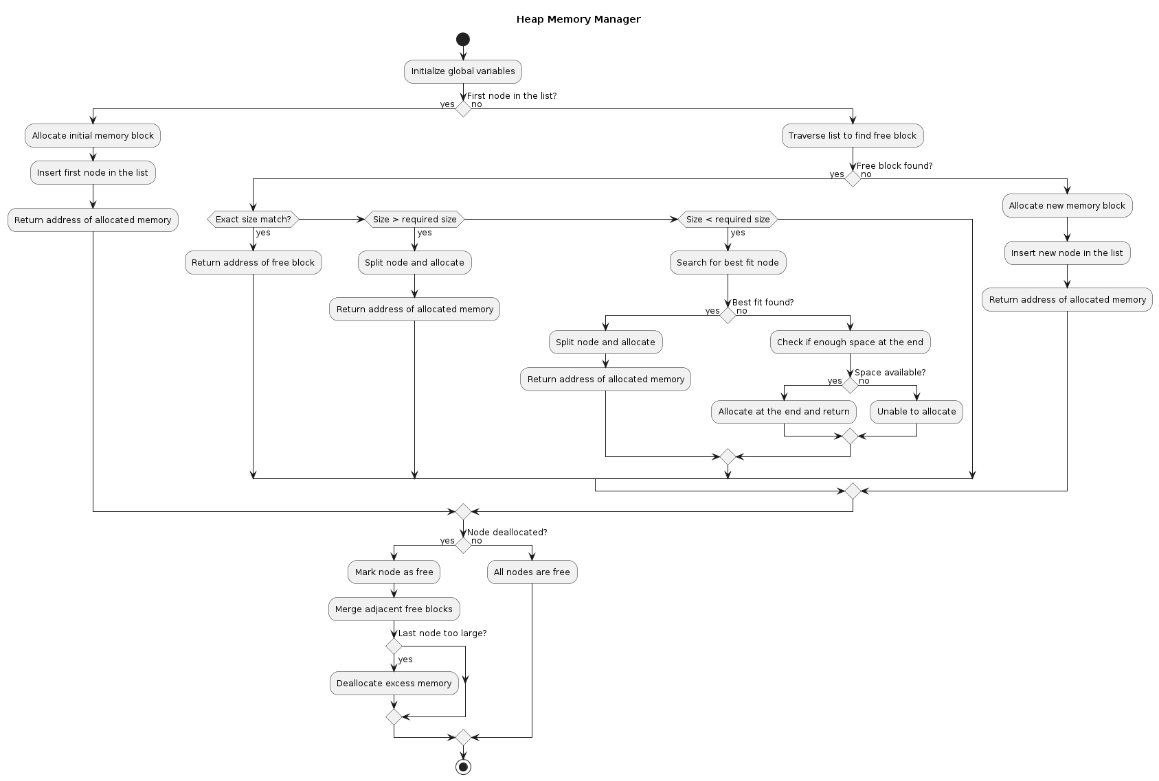
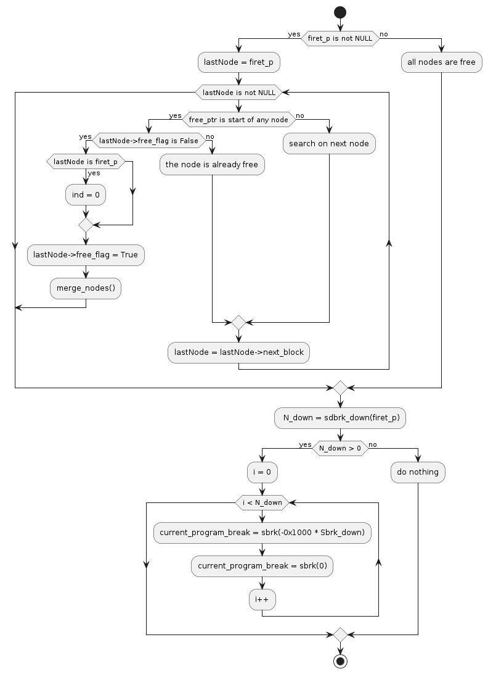
My_malloc():

Slide 2
My_free():

Slide 3
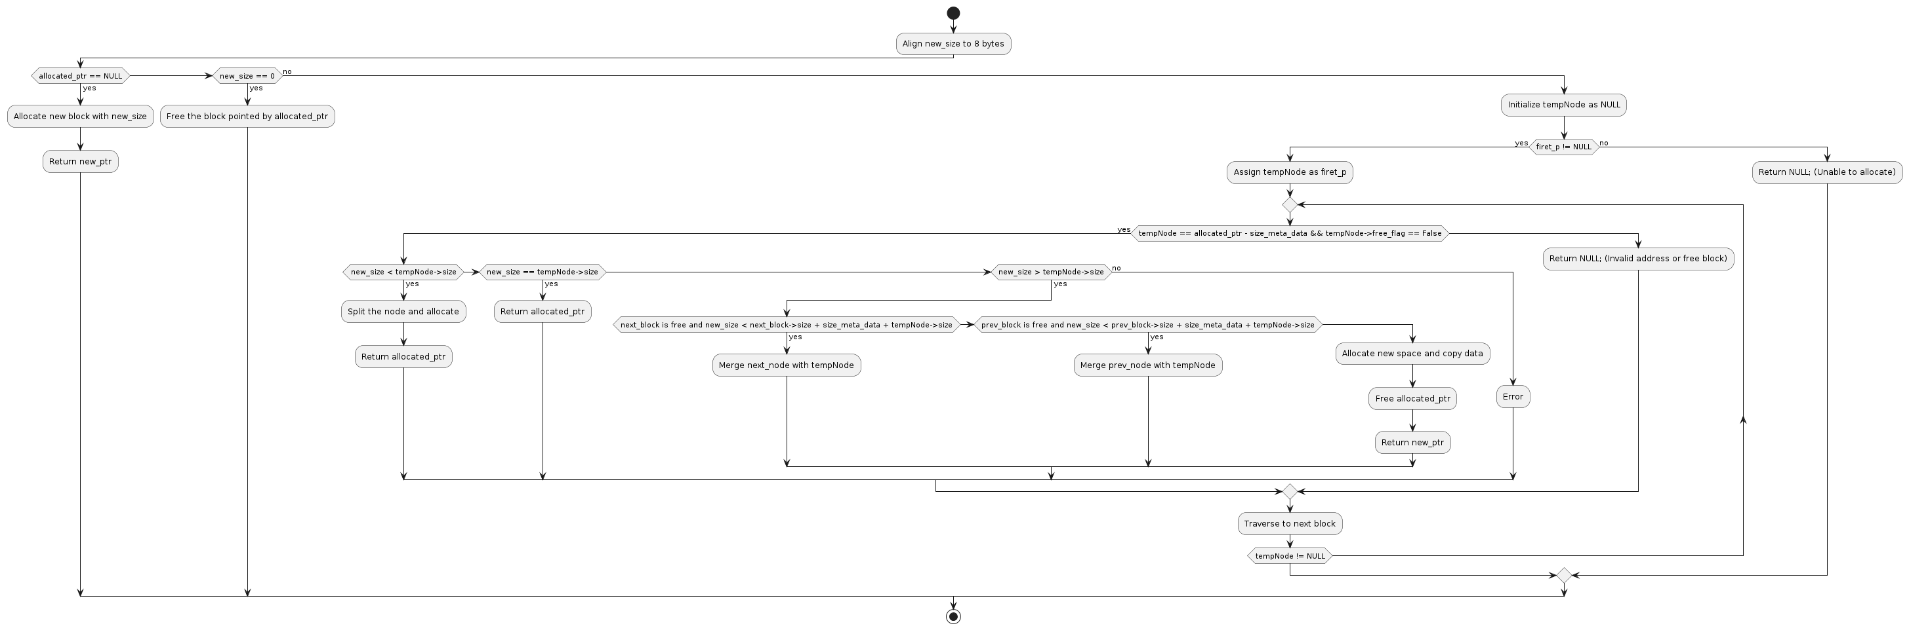
My_realloc():

Slide 4
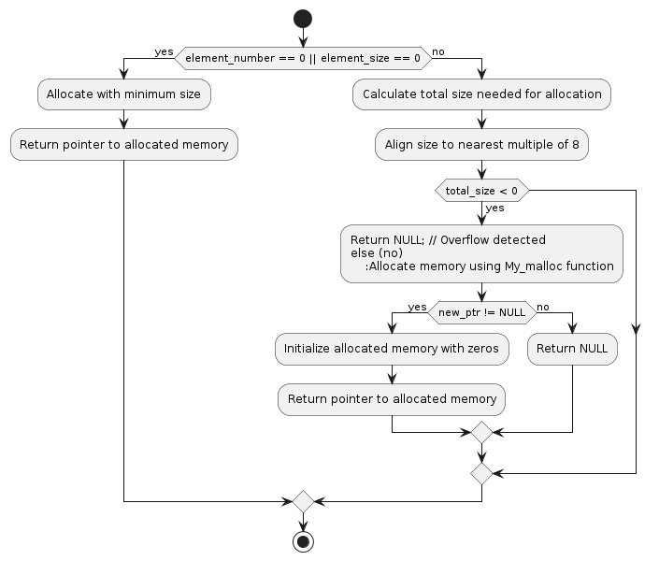
My_calloc():

Slide 5
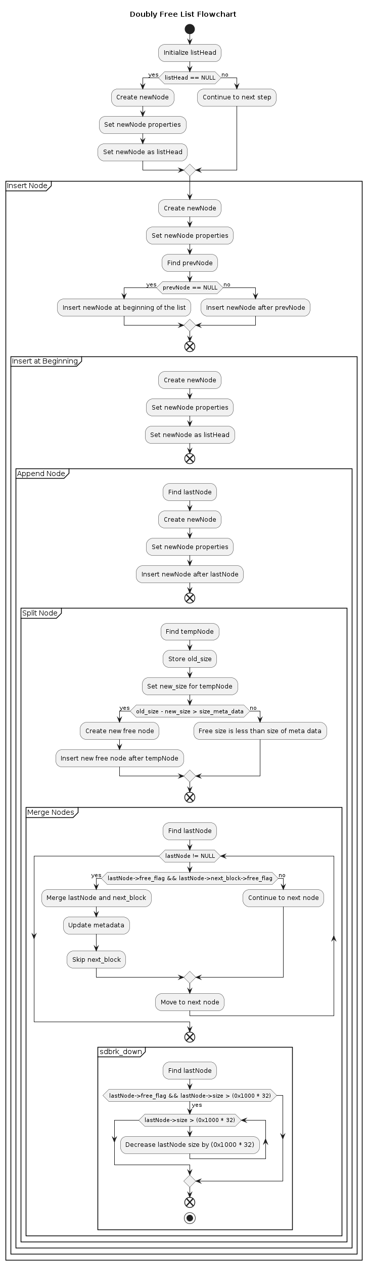
Split node():
Insert node():
Merge nodes():
Sbrk down():

Slide 6
My_malloc():

