Slide 1
Chatbot-MD
By: Omar Qasem

Slide 2
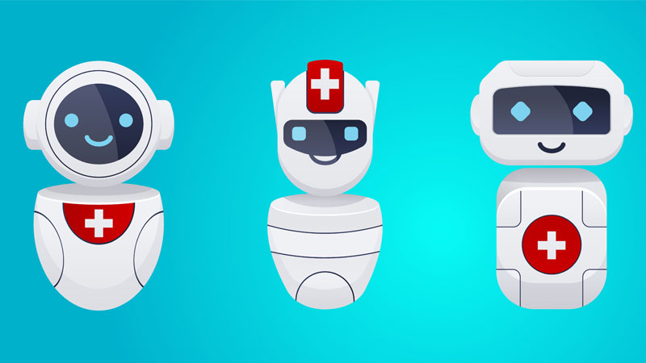
Chabtbot-MD
What is Chatbot-MD?
  A web-based deep learning chatbot that utilizes natural language processing to learn from text data to interpret user input and respond accordingly.
  Chatbot-MD is modeled to interpret the user’s input that pertains to their health and to provide a diagnosis, preventative measures to mitigate or cure the illness, and suggest available professionals that can provide consultation.

Slide 3
Objective & Motivation
  The objective of this project was to create a data product that could assist the health sector by acting as a supplementary resource to provide initial medical advice.
  The motivation behind this project was derived from the shortage of Doctors and Nurses, which adversely affects the quality of the health services provided.

Slide 4
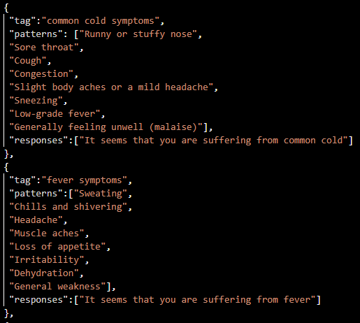
Data
  The data used in this project was sourced from GitHub and is stored in json format.
  The data is segmented into tags, patterns, and responses.
  The segmentation facilitates the training of the model by clustering sentences based on their contents under specific tags, which are associated with specific responses.

Slide 5
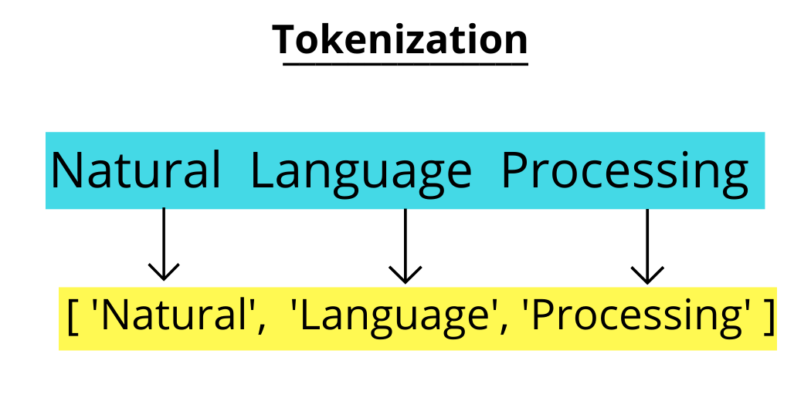
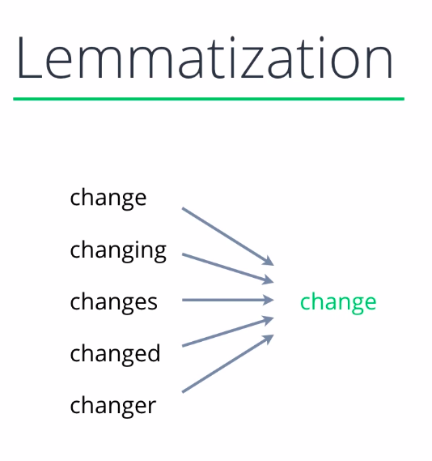
Data preprocessing – tokenization & Lemmatization
Tokenization is the process of breaking down the entire text into words.
Lemmatization aims to remove inflectional endings and to return the base or dictionary form of a word, which is called lemma.

Slide 6
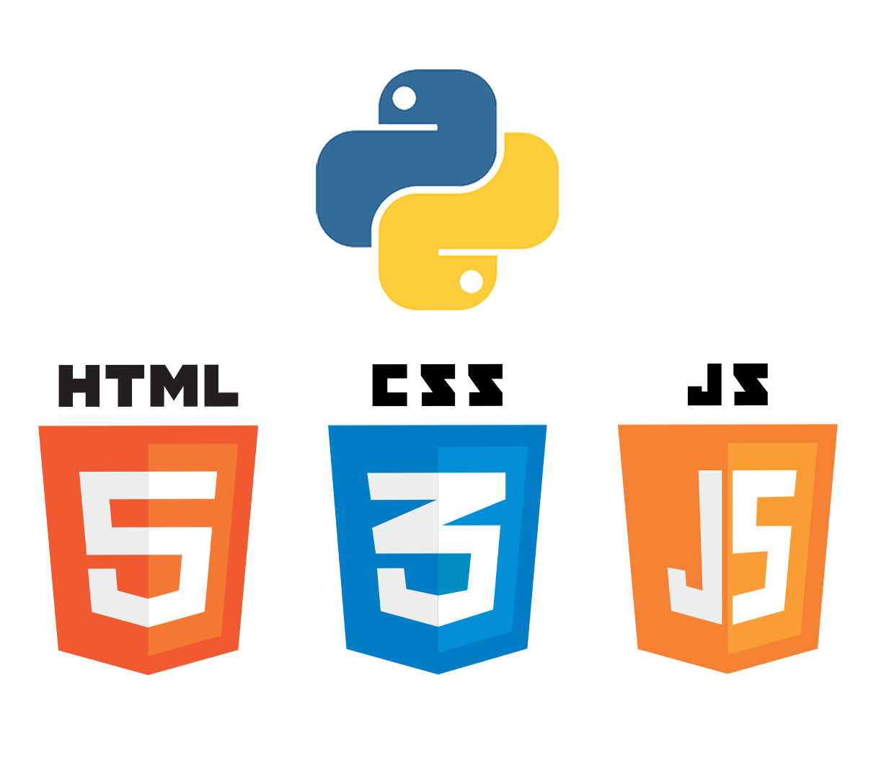
Languages & Tools
  In order to create Chatbot-MD the following languages and tools were utilized:
    Languages: Python, JavaScript, HTML, and CSS.
    Tools: VS Code, MoongoDB, flask, nltk, tensorflow, keras, numpy, pickle, json, random, bootstrap, jQuery, and pymongo.

Slide 7
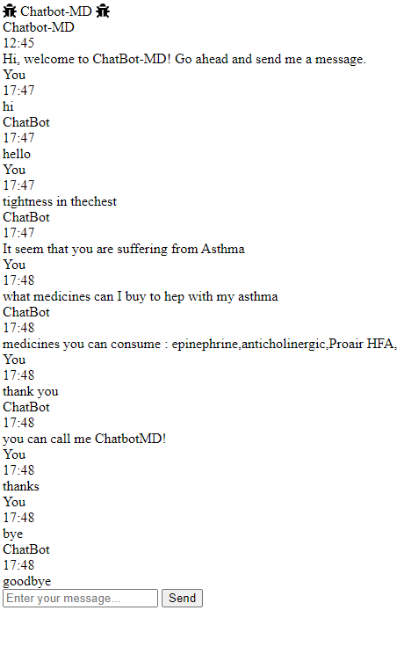
Final Result
The result is a fully operational web-based chatbot that utilizes deep learning to interpret user input and respond accordingly.
The model takes in user input and responds with a diagnoses of the illness, the appropriate medication for the illness, and provides sources to get a consultation form a doctor.
To improve this model to a degree in which it can be operational:
  Integrate data sets that pertain to all sorts of diseases, surgeries, medications, surgeries.
  Incorporate access to personal health records.

