Slide 1
CUSTOMER SEGMENTATION
Using K-Means and
Gaussian Mixture Models
An unsupervised machine learning study of customer behavior
Research project
K-Means • GMM • Customer segmentation
01 / 05

Slide 2
Problem & Research Question
02
THE PROBLEM
LITERATURE CONTEXT
Customers differ in their demographics,
spending, purchasing behavior, and
online engagement.
• John et al. (2023) compared K-Means, GMM, and DBSCAN for retail customer segmentation.
• Ashraf et al. (2025) reported K-Means as the best of four tested clustering methods using RFM features.
• Dogan et al. (2018) found that spending alone was insufficient for customer segmentation.
Clustering can group customers with similar characteristics without predefined segment labels.
RESEARCH QUESTION
How can K-Means and GMM clustering be used to identify distinct customer segments based on age, income, spending behavior, purchase frequency, and online engagement to support targeted marketing strategies?
[1] [2] [3]
02 / 05

Slide 3
Data & Method
03
2,240
customers
29
dataset columns
8
features used
No
predefined target
WORKFLOW
Clean data
Feature engineering
Standardize
K-Means / GMM
Evaluate
FEATURES USED
MODEL & EVALUATION
Age • Income • Total_spend • NumWebPurchases
NumStorePurchases • Recency • NumWebVisitsMonth • Customer_since
K-Means → Elbow Method → K = 4
GMM → BIC → K = 8
Silhouette Score → compare cluster separation
03 / 05

Slide 4
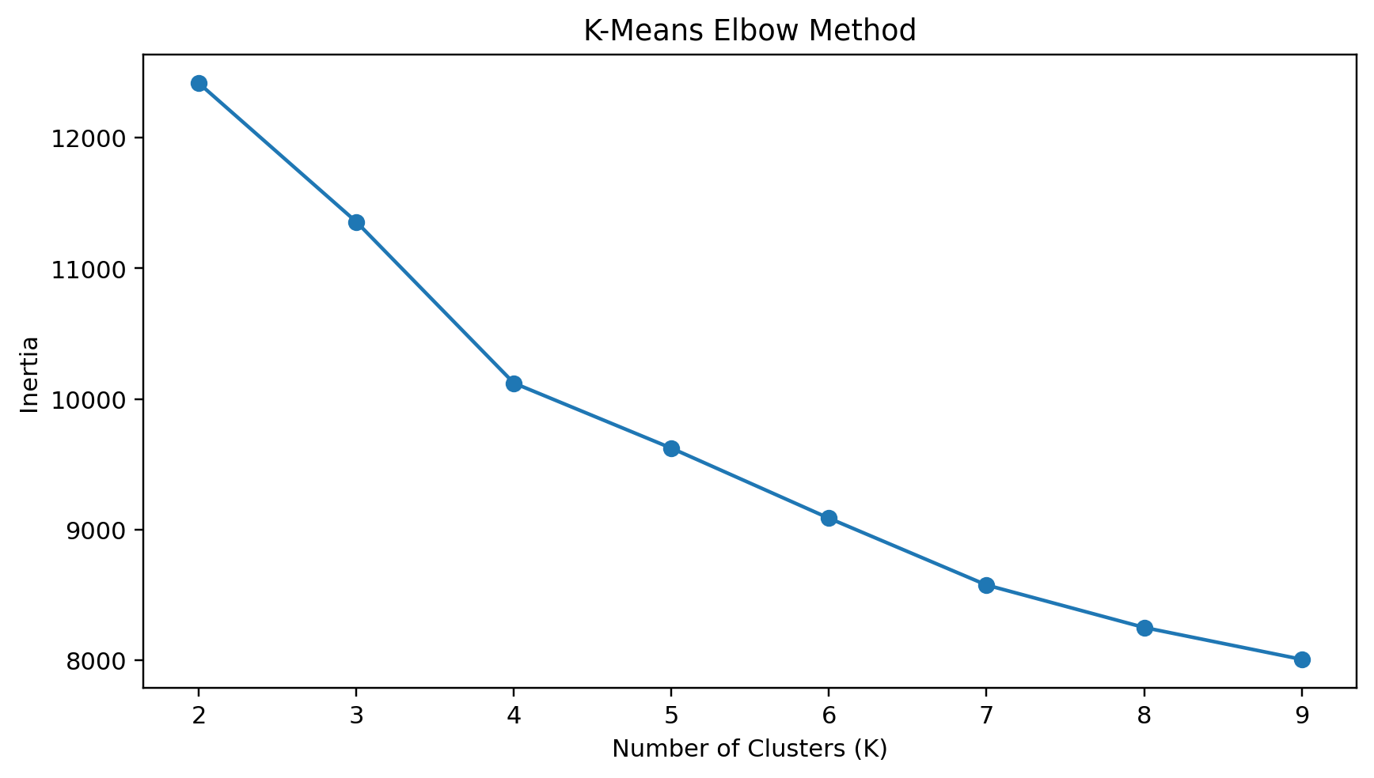
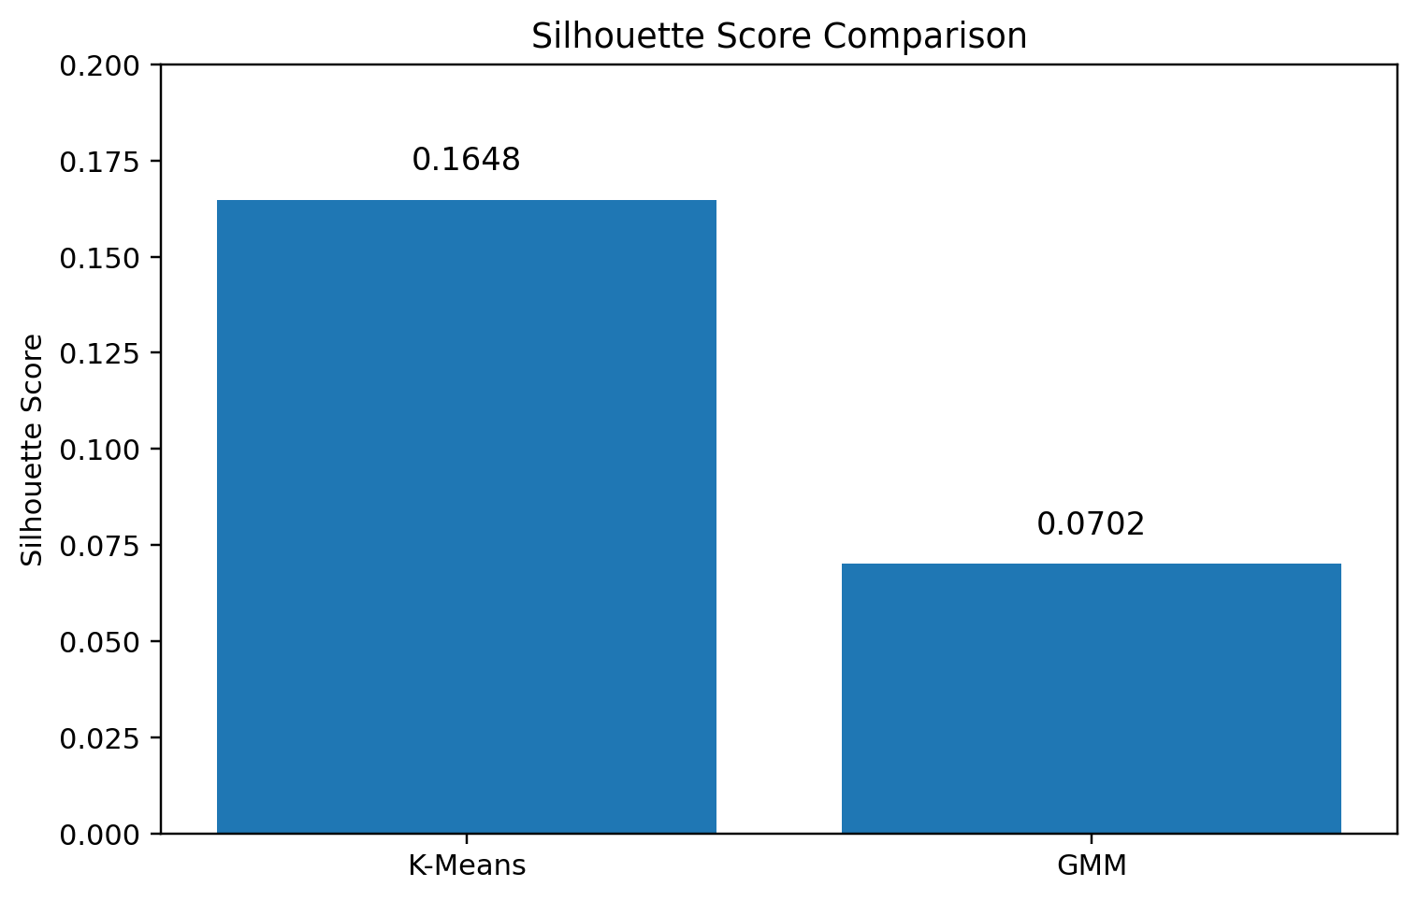
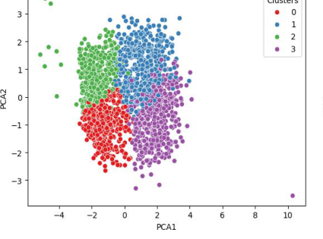
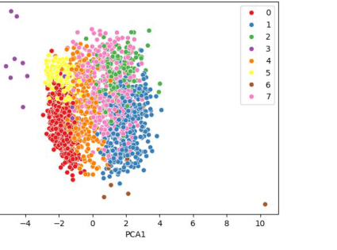
Results
04
K-Means: K = 4 selected from the elbow curve
MODEL COMPARISON
PCA CLUSTER VISUALIZATION
Model K Silhouette
K-Means 4 0.1648
GMM 8 0.0702
K-Means • 4 clusters
GMM • 8 clusters
04 / 05

Slide 5
Discussion, Limitations & Takeaway
05
KEY FINDING
REFERENCES
K-Means performed better than GMM
on the Silhouette Score.
[1] John, J. M., Shobayo, O., & Ogunleye, B. (2023). An Exploration of Clustering Algorithms for Customer Segmentation in the UK Retail Market. Analytics, 2(4), 809–823.
• K-Means: 0.1648 silhouette score.
• GMM: 0.0702 silhouette score.
• Both models show weak cluster separation.
• Missing income values and extreme values remain limitations.
• No predefined customer segments are available for external validation.
[2] Ashraf, A., Rayed, C. A., Awad, N. A., & Sabry, H. M. (2025). A Framework for Customer Segmentation to Improve Marketing Strategies Using Machine Learning. Procedia Computer Science, 260, 616–625.
[3] Doğan, O., Ayçin, E., & Bulut, Z. (2018). Customer Segmentation by Using RFM Model and Clustering Methods: A Case Study in Retail Industry.
TAKEAWAY
K-Means is the better-performing approach in this experiment, but further feature engineering, outlier treatment, and testing could improve the segmentation.
Thank you
05 / 05

