Slide 1

ICPM
Feasibility Study For Establishing a 4-Hotel

Slide 2

Overview
Project Overview
This's a Feasibility Study for Establishing and Operating a 4-Star Hotel In The Western Central Region of Madinah, Plot 3097.
The Hotel is Called Bishara Hotel and Consists of 90 Rooms and 30 Suites, and The Price for The Night In the Room Is 600 SAR and The Suite is 900 SAR.
The Most Popular Landmarks Near To The Hotel are
Prophet's Mosque : 500M
Al Quba Mosque : 5.9KM
Two Qibla Mosque : 5.5KM
Uhud Mountain : 7KM

Slide 3
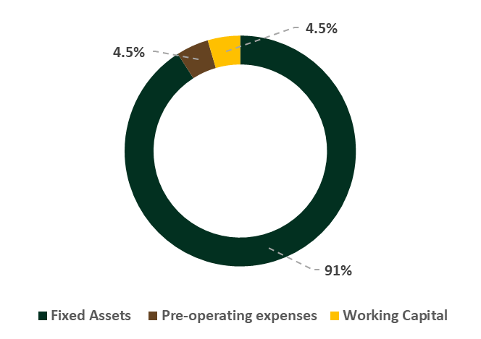
Assumptions
Assumptions And Investment Costs
As We Notice Most of Investment Costs From Fixed Assets and the rest from Pre-operating Expenses and Working Capital.
There are Assumptions For Growth and Discount Rates Annually Included Taxes
Growth and Discount rates
Investment Costs
4% Annual growth rate of accommodation prices
2% Annual growth rate of indirect costs
5% discount rate
20% Tax
SAR 75,159 |  | Fixed Assets
SAR 3,758 |  | Pre-operating expenses
SAR 3,756 |  | Working Capital
SAR 82,673 |  | Total

Slide 4
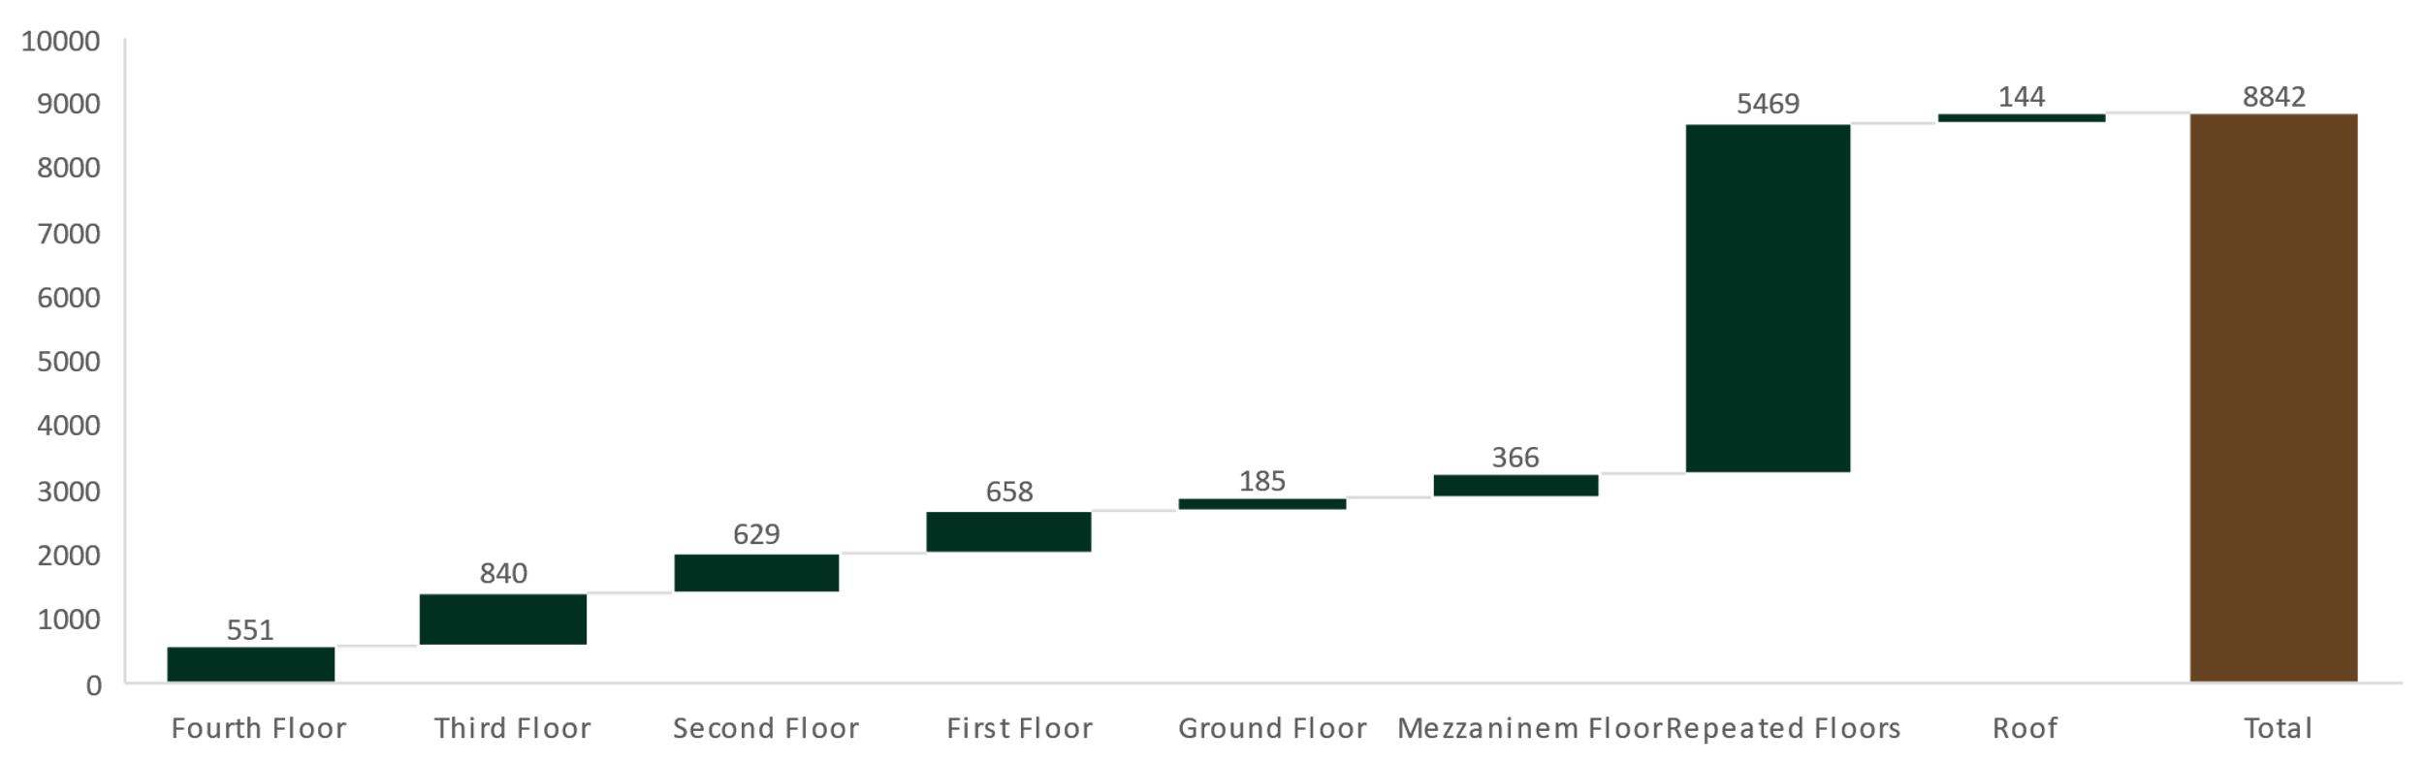
Assets Assessment
Building Area
8842.26 | Building Area
SAR 8,500 | Average cost per square meter
SAR 75,159,210 | Total Cost
The Building Area Is 8842M and The Average Cost Per Square Is 8500 SAR, so The Total Cost is 75 Million SAR, we Can notice the repeated Floor that contains rooms and suites has the most capacity of 5469M That's Good Capacity and the rest of 3373M.

Slide 5
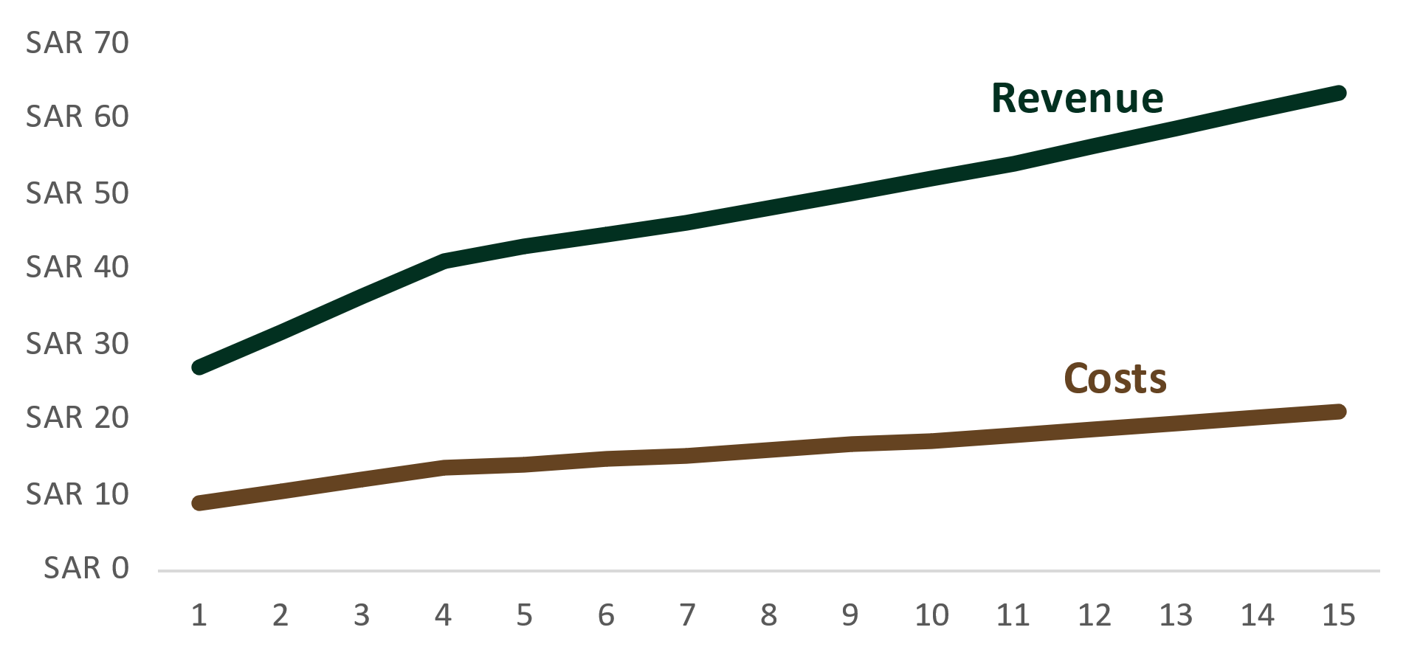
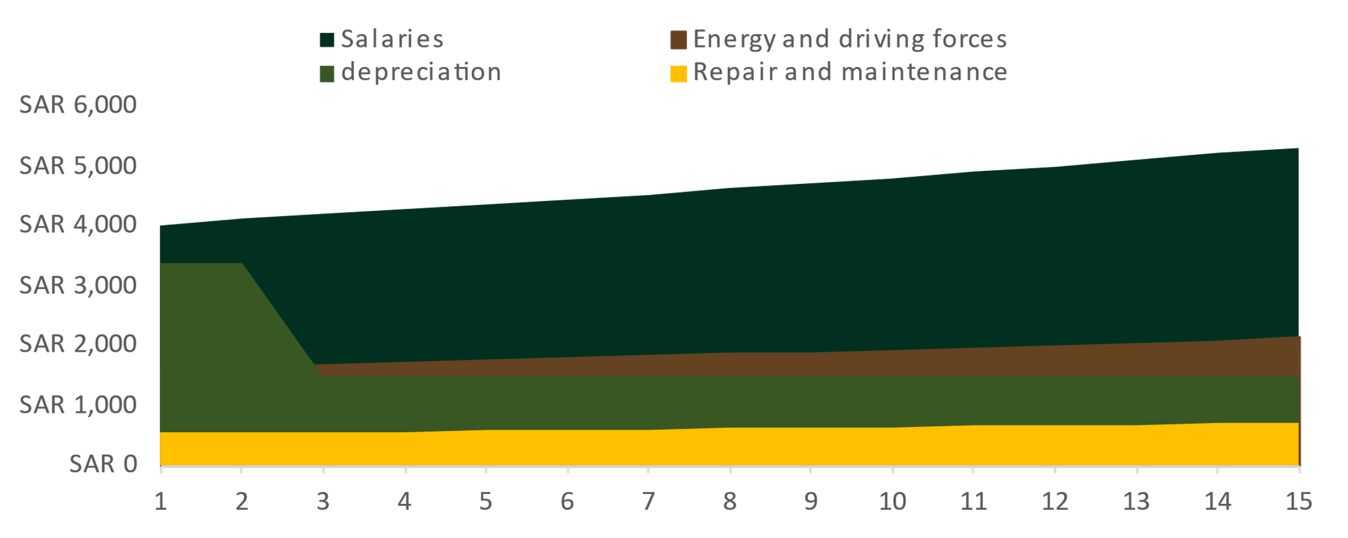
Income List
Revenue, Costs, and Expenses
As We Noticed, The Trend Revenue Compares with Costs Trend Seems Good And Normal.
The Most of Expenses Are Paid on Salaries And That’s Pretty Normal.
In Income List Table, There is a good Net Profit after Paying all Costs, Expenses, and Taxes.
Income List Summary
Revenues |  |  |  |  | SAR 713,056
Costs |  |  |  |  | SAR 235,308
Expenses
Salaries |  |  |  |  | SAR 69,595
Repair and maintenance |  |  |  |  | SAR 9,279
Energy and Driving forces |  |  |  |  | SAR 27,838
Depreciation |  |  |  |  | SAR 26,306
Total Expenses |  |  |  |  | SAR 133,018
Taxes |  |  |  |  | SAR 68,946
Net Profit |  |  |  |  | SAR 275,784

Slide 6
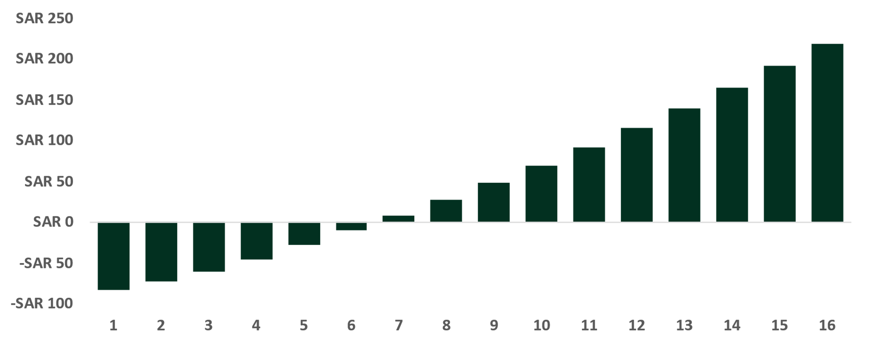
Payback
Forecasting and Financial Analysis
It is expected that the capital, estimated at 82 Million SAR, will be repaid in the sixth year after the construction of the hotel, with a surplus of 8 million, estimated at 92 Million SAR.
In Financial Analysis Summary table, we can notice after 10 years from the construction, the Cumulative Return will estimated at 174 Million SAR.
Financial Analysis Summary
Cumulative Return Over 10 Years |  |  |  |  | SAR 174,680,908
Investment Costs |  |  |  |  | SAR 82,673,231
Net Return |  |  |  |  | SAR 92,007,677
Payback Is Achieved |  |  |  |  | 6
Average Profit Margin |  |  |  |  | 36%
Average of ROI |  |  |  |  | 21%
IRR |  |  |  |  | 14%
Net Present Value |  |  |  |  | SAR 50,408,603
Payback year

Slide 7
Thank You

