Slide 1
Wedding planner
Name: Omar Sameh Said سعيد عمرسامح
Id:20180370

Slide 2
The problem
There is a wedding and I have a list of guests attending the wedding and I have a lookup table so that every guest on a table knows at least another guest on the same table so that they can all sit on the same table.
So we are minimizing tables number.

Slide 3
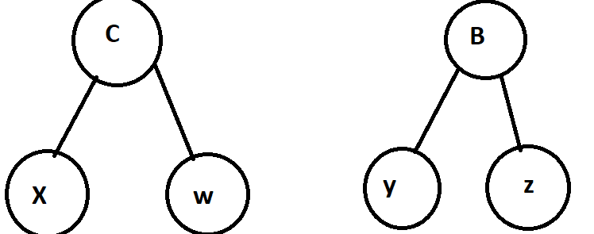
Example
If c knows x and w knows c and if b knows y and z knows b this is how I want to represent the data in a undirected graph
Why undirected
Because if c knows x then for sure x knows c

Slide 4
Algorithm used
In order to visit every vertex in a graph I used Depth first search (DFS)
It is a recursion function
In order to get the minimum number of table iterate every vertex and check if its visited or not
By using DFS we can visit every child from one vertex and checking if this vertex was visited or not and if it’s not visited we increase number of tables by 1 and visit all its child by dfs
After all vertices being visited we return number of tables

Slide 5
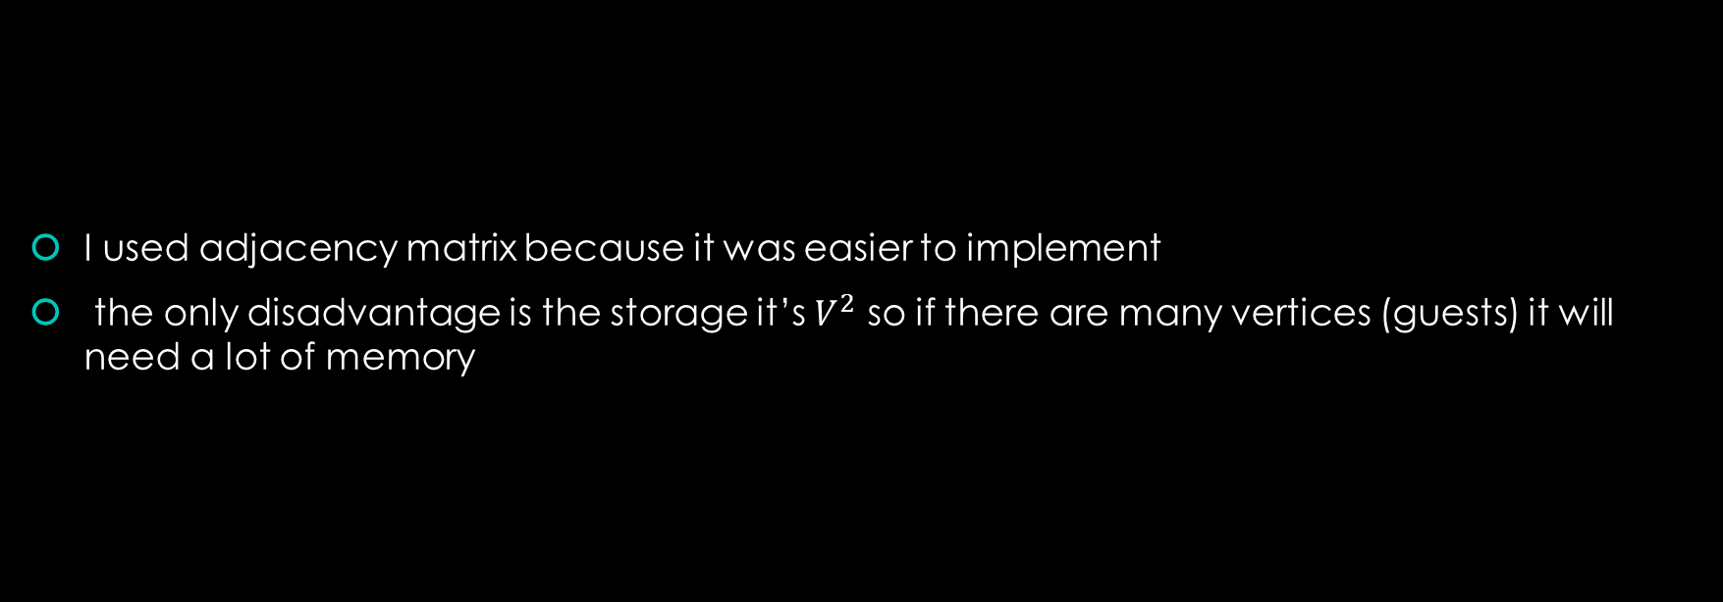
Graph implementation
I used adjacency matrix because it was easier to implement
the only disadvantage is the storage it’s $V^{2}$ so if there are many vertices (guests) it will need a lot of memory

Slide 6
Pseudo code (main)
There are 5 main stage in main
1-scaning number of guests (number of v)
2-scan each guest name
3-scan number of relation for each guest (number of E)
4-scan each the relation (Edges)
5-calling function that calculate NUMBER OF CONNECTED COMPONENTS in graph
1 Read NumberOfGuests;
2 FOR i=0 to NumberOfGuests do
3 Read GuestName
4 AddGuest(GuestName)
5 End For loop
6 FOR i=0 to NumberOfGuests do
7 Read NumerOfRelation
8 FOR j=0 to NumerOfRelation do
9 Read GuestName
10 InsertEdge(GuestList[i],GuestName)
11 End For loop
12 End For loop
13 graph. NumberOfTables()
14 Print Minimum number of tables

Slide 7
Pseudo code (adding)
These two functions used to add vertices and edges
AddGuest(GuestName)
1 GuestList[counter++]= GuestName
InsertEdge(FromN , ToN)
1 FOR I = 0 to NumberOfGuests do
2 If FromN equal GuestList[i] do
3 fromNUMBER equal i
4 If ToN equal GuestList[i] do
5 toNUMBER equal i;
6 End For
7 AdjacentMatrix[fromNUMBER][toNUMBER] equal 1
8 AdjacentMatrix[toNUMBER][fromNUMBER] equal 1

Slide 8
Pseudo code (Algorithm)
This are the two functions that solve our problem
The first function iterate every vertex in the graph to check if its visited or not
If it is not visited it will call the second function and increase number of tables by 1
The second function is the DFS it will visit all children of the vertex that was not visit
after visiting all the vertices at last return the number of tables
NumberOfTables()
1 For i=0 to NumberOfGuests do
2 If Visited[i] not equal 1 do
3 Dfs(i)
4 Increase NumberOfTables by one
5 End if
6 End For
7 return NumberOfTables
Dfs(x)
1 visited[x] equal true
2 For each adjacent vertex do
3 Child equal AdjacentMatrix[x][i]
4 if child equal 1 do
5 If Visited[i] not equal 1 do
6 Dfs(i)
7 End if
8 End if
9 End For

Slide 9
Example
The number of connected components in this example will equal 2

Slide 10
Analysis of DFS
We iterate vertex if it is not visited we increase number of tables by one then we call DFS(i) then mark it as visited and then visit every adjacent child if not visited that means that every vertex and each edge is visited exactly one time so
Total running time of DFS = Θ (V+E).

Slide 11
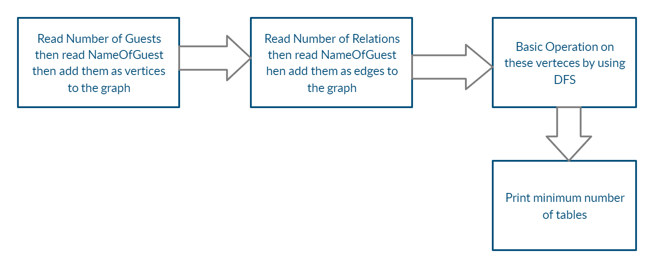
Block diagram

Slide 12
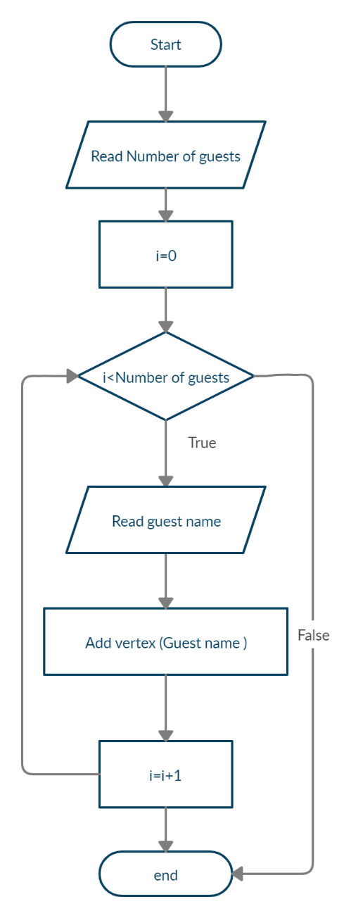
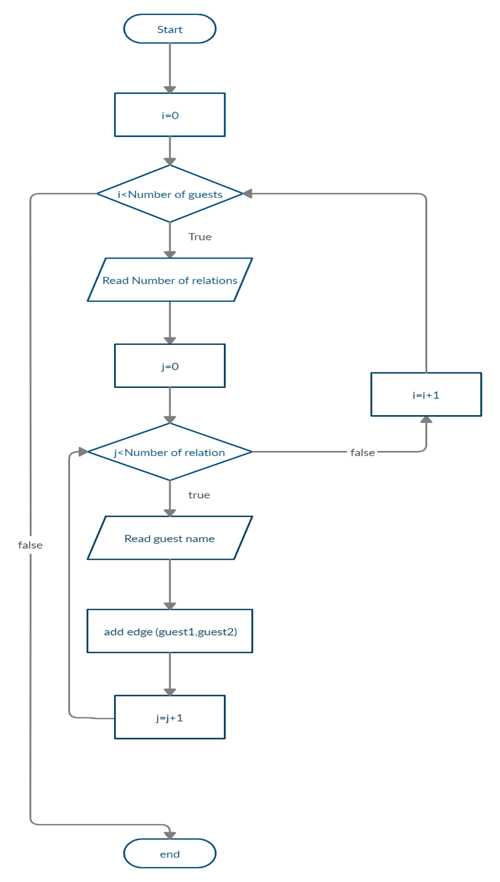
Main flowchart
One for scanning guests (vertices)
One for scanning relation (edges)

Slide 13
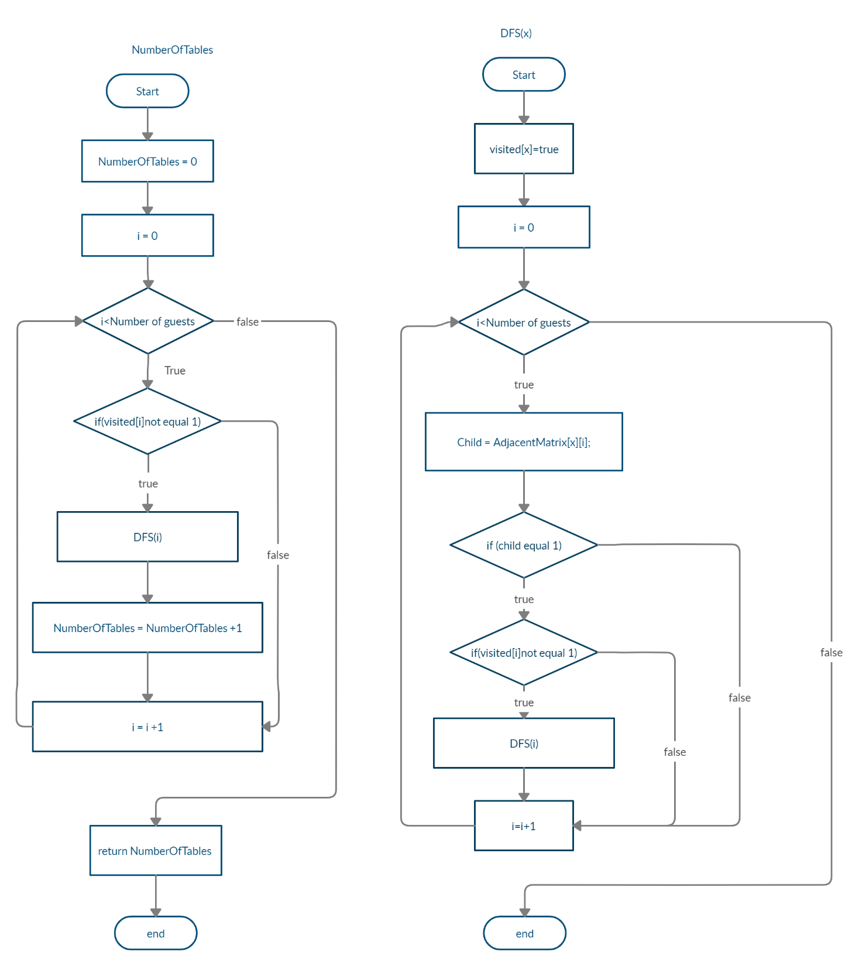
Flowchart Algorithm
One flow chart for NumberOfTables
Do three operations
Check every vertex if its vested or not
Call dfs
Increase NumberOFTables
Return NumberOFTables
One flow chart for DFS()
It visit all children of a vertex and children of children and so on

Slide 14
System performance
By comparing between the time complexity in algorithm and input and output we find that
Time complexity in algorithm = Θ (V+E).
Time complexity in input and output = O (VE).
In the worst case that E is max it will equal to v-1
Therefore =O (V*V-1) approximately O (V^2)
Therefore the complexity of input and output is bigger than the algorithm
And then the complexity of algorithm is better than the system input and output

Slide 15
Special case
If there are edges between all vertices there for number of edges will be equal to V*V-1
Then the time complexity of algorithm will equal
V+V*V-1=V^2+V-V=V^2
which is equal to the system input and output complexity

Slide 16
Example
If there are 4 vertices and the have all edges between each other which is equal to 12 there for
Time complexity of algorithm will =4+12
The system input and output complexity =4^2
Then the time complexity of algorithm will equal the system input and output complexity

Slide 17
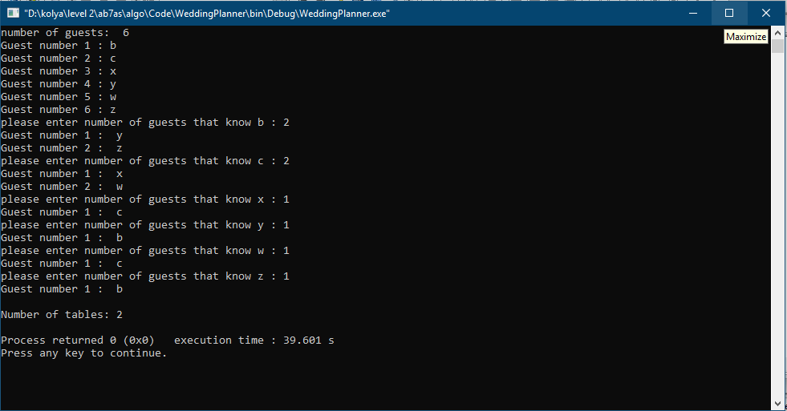
Results
This the result for the example in the beginning

Slide 18
Appendix
The drive
https://drive.google.com/drive/folders/11SSAnAf24MCsxpvS1PvEi1k-bVg302U_?usp=sharing

