Slide 1

Scene Classification
Master Linux Pre-Interview Task

Slide 2
Problem Definition

Slide 3
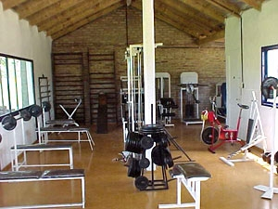
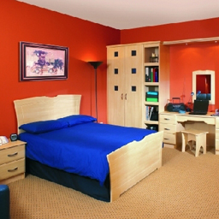
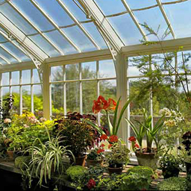
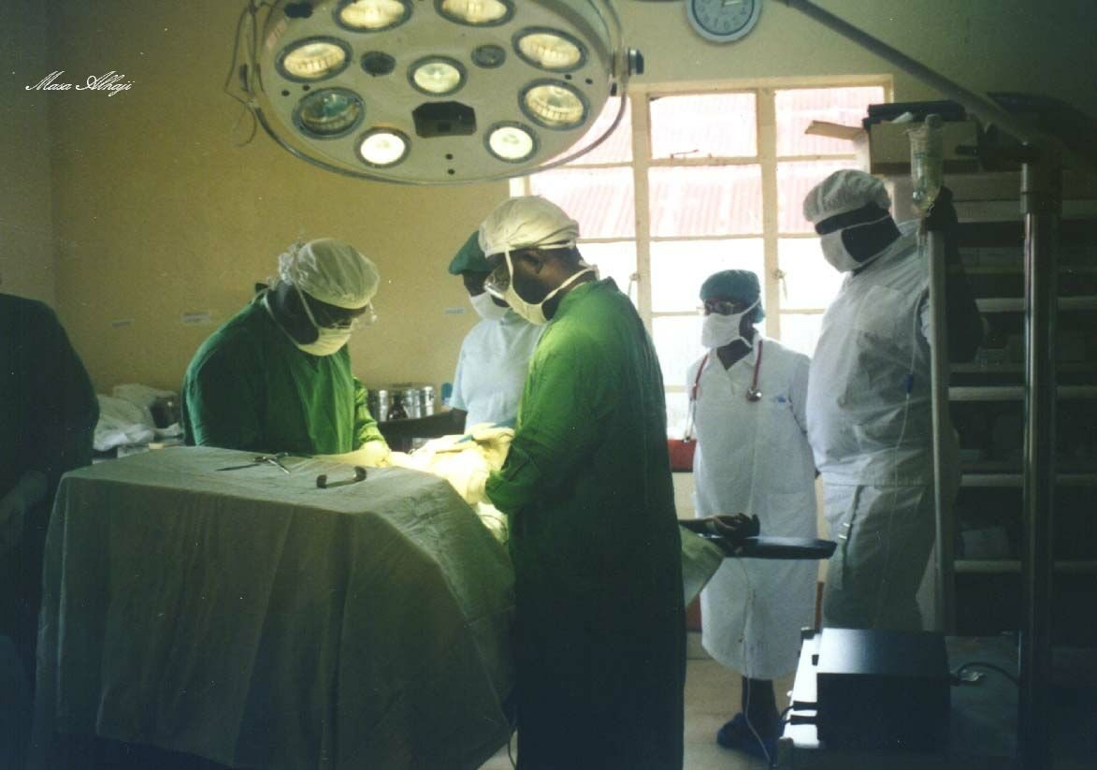
The scene classification is an area of visual recognition where you recognizes and identifies scene of the image. The scene recognition identifies what the image as a whole is about, or where it is taken, like if it's a picture of sea, image of zoo, photo of a party, and so on. It doesn't classify a certain object in the picture, but tries to recognize the whole scene of the picture.
Scene classification is different than object classification where object classification is depending on the object features only regardless the surrounding objects and environment and back ground, where Scene classification require to understand the global context of the image and the objects within the image.
Gym
Bedroom
Green house
Operating room

Slide 4
Approach

Slide 5
Deep learning for computer vision
Recently Deep Learning showed a huge success in computer vision field that including image classification, object detection, face recognition, etc..
It can be used to analyze and understand the local and global context of the image and the objects within it and further more hidden information.
It showed a solid performance in scene classification task so it will our top priority approach for this task.
Deep learning strength relies on Dataset, the more dataset / data examples you feed to it, the more robust learning it gets.

Slide 6
Deep learning Approach
Deep learning approach in scene classification task requires a lot of data/scenes examples so the Deep learning model can learn various features and understand the given information from each scene, so it be able to classify them correctly.
Unfortunately the given Dataset for the task is limited with low examples numbers compared to the expected data for this task.
We can collect or search for already existed dataset which satisfy the required result for this task , but collecting such dataset and train a deep learning model on it, require a lot of resources capability which is not available right now.

Slide 7

Transfer learning
Transfer learning is a research problem in machine learning that focuses on storing knowledge gained while solving one problem and applying it to a different but related problem. For example, knowledge gained while learning to recognize cars could apply when trying to recognize trucks.
So we will use a pre trained model for a task similar or related to our task to transfer its learning so it would compensate our data shortage and speed our model training process.

Slide 8
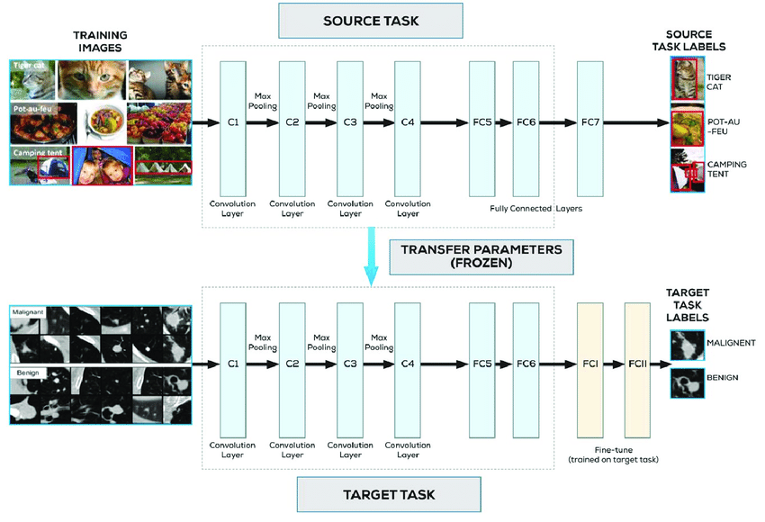
MIT places Scenes Dataset & places-365-cnn-VGG16 model
MIT Places Dataset is the most reach dataset in the area of scene classification which contains more than 10 million images comprising 400+ unique scene categories. The dataset features 5000 to 30,000 training images per class, consistent with real-world frequencies of occurrence.
PLACES-365-CNN-VGG16 model is the latest subset of Places2 Database. The train set of Places365 has ~1.8 million images from 365 scene categories, where there are at most 5000 images per category and it got a high accuracy on both training and testing data.
We will use the CNN Layers of the PLACES-365-CNN-VGG16 model to extract the features from our tiny data set and train a top layers to classify those features into our target classes.
We will use tensorflow and keras frame work as out tools for training our model.

Slide 9
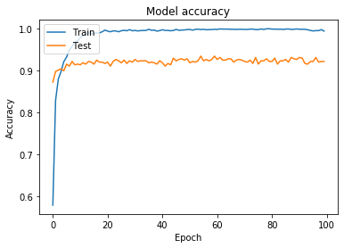
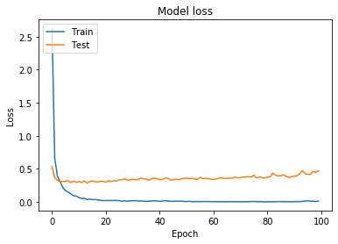
Results
We have used 2513 images for training about 80% of the total data and validate with 625 which is about 20% of the data.
We have achieved best accuracy on training data is 98% while on validation data is 91%.
The result of test data set is save in result.csv file and the model weights on weights folder under name :final_10_scenes_classification_model.h5

