Slide 1




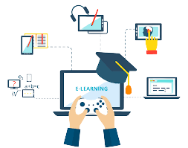
Cyber Learning Adventure (Junior)

Slide 2
Team Members
Member name | Student’s ID
Omar Ahmed Wafaa Eldeen | 2018170946
Abdelrahman Mohamed Kamal | 2018170944
Ahmed Essam El-Deen Mohamed Ahmed | 2018170938
David Moheb Anwar | 2018170940
Omar Magdy Abdelhamed Nassar | 2018170948
Supervised by DR. HANAN HINDY

Slide 3
Agenda
Introduction
Problem Definition
Statistics
Motivation
Objectives
Related Works
Main Functions
Software Used
Time Plan

Slide 4
Introduction
When it comes to internet usage, there is no way for parents who are preoccupied with their daily tasks to monitor what their children are doing on the internet. This is where Cyber Learning Adventure (Junior) kicks in, strengthening children's defences against security threats as well as teaching them how to deal with them.

Slide 5
Problem Definition
Since the Covid-19 pandemic, kids nowadays spend a lot of time in front of screens on a daily basis. And with lack of awareness, children are exposed to a new set of threats as their use of web-based tools, downloading new applications, and reliance on email grows.

Slide 6
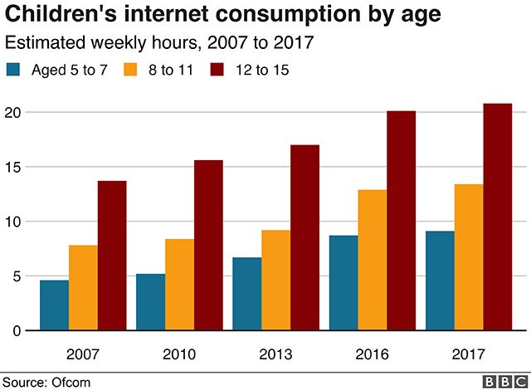
Statistics
[1] 28 January 2019

Slide 7
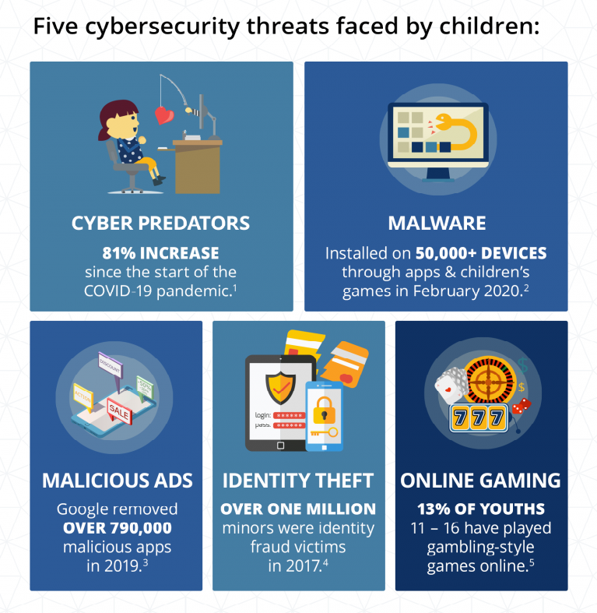
Statistics
[2] August 2020

Slide 8
Motivation
The only available awareness-providing tools are aimed at adults and are far too advanced for children, it has become nearly impossible for children to gain the necessary awareness to protect themselves.

Slide 9
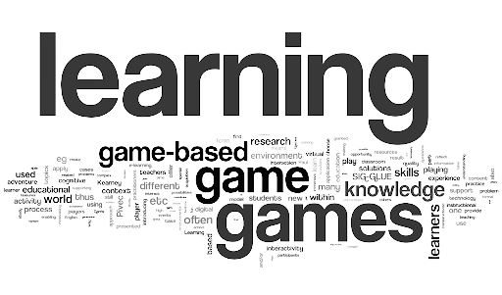
Objectives
Offering a gamified and enjoyable way for kids to learn about cyber security threats and attacks.
Providing a simple, yet efficient ways to report security attacks.
Implementing practical hands-on experience.

Slide 10




Related Work
CTFs
Cyber Talents Kids
Cybersmart Challenge
Introducing a Mobile App to Increase Cybersecurity Awareness in MENA Region

Slide 11
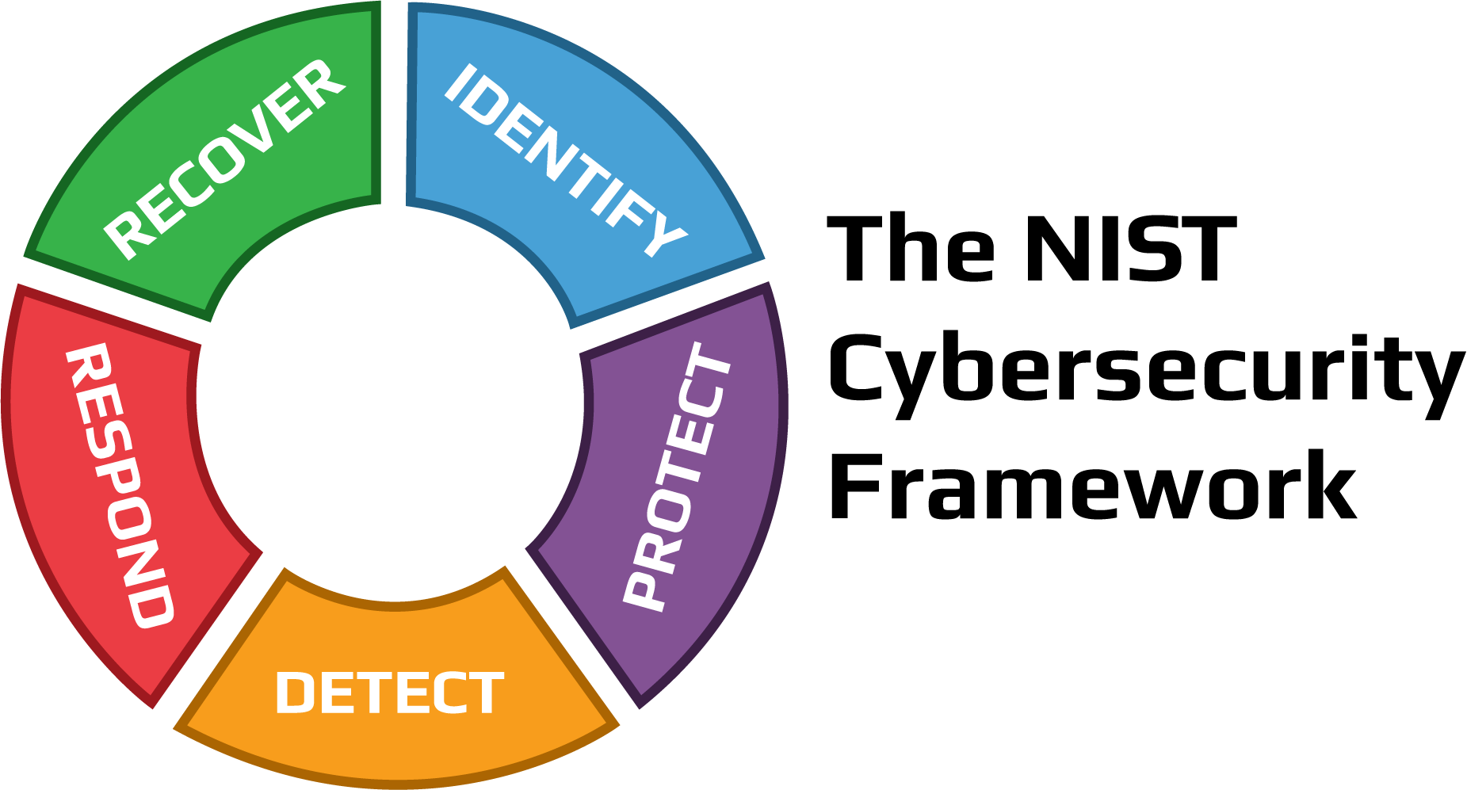


Main Functions
Security Threat Model
User Engagement
Reward
Achievement
Learning
Challenge
Motivation
Goal
Levels

Slide 12




Software Used
Game Engine
Unity
Programming Language
C#
Code IDE
Visual Studio
Graphics Tool
Gimp

Slide 13
Time Plan

Slide 14
Reference
[1]"Screen time 'may harm toddlers'", BBC News, 2019. [Online]. Available: https://www.bbc.com/news/health-47026834. [Accessed: 06- Dec- 2021].
[2]"Cybersecurity in Education: What Teachers, Parents and Students Should Know | Berkeley Boot Camps", Berkeley Boot Camps, 2021. [Online]. Available: https://bootcamp.berkeley.edu/blog/cybersecurity-in-education-what-teachers-parents-and-students-should-know/. [Accessed: 06- Dec- 2021].
[3]"Cybertalentskids » CyberTalents", CybertalentKids, 2021. [Online]. Available: https://cybertalentskids.com/. [Accessed: 06- Dec- 2021].
[4]2021. [Online]. Available: https://www.esafety.gov.au/educators/classroom-resources/cybersmart-challenge. [Accessed: 06- Dec- 2021].
[5]H. M. Jawad and S. Tout, "IEEE Xplore," in Introducing a Mobile App to Increase Cybersecurity Awareness in MENA, Dubai, 2021. [Accessed: 06- Dec- 2021].
[6]"Hacking Training For The Best", Hack The Box, 2021. [Online]. Available: https://www.hackthebox.com/. [Accessed: 06- Dec- 2021].

Slide 15
Reference
[7]"OWASP Foundation | Open Source Foundation for Application Security", Owasp.org, 2021. [Online]. Available: https://owasp.org/. [Accessed: 06- Dec- 2021].
[8]M. Robb, "Common Sense Media," Common Sense Media, 29 October 2019. [Online]. Available: https://www.commonsensemedia.org/blog/tweens-teens-and-phones-what-our-2019-research-reveals#:~:text=A%20majority%20(53%25)%20of,2019%20from%2011%25%20in%202015.. [Accessed 08 November 2021].
[9]Kaspersky, "Kaspersky," Kaspersky, [Online]. Available: https://usa.kaspersky.com/resource-center/threats/top-seven-dangers-children-face-online. [Accessed 08 November 2021].
[10]DQ Institute, "DQ Institute," DQ Institute, [Online]. Available: https://www.dqinstitute.org/child-online-safety-index/. [Accessed 08 November 2021].
[11]C. Li, "Weforum," World Economic Forum, 29 April 2020. [Online]. Available: https://www.weforum.org/agenda/2020/04/coronavirus-education-global-covid19-online-digital-learning/. [Accessed 08 November 2021].

Slide 16
Reference
[12]J. Johnson, "Statista," 06 May 2021. [Online]. Available: https://www.statista.com/statistics/1189204/us-teens-children-screen-time-daily-coronavirus-before-during/. [Accessed 08 November 2021].
[13]Unicef, "Unicef," Unicef, 04 February 2021. [Online]. Available: https://www.unicef.org/coronavirus/keep-your-child-safe-online-at-home-covid-19. [Accessed 10 November 2021].
[14]H. M. Jawad and S. Tout, "IEEE Xplore," in Introducing a Mobile App to Increase Cybersecurity Awareness in MENA, Dubai, 2021.
[15]I. M.Venter, R. J.Blignaut, K. Renaud and M. A. Venter, "Cyber security education is as essential as “the three R's”," Heliyon, vol. 5, no. 12, 2019.
[16]F. Quayyum, D. S.Cruzes and L. Jaccheri, "Cybersecurity awareness for children: A systematic literature review," International Journal of Child-Computer Interaction, vol. 30, 2021.

Slide 17
Thank You

Slide 18
Questions ?

