Slide 1





Cyber Learning Adventure (Junior)

Slide 2
Team Members
Member name | Student’s ID
Omar Ahmed Wafaa Eldeen | 2018170946
Abdelrahman Mohamed Kamal | 2018170944
Ahmed Essam El-Deen Mohamed Ahmed | 2018170938
David Moheb Anwar | 2018170940
Omar Magdy Abdelhamed Nassar | 2018170948
Supervised by DR. HANAN HINDY

Slide 3
Agenda
Introduction
Architecture
Main Functions
Progress
Future Plans
Challenges
Solutions
Time Plan
Demo

Slide 4
Introduction
Cyber Learning Adventure (Junior) is a game which strengths children’s defences against security threats that they can face while using the internet as well as teaching them how to deal with them. It is designed particularly for children to help them gain the necessary awareness to protect themselves against different type of attacks.

Slide 5
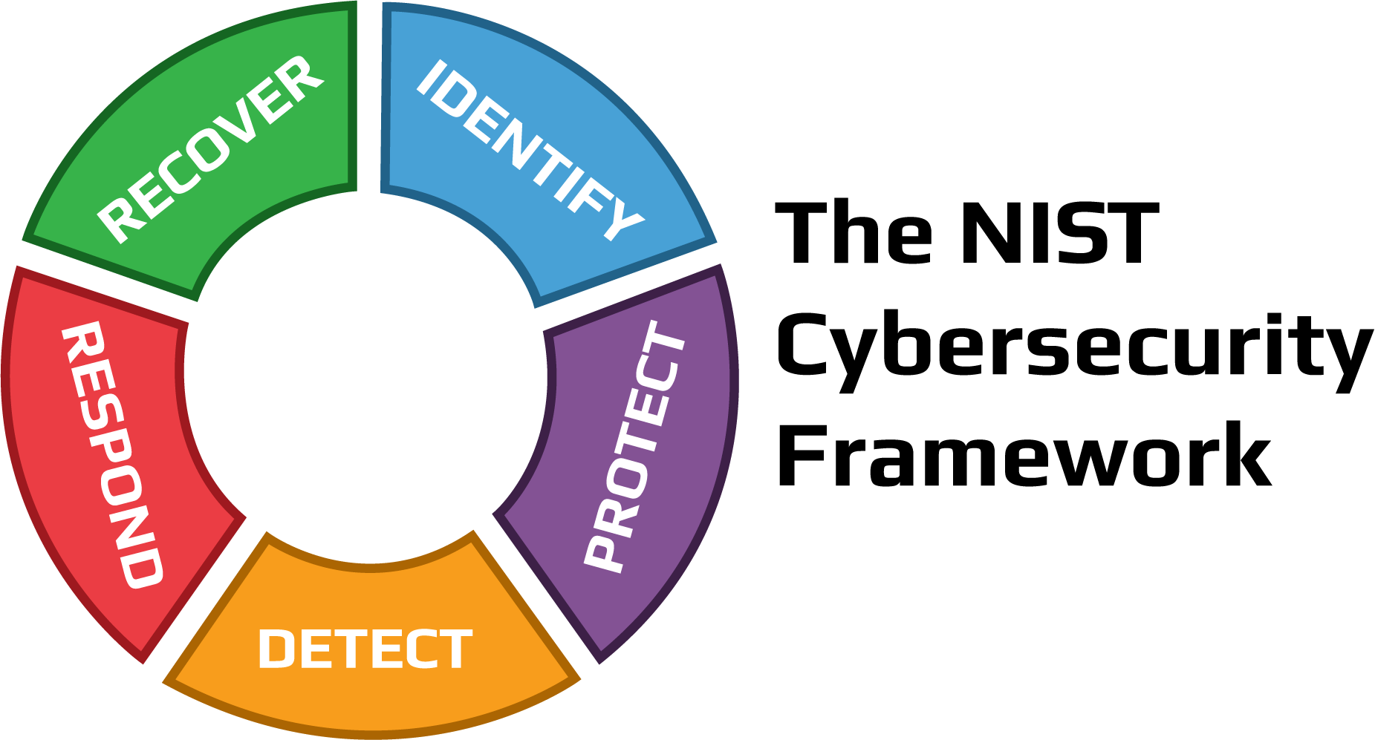
Architecture
NIST
Security Threat Model
Learning
Challenge
Goal
Game Engine
User Engagement
Reward
Achievement
Motivation
Levels
Done
Not Done

Slide 6
Main Functions
According to NIST Security Threat Model
Passwords
A minimum length of 8 characters and a maximum length of 64 characters.
Include uppercase, lowercase characters, numbers and special characters.
Restrict commonly used passwords (e.g. p@ssw0rd, etc.) and dictionary words.

Slide 7
Main Functions Cont’d
According to NIST Security Threat Model
Phishing
Always be suspicious of any message that requests you to click a link or open an attachment.
Be careful not to provide personal or sensitive information in response to a message.
Be cautious of any message communicating a sense of urgency or dire consequences should you fail to take immediate action.
If you are concerned about a message, contact the person or the organization using a different, validated method like a phone number you already had or check the organization’s website ‘Contact Us’ information. Never use the links or contact information in the message you are concerned about.

Slide 8
Progress
Working prototype Game1 & Game2
Implementation of Main Menu in Game1
Implementation of About section in Game1 which describes and states information about the game and its different levels
Password Levels in Game1
Phishing Level in Game1
Password Level in Game2

Slide 9
Future Plans
Transfer phishing levels from game1 to game2
Improve the gamification to make it more enjoyable and attractive for the kids
Create Leaderboard for Motivation
Implement reward system
Implement more levels

Slide 10
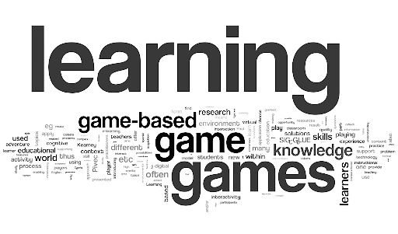
Challenges
Offering a gamified and enjoyable way for kids to learn about cyber security threats and attacks.
Providing a simple, yet efficient ways to report security attacks.
First time to use unity and to make a game.
Making scenario that can be related to children.
How to integrate suitable challenges in the game.

Slide 11
Solutions
Implement reward system & achievements.
Create Leaderboard for Motivation.
Followed online tutorials to gain experience in using unity.

Slide 12
Time Plan

Slide 13
Reference
[1]"Screen time 'may harm toddlers'", BBC News, 2019. [Online]. Available: https://www.bbc.com/news/health-47026834. [Accessed: 06- Dec- 2021].
[2]"Cybersecurity in Education: What Teachers, Parents and Students Should Know | Berkeley Boot Camps", Berkeley Boot Camps, 2021. [Online]. Available: https://bootcamp.berkeley.edu/blog/cybersecurity-in-education-what-teachers-parents-and-students-should-know/. [Accessed: 06- Dec- 2021].
[3]"Cybertalentskids » CyberTalents", CybertalentKids, 2021. [Online]. Available: https://cybertalentskids.com/. [Accessed: 06- Dec- 2021].
[4]2021. [Online]. Available: https://www.esafety.gov.au/educators/classroom-resources/cybersmart-challenge. [Accessed: 06- Dec- 2021].
[5]H. M. Jawad and S. Tout, "IEEE Xplore," in Introducing a Mobile App to Increase Cybersecurity Awareness in MENA, Dubai, 2021. [Accessed: 06- Dec- 2021].
[6]"Hacking Training For The Best", Hack The Box, 2021. [Online]. Available: https://www.hackthebox.com/. [Accessed: 06- Dec- 2021].

Slide 14
Reference
[7]"OWASP Foundation | Open Source Foundation for Application Security", Owasp.org, 2021. [Online]. Available: https://owasp.org/. [Accessed: 06- Dec- 2021].
[8]M. Robb, "Common Sense Media," Common Sense Media, 29 October 2019. [Online]. Available: https://www.commonsensemedia.org/blog/tweens-teens-and-phones-what-our-2019-research-reveals#:~:text=A%20majority%20(53%25)%20of,2019%20from%2011%25%20in%202015.. [Accessed 08 November 2021].
[9]Kaspersky, "Kaspersky," Kaspersky, [Online]. Available: https://usa.kaspersky.com/resource-center/threats/top-seven-dangers-children-face-online. [Accessed 08 November 2021].
[10]DQ Institute, "DQ Institute," DQ Institute, [Online]. Available: https://www.dqinstitute.org/child-online-safety-index/. [Accessed 08 November 2021].
[11]C. Li, "Weforum," World Economic Forum, 29 April 2020. [Online]. Available: https://www.weforum.org/agenda/2020/04/coronavirus-education-global-covid19-online-digital-learning/. [Accessed 08 November 2021].

Slide 15
Reference
[12]J. Johnson, "Statista," 06 May 2021. [Online]. Available: https://www.statista.com/statistics/1189204/us-teens-children-screen-time-daily-coronavirus-before-during/. [Accessed 08 November 2021].
[13]Unicef, "Unicef," Unicef, 04 February 2021. [Online]. Available: https://www.unicef.org/coronavirus/keep-your-child-safe-online-at-home-covid-19. [Accessed 10 November 2021].
[14]H. M. Jawad and S. Tout, "IEEE Xplore," in Introducing a Mobile App to Increase Cybersecurity Awareness in MENA, Dubai, 2021.
[15]I. M.Venter, R. J.Blignaut, K. Renaud and M. A. Venter, "Cyber security education is as essential as “the three R's”," Heliyon, vol. 5, no. 12, 2019.
[16]F. Quayyum, D. S.Cruzes and L. Jaccheri, "Cybersecurity awareness for children: A systematic literature review," International Journal of Child-Computer Interaction, vol. 30, 2021.

Slide 16
Demo

Slide 17
Thank You

Slide 18
Questions ?

