Slide 1






Cyber Learning Adventure (Junior)

Slide 2
Team Members
Member name
Omar Ahmed Wafaa Eldeen
Abdelrahman Mohamed Kamal
Ahmed Essam El-Deen Mohamed Ahmed
David Moheb Anwar
Omar Magdy Abdelhamed Nassar
Supervised by DR. HANAN HINDY

Slide 3
Agenda
Introduction
Problem Definition
Objectives
Block Diagram
Main Functions
Challenges
Demo
Future Work

Slide 4
Introduction
Cyber Learning Adventure (Junior) is a game which strengths children’s defences against security threats that they can face while using the internet as well as teaching them how to deal with them. It is designed particularly for children to help them gain the necessary awareness to protect themselves against different type of attacks.

Slide 5
Problem Definition
Since the Covid-19 pandemic, kids nowadays spend a lot of time in front of screens on a daily basis. And with lack of awareness, children are exposed to a new set of threats as their use of web-based tools, downloading new applications, and reliance on email grows.

Slide 6
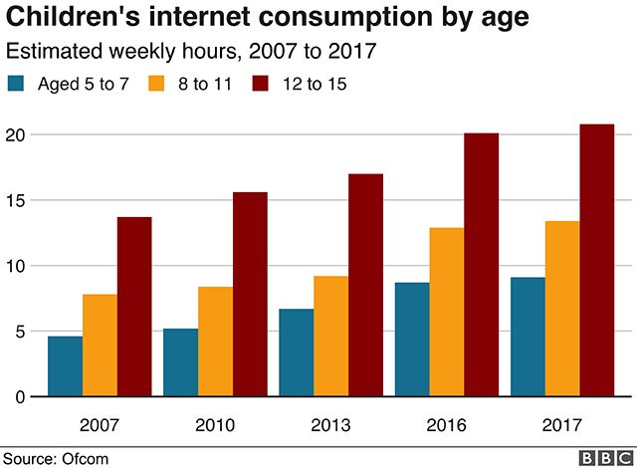
Statistics
BBC News, 2019 [1]

Slide 7
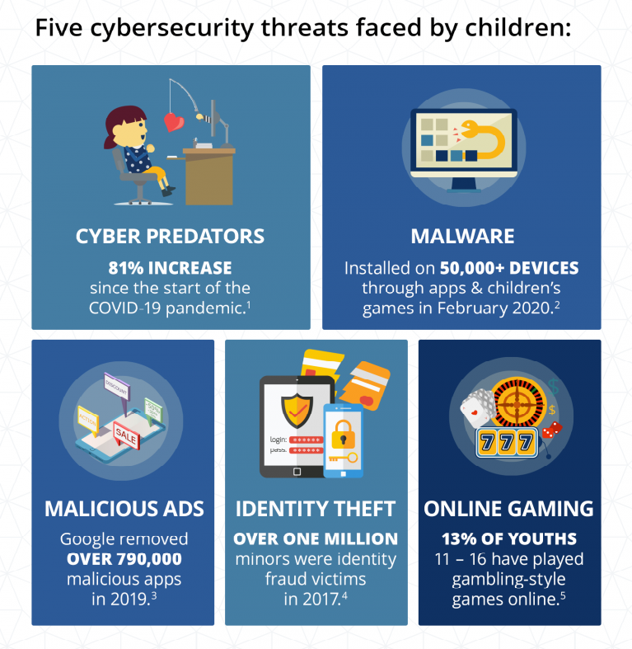
Statistics
Berkeley Boot Camps, 2021[2]

Slide 8
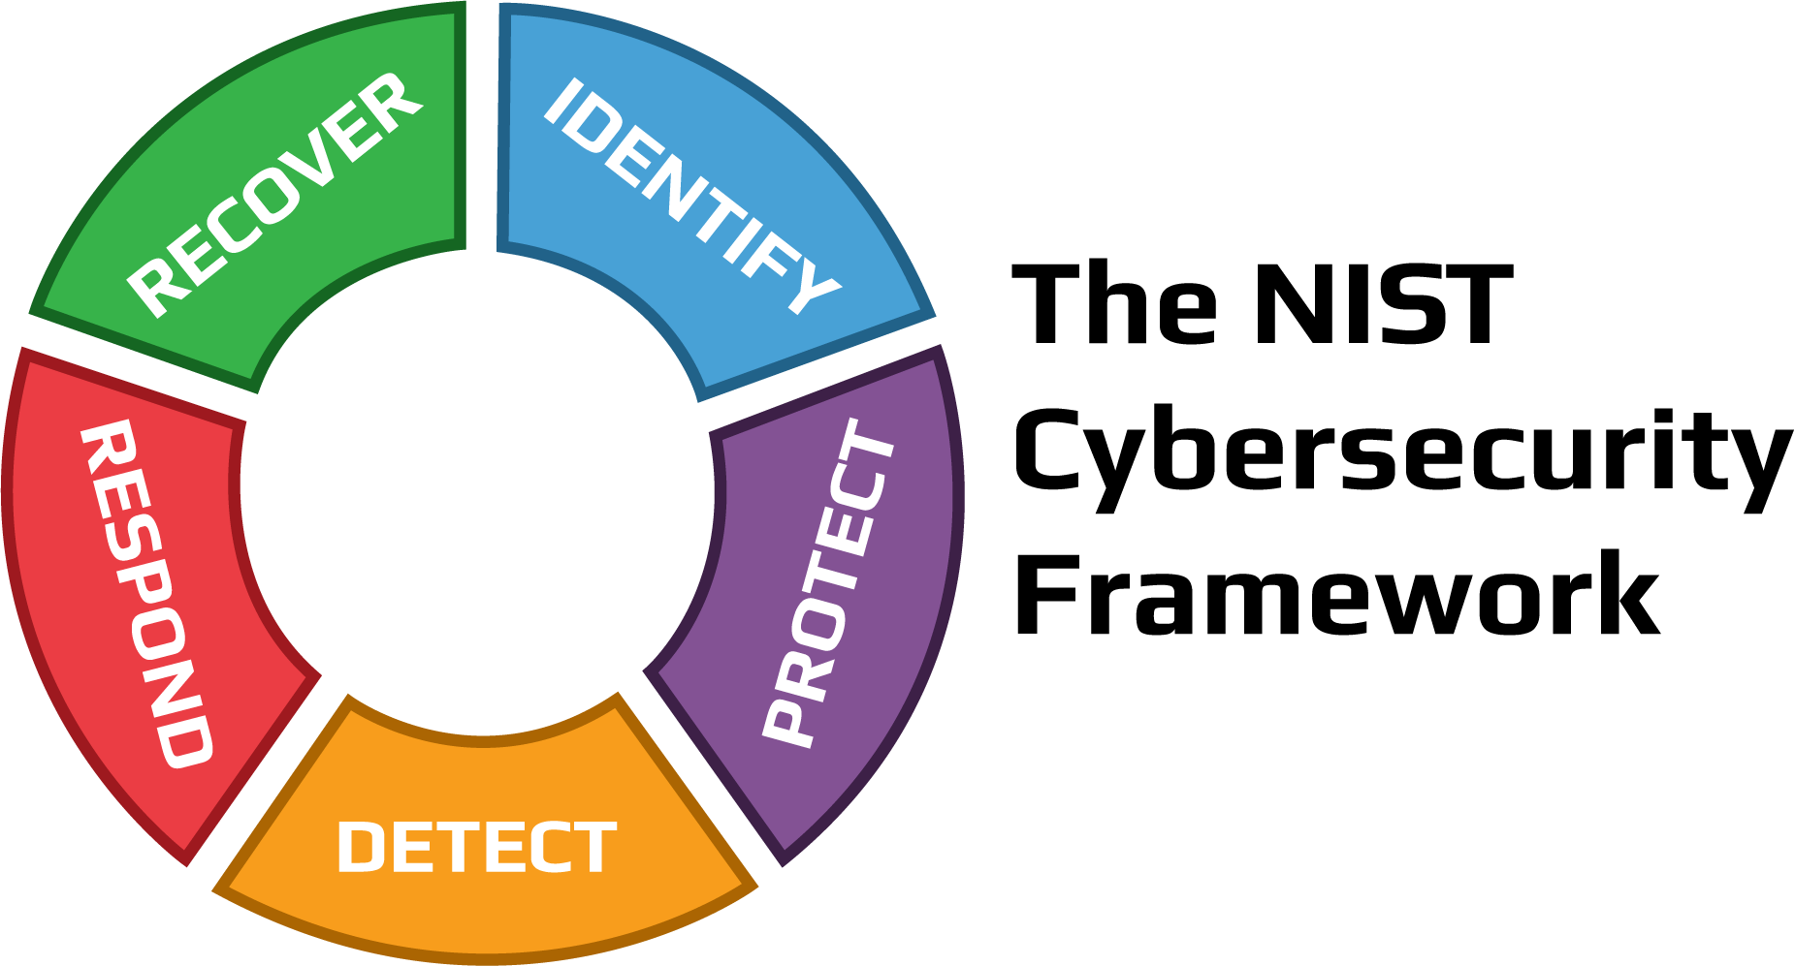
Block Diagram
NIST
Security Threat Model
Learning
Challenge
Goal
Game Engine
User Engagement
Reward
Achievement
Levels

Slide 9




Software & Techniques Used
ChatBot
Syn.Bot (OSCOVA)
Game Engine
Unity
Programming Language
C#
Code IDE
Visual Studio
Graphics Tool
Photoshop

Slide 10
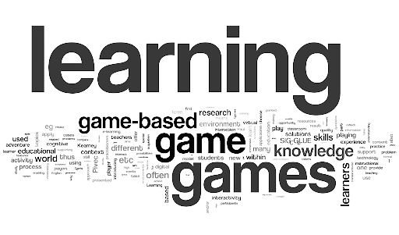
Objectives
Offering a gamified and enjoyable way for kids to learn about cyber security threats and attacks.
Provide a simple yet effective means of reporting security attacks.
Implementing practical hands-on experience.

Slide 11
Main Functions
According to NIST
Passwords
A minimum length of 8 characters and a maximum length of 64 characters.
Include uppercase, lowercase characters, numbers and special characters.
Restrict commonly used passwords (e.g. p@ssw0rd, etc.).

Slide 12
Main Functions Cont’d
According to NIST
Social Engineering
An attacker uses human interaction (social skills) into deceiving an individual into revealing sensitive information, obtaining unauthorized access, or committing fraud by associating with the individual to gain confidence and trust.

Slide 13
Main Functions Cont’d
According to NIST
Phishing
Always be suspicious of any message that requests you to click a link or open an attachment.
Be careful not to provide personal or sensitive information in response to a message.
Be cautious of any message communicating a sense of urgency or dire consequences should you fail to take immediate action.
If you are concerned about a message, contact the person or the organization using a different, validated method like a phone number you already had or check the organization’s website ‘Contact Us’ information. Never use the links or contact information in the message you are concerned about.

Slide 14
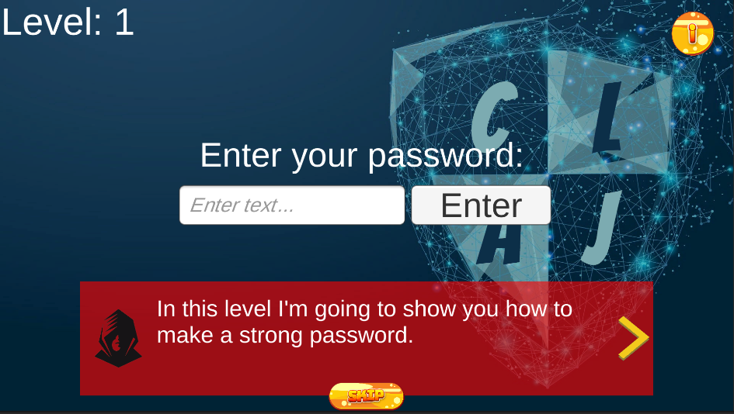
Challenges
Implementing the objectives was challenging.

Slide 15
Challenges
Making scenarios that children can relate to.
How to integrate suitable challenges in the game.

Slide 16
Demo

Slide 17
Future Work
Gamification
Improve the gamification to make it more enjoyable and attractive for the kids.
Create Leaderboard for Motivation.
Attack Threats
Implement more levels & focusing on different types of threats.
Impact Of The Game
Doing surveys on real children and reviewing the impact.

Slide 18
Reference
[1]"Screen time 'may harm toddlers'", BBC News, 2019. [Online]. Available: https://www.bbc.com/news/health-47026834. [Accessed: 06- Dec- 2021].
[2]"Cybersecurity in Education: What Teachers, Parents and Students Should Know | Berkeley Boot Camps", Berkeley Boot Camps, 2021. [Online]. Available: https://bootcamp.berkeley.edu/blog/cybersecurity-in-education-what-teachers-parents-and-students-should-know/. [Accessed: 06- Dec- 2021].
[3]"Cybertalentskids » CyberTalents", CybertalentKids, 2021. [Online]. Available: https://cybertalentskids.com/. [Accessed: 06- Dec- 2021].
[4]2021. [Online]. Available: https://www.esafety.gov.au/educators/classroom-resources/cybersmart-challenge. [Accessed: 06- Dec- 2021].
[5] H. M. Jawad and S. Tout, "Introducing a Mobile App to Increase Cybersecurity Awareness in MENA," 2020 3rd International Conference on Signal Processing and Information Security (ICSPIS), 2020, pp. 1-4, doi: 10.1109/ICSPIS51252.2020.9340128. [Accessed: 06- Dec- 2021].[6]"Hacking Training For The Best", Hack The Box, 2021. [Online]. Available: https://www.hackthebox.com/. [Accessed: 06- Dec- 2021].
[7]"OWASP Foundation | Open Source Foundation for Application Security", Owasp.org, 2021. [Online]. Available: https://owasp.org/. [Accessed: 06- Dec- 2021].
[8]M. Robb, "Common Sense Media," Common Sense Media, 29 October 2019. [Online]. Available: https://www.commonsensemedia.org/blog/tweens-teens-and-phones-what-our-2019-research-reveals#:~:text=A%20majority%20(53%25)%20of,2019%20from%2011%25%20in%202015.. [Accessed 08 November 2021].

Slide 19
Reference
[9]Kaspersky, "Kaspersky," Kaspersky, [Online]. Available: https://usa.kaspersky.com/resource-center/threats/top-seven-dangers-children-face-online. [Accessed 08 November 2021].
[10]DQ Institute, "DQ Institute," DQ Institute, [Online]. Available: https://www.dqinstitute.org/child-online-safety-index/. [Accessed 08 November 2021].
[11]C. Li, "Weforum," World Economic Forum, 29 April 2020. [Online]. Available: https://www.weforum.org/agenda/2020/04/coronavirus-education-global-covid19-online-digital-learning/. [Accessed 08 November 2021].
[12]J. Johnson, "Statista," 06 May 2021. [Online]. Available: https://www.statista.com/statistics/1189204/us-teens-children-screen-time-daily-coronavirus-before-during/. [Accessed 08 November 2021].
[13]Unicef, "Unicef," Unicef, 04 February 2021. [Online]. Available: https://www.unicef.org/coronavirus/keep-your-child-safe-online-at-home-covid-19. [Accessed 10 November 2021].
[14]H. M. Jawad and S. Tout, "IEEE Xplore," in Introducing a Mobile App to Increase Cybersecurity Awareness in MENA, Dubai, 2021.
[15]I. M.Venter, R. J.Blignaut, K. Renaud and M. A. Venter, "Cyber security education is as essential as “the three R's”," Heliyon, vol. 5, no. 12, 2019.
[16]F. Quayyum, D. S.Cruzes and L. Jaccheri, "Cybersecurity awareness for children: A systematic literature review," International Journal of Child-Computer Interaction, vol. 30, 2021.

Slide 20
Thank You

Slide 21
Questions ?

