Slide 1





Cyber Learning Adventure (Junior)

Slide 2
Team Members
Member name | Student’s ID
Omar Ahmed Wafaa Eldeen | 2018170946
Abdelrahman Mohamed Kamal | 2018170944
Ahmed Essam El-Deen Mohamed Ahmed | 2018170938
David Moheb Anwar | 2018170940
Omar Magdy Abdelhamed Nassar | 2018170948
Supervised by DR. HANAN HINDY

Slide 3
Agenda
Introduction
Objectives
Progress
Related Works
Main Functions
TO DO
Software Used
Time Plan

Slide 4
Introduction
Cyber Learning Adventure (Junior) is a game which strengths children’s defences against security threats that they can face while using the internet as well as teaching them how to deal with them. It is designed particularly for children to help them gain the necessary awareness to protect themselves against different type of attacks.

Slide 5
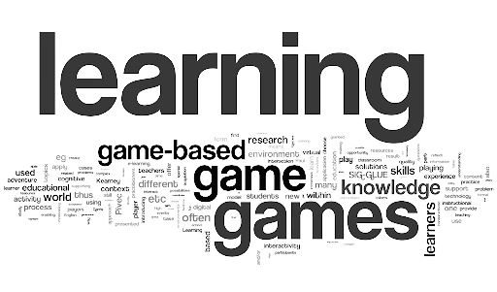
Objectives
Offering a gamified and enjoyable way for kids to learn about cyber security threats and attacks.
Providing a simple, yet efficient ways to report security attacks.
Implementing practical hands-on experience.

Slide 6
Progress
Working prototype Game1 & Game2
Implementation of Main Menu in Game1
Implementation of About section in Game1 which describes and states information about the game and its different levels
Password Levels in Game1
Phishing Level in Game1
Phishing Level in Game2
Password Level in Game2

Slide 7




Related Work
CTFs
Cyber Talents Kids
Cybersmart Challenge
Introducing a Mobile App to Increase Cybersecurity Awareness in MENA Region

Slide 8
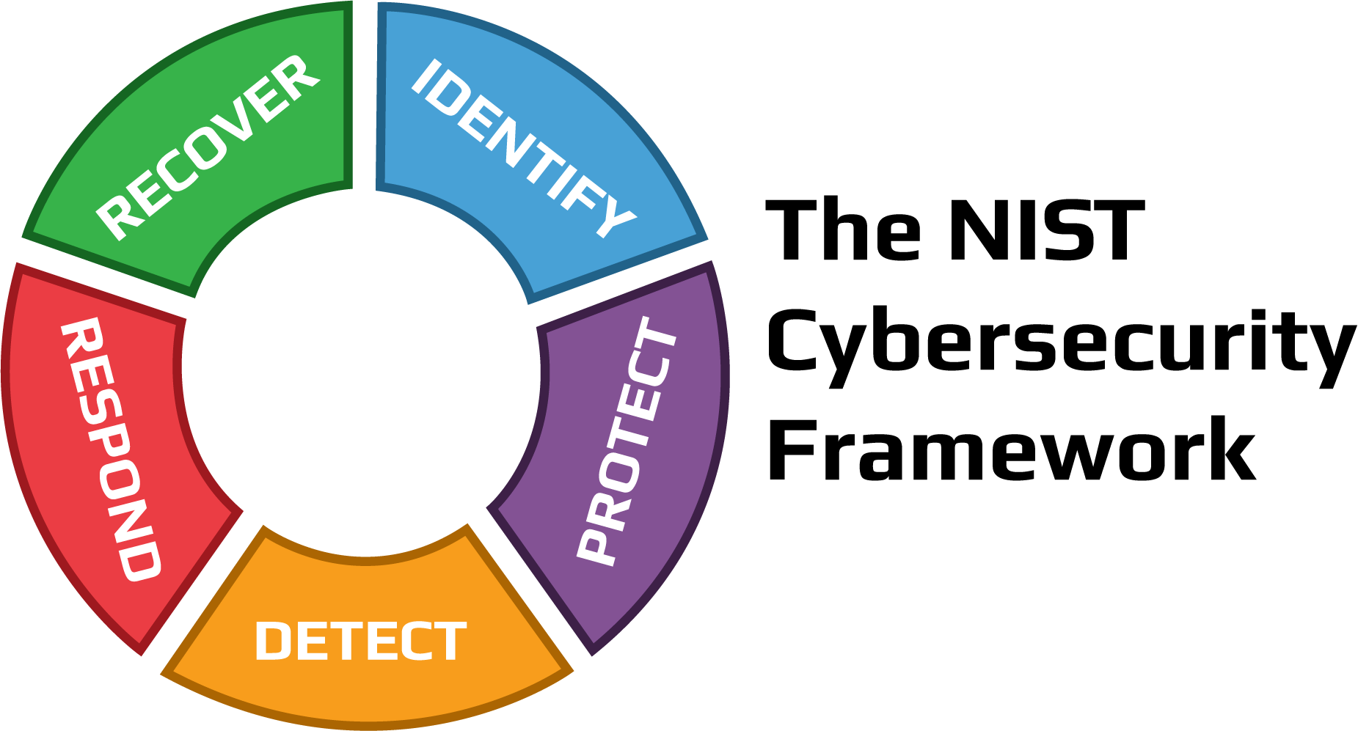


Main Functions
Security Threat Model
User Engagement
Reward
Achievement
Learning
Challenge
Motivation
Goal
Levels
Green – Done
Red – Not done

Slide 9
TO DO
Implement more levels
Improve the gamification to make it more enjoyable and attractive for the kids
Transfer phishing levels from game1 to game2
Create Leadership for Motivation
Implement reward system

Slide 10




Software Used
Game Engine
Unity
Programming Language
C#
Code IDE
Visual Studio
Graphics Tool
Gimp

Slide 11
Time Plan

Slide 12
Reference
[1]"Screen time 'may harm toddlers'", BBC News, 2019. [Online]. Available: https://www.bbc.com/news/health-47026834. [Accessed: 06- Dec- 2021].
[2]"Cybersecurity in Education: What Teachers, Parents and Students Should Know | Berkeley Boot Camps", Berkeley Boot Camps, 2021. [Online]. Available: https://bootcamp.berkeley.edu/blog/cybersecurity-in-education-what-teachers-parents-and-students-should-know/. [Accessed: 06- Dec- 2021].
[3]"Cybertalentskids » CyberTalents", CybertalentKids, 2021. [Online]. Available: https://cybertalentskids.com/. [Accessed: 06- Dec- 2021].
[4]2021. [Online]. Available: https://www.esafety.gov.au/educators/classroom-resources/cybersmart-challenge. [Accessed: 06- Dec- 2021].
[5]H. M. Jawad and S. Tout, "IEEE Xplore," in Introducing a Mobile App to Increase Cybersecurity Awareness in MENA, Dubai, 2021. [Accessed: 06- Dec- 2021].
[6]"Hacking Training For The Best", Hack The Box, 2021. [Online]. Available: https://www.hackthebox.com/. [Accessed: 06- Dec- 2021].

Slide 13
Reference
[7]"OWASP Foundation | Open Source Foundation for Application Security", Owasp.org, 2021. [Online]. Available: https://owasp.org/. [Accessed: 06- Dec- 2021].
[8]M. Robb, "Common Sense Media," Common Sense Media, 29 October 2019. [Online]. Available: https://www.commonsensemedia.org/blog/tweens-teens-and-phones-what-our-2019-research-reveals#:~:text=A%20majority%20(53%25)%20of,2019%20from%2011%25%20in%202015.. [Accessed 08 November 2021].
[9]Kaspersky, "Kaspersky," Kaspersky, [Online]. Available: https://usa.kaspersky.com/resource-center/threats/top-seven-dangers-children-face-online. [Accessed 08 November 2021].
[10]DQ Institute, "DQ Institute," DQ Institute, [Online]. Available: https://www.dqinstitute.org/child-online-safety-index/. [Accessed 08 November 2021].
[11]C. Li, "Weforum," World Economic Forum, 29 April 2020. [Online]. Available: https://www.weforum.org/agenda/2020/04/coronavirus-education-global-covid19-online-digital-learning/. [Accessed 08 November 2021].

Slide 14
Reference
[12]J. Johnson, "Statista," 06 May 2021. [Online]. Available: https://www.statista.com/statistics/1189204/us-teens-children-screen-time-daily-coronavirus-before-during/. [Accessed 08 November 2021].
[13]Unicef, "Unicef," Unicef, 04 February 2021. [Online]. Available: https://www.unicef.org/coronavirus/keep-your-child-safe-online-at-home-covid-19. [Accessed 10 November 2021].
[14]H. M. Jawad and S. Tout, "IEEE Xplore," in Introducing a Mobile App to Increase Cybersecurity Awareness in MENA, Dubai, 2021.
[15]I. M.Venter, R. J.Blignaut, K. Renaud and M. A. Venter, "Cyber security education is as essential as “the three R's”," Heliyon, vol. 5, no. 12, 2019.
[16]F. Quayyum, D. S.Cruzes and L. Jaccheri, "Cybersecurity awareness for children: A systematic literature review," International Journal of Child-Computer Interaction, vol. 30, 2021.

Slide 15
Thank You

Slide 16
Questions ?

