Slide 1



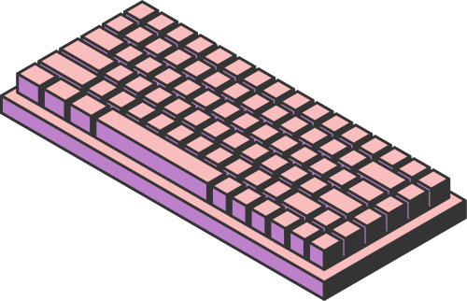
GOPLAN
Your Path Perfectly Planned
Page 01

Slide 2


Slide 3


Slide 4


Slide 5

GOPLAN

Slide 6
GoPlan is an innovative AI-powered application tailored for students seeking to efficiently plan their academic paths. By streamlining course selection, tracking progress, and optimizing future degree plan, it transforms the academic planning experience into a personalized journey

Slide 7
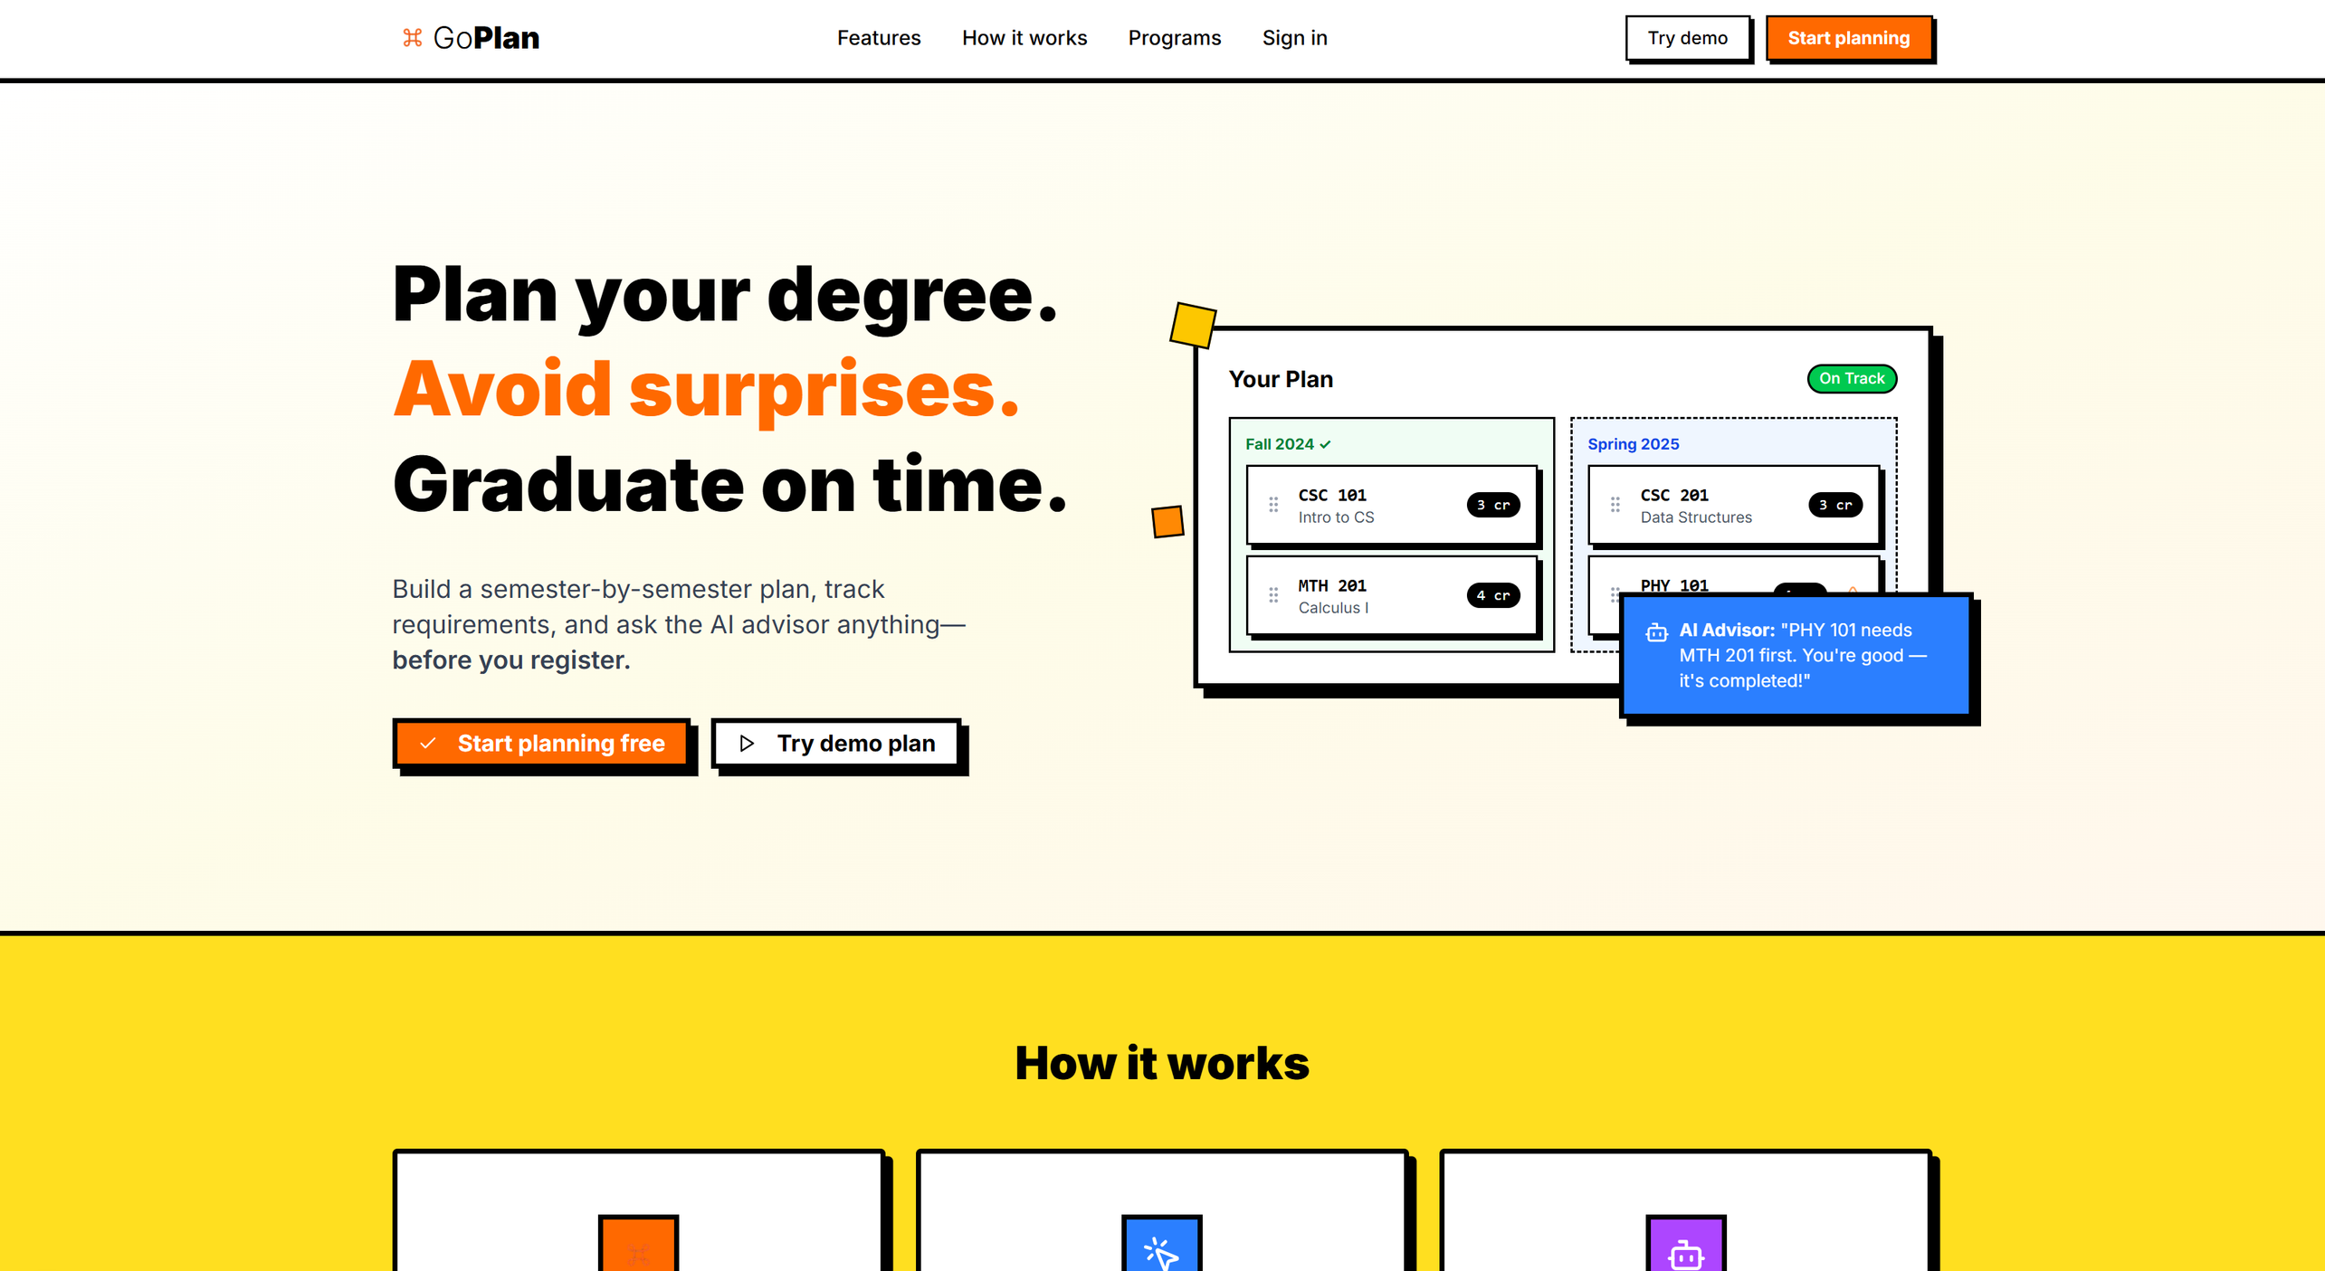

Slide 8
17-TABLE NORMALIZED

Slide 9
150+ COURSES

Slide 10
4 USERS

Slide 11
3 PROGRAMS

Slide 12
11 DATABASE TRIGGERS

Slide 13
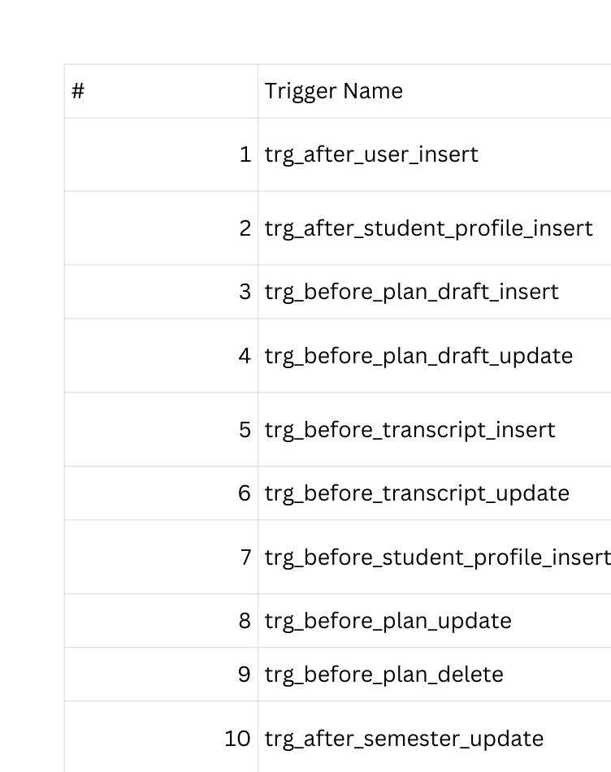

Slide 14
5 STORED PROCEDURES

Slide 15


Slide 16
7 OPTIMIZED VIEWS

Slide 17
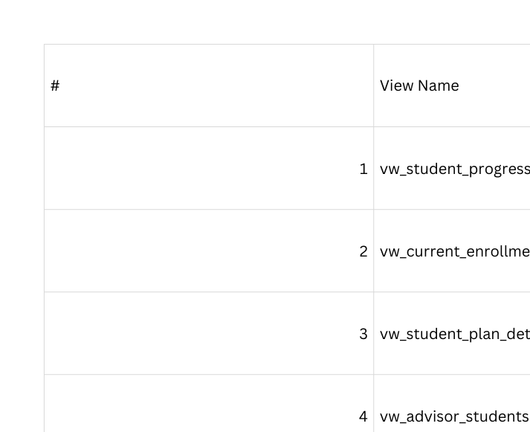

Slide 18
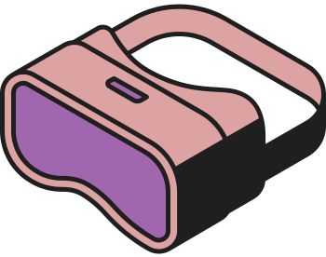



DEMO TIME

