Slide 1





Multi-Model
Offline Chat App
🔒 Privacy-First · 100% Offline · Local AI · No Cloud · No APIs
Python 3.10
Streamlit
LangChain
GGUF Models
ChromaDB
PRESENTED BY
Group 1— Team of 5 Members
Digital Egypt Pioneers Initiative (DEPI) · Round 4 · 2026
DEPI Graduation Project · 2026

Slide 2
Agenda
PRESENTATION OUTLINE
01
Project Overview
01
Problem Statement, Goals & Vision
02
System Architecture
02
Tech Stack, Project Structure & Flow
03
Core Features Walkthrough
03
Chat, Voice, PDF RAG & Session Management
04
AI & LLM Integration
04
Models, RAG Pipeline & Audio Transcription
05
UI/UX Design & Demo
05
Interface, Screenshots & Live Walkthrough
06
Code Deep Dive
06
app.py Architecture & Key Functions
07
Privacy, Security & Future
07
Roadmap, Improvements & Q&A

Slide 3




Section 01
Project Overview
Section 01
The Problem
AI chatbots traditionally rely on cloud APIs and internet connectivity. This means sensitive conversations, uploaded documents, and audio recordings are transmitted to external servers — raising serious privacy concerns for personal, legal, medical, and enterprise use cases.
Privacy First
100% Offline
Zero data leaves device
No internet dependency
Our Solution
A fully self-contained AI platform running entirely on local hardware. No API keys. No cloud. No telemetry. Everything — LLM inference, RAG, audio transcription, and chat history — lives on your machine.
Local LLMs
No API Keys
GGUF models on hardware
Fully self-sufficient
100%
0
Local
Full
Real-Time
Offline Operation
API Keys Needed
LLM Inference
Data Privacy
Streaming

Slide 4
Section 02
System Architecture
Section 02
User Input
(Text / Voice / Audio / PDF)
Streamlit
Frontend UI
LangChain
Orchestration
Local LLM
(CTransformers)
→
→
→
Whisper
Audio ASR
pypdfium2
PDF Parser
ChromaDB
Vector Store
InstructorEmbed
Embeddings
→
→
→
📁 Project Structure
• app.py — Main UI & Logic
• llm_chains.py — LangChain Chains
• audio_handler.py — Whisper ASR
• pdf_handler.py — RAG Ingestion
• utils.py — Helpers
• config.yaml — Settings

Slide 5








Tech Stack
Section 02
Section 02 — Continued
Frontend UI
Streamlit 1.29
LLM Inference
CTransformers 0.2.27 — GGUF Models
AI Orchestration
LangChain 0.0.354
Vector Database
ChromaDB 0.4.22
Embeddings
InstructorEmbedding + sentence-transformers
Audio Processing
librosa 0.10.1 + OpenAI Whisper
PDF Parsing
pypdfium2 4.24.0
Deep Learning
PyTorch 2.1.2 + Transformers 4.35.2
System Monitoring
psutil + pynvml (NVIDIA NVML)

Slide 6







Core Features
Section 03
Section 03
Local LLM Chat
Voice Input
PDF RAG Chat
Real-time streaming responses from GGUF models. No cloud required.
Record from browser microphone, auto-transcribed via Whisper.
Upload PDFs, semantic search via ChromaDB, LLM answers from context.
Chat History
Memory Window
Custom System Prompt
All sessions persisted as JSON locally. Resume any conversation.
Dynamically control context size (2–50 msgs) to balance performance.
Edit assistant persona and behavior. Saved directly to config.yaml.
Stop Generation
Export Chats
Hardware Monitor
Interrupt streaming responses instantly. Thread-safe stop event.
Download conversations as TXT or JSON for backup or analysis.
Live CPU, RAM, GPU & VRAM stats in the sidebar via psutil + NVML.

Slide 7
AI & LLM Integration
Section 04
Section 04
Supported GGUF Models
RAG Pipeline (PDF Chat)
LLaMA 2
📄
Upload PDF documents via Streamlit sidebar
Mistral 7B
✂️
pypdfium2 chunks and parses document text
TinyLlama
🧬
InstructorEmbedding vectorizes text chunks
Phi-2
💾
Vectors stored in local ChromaDB collection
Gemma
🔍
Cosine similarity search on user query
DeepSeek
📤
Top-k chunks injected into LLM context
Any CTransformers GGUF
🤖
CTransformers LLM generates grounded answer
Audio Pipeline:
🎤 Record / Upload WAV·MP3·OGG
→
🔊 librosa resamples & normalizes
→
✍️ Whisper ASR transcribes
→
🤖 LLM summarizes / responds

Slide 8
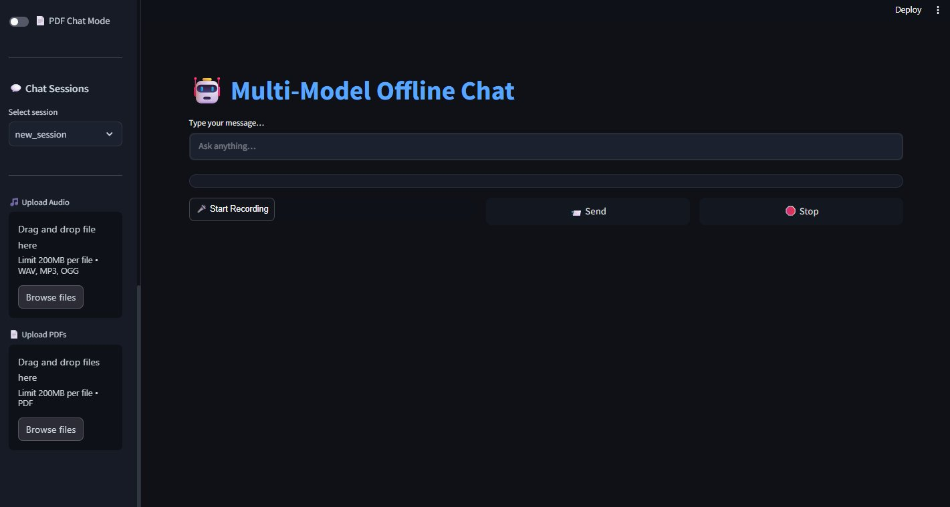
UI/UX Design — Settings Panel
Section 05
Section 05
System Monitor
Real-time CPU, RAM & GPU with animated progress bars
Model Selector
Switch between any GGUF model at runtime
Active GGUF File
Dropdown scans models/ directory automatically
Dark Theme
Custom CSS dark UI with Segoe UI typography
Settings & Hardware Monitor Sidebar

Slide 9
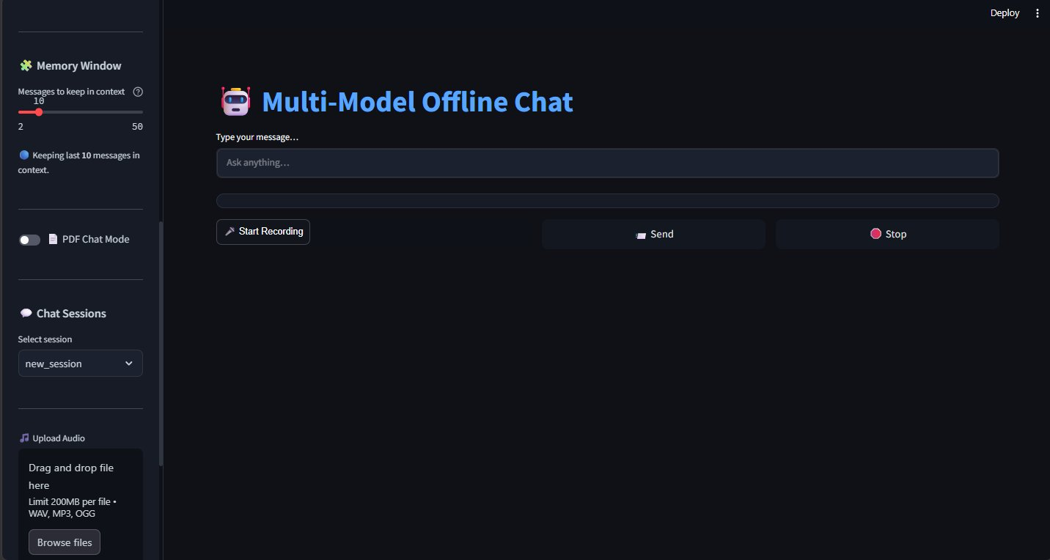
UI/UX Design — Memory & Sessions
Section 05 — Continued
Section 05
Memory Window Slider
Dynamically controls how many past messages the LLM sees (2–50)
PDF Chat Toggle
Switches the chain between normal chat and ChromaDB RAG mode
Chat Session Manager
Dropdown lists all saved sessions, sorted by last-modified time
Audio Upload Widget
Drag-and-drop WAV/MP3/OGG — auto-transcribes and summarizes
Memory Window & Session Management Sidebar

Slide 10
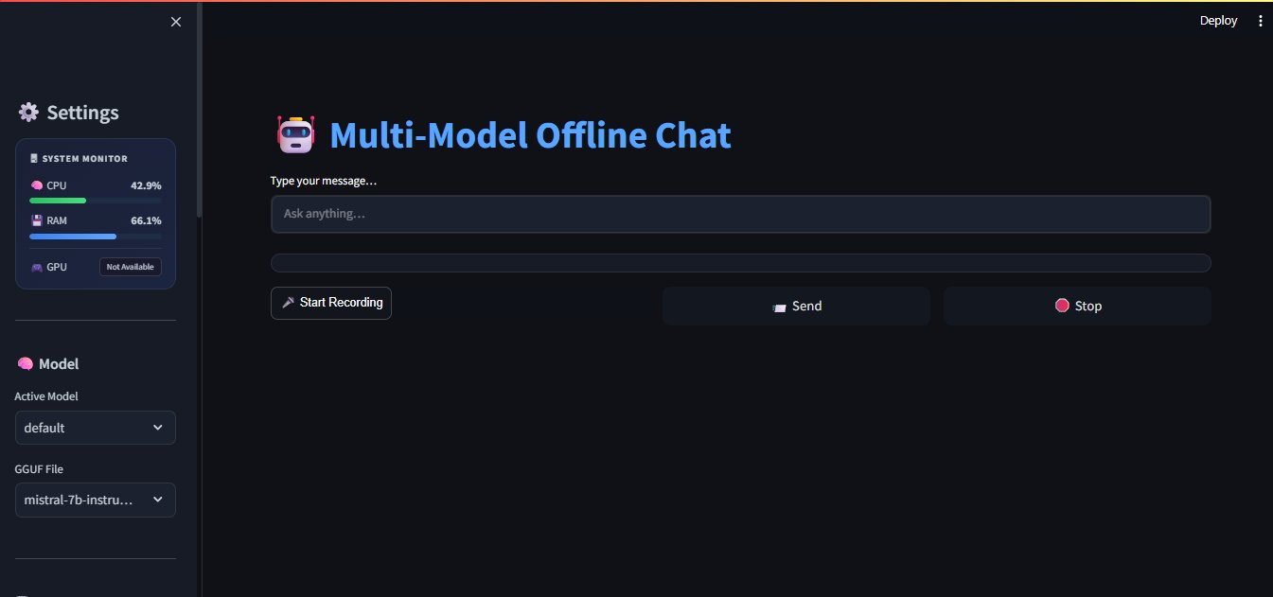
UI/UX Design — Input & Upload Panel
Section 05 — Continued
Section 05
Mic Recorder Button
streamlit-mic-recorder captures browser audio for voice queries
Send & Stop Buttons
Custom CSS gradient buttons with hover effects and threading stop event
PDF Upload Drop Zone
Multi-file PDF uploader — triggers ChromaDB ingestion on first upload
Typing Animation
Custom CSS blinking cursor renders as tokens stream from the LLM
Action Row — Voice · Send · Stop + File Upload Widgets

Slide 11
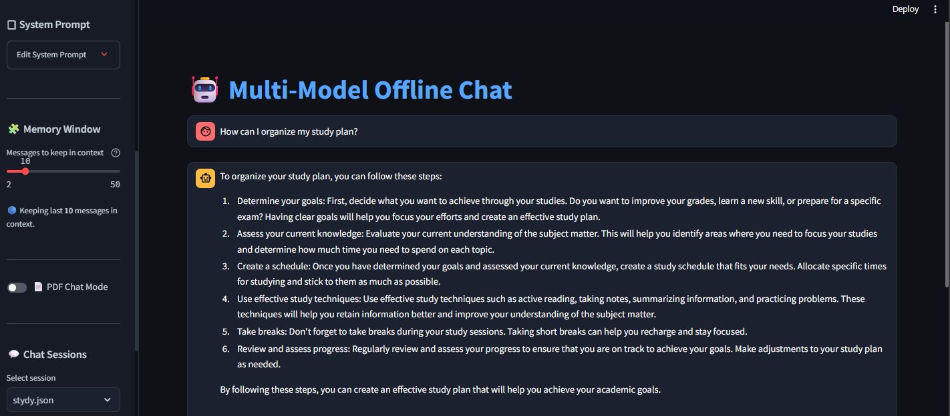
UI/UX Design — Live Chat Response
Section 05 — Continued
Section 05
Chat Bubbles
Styled with custom CSS — distinct colors for user vs assistant
Numbered LLM Output
LLM returns structured answers; rendered via st.markdown()
System Prompt
Prepended to every query: [SYSTEM]...[/SYSTEM] wrapper pattern
Session Dropdown
Auto-named sessions using LLM title generation on first message
Live Chat — Streaming Markdown Response with Copy Button

Slide 12
Code Deep Dive — app.py Architecture
Section 06
Section 06
inject_css()
Injects 200+ lines of custom CSS into Streamlit — dark theme, animated buttons, chat bubbles, copy-button JS, typing cursor animation.
render_monitor()
Builds HTML progress bars for CPU/RAM/GPU using psutil + pynvml. Runs inside the sidebar context to avoid HTML leaking into main area.
stream_response()
Iterates LLM token stream with threading.Event() stop control. Falls back to .run() for non-streaming models. Wraps system prompt inline.
save_chat_history()
Persists history to JSON. Avoids touching session_key (widget-owned). Uses new_session_key + session_index_tracker for safe state updates.
load_chain()
Routes to load_pdf_chat_chain() (RAG mode) or load_normal_chain() (standard) based on pdf_chat session flag.
generate_session_name()
Invokes the LLM with a title-generation prompt on the user's first message. Sanitizes filename, deduplicates with a counter suffix.
render_message()
Splits content on ``` fences, renders code blocks via st.code(), prose via st.markdown(), and injects a copy-button via innerHTML trick.

Slide 13
Code Deep Dive — Key Engineering Patterns
Section 06 — Continued
Section 06
Thread-Safe Stop Generation
Memory Window Slicing
stop_event = threading.Event()
for chunk in llm_chain.stream(question):
if stop_event.is_set(): break
full_text += chunk
if window > 0 and len(history) > window:
st.session_state.history = history[-window:]
Session Key Safety (Widget-Owned State)
System Prompt Injection
# Never write session_key directly — it's widget-owned
st.session_state.session_index_tracker = new_filename
# selectbox reads index= from tracker on next rerun
if system_prompt:
question = f"[SYSTEM]\n{system_prompt}\n[/SYSTEM]\n\n{question}"
💡 Pattern: Streamlit reruns the entire script on each interaction — all state flows through st.session_state; widget keys are never overwritten from code logic.

Slide 14
Section 07
Privacy & Security
Section 07
Your Data Never Leaves Your Device
❌
No API Keys
❌
No Internet Required
Zero external service credentials required
Fully air-gapped operation supported
❌
No Cloud Processing
✅
Local Storage Only
All inference runs on local CPU/GPU
JSON history files stored in chat_history/
❌
No Third-Party Data
✅
Full Data Ownership
Documents and audio never leave the machine
User controls every file and model asset

Slide 15
Future Roadmap
Section 07
Section 07 — Continued
Phase 1 — Near Term
Phase 2 — Mid Term
Phase 3 — Long Term
🌐 Multi-language UI support
🖼️ (LLaVA / multimodal)
🤝 Multi-agent collaboration framework
⚡ GPU acceleration optimization
🧩 Plugin / extension system
🎙️ Real-time voice conversation mode
📱 Mobile-responsive layout
📊 Usage analytics dashboard
📁 Folder-level RAG ingestion
🔍 Improved semantic search ranking
🔐 Conversation encryption at rest
🧠 Long-term memory across sessions
🚀 Built for DEPI Round 4 · Designed to evolve into a production-grade private AI workspace

Slide 16
TEAM
1- Omar Tamer
2- Mina Youssef
3-Mahmoud Alaa
4- Seif Ayman
5- Hussien Alaa

Slide 17
Thank You!
Multi-Model Offline Chat App · DEPI Final Project Round 4
Group 1
Digital Egypt Pioneers Initiative (DEPI) · Round 4
Questions & Discussion Welcome
Streamlit
LangChain
CTransformers
ChromaDB
Whisper
PyTorch
psutil + NVML
github.com/OmarTamer2004/DEPI-FINAL-PROJECT-R4_Multi-Local-Offline-Chat-App

