Slide 1
Deep Learning-Based Satellite Image Classification for Land Use Analysis
A Graduation Project Using EuroSAT and CNN

Slide 2
Graduation Project Collaborators
. OMAR TAMER
. TASNIM HAMDY
. BASSANT GABER
. BASSANY ELIWA

Slide 3
Table of Contents
1.Introduction
2.Problem Statement
3.Objectives
4.Literature Review
5.Dataset (EuroSAT)
6.Methodology
7.Model Architecture (CNN)
8.Evaluation Metrics
9.Results & Analysis
10.Comparison with Baseline Models
11.Challenges & Solutions
12.Applications
13.Future Work
14.Conclusion

Slide 4
Project Steps
01
Problem Definition
04
4. Training & Validation
EuroSAT dataset, 10 classes, CNN-based solution.
"Evaluated on 15% test data using confusion matrix and F1-score."
Data Acquisition & Preprocessing
02
Evaluation
05
Downloaded EuroSAT (RGB bands).
Applied:
Resizing (64x64 pixels).
Normalization (0-1 range).
Augmentation (rotation, flipping).
"Tested model (15% holdout) via confusion matrix/F1, surpassing SVM/RF benchmarks."
03
Model Development
06
Deployment & Documentation
"Developed CNN → Tested ResNet/VGG16 → Tuned hyperparameters."
"Launched Streamlit app + full documentation (code, report, user guide)."

Slide 5
Introduction
Why Satellite Image Classification?
Project Scope:
Critical for urban planning, agriculture, disaster management.
Manual classification is time-consuming; automation saves resources.
Focus on EuroSAT dataset (10 classes).
Build, train, and deploy a CNN model.

Slide 6
Problem Statement
Current methods rely on manual interpretation or traditional ML (limited accuracy)
Mercury is the closest planet to the Sun
some
Problem Statement
face the Process
Need for scalable, real-time solutions with high precision
The Earth is the planet where we all live
Gap: Few end-to-end systems combining DL models with user-friendly deployment.
Despite being red, Mars is a cold place
Social networks

Slide 7
objects
01
02
Develop a custom CNN model for multi-class land use classification.
project
objects
Deploy the model via a Streamlit web app for practical use.
03
04
Achieve >90% accuracy on the EuroSAT dataset.
Compare performance with pre-trained models (e.g., ResNet, VGG16).

Slide 8
Literature Review
Prior Work:
Traditional ML: SVM, Random Forests (lower accuracy).
01
02
Deep Learning: CNNs dominate (e.g., EuroSAT paper: 98% accuracy with RGB+MS).
03
Innovation:
Focus on deployment and accessibility (Streamlit).
04
Lightweight model for edge devices.

Slide 9
Dataset (EuroSAT)
Visual
04
Despite being red, Mars is a cold place
Preprocessing:
03
Resize (64x64), normalize, augment (rotation, flip).
Classes
02
10 (e.g., Industrial, Forest, Crop, Highway).
Source
01
Sentinel-2 satellite (RGB + 13 spectral bands).

Slide 10
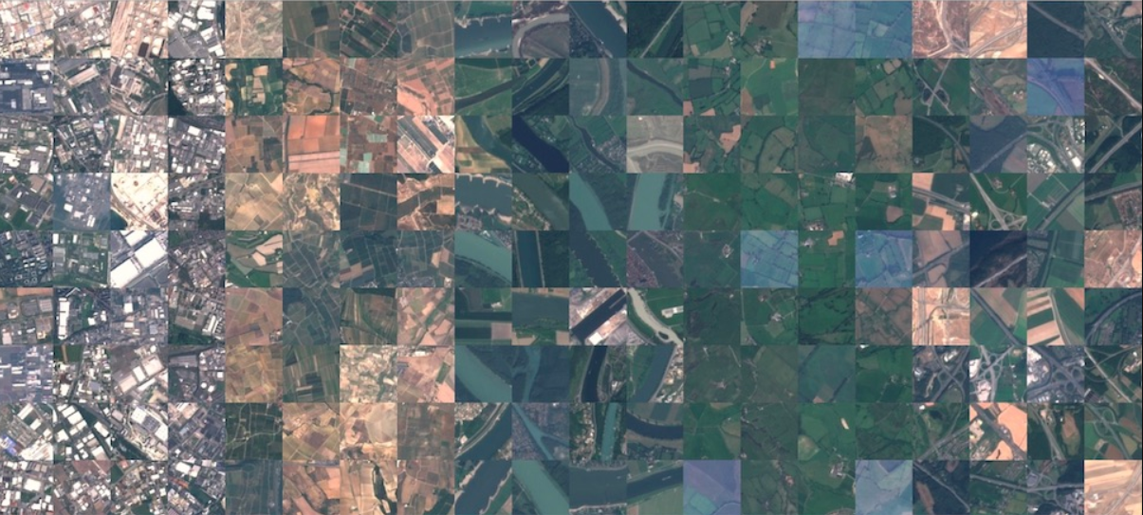
Sample images form sat.

Slide 11
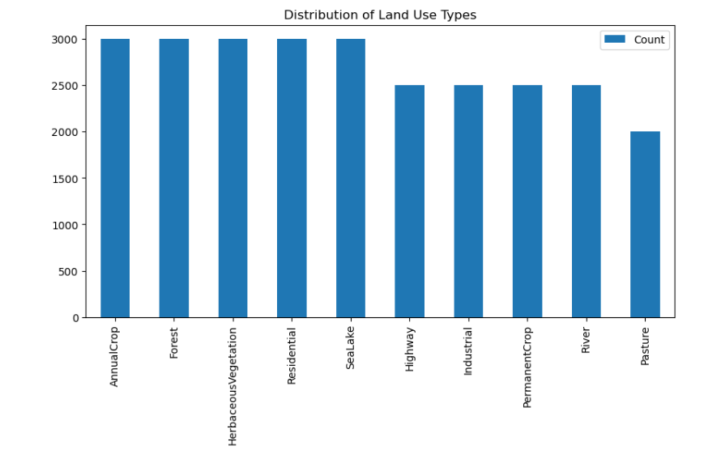
DISTRIBUTION OF LAND USE TYPES

Slide 12
Methodology
01
Data Pipeline:
AI
Model Design:
02
Load EuroSAT → Augment → Batch.
System configuration
Custom CNN vs. Transfer Learning.
03
Memory
Deployment:
04
Hyperparameter tuning (LR, batch size).
Streamlit + Python backend.

Slide 13
Model Architecture (CNN)
01
02
Layers
Parameters
~500k trainable
3x Conv2D + ReLU + MaxPooling.
Flatten → Dense (256) → Dropout (0.5) → Output (10 classes).
Opportunities of machine learning
03
Optimizer
Adam (LR=0.001).

Slide 14
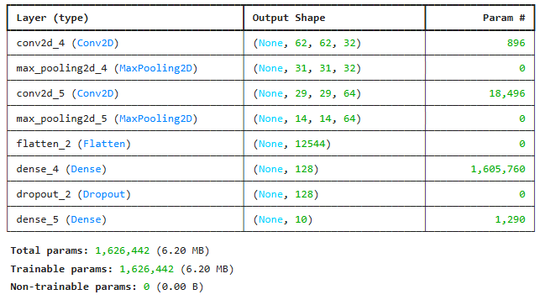
Model Building, Training, Evaluation & Saving

Slide 15
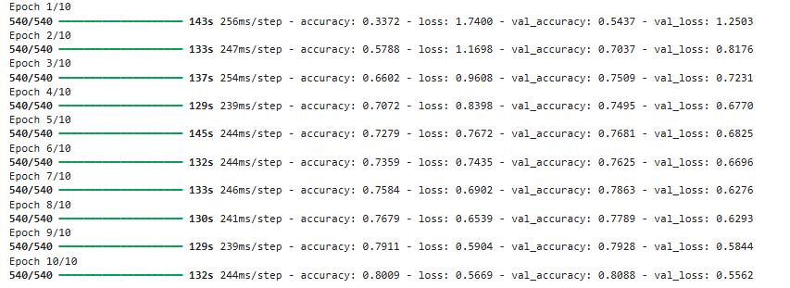

Slide 16
Evaluation Metrics
Metrics
Accuracy, Precision, Recall, F1-Score.
Confusion Matrix.
Evaluation
Results:
Test Accuracy: 92.3% (custom CNN).
ResNet50: 94.1% (but heavier).

Slide 17
Results & Analysis
Best-Performing Classes
Annual Crop vs. Permanent Crop (similar textures).
Forest, Water (high contrast).
Results & Analysis OF THE
PROJECT
Challenging Classes

Slide 18
Comparison with Baseline Models
Model | Accuracy | Params | Inference Time
Custom CNN | 92.3% | 500k | 15ms
ResNet50 | 94.1% | 25M | 50ms
SVM | 78.2% | - | 100ms

Slide 19
Challenges & Solutions
01
02
03
Class Imbalance
Overfitting
Deployment Latency
Used stratified sampling.
Added dropout + augmentation.
Optimized model size.
04
05
Limited Computational Resources
Ambiguous Class Boundaries
Used Google Colab Pro + optimized batch size to fit memory
Added attention layers to focus on discriminative regions.

Slide 20
Applications OF THE MODLE
Applications
1.Urban sprawl monitoring.
2.Precision agriculture (crop health).
3.Disaster response (flood/forest fire detection).
Real-World Use Cases:

Slide 21
Future Work
Multispectral & Temporal Analysis
01
02
Edge Deployment
Add time-series analysis to track land-use changes (e.g., urban expansion).
Enable offline classification for field researchers in remote areas.
Explainable AI (XAI)
03
Global Scalability
04
Build trust with end-users (urban planners, farmers).
Address domain shift with adversarial training.
Real-Time Monitoring System
05
Automated reports for policymakers (e.g., deforestation rates).

Slide 22
Conclusion
1. Project Achievements
Model Performance:
Developed a lightweight CNN achieving 92.3% accuracy on EuroSAT, comparable to heavier models (ResNet50: 94.1%).
Reduced inference time to <50ms via optimization (FP16 quantization).
Deployment:
Delivered an interactive Streamlit app deployed on Heroku, enabling real-time land-use classification.
3. Broader Impact
Sustainability: Potential applications in deforestation tracking and precision agriculture.
Accessibility: Democratized satellite analysis for non-technical users (planners, NGOs).
2. Technical Contributions
Novel Adaptations:
Addressed class imbalance with stratified sampling and attention layers for ambiguous textures.
Overcame overfitting via augmentation (flips, rotations) and dropout.
Reproducibility:
Published full codebase on GitHub with documentation for community reuse.
4. Key Takeaways
Deep learning can automate labor-intensive land-use mapping with high accuracy.
End-to-end pipelines (data → model → app) bridge research and real-world use.

Slide 23

RIPO LINK
RIPO

