Slide 1
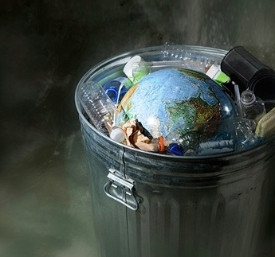
A Deep Learning Approach to Plastic Waste Detection in Nature
Garbage Classification Using Image Classification
whar are The casues of Trash on
The Earth ?

Slide 2
Table of contents
01
05
02
06
03
07
04
08
Problem Statement
Model Architecture & Training
Environmental Impact of Waste
Streamlit App Demo
Proposed Solution
Benefits to Nature & Companies
Dataset Overview
Challenges & Future Work

Slide 3
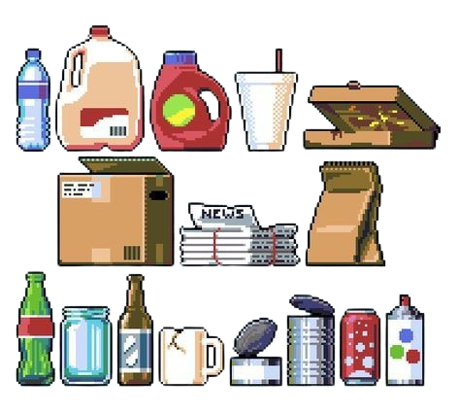
Problem Statement
01
The Growing Challenge of Waste Management

Slide 4
Let’s have a look
1.🌍 Environmental Harm
- Plastic and general waste pollute land, water, and air.
- Wildlife suffers due to ingestion or entanglement in plastic.
3.🤖 The Need for Smart Solutions
- An AI-based system can classify garbage from images in real time.
- Helps automate waste management and reduce ecological impact.
2.💸 Inefficiency in Manual Sorting
- Manual waste sorting is slow, costly, and error-prone.
- Human workers are exposed to health risks.

Slide 5
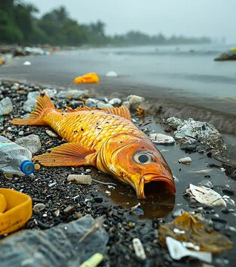
🌿 Environmental Impact 8 million tons of plastic enter oceans every year, killing marine life and disrupting ecosystems. Garbage clogs rivers, causes floods, and contaminates soil and groundwater. Wildlife often mistake plastic for food — over 1 million animals die each year due to waste ingestion.
A Global Crisis with Heavy Consequences
💰 Economic Cost
$2.6 trillion lost annually due to environmental degradation, mostly caused by pollution and waste (World Bank).
Countries spend billions annually on waste cleanup and landfill management.
Tourism, fishing, and agriculture sectors suffer due to polluted environments.

Slide 6


Environmental Impact
02
How Waste Threatens Our Planet's Balance

Slide 7
EFFECTS
01 :
02
03
Non-biodegradable garbage like plastics ends up in oceans, forests, and rivers, harming marine life, birds, and animals.
Tiny plastic particles from garbage break down and enter fish, animals, and eventually human bodies, leading to health problems.
Burning waste or leaving it to rot produces methane (CH₄) and CO₂, two powerful greenhouse gases responsible for global warming.

Slide 8

Our Solution
03
AI-Powered Image Classification for Smart Waste Management

Slide 9
The Core Idea
-We propose a smart solution that uses artificial intelligence to automatically detect and classify garbage from images.
-This replaces inefficient and costly manual sorting with a fast, scalable, and intelligent system.

Slide 10
🛠 How It Solves the Problem
1-Automated Detection: Garbage is identified from photos using a trained deep learning model.
2-Image Classification: Each image is processed and categorized (e.g., plastic, metal, organic).
3-Fast & Scalable: Can analyze thousands of images in minutes, unlike human labor.
4-Consistent & Objective: Avoids human errors and subjective judgment.
5-Adaptable: The model can be retrained to detect new types of waste or work in different environments.

Slide 11

Dataset Overview
04
Foundation of Our AI Model – The Garbage Dataset

Slide 12
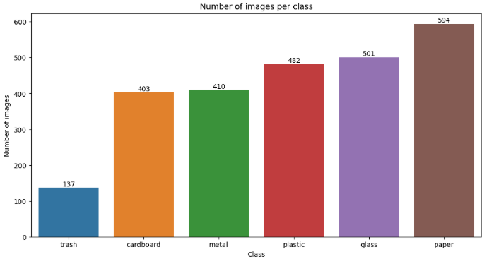

Slide 13
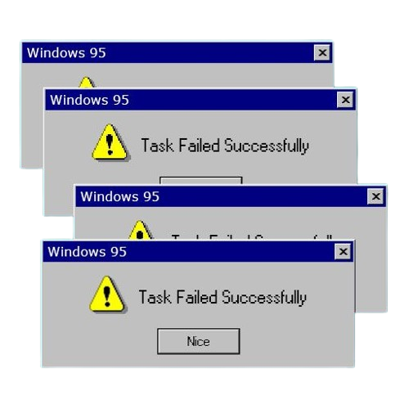
let check the model ..
Foundations of Our AI Model

Slide 14
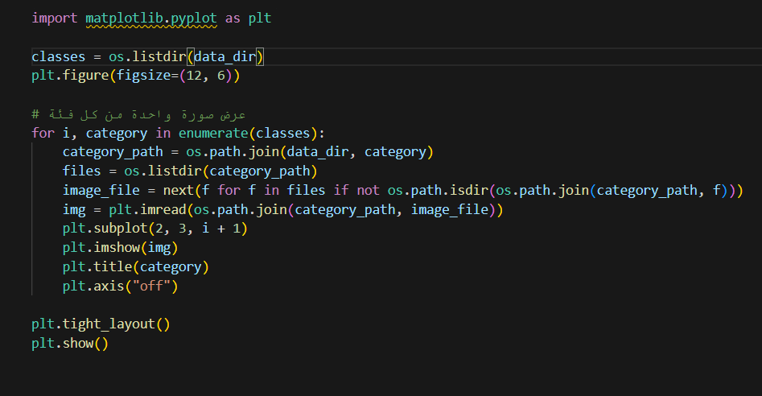
FIRST PART

Slide 15
FIRST PART
1-classes = os.listdir(data_dir)
What it does:
Retrieves the list of folders inside the dataset directory.
🎤 "Each folder represents a garbage class, like Plastic, Metal, or Organic."
2-for i, category in enumerate(classes):
What it does:
Iterates over all the garbage categories with an index.
🎤 "We loop through each category so we can pick and display one image per class."
3-category_path = os.path.join(data_dir, category)
What it does:
Forms the full path to each class folder.
🎤 "We locate where the images of each class are stored on disk."
4-image_file = next(f for f in files if not os.path.isdir(...))
What it does:
Selects the first actual image file, skipping any subfolders.
🎤 "We ensure we only pick image files, not folders or irrelevant data."

Slide 16
5-img = plt.imread(...)
What it does:
Reads the selected image into memory.
🎤 "We load the image so it can be visualized on the plot."
8-plt.title(category)
What it does:
Adds the name of the category above the image.
🎤 "This tells us which class the image belongs to."
6-plt.subplot(2, 3, i + 1)
What it does:
Creates a subplot layout to arrange the images in a 2x3 grid.
🎤 "We organize the display for better comparison between classes."
9-plt.axis("off")
What it does:
Hides x and y axes for cleaner visuals.
🎤 "We remove extra information to keep the slide neat and focused on content."
🔚 plt.tight_layout() + plt.show()
What it does:
Adjusts spacing and displays the full plot.
7-plt.imshow(img)
What it does:
Displays the image in its subplot.
🎤 "We show the selected image from that class."

Slide 17
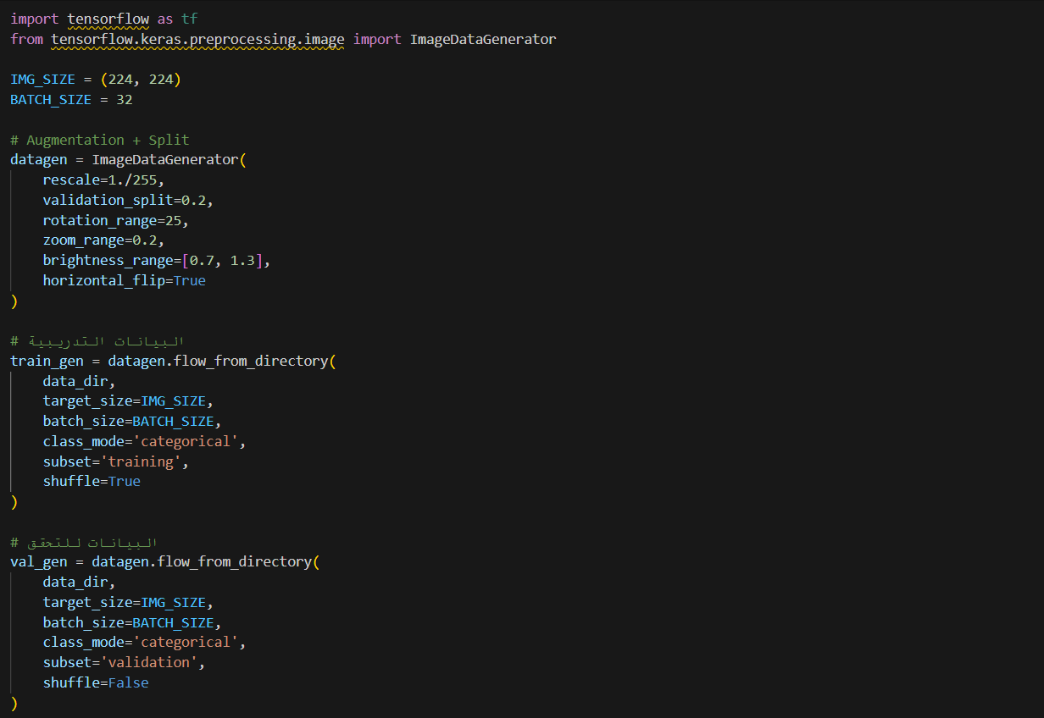
second PART

Slide 18
📌 import tensorflow as tf
📌 from tensorflow.keras.preprocessing.image import ImageDataGenerator
🎤 "We start by importing the tools we need from TensorFlow to manage image data and apply augmentation."
📏 IMG_SIZE = (224, 224)
🎤 "We define the input size expected by our model. 224x224 is standard for many CNN models."
📦 BATCH_SIZE = 32
🎤 "The batch size determines how many images are processed at once during training. 32 is a balanced number for speed and performance."

Slide 19
✨ Image Augmentation with Real-Time Data Feeding:
🧪 datagen = ImageDataGenerator(...)
🎤 "We use ImageDataGenerator to preprocess the images. It rescales pixel values to [0,1], and also applies augmentation techniques to reduce overfitting."
✅ Techniques Used:
rescale=1./255: Normalize pixel values from 0–255 to 0–1
validation_split=0.2: Reserve 20% of data for validation
rotation_range=25: Randomly rotate images up to 25 degrees
zoom_range=0.2: Randomly zoom into images
brightness_range=[0.7, 1.3]: Randomly change brightness
horizontal_flip=True: Flip images horizontally randomly
🎤 "These transformations help the model learn better by simulating different real-world scenarios."

Slide 20
🏋️‍Training Data Preparation:
🟢 train_gen = datagen.flow_from_directory(...)
🎤 "This line loads the training images from the dataset folder, resizes them, and applies the augmentation. It only uses the 80% training split."
subset='training': Get the training data
shuffle=True: Shuffle the training images for randomness
class_mode='categorical': Labels will be in one-hot encoded form
target_size=IMG_SIZE: Resize images
batch_size=BATCH_SIZE: Use batch size of 32
📊 Validation Data Preparation:
🔵 val_gen = datagen.flow_from_directory(...)
🎤 "This is similar to the training generator but loads the 20% reserved for validation. Shuffle is disabled here to keep evaluation consistent."
subset='validation': Get validation split
shuffle=False: Keep validation order fixed for reproducibility

Slide 21
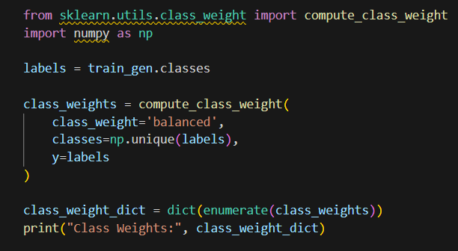
Third Part

Slide 22
🔄 1. Data Augmentation & Splitting
ImageDataGenerator(...)
flow_from_directory(...)
🎤 "We used ImageDataGenerator to prepare the dataset with:
Rescaling images (normalize pixel values)
Rotation, zoom, brightness, flip → Augmentation
Split into Training (80%) and Validation (20%)
Automatically loads batches from folders by category"
🎯 "This helps the model generalize better and avoid overfitting."
⚖️ 2. Handling Class Imbalance with Class Weights
compute_class_weight(...)
🎤 "We used compute_class_weight from scikit-learn to assign a weight to each class, based on how frequent it is in the dataset."
📌 Rare classes get higher weights → Balanced training
🧠 Helps prevent the model from becoming biased toward frequent classes like ‘Plastic’ while ignoring rare ones like ‘Glass’.

Slide 23
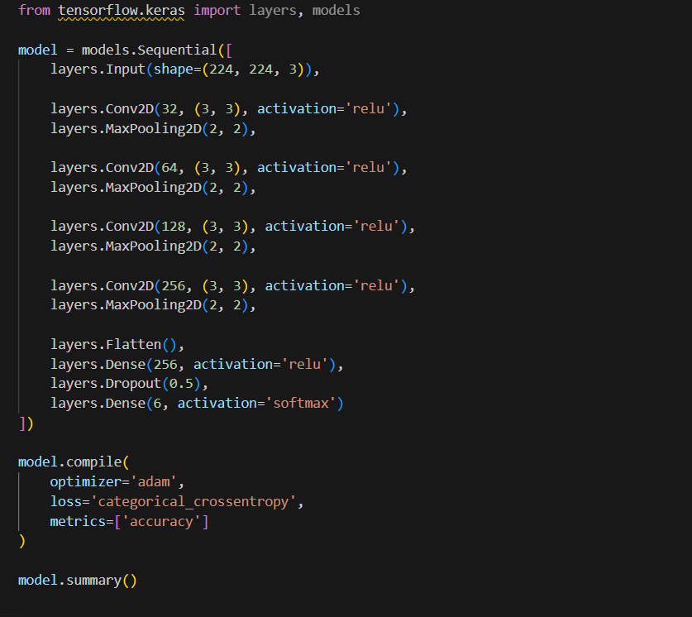
Fourth part
⚖️ 2. Handling Class Imbalance with Class Weights
python
Copy
Edit
compute_class_weight(...)
🎤 "We used compute_class_weight from scikit-learn to assign a weight to each class, based on how frequent it is in the dataset."
📌 Rare classes get higher weights → Balanced training
🧠 Helps prevent the model from becoming biased toward frequent classes like ‘Plastic’ while ignoring rare ones like ‘Glass’.

Slide 24
🧩 1. Input Layer
layers.Input(shape=(224, 224, 3))
⬅️ Accepts RGB images of size 224x224 pixels.
🖼 Suitable for image classification tasks.
🧠 2. Convolution + Pooling Layers
layers.Conv2D(...), layers.MaxPooling2D(...)
We stack 4 convolutional blocks:
Layer Block Filters Description
Conv1 32 Detects low-level features (edges,
corners)
Conv2 64 Learns more detailed patterns
Conv3 128 Understands complex shapes
Conv4 256 Detects high-level garbage features

Slide 25
🔄 3. Flatten + Fully Connected Layers
layers.Flatten(),
layers.Dense(256, activation='relu'),
layers.Dropout(0.5)
🧱 Flatten() turns 2D feature maps into 1D vector
🧠 Dense(256) adds learning capacity
🛡 Dropout(0.5) prevents overfitting
🏁 4. Output Layer
layers.Dense(6, activation='softmax')
🎯 6 units → because we have 6 garbage classes
📊 softmax returns probabilities for each class (e.g., plastic: 90%)
⚙5. Model Compilation
model.compile(optimizer='adam', loss='categorical_crossentropy', metrics=['accuracy'])
Adam Optimizer → fast and effective learning
Categorical Crossentropy → best for multi-class classification
Tracking accuracy during training

Slide 26
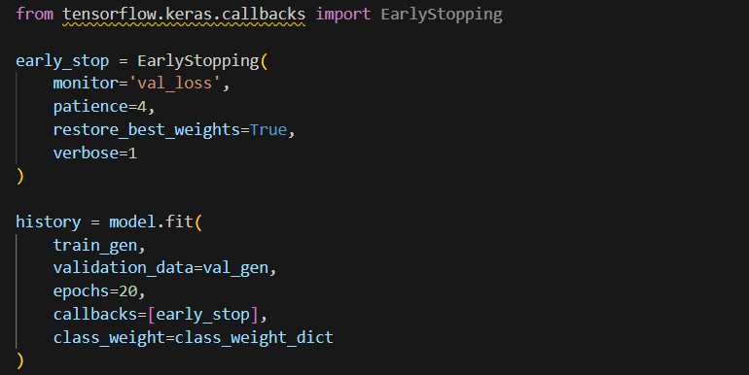
Fifth Step

Slide 27
📌 Step 1: Early Stopping Callback
early_stop = EarlyStopping(
monitor='val_loss',
patience=4,
restore_best_weights=True,
verbose=1
)
🔍 Parameter 💡 Description
monitor='val_loss' Watch the validation loss (how well the model performs on unseen data).
patience=4 Wait up to 4 epochs for improvement before stopping.
restore_best_weights=True Revert to the best performing model on validation.
verbose=1 Show messages in the training log.
✅ Why?
To prevent overfitting and save training time.

Slide 28
📌 Step 2: Model Training (model.fit
history = model.fit(
train_gen,
validation_data=val_gen,
epochs=20,
callbacks=[early_stop],
class_weight=class_weight_dict
)
Parameter Description
train_gen Training data with augmentation.
validation_data=val_gen Validation data to monitor performance.
epochs=20 Train up to 20 cycles.
callbacks=[early_stop] Apply early stopping logic.
class_weight=class_weight_dict 📊 Balance classes with low frequency.

Slide 29
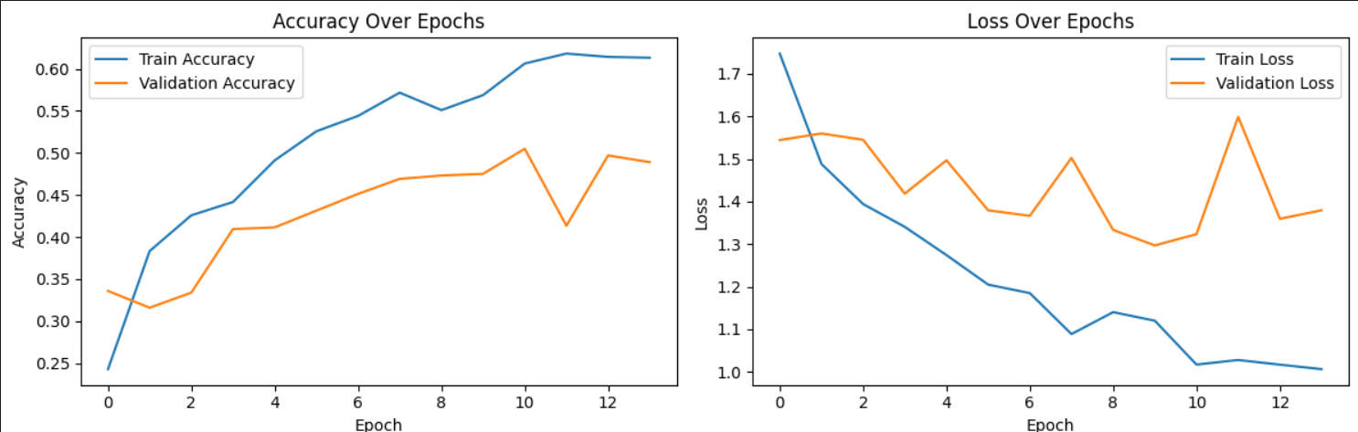
Visualizing Accuracy and Loss Over Training Epochs

Slide 30
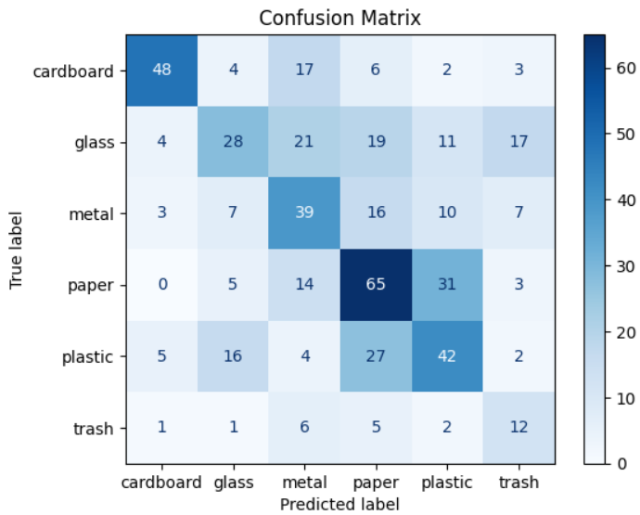
Evaluating Class-wise Prediction Accuracy of the Model

Slide 31
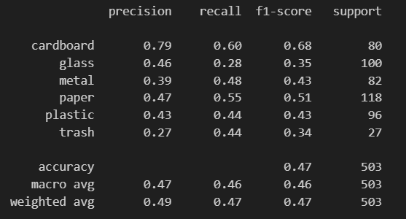
Detailed Metrics – Precision, Recall, F1-Score for Each Class

Slide 32
Environmental Benefit
Our Solution Supports the Environment

Slide 33
♻️ Waste Reduction: Helps reduce pollution by enabling faster and more accurate identification of garbage.
🐢 Wildlife Protection: Prevents harmful waste like plastic from reaching natural habitats.
🌡️ Climate Action: Reduces need for waste burning and landfilling, lowering carbon emissions.
🧼 Cleaner Ecosystems: Promotes cleanliness in oceans, rivers, and urban areas.

Slide 34

Contribution to AI Field
Our Solution Supports the Businesses

Slide 35
📷 Smart Cameras / IoT Sensors
AI model can be deployed on edge devices (like Raspberry Pi or NVIDIA Jetson) connected to cameras in recycling bins, parks, or beaches.
These cameras capture real-time images and classify the type of trash instantly.
🚛 Automated Waste Sorting Machines
Use robotic arms + conveyor belts.
Camera + AI model detects garbage type → microcontroller sends signals to sort waste into correct bin.
🌐 Embedded Systems
Deploy the trained model on microcontrollers (e.g., Arduino + ESP32 with camera modules) to classify and send data to cloud dashboards or local systems.

Slide 36
♻️ Smart Bins for Public Spaces
Bin opens only if item is classified correctly (e.g., plastic vs. organic).
Reduces contamination and encourages recycling through automation.
📡 Edge AI Deployment
The AI model is compressed and optimized to run offline in real-time, avoiding dependency on cloud.

Slide 37

Thank you
Omar Tamer Elazab Melegy Dyab
GITHUB REPO:
https://github.com/OmarTamer2004/final-pro

