Slide 1
S Y R I A N P R I V A T E U N I V E R S I T Y
Faculty of Artificial Intelligence Engineering · Department of Intelligent Information Security Systems Engineering
Agentic AI Security Supervisor
An Agentic LLM Framework for Autonomous Living-off-the-Land Attack Investigation and Response
Omar Tanah · Louay Almarri · Hamza Beirouti
Supervisors: Dr. Waseem Juneidi · Eng. Ahmad Shekha
Graduation Project Seminar 1 — 2026
Notes:
Good morning everyone. We are Omar, Louay, and Hamza, graduating students in Intelligent Information Security Systems Engineering at Syrian Private University, supervised by Dr. Waseem Juneidi and Eng. Ahmad Shekha. Our graduation project is LOTL-ARIA — an agentic AI security supervisor that autonomously investigates Linux living-off-the-land attacks and proposes graded responses.

Slide 2
Project Overview
• Agentic LLM framework investigating LOTL attacks
• Replaces passive ML detectors with autonomous LLM agents
• Wazuh SIEM for real-time log ingestion and response
Rule-Based Detection
Passive classification
ML Detector
Passive classification
LOTL-ARIA Agent
Investigates and correlates
Existing pipelines stop at detection; LOTL-ARIA adds a transparent investigation and graded-response layer on top.
LOTL-ARIA — Graduation Project Seminar · Syrian Private University, 2026
2
Notes:
LOTL-ARIA is an agentic LLM framework that investigates Linux living-off-the-land attacks and proposes graded responses. It sits one step beyond today's pipeline: rule-based systems and ML detectors both stop at passive classification. LOTL-ARIA takes their alerts and investigates them using Wazuh SIEM for real-time log ingestion and response hooks.

Slide 3
The 3 Core Research Gaps
I.
Lack of Contextual Understanding
ML evaluates commands in isolation
II.
Absence of Explainability
Black-box models fail to justify decisions
III.
No Response Capability
Systems detect but cannot autonomously act
LOTL-ARIA — Graduation Project Seminar · Syrian Private University, 2026
3
Notes:
These three gaps come directly from our foundational paper, LOTLDetector (2026), and they define our problem. First, lack of contextual understanding: ML evaluates each command in isolation. Second, absence of explainability: black-box models cannot justify their decisions. Third, no response capability: current systems detect but cannot autonomously act. Our project is designed to solve all three.

Slide 4
Previous Work — Part 1: The Foundations
Paper & Year | Core Contribution | Relationship to Project
LOTLDetector (2026) [1] | Achieved high in-distribution accuracy (F1: 0.9727) using hybrid ML, but suffers from context-blindness, lack of interpretability, and lack of generalization (F1 drops to 0.6532 cross-platform) | Foundational paper, ML baseline (RQ1)
RACONTEUR (2025) [2] | LLM shell explainer, passive only | Extends explanation into active investigation
Risk Assessment (2025) [3] | LLM risk scoring (R0–R4) | Foundation for graded response actions
SENTINEL (2026) [4] | Identifies obfuscation failure modes | Validates our obfuscation datasets
Supervised LOLBins (2024) [5] | Class imbalance in ML datasets | Supports LLM approach (no large labels needed)
BlueSTAR (2026) [6] | Tiered architecture (rules + LLM) | Inspires our rules/AI split architecture
LOTL-ARIA — Graduation Project Seminar · Syrian Private University, 2026
4
Notes:
Part 1 covers the foundations. LOTLDetector is our foundational paper and the ML baseline for RQ1, but it lacks context. RACONTEUR explains shell commands with an LLM but stays passive — we extend that into active investigation. The 2025 risk assessment work gives us graded R0–R4 scoring, which underpins our graded response. SENTINEL validates our obfuscation datasets, Supervised LOLBins shows why an LLM approach needs no large labels, and BlueSTAR inspires our rules/AI split architecture.

Slide 5
Previous Work — Part 2: The Agentic Era
Paper & Year | Core Contribution | Relationship to Project
AgentSOC (2026) [7] | Multi-layer agentic SOC, dry-run only | We fix their dry-run limitation with live execution
Hyper-Auto SOAR (2025) [8] | Dynamic AI playbooks, safety risks | Motivates our deterministic Safety Gate
GIRA (2026) [9] | 5-layer Safety Gate | Informs our Safety Gate design
Poisoning Watchtower (2026) [10] | Log-based prompt injection | Threat model for our injection tests
LogJack (2026) [11] | Injected commands in logs | Reinforces isolating Action Tools from Agent
LOTL-ARIA — Graduation Project Seminar · Syrian Private University, 2026
5
Notes:
Part 2 covers the agentic era. AgentSOC built a multi-layer agentic SOC but only in dry-run mode — we fix that with controlled live execution. Hyper-Auto SOAR showed the safety risks of dynamic AI playbooks, which motivates our deterministic Safety Gate. GIRA's 5-layer gate informs our design. Finally, Poisoning Watchtower and LogJack demonstrate prompt injection through log content, which is why our Action Tools are strictly isolated from the Agent.

Slide 6
Proposed Solutions to the 3 Gaps
Solution I
Solution II
Solution III
Glass-Box ReAct Agent
Solves Lack of Context & Explainability
Autonomous Response
Solves No Response Capability
Safety Gate
Defends against Prompt Injection
Each solution maps one-to-one onto a research gap identified in Slide 3.
LOTL-ARIA — Graduation Project Seminar · Syrian Private University, 2026
6
Notes:
Our three solutions map one-to-one onto the gaps. Solution 1 is a glass-box ReAct agent: a transparent reasoning loop with read-only investigation tools, solving both context and explainability. Solution 2 is graded autonomous response — R0 to R4 style actions from monitor to isolate — solving the no-response gap. Solution 3 is a multi-layer deterministic Safety Gate that intercepts every proposed action, defending against prompt injection.

Slide 7
System Architecture
Layer 1: Data Ingestion &Normalization
Layer 2: ReAct core (Investigation Only)
Layer 3: Safety Gate (Determimistic Validation)
Layer 4: Execution & Audit
LOTL-ARIA — Graduation Project Seminar · Syrian Private University, 2026
7

Slide 8
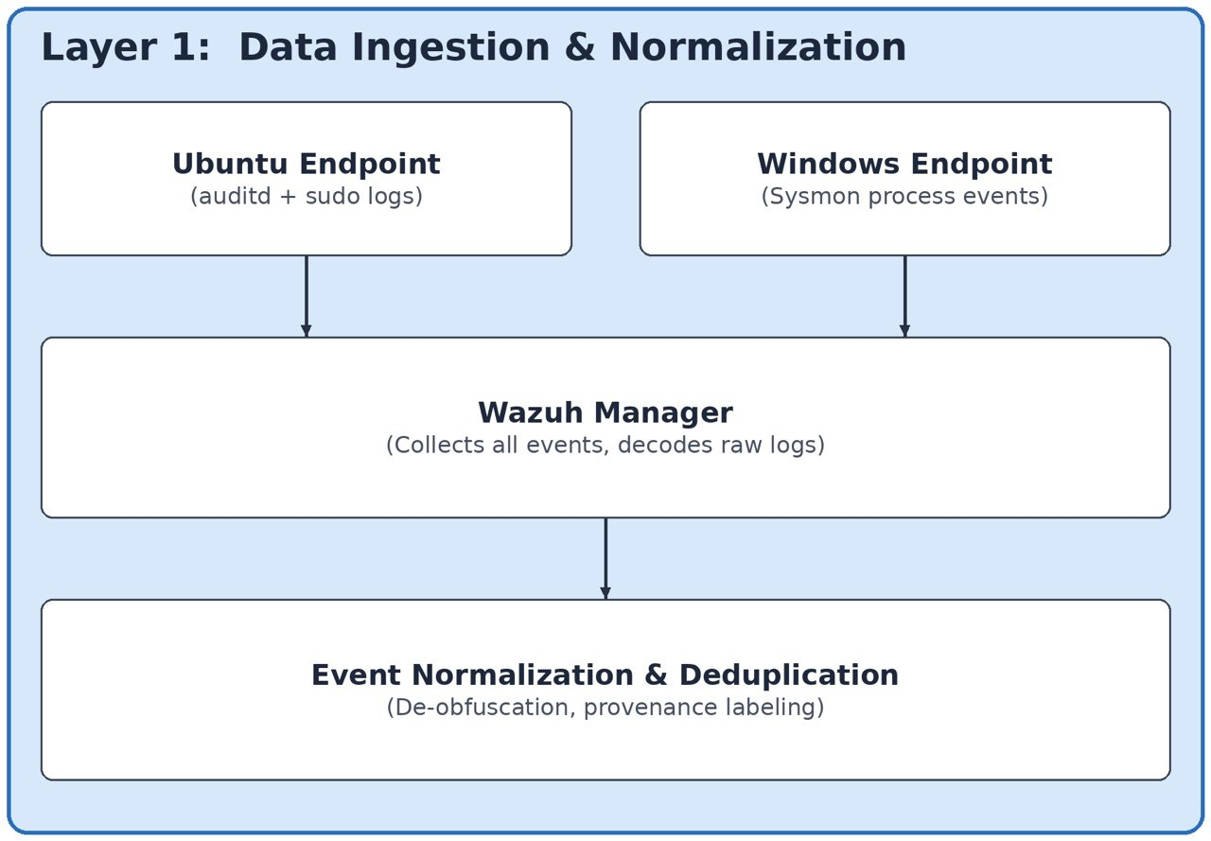
LOTL-ARIA — Graduation Project Seminar · Syrian Private University, 2026
8

Slide 9
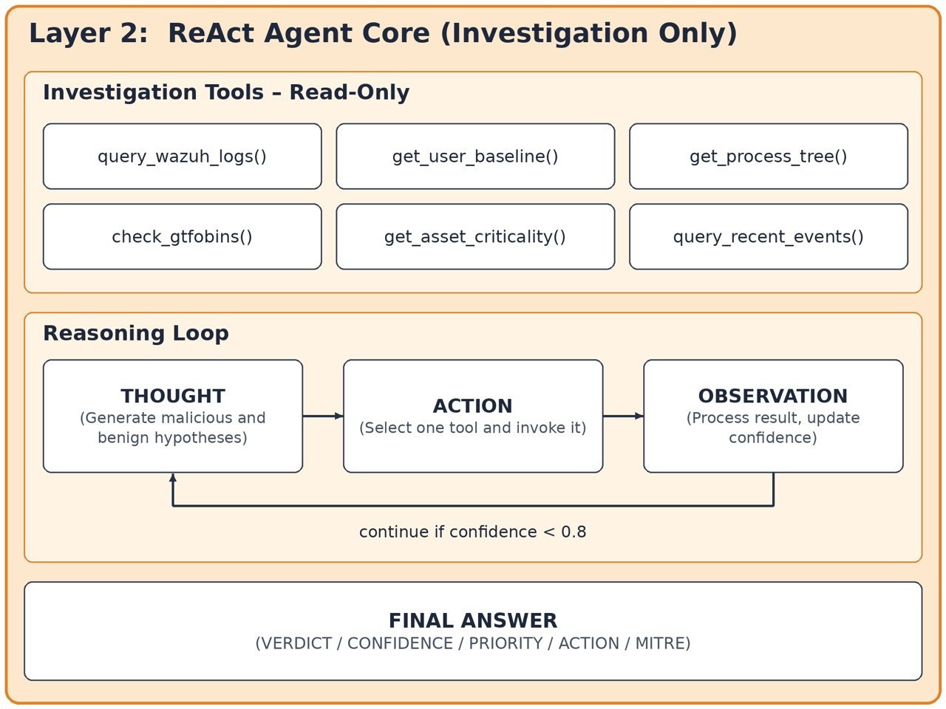
LOTL-ARIA — Graduation Project Seminar · Syrian Private University, 2026
9

Slide 10
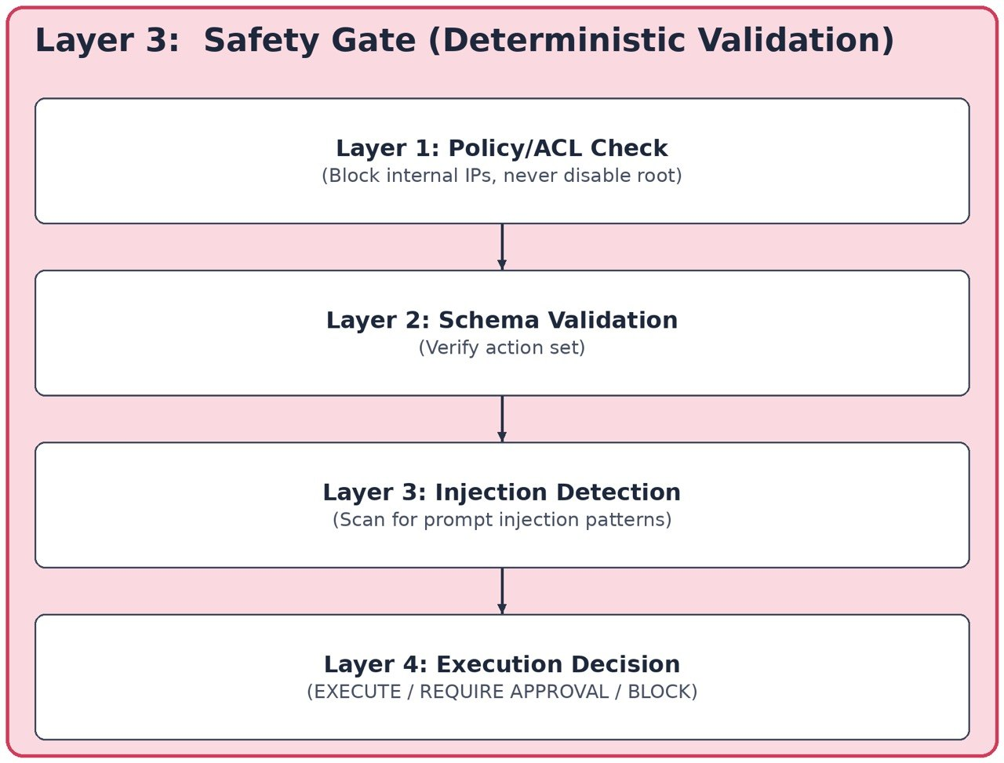
LOTL-ARIA — Graduation Project Seminar · Syrian Private University, 2026
10

Slide 11
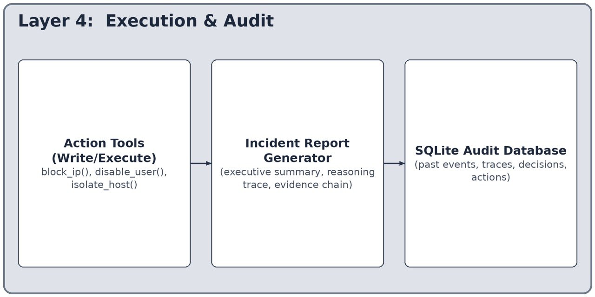
LOTL-ARIA — Graduation Project Seminar · Syrian Private University, 2026
11

Slide 12
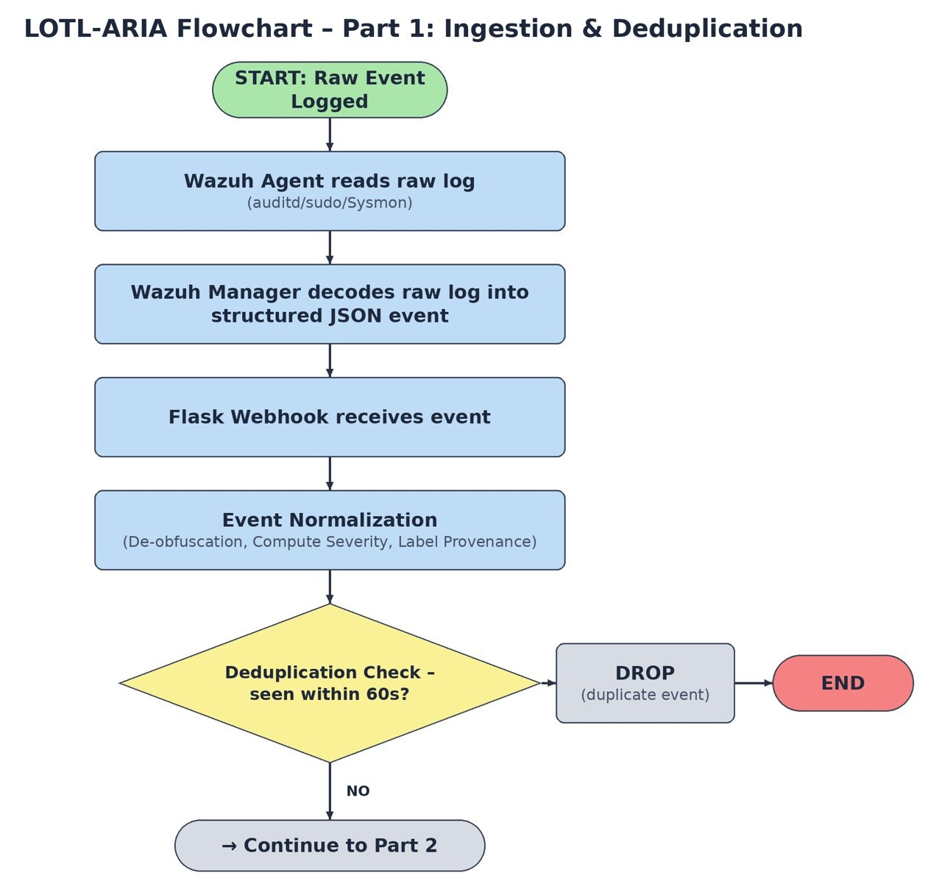
LOTL-ARIA — Graduation Project Seminar · Syrian Private University, 2026
12

Slide 13
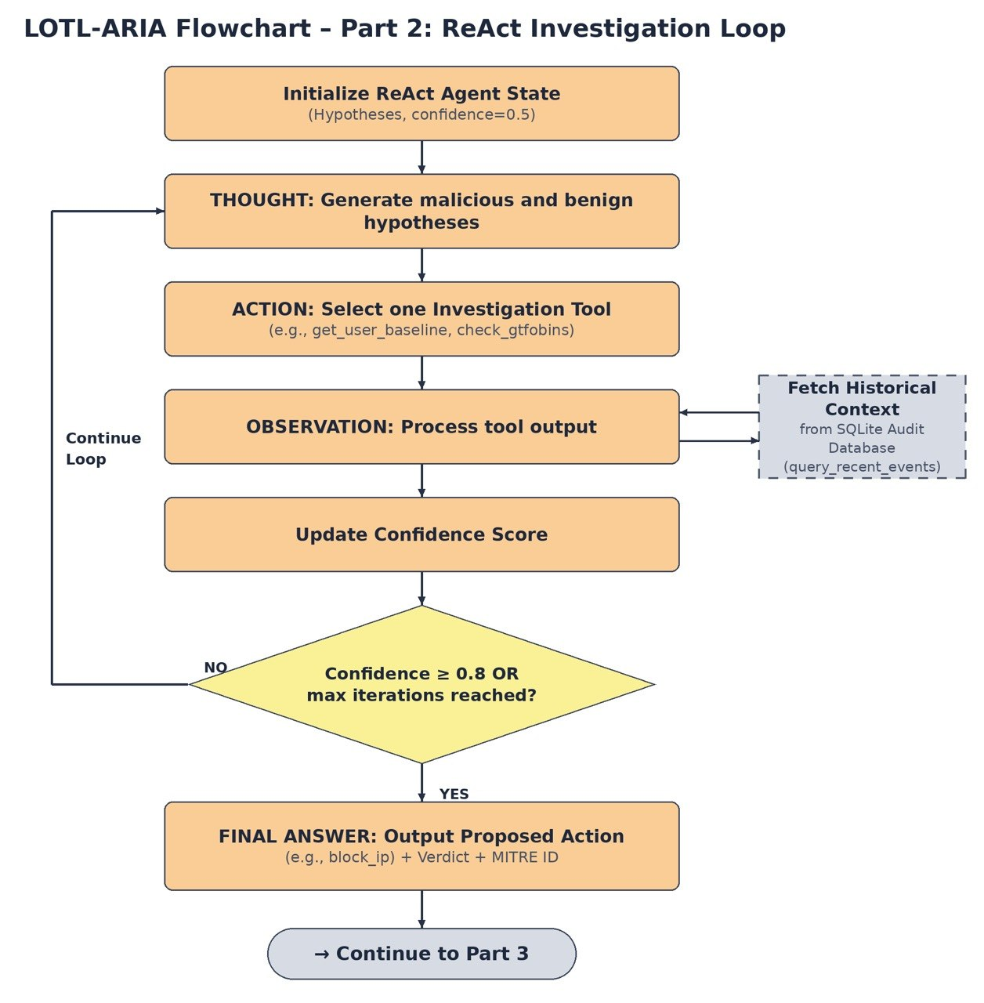
LOTL-ARIA — Graduation Project Seminar · Syrian Private University, 2026
13

Slide 14
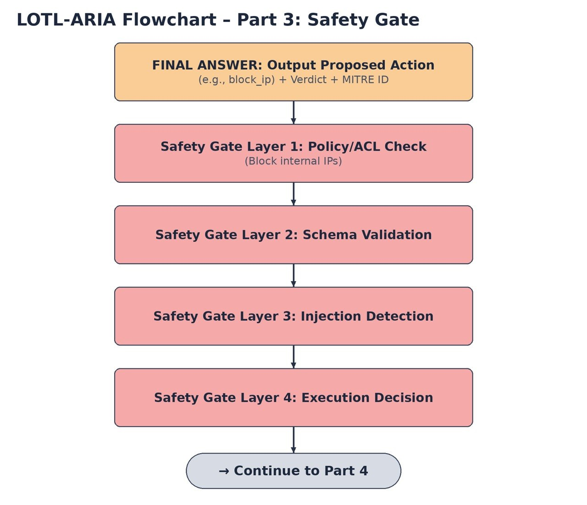
LOTL-ARIA — Graduation Project Seminar · Syrian Private University, 2026
14

Slide 15
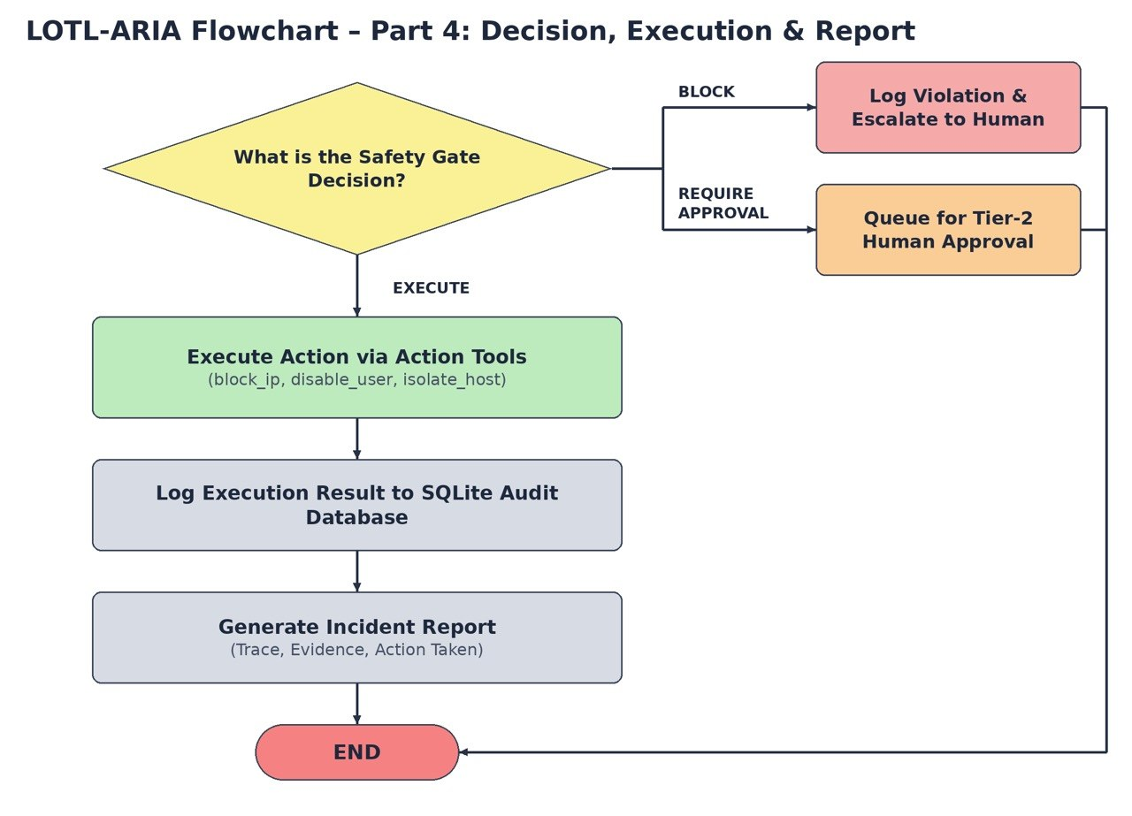
LOTL-ARIA — Graduation Project Seminar · Syrian Private University, 2026
15

Slide 16
Tools & Technologies
Wazuh SIEM — Log collection, alerting, response hooks
Python & LangGraph — Core implementation, agent orchestration
GPT-OSS via Ollama — Local, private LLM inference
VirtualBox — Ubuntu, Kali, Windows labs
SQLite — Investigation and audit storage
LOTL-ARIA — Graduation Project Seminar · Syrian Private University, 2026
16
Notes:
Our stack: Wazuh SIEM for log collection, alerting, and response hooks; Python with LangGraph for the core implementation and agent orchestration; GPT-OSS served through Ollama for fully local, private LLM inference — no data leaves the lab; VirtualBox for our Ubuntu, Kali, and Windows test environments; and SQLite for investigation and audit storage.

Slide 17
Conclusion
LOTL-ARIA makes autonomous SOC agents Safe, Reliable, and Context-aware.
It moves the industry from passive detection to transparent investigation and controlled response.
Safe
Deterministic Safety Gate
Reliable
Auditable reasoning
Context-aware
Full provenance chain
Thank You — Questions?
LOTL-ARIA — Graduation Project Seminar · Syrian Private University, 2026
17
Notes:
To conclude: LOTL-ARIA makes autonomous SOC agents safe, reliable, and context-aware — moving the industry from passive detection to transparent investigation and controlled response. The Safety Gate keeps it safe, the audit trail keeps it reliable, and the ReAct investigation keeps it context-aware. Thank you — we are happy to take questions.

Slide 18
References
[1] T. Zhu, J. Zheng, T. Chen, M. Lv, C. Xiong, Z. Weng, and X. Zheng, "Lotldetector: living off the land attacks detection system based on feature fusion," Cybersecurity, vol. 9, article no. 4, Jan. 2026. [Online]. Available: https://link.springer.com/article/10.1186/s42400-025-00531-w
[2] NDSS, "RACONTEUR: LLM-Based Shell Command Explanation," in Proc. Network and Distributed System Security Symposium (NDSS), 2025. [Online]. Available: https://www.ndss-symposium.org/wp-content/uploads/2025-s798-paper.pdf
[3] Springer, "Automated Risk Assessment of Shell-Based Attacks Using a LLM," in Proc. Springer Conference, 2025. [Online].
[4] MILCOM, "SENTINEL: LOTL Failure Modes," in Proc. IEEE Military Communications Conference (MILCOM), 2026. [Online]. Available: https://arxiv.org/abs/2609.14593
[5] Springer, "Supervised Learning for LOLBins Detection in Linux Machines," in Proc. Springer Conference, 2026. [Online]. Available: https://link.springer.com/chapter/10.1007/978-3-032-12876-8_26
[6] BlueSTAR, "BlueSTAR: Rules-First Tiered Architecture," arXiv preprint arXiv:2609.11852, 2026.
LOTL-ARIA — Graduation Project Seminar · Syrian Private University, 2026
18
Notes:
This flowchart traces one event end to end. Wazuh reads the raw log, the manager decodes it, our Flask webhook receives it, and we normalize, de-obfuscate, and de-duplicate. The ReAct agent then loops: THOUGHT generates malicious and benign hypotheses, ACTION invokes one investigation tool, OBSERVATION updates confidence. When confidence reaches 0.8, the agent proposes a final action, which must pass all four Safety Gate layers before execution — or it is blocked, escalated, or queued for human approval. Every decision lands in the audit database.

Slide 19
References
[7] J. Roy and S. K. Singh, "AgentSOC: A Multi-Layer Agentic AI Framework for Security Operations Automation," in Proc. IEEE 5th Int. Conf. Artificial Intelligence in Cybersecurity (ICAIC), Houston, TX, USA, Feb. 2026. [Online]. Available: https://doi.org/10.1109/ICAIC67076.2026.11395783
[8] Kim, "Hyper-Automation SOAR with Agentic AI," MDPI Journal, vol. 16, no. 5, 2025. [Online]. Available: https://www.mdpi.com/2078-2489/16/5/365
[9] GIRA, "GIRA: Safety Gate for Incident Response Agents," in Proc. ICLR 2026 Workshop, 2026. [Online]. Available: https://openreview.net/attachment?id=LBt5eX6OKx&name=pdf
[10] "Poisoning the Watchtower: Log-Based Prompt Injection Against SOC LLMs," arXiv preprint arXiv:2605.24421, 2026.
[11] "LogJack: Injected Commands Executed by Tool-Using Agents," arXiv preprint arXiv:2604.15368, 2026.
LOTL-ARIA — Graduation Project Seminar · Syrian Private University, 2026
19

