Slide 1
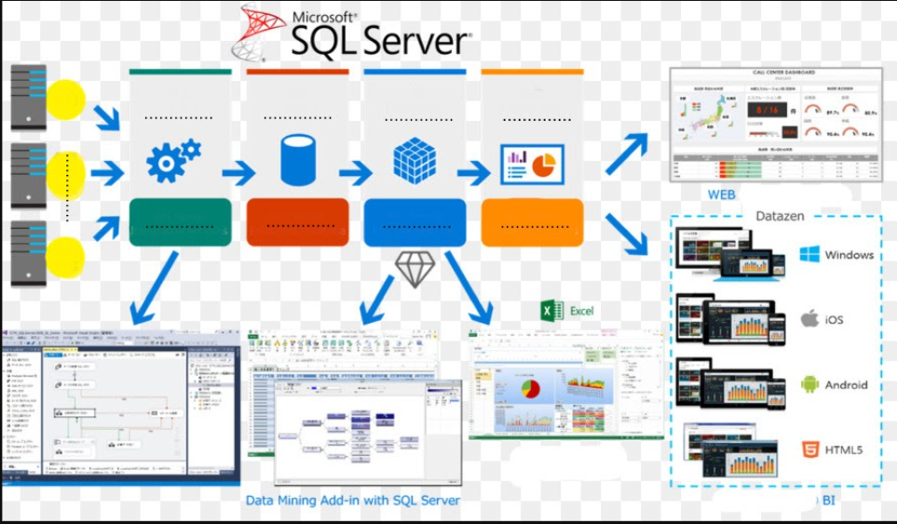
SSIS
SSMS
SSAS
SSRS
integration
management
analysis
Reporting

