Slide 1

Network-flow in machine learning
Presented by : Omar Belal
Supervised by : Mr.naveed Ahmed

Slide 2

Problems to tackle using net-flow
Network attacks classification
fingerprinting
Botnet detection in IoT
Malware detection
APT DETECTION
Zero Day attacks detection
….

Slide 3
Phases of Net-flow analysis
Define your pipeline
Collect data
Convert to ready and extract features format
Data preparation and preprocessing
Model selection
Evaluation
Notes:
https://www.unb.ca/cic/datasets/index.html

Slide 4
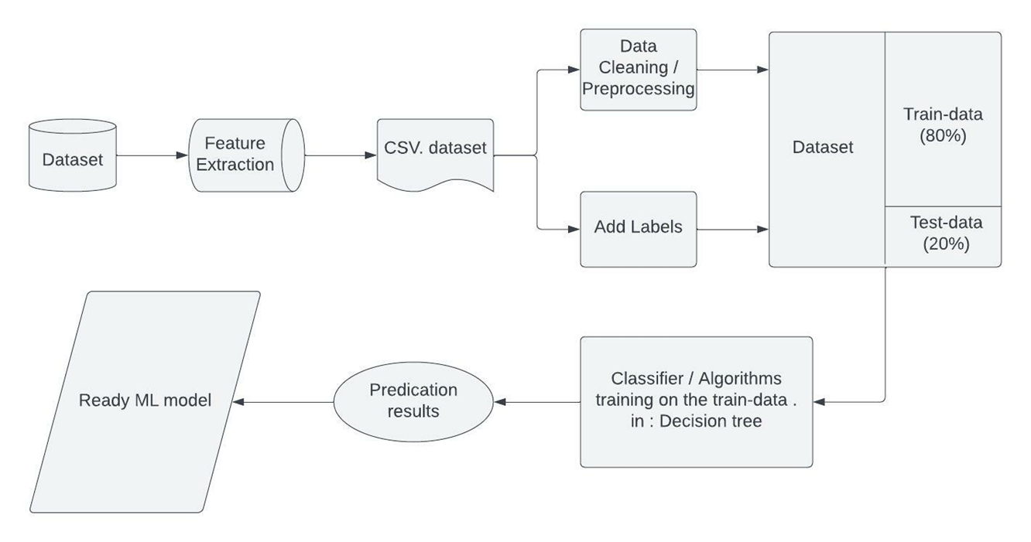
Example : Pipeline Creation
Notes:
https://towardsdatascience.com/master-the-most-hated-task-in-ds-ml-3b9779276d7c

Slide 5
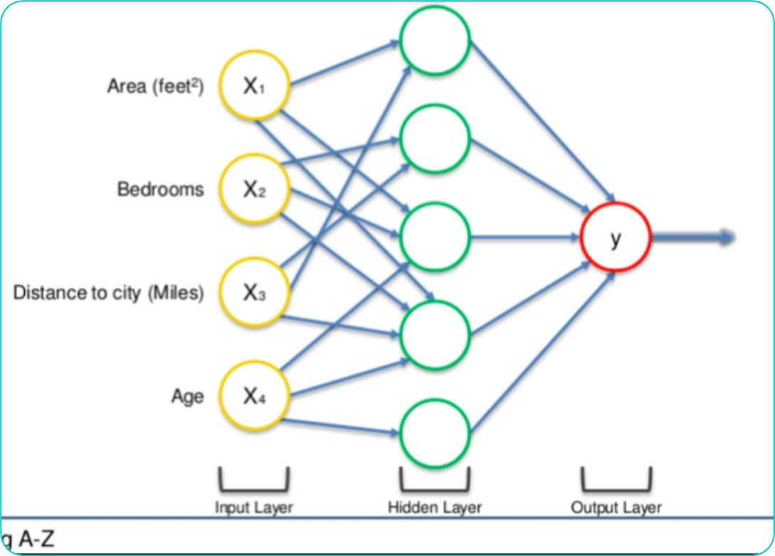

Neural Network (NN)
W
Independent variables (features)
Weights are how Neural Networks learn
Output could be :
Continuous
Binary
Categorical
Notes:
https://www.superdatascience.com/blogs/the-ultimate-guide-to-artificial-neural-networks-ann

Slide 7
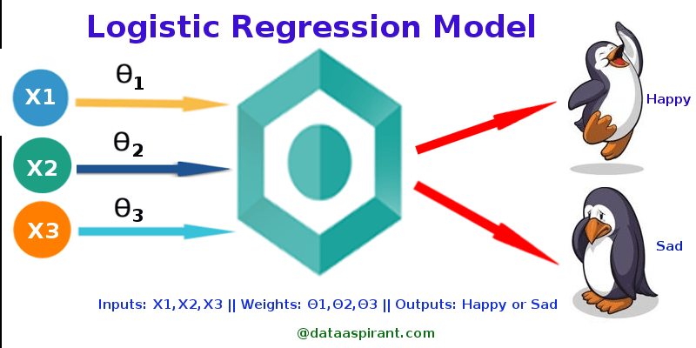

Slide 8
Feature examples
Problems | Feature name | Feature Description
OS fingerprinting | t c p . f l a g s . ack | TCP reset (RST flag)
 | ip.ttl | Time to live
 | ip.len | IP packet length
Network attack classification | ack_flag_cnt | ACK flag packets
 | fl_dur | Flow duration
 | fl_pkt_s | number of packets transferred per second

Slide 9
Hands-on
Using : pandas , seaborn , matplotlib , and NumPy ….
Steps of data Pre-processing
Do some EDA ( Exploratory Data Analysis )
Split the dataset into training and testing sets
Use logistic regression algorithm
Random forest algorithm
ANN (Dense) model
Store the model as pickle

