Slide 1

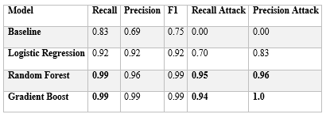
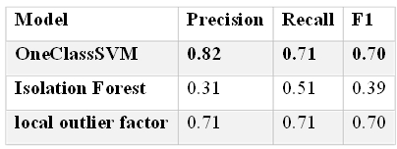
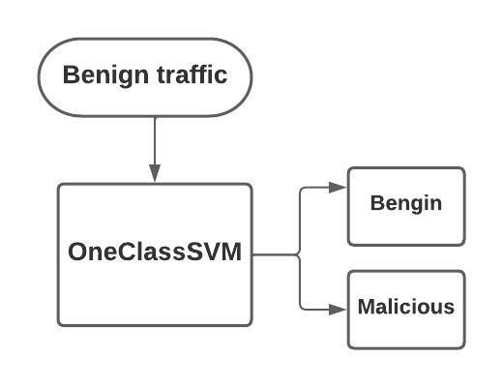
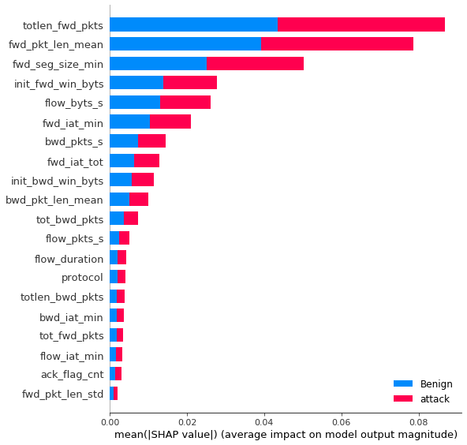
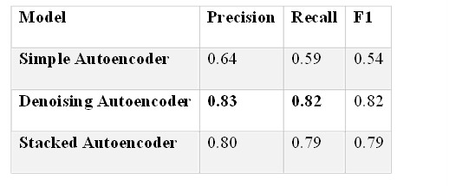
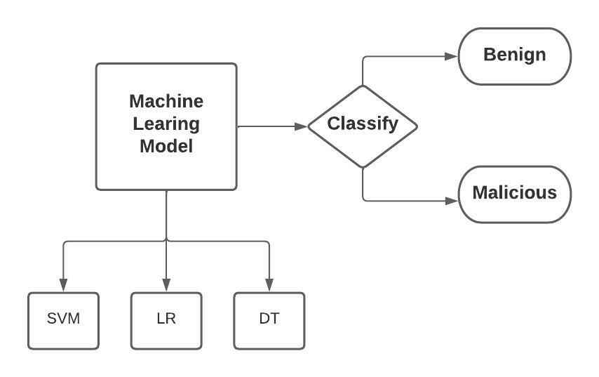
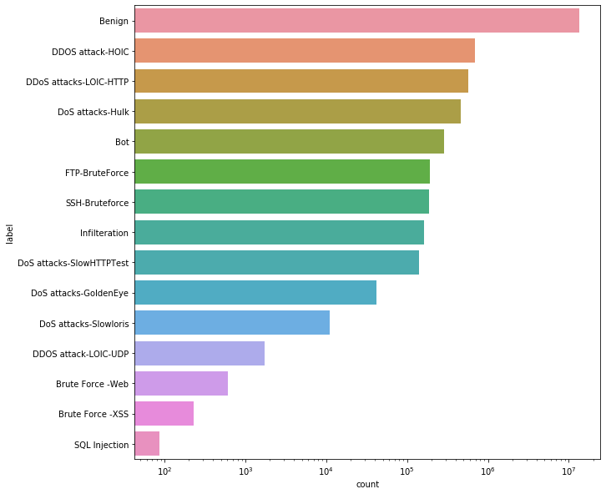
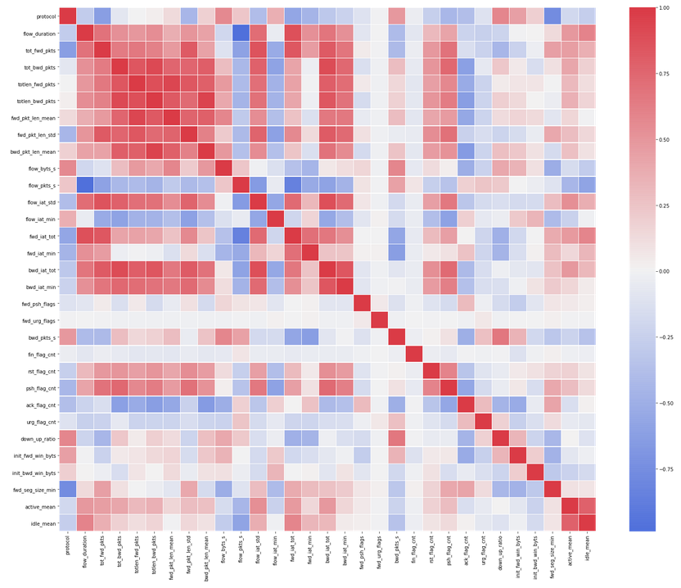
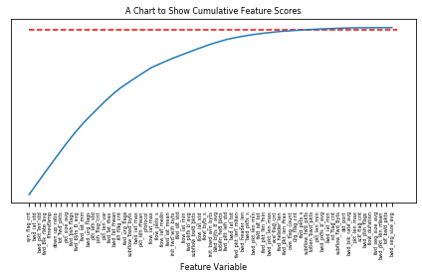
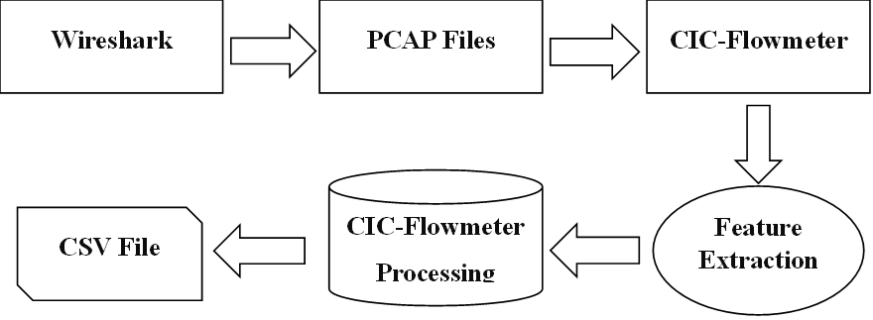
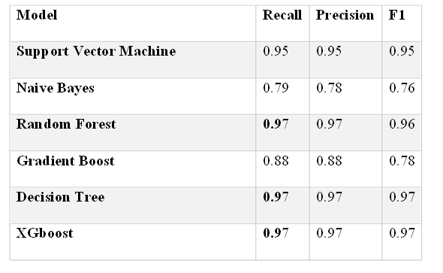
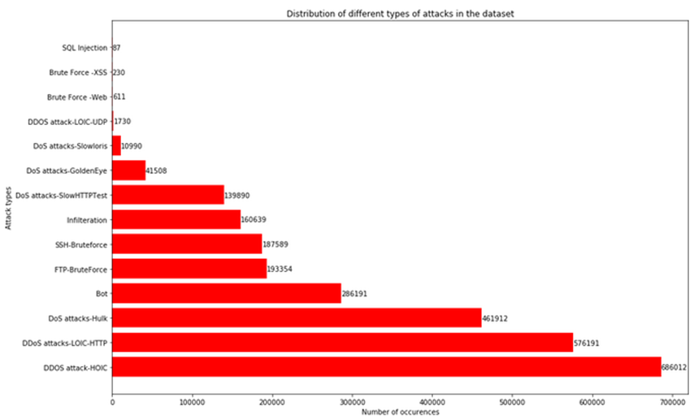
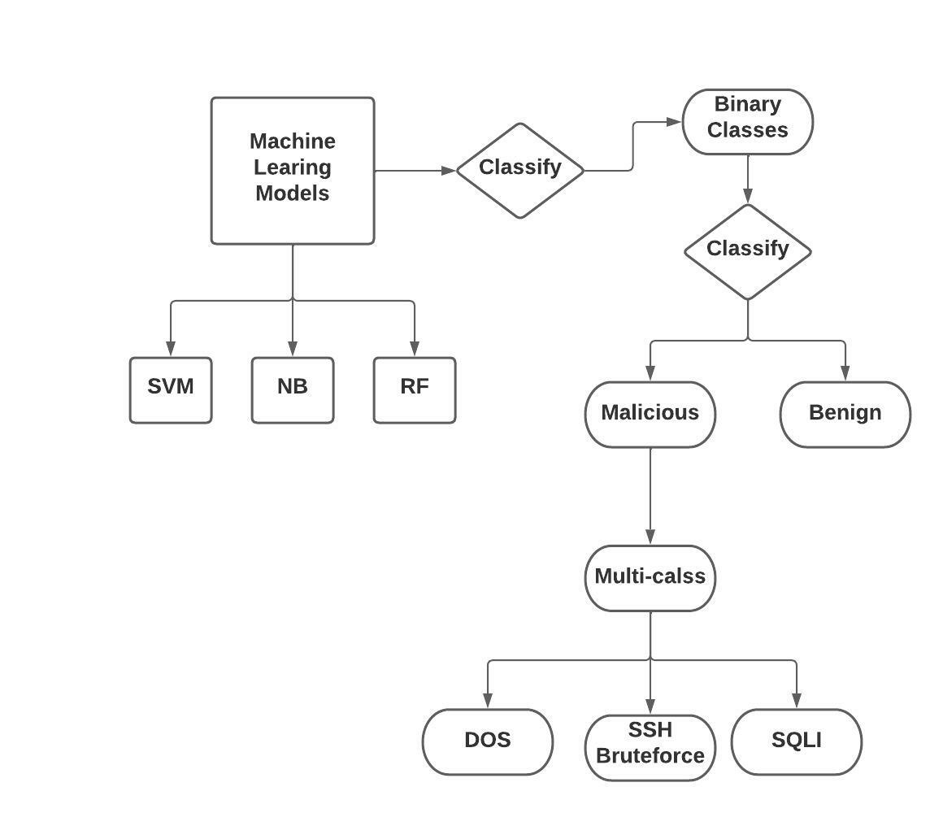
Machine Learning Framework for Intrusion Detection Systems
Naveed Ahmed , Mohammed alkhatib , Omar Belal . Bayan Ghannam . Rafif Altayar . Aghiad Massarani . Abdullah Basalama
University Of Prince Mugrin , Medina KSA
Abstract
Methodology (Cont'd)
Results
Results (Cont'd)
Machine learning algorithms are being consistently used to enhance intrusion detection systems (IDS) capabilities by applying several useful techniques that should be expected to allow high quality detection and classification methodologies for the corresponding network traffic in both host (HIDS) and network (NIDS) based systems. Yet researchers face different challenges while developing machine learning IDS systems as the surface of cyber network attacks is changing rapidly in today's age. That will represent the challenge of finding a high-quality and updated analysis of newly created and publicly available malicious network datasets. In this study, a detailed analysis of three classification phases is performed on the CICIDS-2018 dataset [1] (the dataset generated by Canadian institute researchers where the whole network structure is created on an AWS cloud service provider).
Anomaly detection in one class classification phase provides comprehensive results using three different architectures of autoencoder (a type of anomaly detection method that utilizes the benefits of encoder and decoder functionalities). Denoising, Undercomplete, and Stacked All the autoencoder model’s experiments ran with 50 epochs. In comparison with Autoencoder deep learning models, three classical machine learning algorithms have been created to ensure the usability of unsupervised learning and novelty detection in network traffic analysis using Isolation Forest, One Class SVM, and Local Outlier Factor (LOF).
In terms of supervised learning, a comparison of five classical algorithms has been conducted to finalize the best and final estimator in the binary classification phase using algorithms represented as logistic regression, random forest, decision tree, and Catboost (a variation of the gradient boost algorithm).
Final analysis was provided as a multiclass-classification phase that was performed only on the corresponding malicious attack labels with ignorance of benign network traffic. A total of five classical machine learning algorithms (XGboost, Random Forest, Decision Tree, SVM, and Naïve bayes) have been trained on the training malicious set only. All the experiments of binary, multiclass, and one-class algorithms were enhanced using two feature selection methods: filter correlation and selectKbest, in order to identify the final best predictors (features) from the whole dataset. Optimal model parameters were chosen for the Catboost estimator using Grid Search hyperparameter optimization. Through various experimental phases, it was confirmed that the Catboost algorithm performed well in comparison with all the classical and deep learning autoencoder models, with a recall and precision of 0.99 percent and an F1 score of 0.98.
Finally, we have proposed a PoC script that presents a simple classification pipeline starting with the distinguishment of the network traffic from an input CSV file that will be generated from the CICFlowmeter tool (feature extraction tool). Our final binary estimator (Catboost) is going to classify the network packets (instances) as either malicious or benign. Then, if any malicious pattern is found in the CSV file, the pipeline will continue to the next multiclassification phase to reveal the attack type using the XGBoost algorithm.
The following section describes all three phases of the machine learning algorithms. Following implementation will highlight the creation of the best performing algorithms in each phase, and a final estimator will be chosen from each phase for future deployment.
It is useful to note that our main target here is to perform multiple algorithms and follow a try-and-error approach to produce the best result possible from the running experiments.
Most of the classification algorithms are assigned to do only one type of classification unless some special parameter is passed to ensure the right type of classification. Another major component that must be clear to the machine learning classifier is the labels assigned in the training and testing, which must be either binary for a binary classifier or multiclass in terms of a multiclassification classifier [2]. In a final stage, if the target experiment is anomaly detection, we will only apply one class of the labels during the training process where there is mostly benign traffic.
Using publicly available datasets, we were able to evaluate the performance of both classical machine learning models and the autoencoder on three different structures. This also allows us to find the optimal model that could generalize well and could be considered the baseline model for our research in terms of all phases: binary, multiclass, and one-class classifications. Both the CICIDS-2017 [3] and main CICIDS-2018 datasets were combined to evaluate and optimize the final estimator. The datasets are split into train, test, and validate sets, and the final features are extracted using the filter correlation method. Train sets were used to train all the machine learning models for both benign and malicious traffic, except for the anomaly detection phase, which only had one type of class that was identified as the benign class following the novelty detection approach. The validated and test sets are used to evaluate the model performance in all phases by combining the numeric class labels and prediction data.
we have tested several machine learning models that will provide binary class behavior in the training process, for a total of five models: SVM, DT, RF, Catboost, and LR. They have been tested to come up with the best performing model as the final estimator for the experiment, where the thing was determined by the Catboost model with the highest 99% weighted recall and precision.
One of the most resilient and practical methodologies in anomaly detection in general is one class classification. In the following section, we are only dealing with our benign traffic in the training phase. Basically, the algorithm will take the benign traffic as an input and perform the necessary training afterwards. We combine both training and testing to test the model if they can spot the outliers or abnormal behaviors in the testing or validation phase.
SHAP analysis provides us with the features that have the highest influence on the predictions of the model:
The provided data tells us that anomaly detection [4] methods weren’t the best option for real-life implementation. Surprisingly, the classical machine learning models in the previous experiments outperform the 3 structures of autoencoder neural networks. However, the best advantage of this process is that anomaly detection can take only one class/label during the training, which is a very good option in the absence of malicious network traffic during the training phase.
In general, binary classification algorithms represent a quick and precise insight of the required precision. In this specific problem, we are targeting binary prediction models that will give us a precise result of the input traffic to know whether it is benign or suspicious traffic. Moreover, this is the first practical face of our project pipeline that will come up as the first output to the user, and it could be implemented in different machine learning algorithms to produce the best high-performing model.
The below heatmap represents the correlation after removing all the correlated features by iterating over the whole dataset columns and only selecting certain selected features to use in the training process.
a clear visualization of the best selected 40 features by the identifying k value with k = 40 and Score_fun = chi2, which is a unique parameter used for non-negative features in multiclass classification problems. The selected features have been selected according to the k score.
Conclusion
Intrusion detection systems (IDS) are such a useful methodology to catch and analyze network attacks by performing network traffic monitoring. In this study, we took an extra step to leverage AI in IDS technologies by presenting a proof of concept of three different classification techniques (Novelty detection, binary class, and multiclass classifications) on network traffic at the NetFlow features level. Afterwards, we examined the performance of a total of 12 classical machine learning and deep learning models by splitting the dataset into training, validation, and testing. Finally, we have compared all machine learning models to the autoencoder different variations, where we observed a significant leverage of the machine learning algorithms on the deep learning autoencoder models. For future work, we would like to test different deep learning models against the classical algorithms, implement a wrapper feature selection method, and go for further real-live deployment of an AI-based IDS system.
Methodology
In order to get a high-level overview of the project implementation steps, the project will be divided into eight different milestones, starting from data collection, data preprocessing, EDA, feature selection methods, binary classification, multiclass classification, anomaly detection, and finally a model deployment for the sake of proof of concept (POC).
By using the CICFLOWMETER tool, the researchers extracted eighty-five features from the collected PCAP files so they could be utilized in the ML models. Table 5 gives a clear description of each feature extracted from the PCAP files to CSV useable files.
After the completion of the first phase: binary classification, in order to deal with our implemented dataset and ensure high model performance, we will transfer all the attack traffic to an external CSV file and eliminate any benign or normal traffic that could appear in the multiclass phase. This section, however, goes deep into only the best performing models in our multiclass experiment.
Random Forest and XGBoost are two of the most efficient models in the multiclassification phase, and they are described in detail below, with XGBoost taking a more technical approach because it outperforms all other multiclass models in our multiclass prediction phase.
Multiclass classification has been tested with only a total of fourteen attack traffic classes by eliminating the benign traffic class in the first place. Using our classical ML approach, all five multiclass algorithms (DT, RF, NB, SVM-RBF, XGBoost) were evaluated to finalize the best performed estimator in the multiclass phase, which was identified as XGBoost with the highest accuracy of 97%.
References
[1] Iman Sharafaldin, Arash Habibi Lashkari, and Ali A. Ghorbani, “Toward Generating a New Intrusion Detection Dataset and Intrusion Traffic Characterization”, 4th International Conference on Information Systems Security and Privacy (ICISSP), Portugal, January 2018
[2] A. Ferriyan, A. H. Thamrin, K. Takeda, and J. Murai, “Generating network intrusion detection dataset based on real and encrypted synthetic attack traffic,” Appl. Sci., vol. 11, no. 17, Sep. 2021, doi: 10.3390/app11177868.
[3] R. Panigrahi and S. Borah, “A detailed analysis of CICIDS2017 dataset for designing Intrusion Detection Systems,” Int. J. Eng. Technol., vol. 7, no. 3.24 Special Issue 24, pp. 479–482, 2018.
[4] Lilian Weng, “denoising autoencoder.” https://lilianweng.github.io/posts/2018-08-12-vae/.

