Slide 1

Introduction to Flutter

Slide 2


Flutter
Flutter is framework created by google.
A cross-platform framework used to develop application for
Android
iOS
Web
and Desktop
Dart Programming language

Slide 3


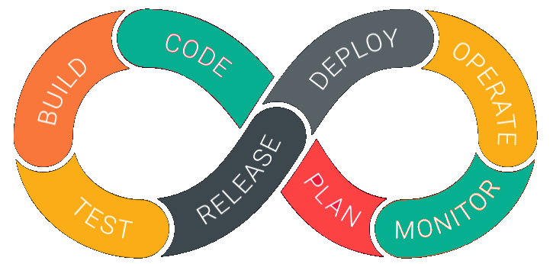
Why Flutter for App Development
1. Open Source | 2. Faster development Cycle | 3. Super Productive
Flutter is Open-Source framework
Therefore, anyone can use it for any given purpose.
Flutter is so fast that it takes less then 30 sec for first full compilation.
Comes with Hot-Reload & Hot-Restart.
Comes with Hot-Reload & Hot-Restart.
Due to Stateful widget hot-reload feature Flutter is very fast iterative coding style.

Slide 4



Why Flutter for App Development
4. Ease to learn & code sharing | 5. Widget Libraries | 6. Community Support
Any one who have basic knowledge of OOPS & UI Designing can easily learn Flutter.
Ready to use widget, Flutter have many widget that you can use to build flutter application.
Such as : http, get, share plus, toggle switch etc.
Flutter Community is bit small if we compare with other framework like React.
But Flutter is grow very fast then other framework.

Slide 5
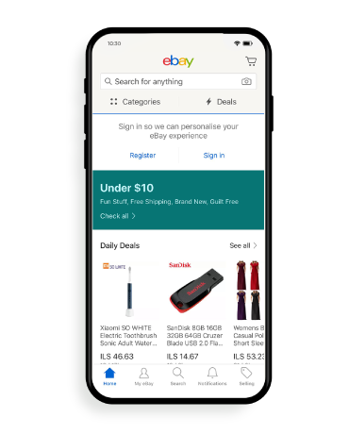
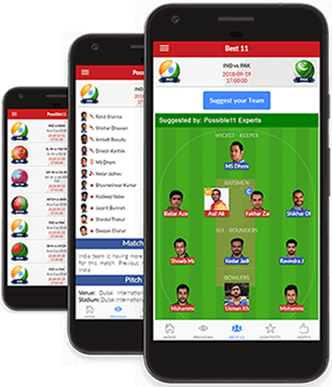
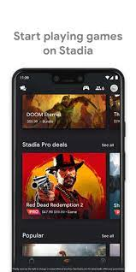
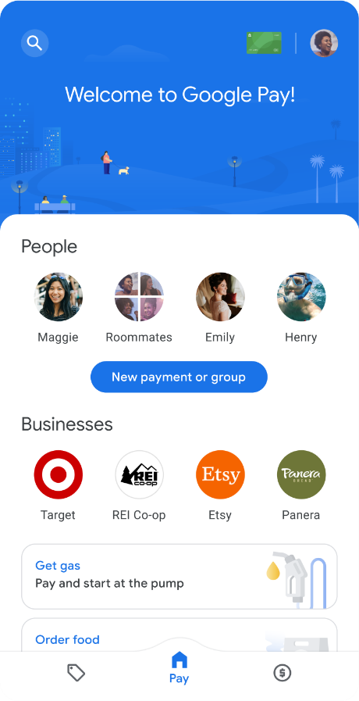
Apps that are build using Flutter
Stadia gaming platform.
Dream 11
eBay
Google Pay

Slide 6

Feature of Flutter
Cross Platform App Development.
Easy access to Native Features.
Minimal Coding.
Fast Development
Hot Reload & Hot Restart

Slide 7
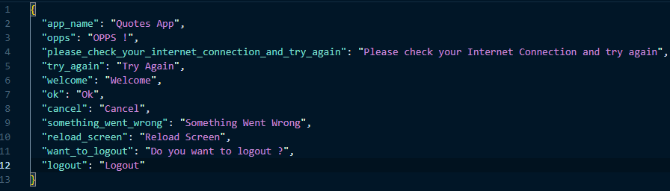
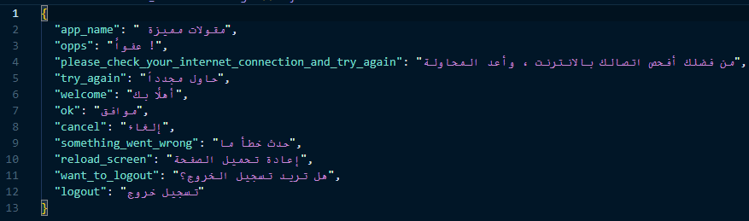
Collections: Maps
For Example :
Translation from English To
Arabic
The Map object is a simple key/value pair
Keys and values in a map may be of any type
A Map is a dynamic collection. In other words
Maps can grow and shrink at runtime.

Slide 8
Object-Oriented Programming

Slide 9

OOP ( Object-Oriented Programming ):is a core concept to design programs using Classes and Objects
Class is like a blueprint for creating objects.
A-Class has a constructor/initializer for creating objects.
An object is an instance نسخة او اصدار of a class
Instance Classes also have properties and methods that each object can utilize يستخدم
4 Pillers اعمدة of Object-Oriented Programming
we will know later.........

Slide 10

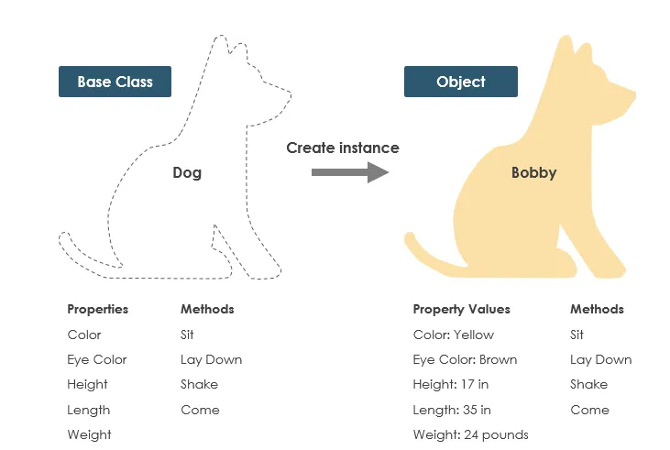

Slide 11

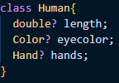



Syntax
Classes & Objects
We consider that the Class is the human being and that the Object is a person. Let it be for example.
You have it for example.
You have all the attributes which are length and color,
the hands, the legs, and so on. "Methods
Structure
Structure
Logic
Logic

Slide 12
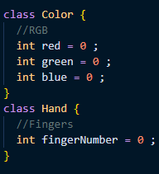
When we see Details
, we see Class
As long as it’s simple , it’s field or attribute

Slide 13


Stack VS Heap

Slide 14
Stack
Like a Stack of books
We always say First-in-Last-out
Any method we call is inside it
Also contains Data types with Single-value
Local Variables

Slide 15
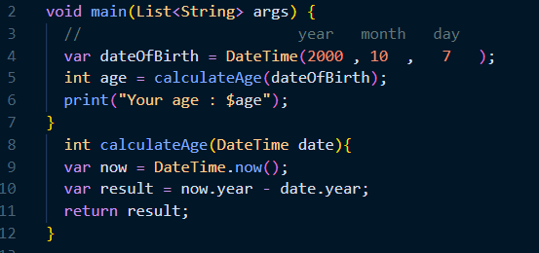
calculateAge(DateTime date)
var now
var result
print("Your age : $age");
Void main(List<String args>)
var dateOfBirth
int age
Stack

Slide 16
print("Your age : $age");
Void main(List<String args>)
var dateOfBirth
int age
Stack
Heap

Slide 17
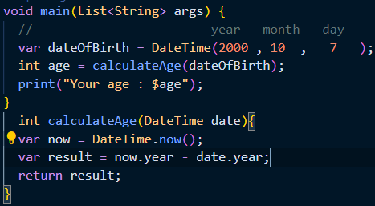
calculateAge(DateTime date)
var now
var result
DateTime(2023,3,13)
Void main(List<String args>)
var dateOfBirth
int age
Stack
Heap

Slide 18
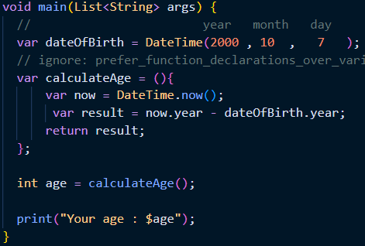
dateOfBirth
DateTime(2000,10,7)
calculateAge(DateTime date)
var now
var result
DateTime(2023,3,13)
Void main(List<String args>)
var dateOfBirth
int age
Stack
Heap

Slide 19
THANK YOU

