Slide 1

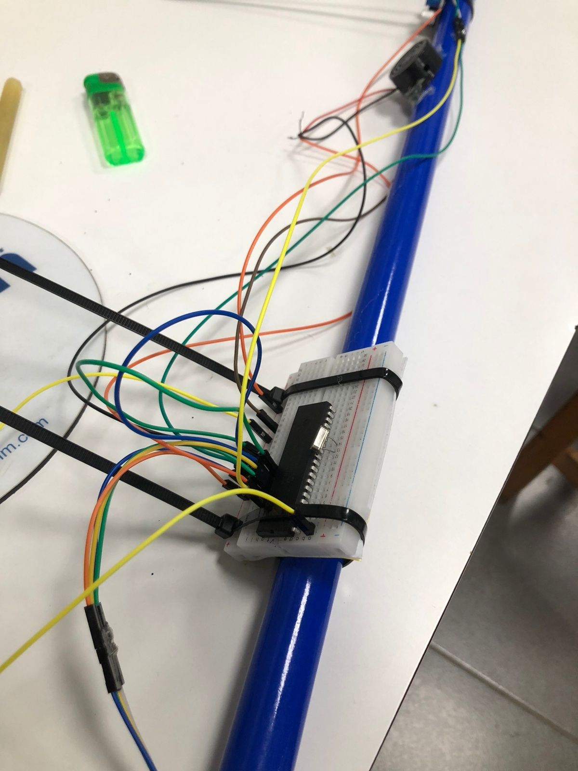
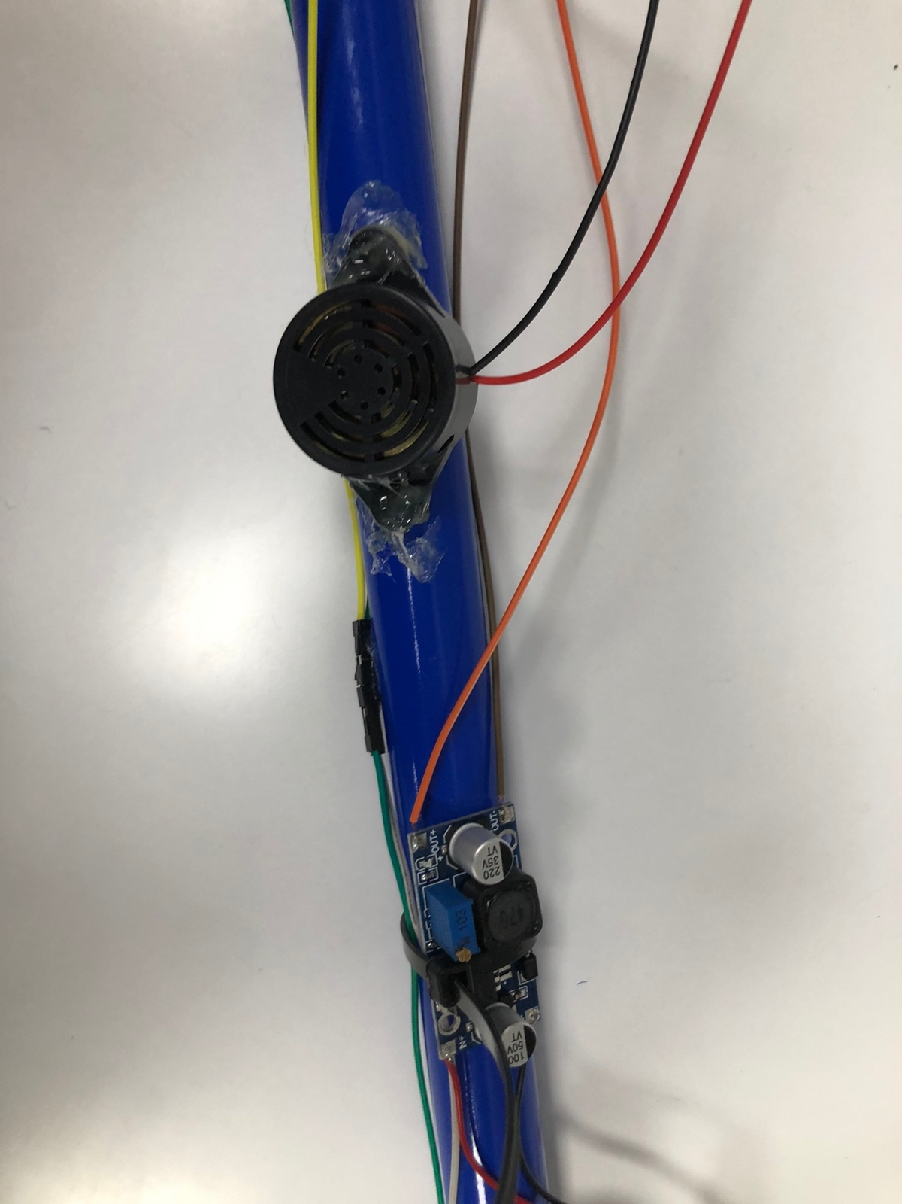
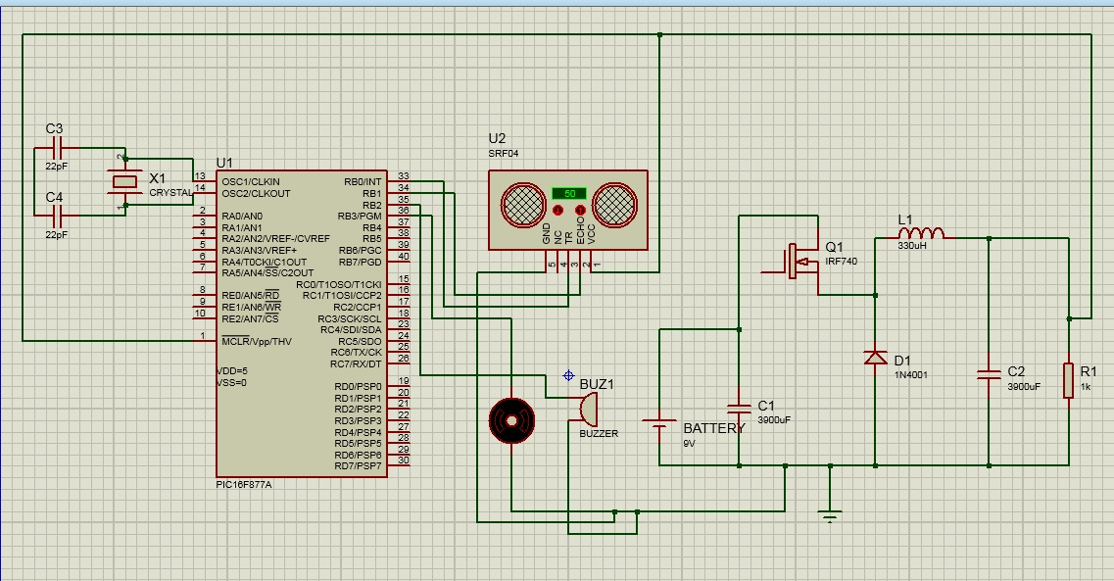
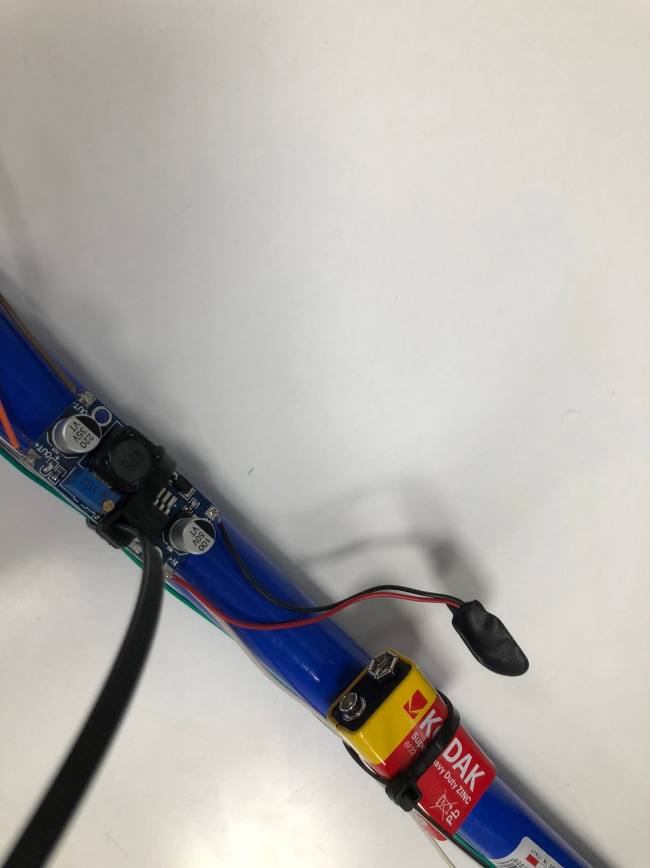
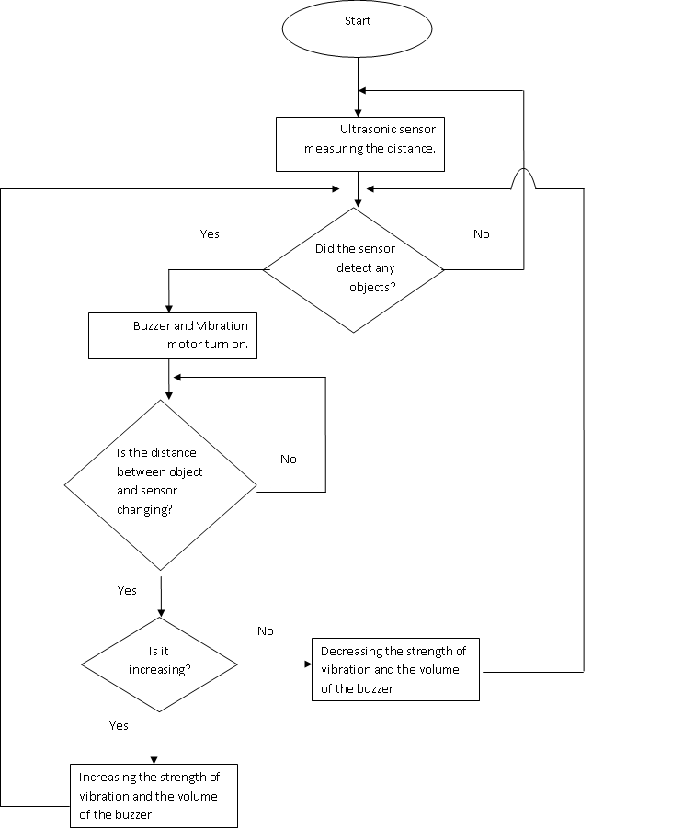
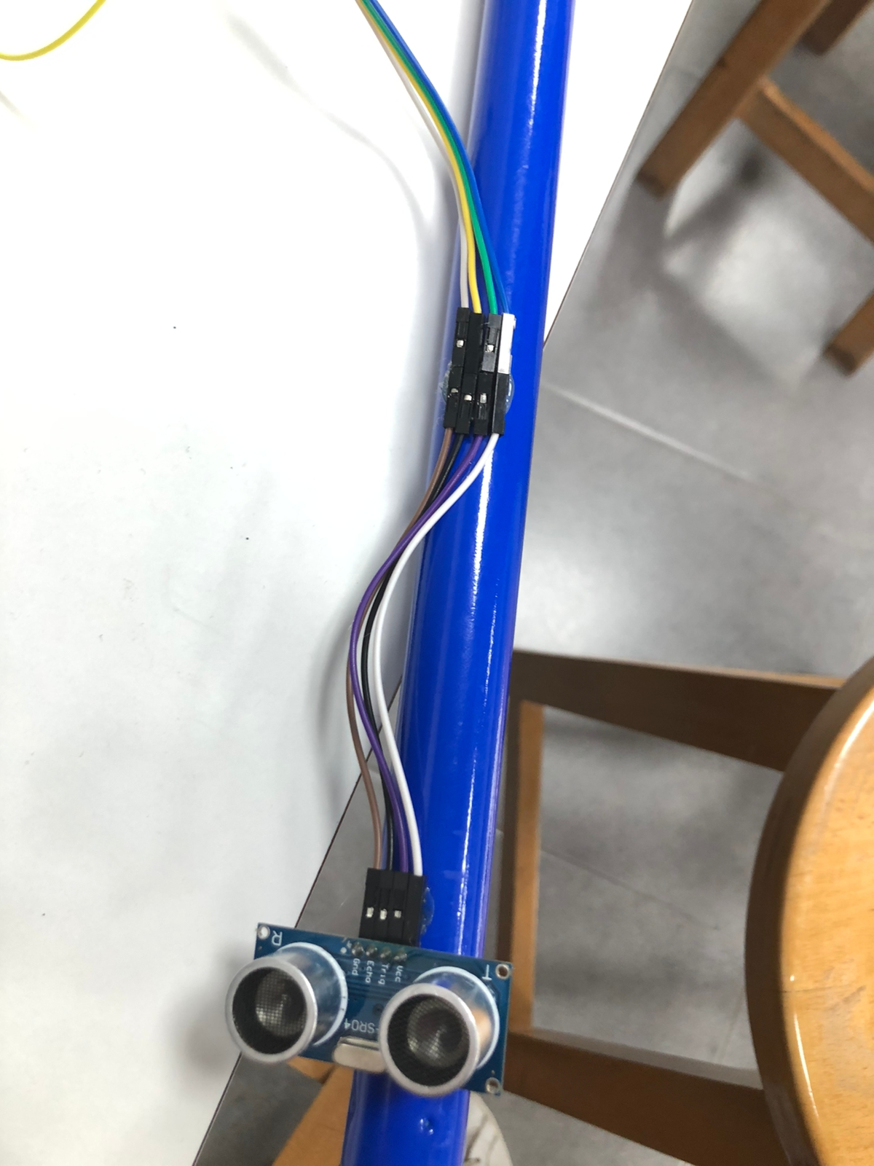
Smart White Cane
F.Sharaiha, A.Arafeh and O.Zalloum
Supervisor: Dr. Belal Sababha Embedded Systems Final Design Project, Fall 2022 King Abdullah II School of Engineering
Princess Sumaya University for Technology
Introduction
Blind people are some of the most unfortunate people on this planet and we want to make it easier for them to navigate around. One of the most helpful tools that was created for them is the white cane but still it didn’t solve everything. So we thought of a way to improve on it making it more useful and making it easier for them to walk around without worrying about hitting any objects in front of them, we even took it a step further in case the person was not only blind but deaf too by adding a vibrator motor with a buzzer so the user will be alerted whatever the circumstances that he’s in. The cane will release a sound and vibrate once it detect s an object in front of it, the vibration and the sound will continue to increase as long as the cane is still approaching the object.
Results
Figure 3: Breadboard connection.
Figure 4: Buzzer Placement
Figure 5: Buck converter connection with voltage source.
Figure 6: Ultrasonic sensor placement.
Design
Our Project was designed using Pic16f877a that controls the system which consists of : 9V power source, step-down buck converter, vibration motor, ultrasonic sensor and a buzzer.
Figure 1: System Pin Diagram
Figure 2: System State Diagram.
Conclusion
Over this course we had learned everything we need to be able to complete this project. Even though we faced multiple obstacles software and hardware wise which includes damaging some components and other components not giving us our desired output, we were still able to complete this project that not only works but also have a way to benefit others. Our cane is able to detect distance changes which in return alters the strength or the vibration motor and the volume of the buzzer for the user to be able to have a feeling of their surroundings which makes it easier for people with impaired vision to move around comfortably and most importantly safely.
.

