Slide 1

WebPack
By: Omar Zayed

Slide 2


Tools
NodeJS
Text Editor (VS Code)

Slide 3





prerequisites

Slide 4
Content
Must
should
could
SSR vs. CSR (SPA)
Bundling, Minifying & Uglifying
Modularity
NPM and semantic versioning
Default Configurations
Entry and output
Source map
Cache Busting
Loaders
Plugins
Separating configurations
Lazy Loading
Proxy
Your own Framework!

Slide 5


Slide 6
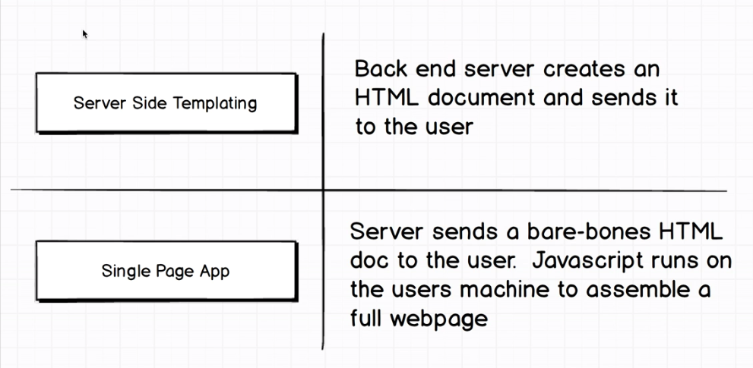
SSR vs. CSR (SPA)

Slide 7
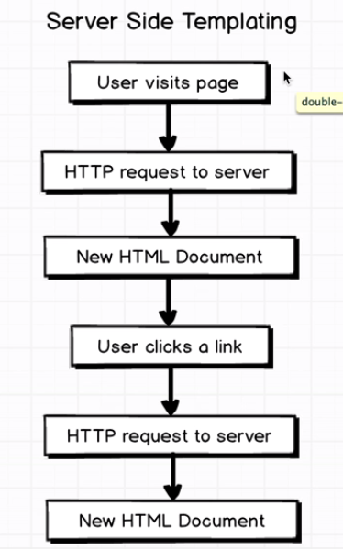
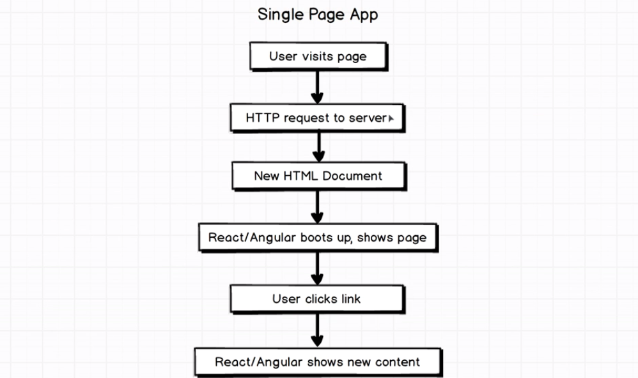
SSR vs. CSR (SPA) cont.

Slide 8
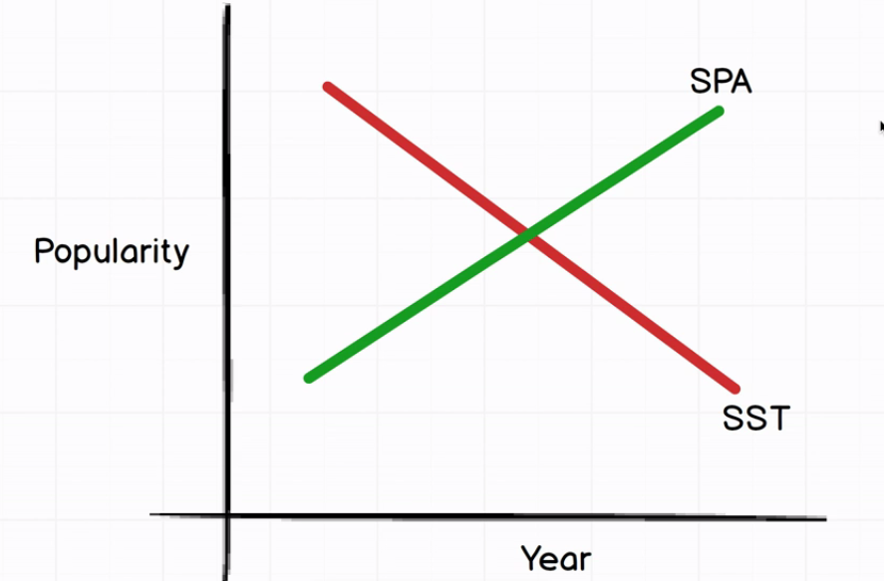
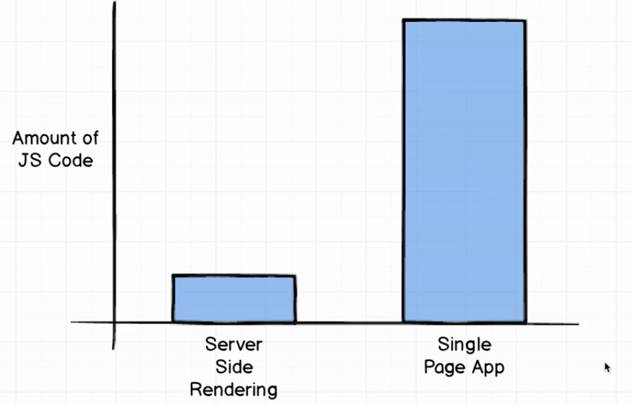
SSR vs. CSR (SPA) cont.

Slide 9
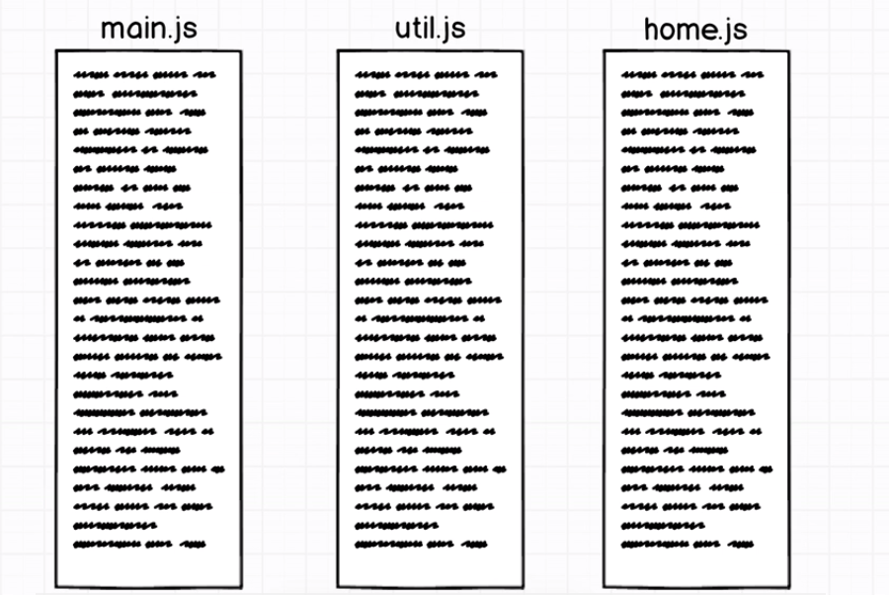
Single page application

Slide 10
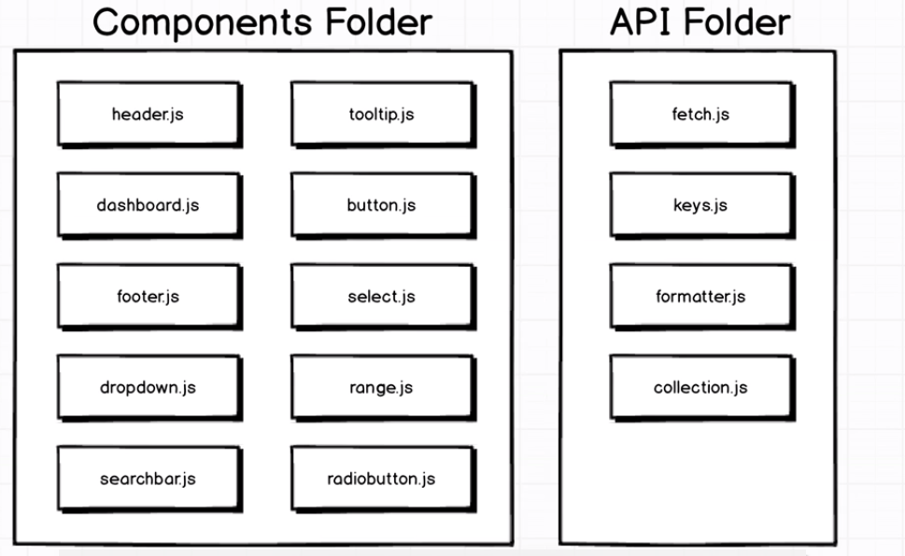
Modularity

Slide 11
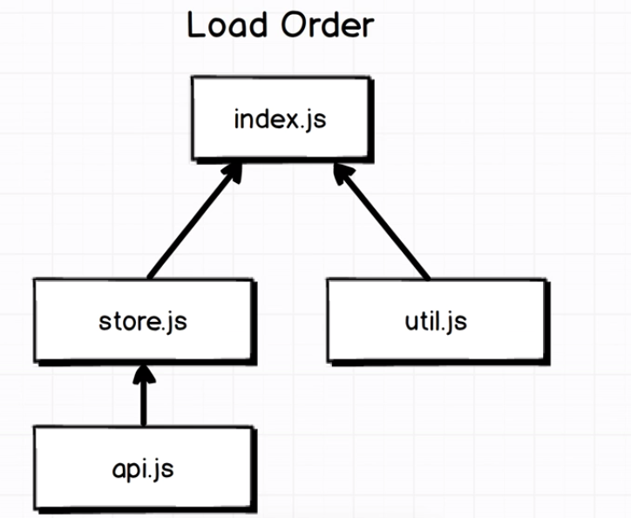
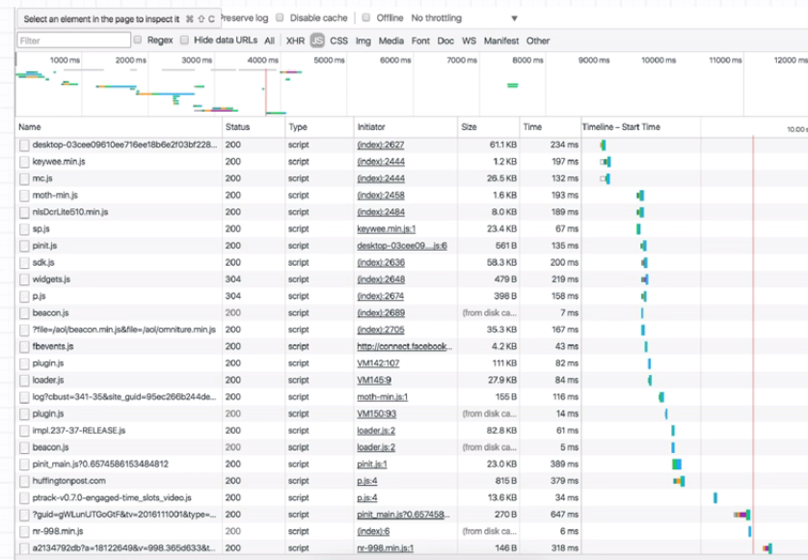
Modularity limitations

Slide 12
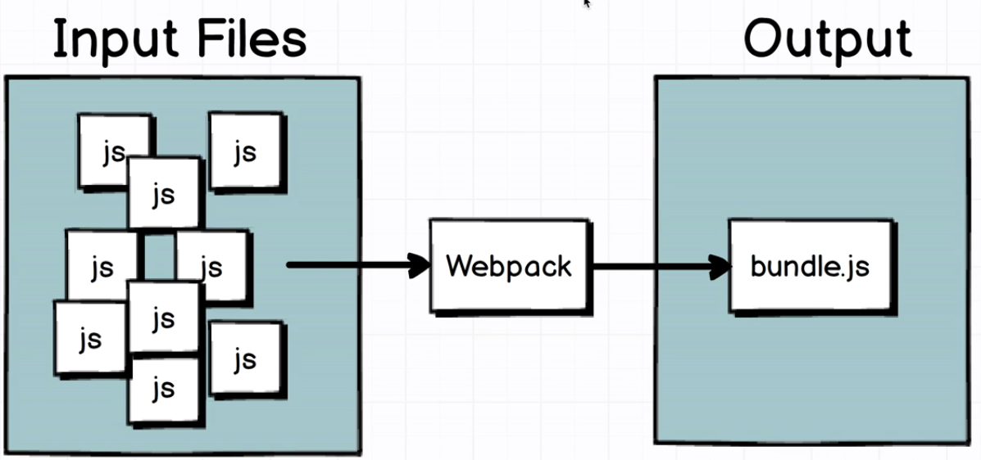
& that take us to “webpack”
v4 => February 2018
v5 => October, 2020
Let’s Start!

Slide 13
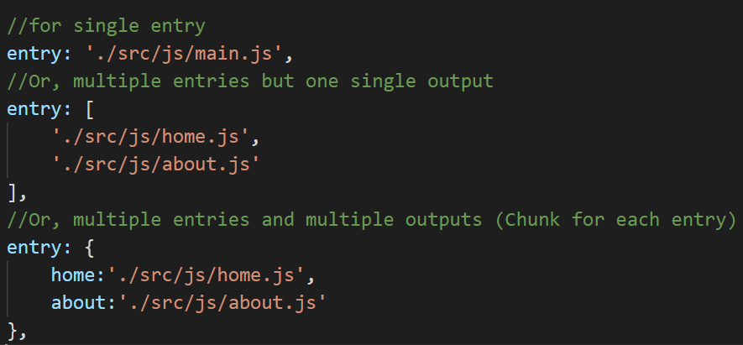
Configurations Syntax
Entry

Slide 14
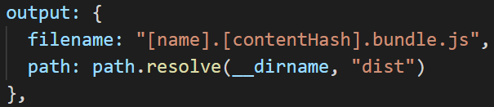
Configurations Syntax (cont.)
output

Slide 15
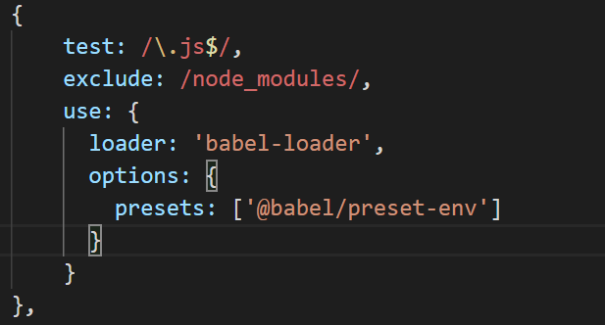
Configurations Syntax (cont.)
npm install -D babel-loader @babel/core @babel/preset-env
ES6

Slide 16
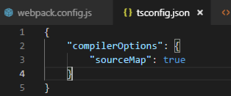
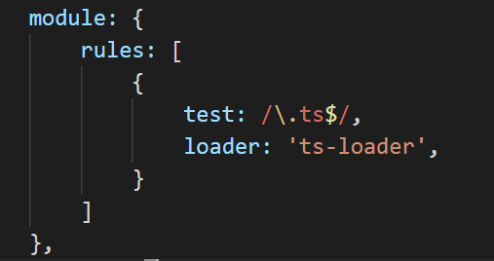
Configurations Syntax (cont.)
npm install –D ts-loader typescript
typescript

Slide 17
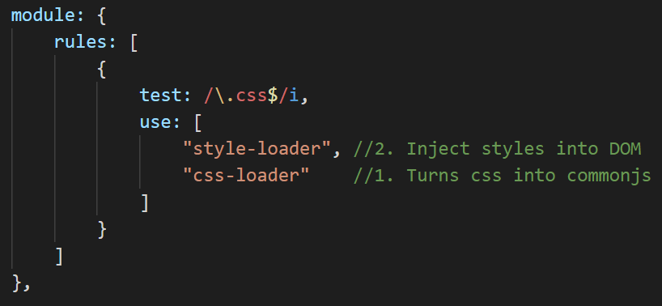
Configurations Syntax (cont.)
npm i -D style-loader css-loader
css

Slide 18
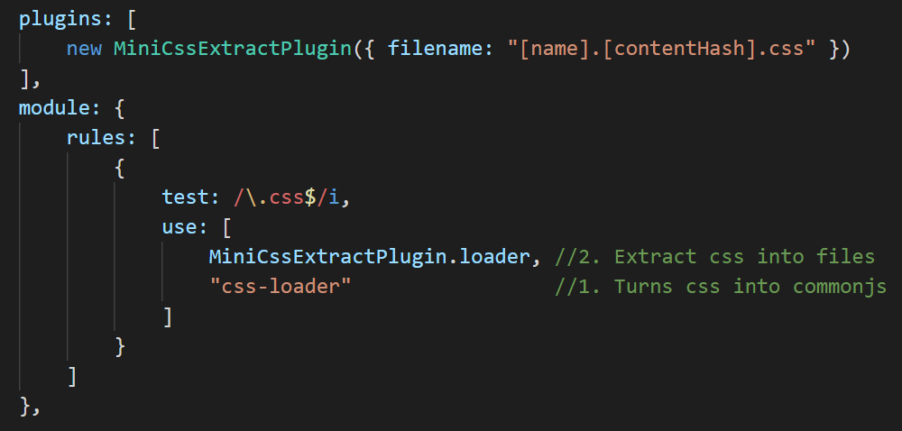
Configurations Syntax (cont.)
npm i -D mini-css-extract-plugin
Css (separate style file)

Slide 19
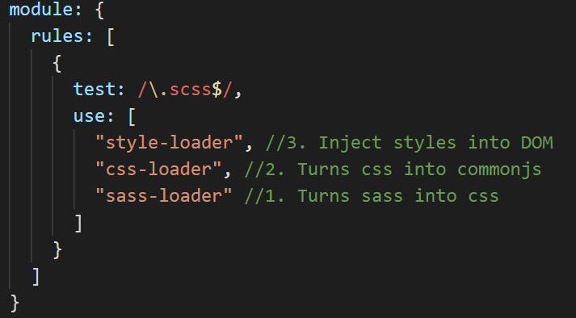
Configurations Syntax (cont.)
npm i -D style-loader css-loader sass-loader node-sass
sass

Slide 20
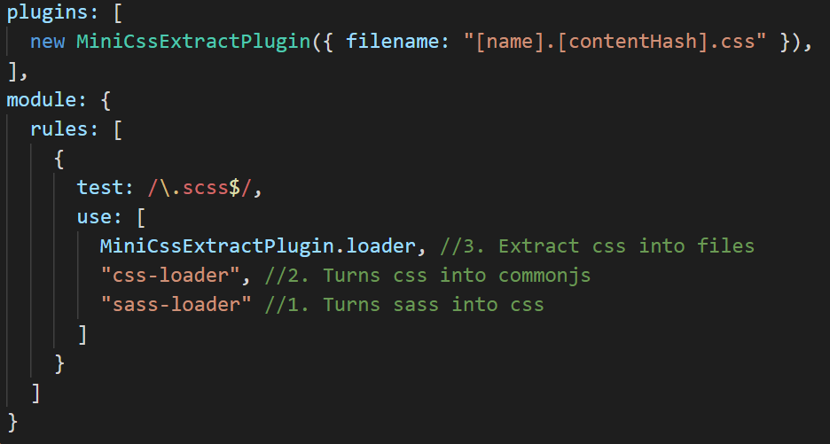
Configurations Syntax (cont.)
npm i -D mini-css-extract-plugin
sass (separate style file)

Slide 21
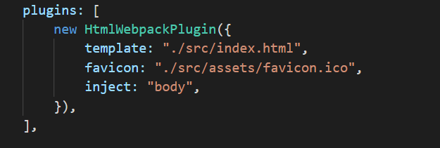
Configurations Syntax (cont.)
npm i -D html-webpack-plugin
html

Slide 22
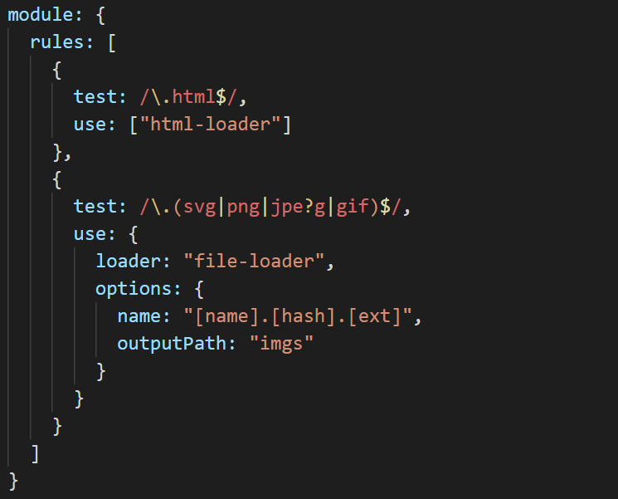
Configurations Syntax (cont.)
npm i -D file-loader html-loader
Images (v4)

Slide 23
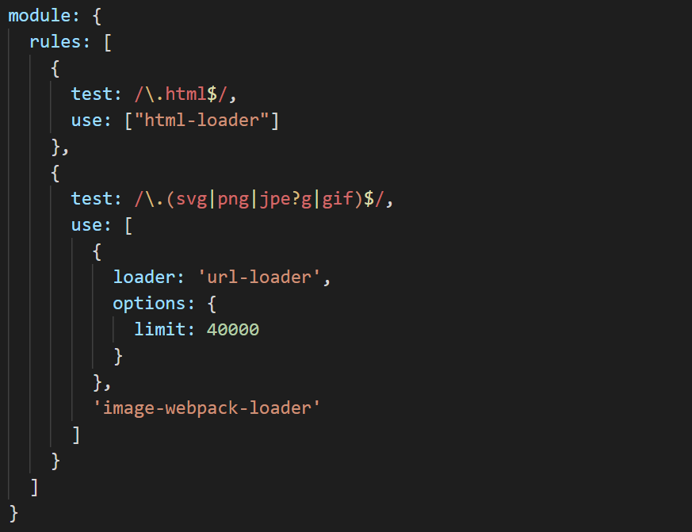
Configurations Syntax (cont.)
npm i -D image-webpack-loader url-loader file-loader html-loader
Images With optimization (v4)

Slide 24
Configurations Syntax (cont.)
Images (v5)
P.S. included by default with webpack 5 html plugin

Slide 25
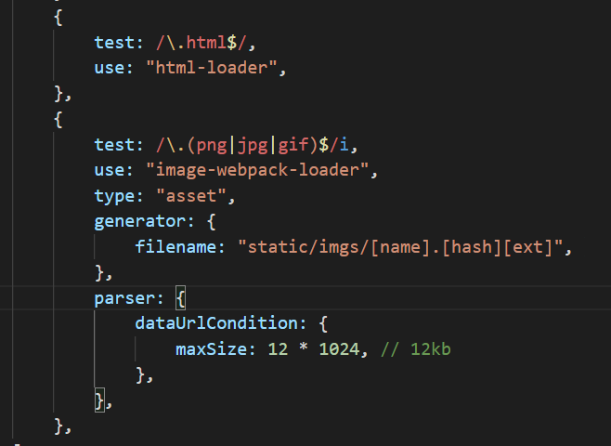
Configurations Syntax (cont.)
npm i -D image-webpack-loader html-loader
Images With optimization (v5)

Slide 26
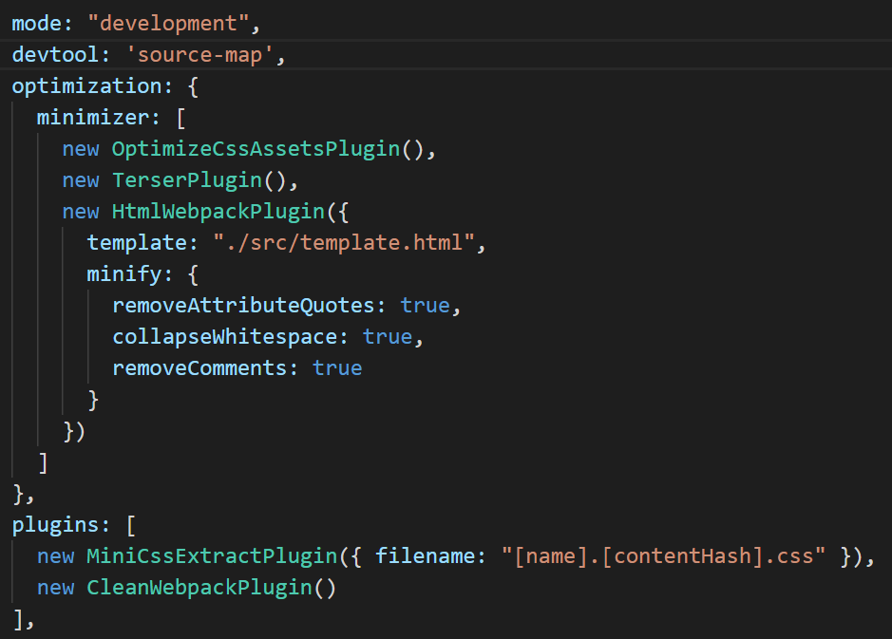
Configurations Syntax (cont.)
Mode, devtool & plugins (v4)

Slide 27
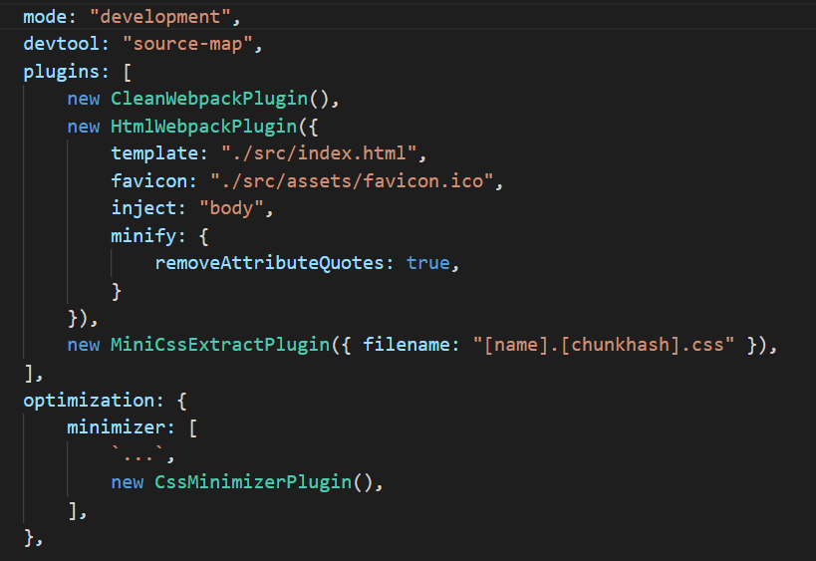
Configurations Syntax (cont.)
Mode, devtool & plugins (v5)

Slide 28
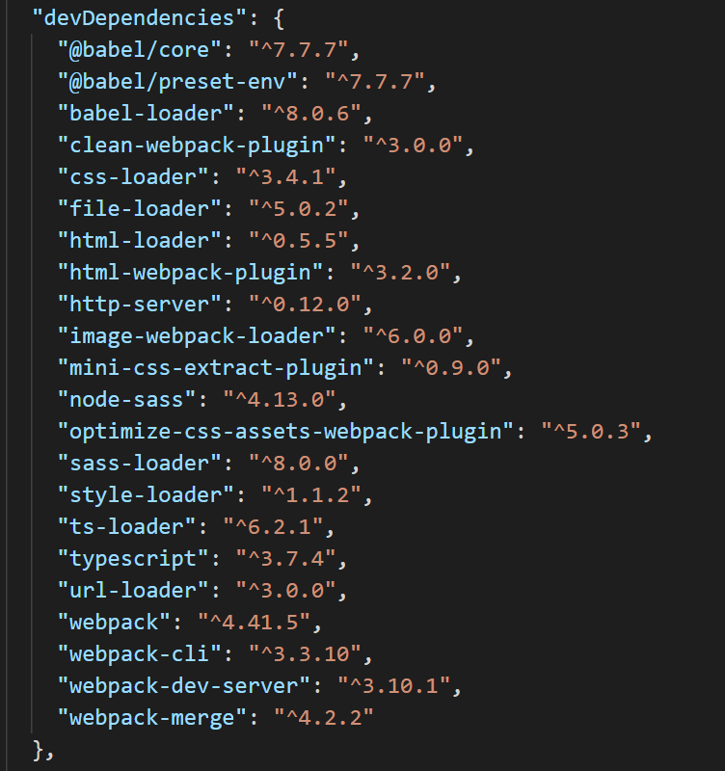
All Dependencies (v4)

Slide 29
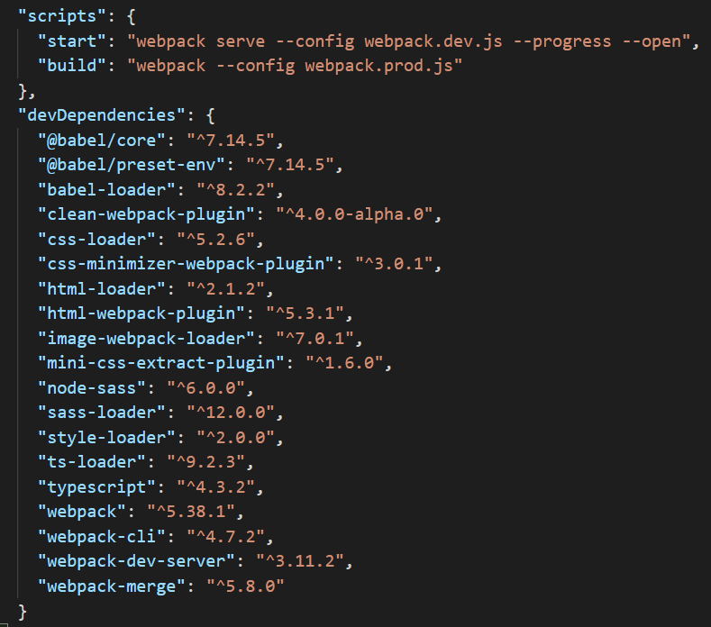
All Dependencies (v5)

Slide 30

Can you now tell the difference?

Slide 31
Thank You
My Contacts:
Work Email: omar.zayed@valeo.com
Personal Email: zayedomarr@gmail.com
Facebook: facebook.com/o.zayed.7
LinkedIn: linkedin.com/in/omar-Zayed
Github: github.com/OmarZayed77
Mobile: 01110399987

