Slide 1


Setting a MERN app with this topic:
apple accessories
(Details Will follow …)
Presented by :
Omar ZOUARI
Supervised by :
Khalil SALHI

Slide 2
Introduction

Slide 3
Introduction
My website is a shopping site oriented for apple users
We are going to sell Apple products with special price

Slide 4
Actors

Slide 5
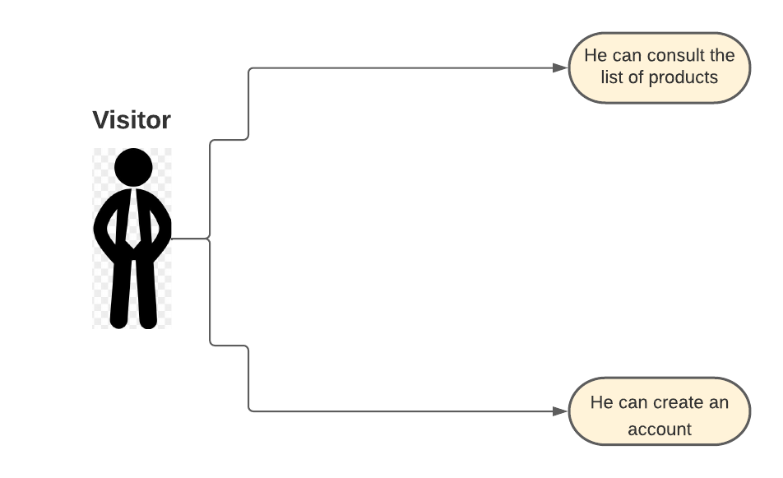

Slide 6
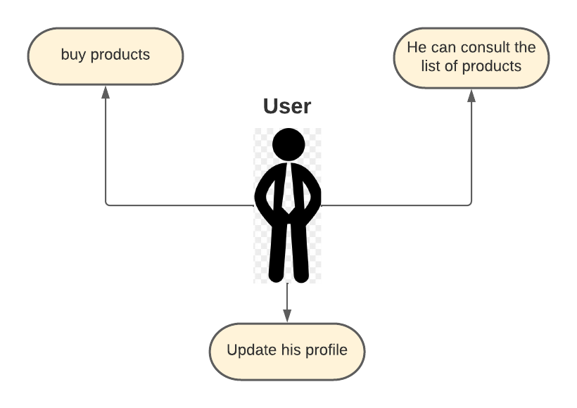

Slide 7
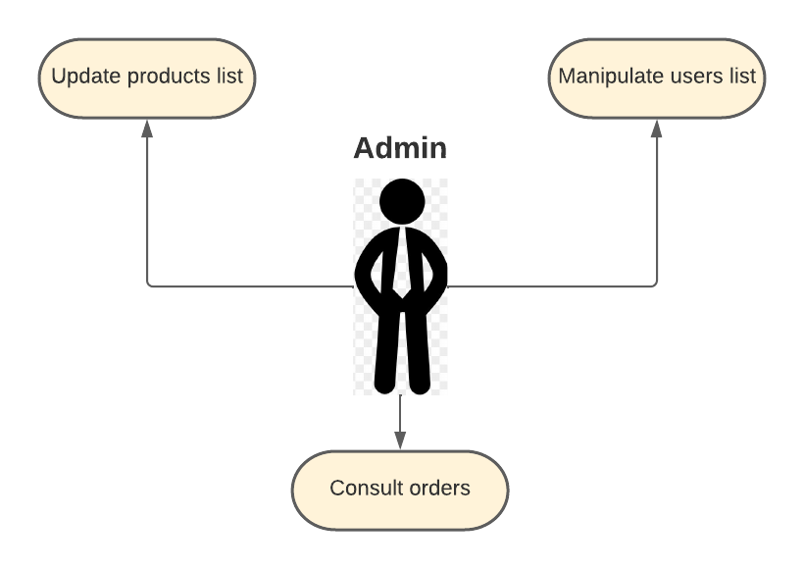

Slide 8
Conclusion
We have a simple website with three actors (admin,user,visitor)

Slide 9
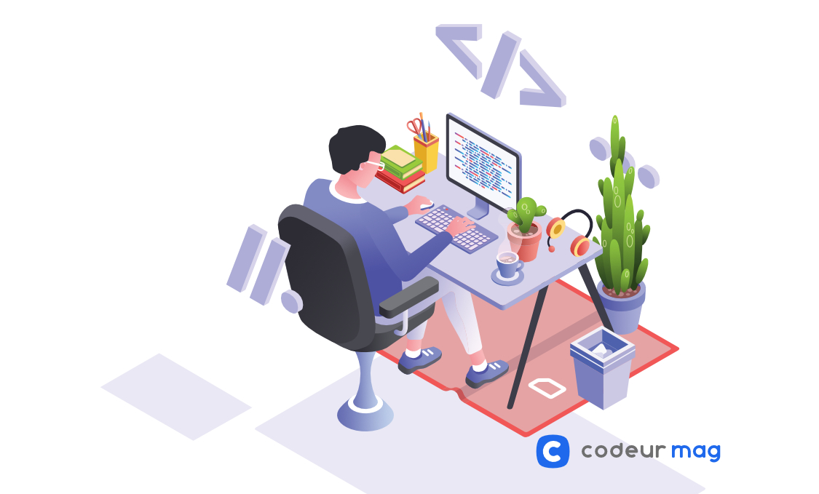
Thank you

