Slide 1


Support Vector Regression for Predicting News Article
Popularity
This presentation explores using Support Vector Regression (SVR) to predict news article popularity. We will discuss our approach, results, and future research directions.
Omar Alhaymoni
Mohammad Al-masri

Slide 2

Dataset Description
We used the UCI Machine Learning Repository's Online News Popularity Dataset. It has 61 attributes, including title tokens and shares. The target variable is ' shares'.
Source: UCI Machine Learning Repository
Key Features: n_non_stop_words,n_unique_to kens, kw_avg_avg
Target Variable: Shares (number of social media shares)

Slide 3


Preprocessing Steps
Our preprocessing pipeline prepared the data for SVR. We handled non- predictive columns and skewed distributions. Data was split and scaled for effective model training.
Remove Columns
Removed 'url' and 'timedelta' for better focus.
Log-Transform Shares
Handled skewness in the 'shares' target variable.
Split Data
Divided into 80% training and 20% testing sets.
Scale Features
Applied StandardScaler to normalize feature values.

Slide 4
Chosen Technique: SVR with L1 & L2 Regularization
We chose SVR for its effectiveness with non-linear regression and robustness to outliers. Regularization helps prevent overfitting and improves model generalization.
Why SVR? Regularization Types:
Effective for non-linear regression. • L2 (Ridge-like) Regularization for smoother predictions.
Robust to outliers (viral articles).
L1 (Lasso-like) Regularization for feature selection.

Slide 5

Results & Evaluation
SVR with L2 regularization performed slightly better than L1, with a higher R² and lower MSE. However, the low R² suggests that more complex relationships might not be fully captured.
Model | MSE (↓) | R² (↑)
SVR (L2 - RBF) | 0.7507 | 0.1242
LinearSVR (L1) | 0.7837 | 0.0857

Slide 6




Conclusion & Next Steps
SVR with L2 regularization provided a better baseline, explaining about 12% of the variance. Future work involves exploring other kernels, feature importance, and ensemble methods.
Analyze Other Kernels
Investigate polynomial or
sigmoid kernels for SVR.
Feature Importance
Conduct SHAP value analysis to
understand key features.
Explore Ensemble
Methods
Consider Gradient Boosting or Random Forests for prediction.

Slide 7
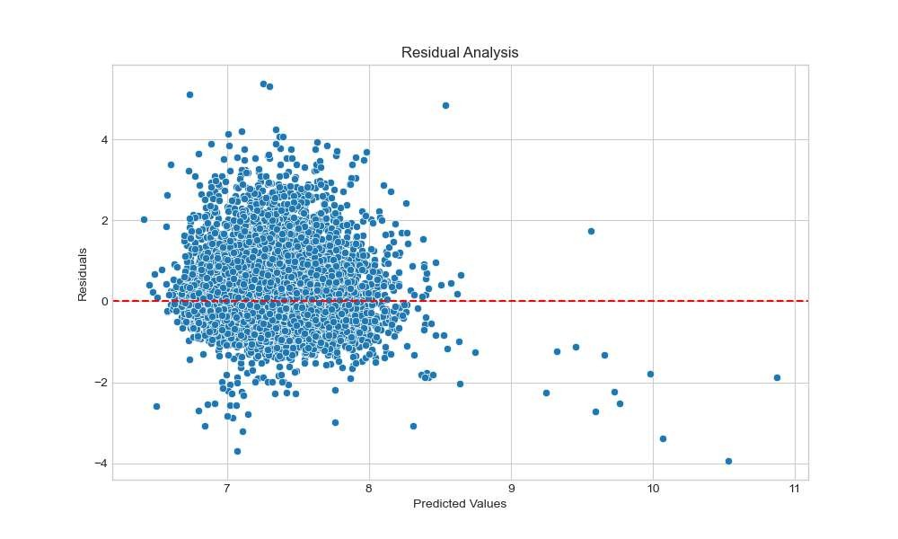
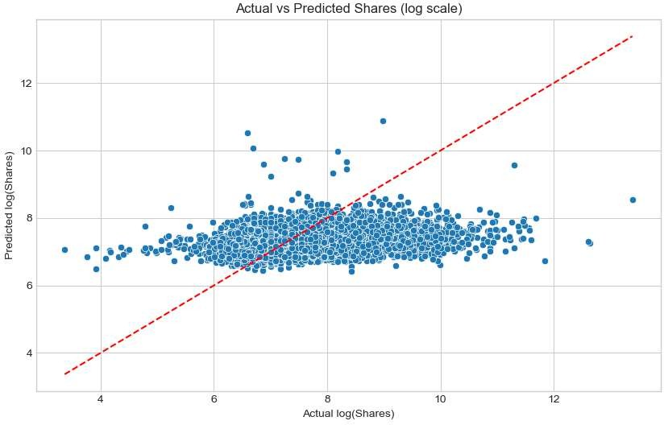
Visualizing the performance:

Slide 8
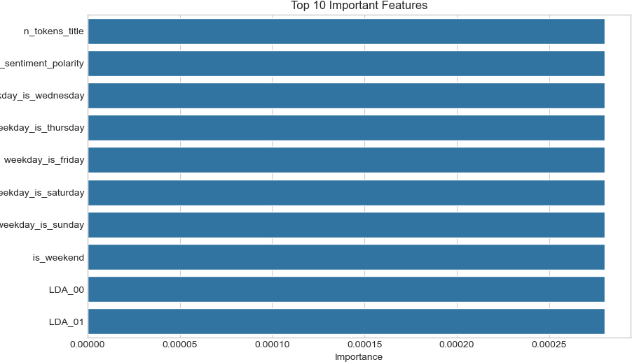
Feature Importance:

Slide 9
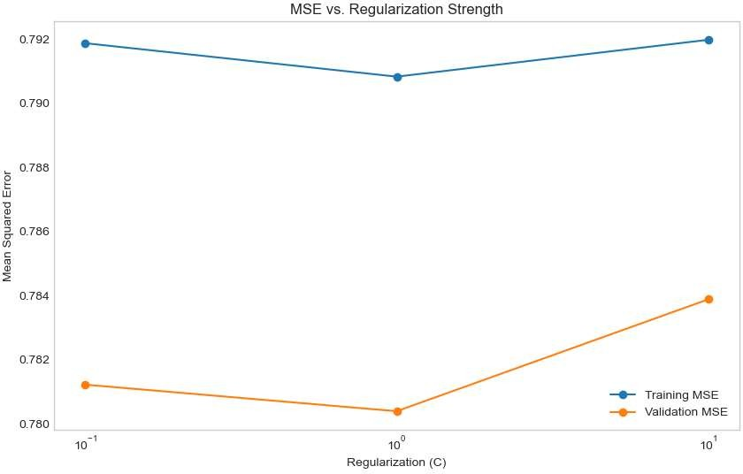
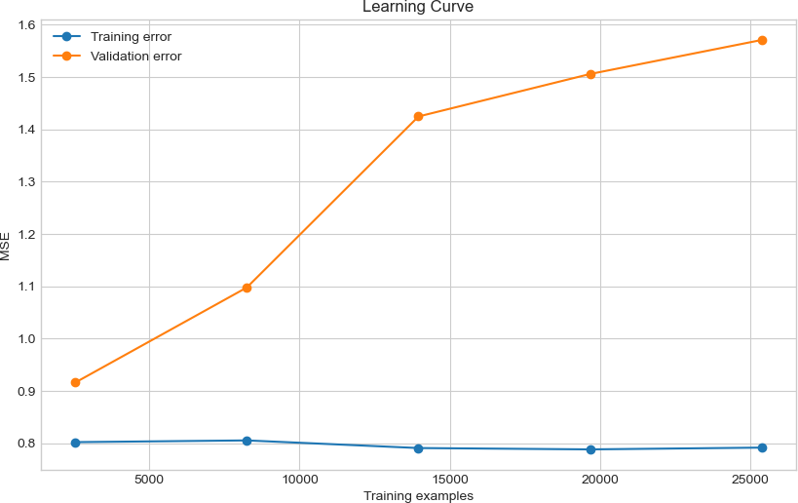
MSE and Regularization comparing:

Slide 10
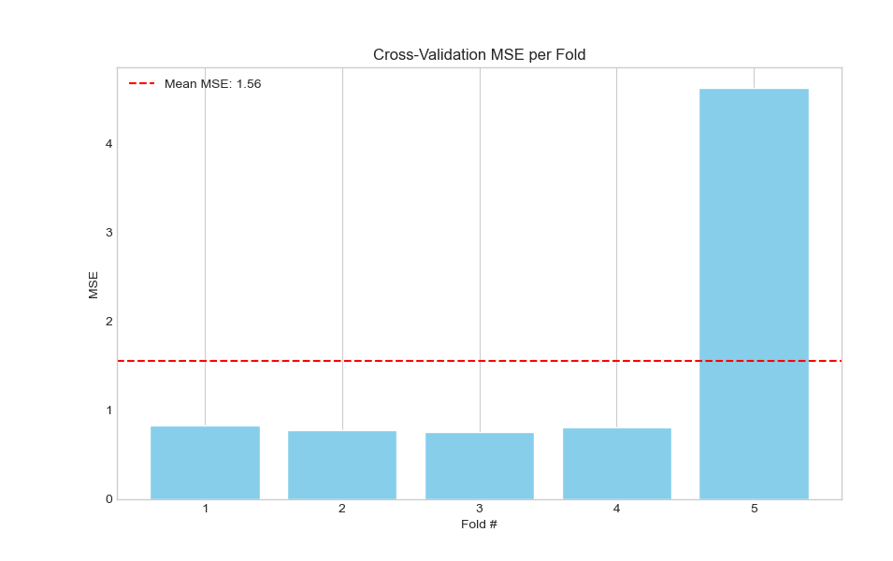
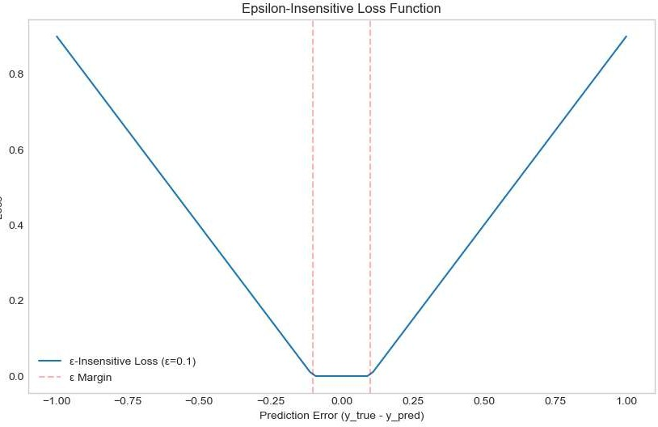
Loss function & Cross- Validation

Slide 11
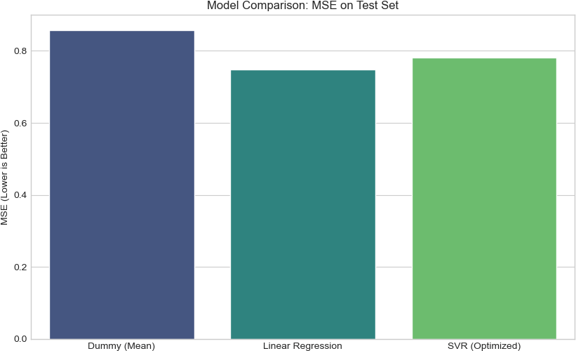
Models Comparison:

