Slide 1
Understanding and Preventing Phishing Attacks
A Guide to Recognizing and Avoiding Phishing Threats
Done by: Mohammad Omar Allaham

Slide 2
Introduction
Phishing attacks have become one of the most prevalent and damaging forms of cybercrime in today's digital landscape. These attacks exploit human vulnerabilities, tricking individuals into revealing sensitive information or downloading malicious software. Phishing can lead to severe financial loss, identity theft, and data breaches, whether through deceptive emails, fake websites, or cunning social engineering tactics. Understanding how to recognize and avoid phishing attacks is crucial for protecting both personal and organizational security.

Slide 3
What is a “phishing attack”?
It is an attempt to steal sensitive information, typically usernames, passwords, credit card numbers, bank account information, or other important data to utilize or sell the stolen information. By masquerading as a reputable source with an enticing request, an attacker lures in the victim to trick them, similarly to how a fisherman uses bait to catch a fish.

Slide 4
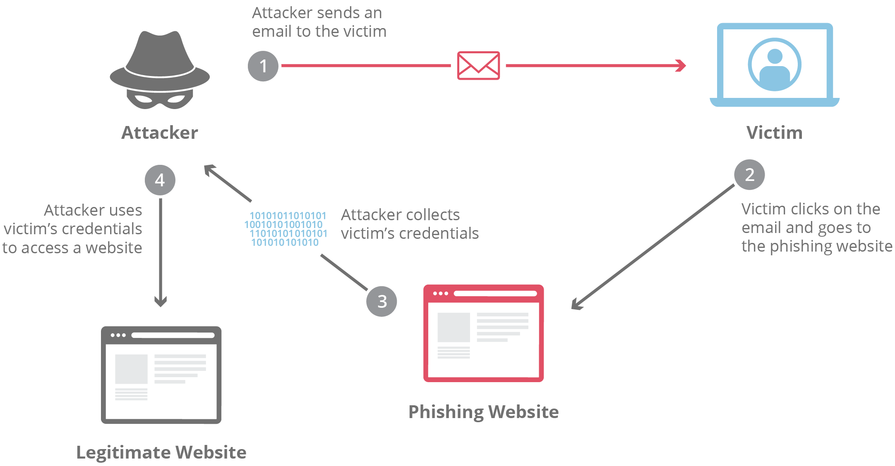

Slide 5
Types of phishing attacks
Spear Phishing
Vishing
Email Phishing
Clone Phishing
Social Engineering Attacks

Slide 6
1. Spear phishing
Spear phishing involves targeting a specific individual in an organization to try to steal their login credentials. The attacker often first gathers information about the person before starting the attack, such as their name, position, and contact details
Example: An attacker tried to target an employee of NTL World, which is a part of the Virgin Media company, using spear phishing. The attacker claimed that the victim needed to sign a new employee handbook. This was designed to lure them into clicking a link where they would have been asked to submit private information

Slide 7
2. Vishing
Vishing, which is short for "voice phishing," is when someone uses the phone to try to steal information. The attacker may pretend to be a trusted friend or relative or to represent them.
Example: In 2019, there was a vishing campaign that targeted members of the UK’s parliament and their staffers. The attack was part of an assault that involved at least 21 million spam emails targeting UK lawmakers.

Slide 8
3. Email phishing
In an email phishing scam, the attacker sends an email that looks legitimate, designed to trick the recipient into entering information in reply or on a site that the hacker can use to steal or sell their data.
Example: Hackers used LinkedIn to grab contact information from employees at Sony and targeted them with an email phishing campaign. They got away with over 100 terabytes of data.

Slide 9
4. Clone phishing
A clone phishing attack involves a hacker making an identical copy of a message the recipient already received. They may include something like “resending this” and put a malicious link in the email.
Example: In a recent attack, a hacker copied the information from a previous email and used the same name as a legitimate contact that had messaged the victim about a deal. The hacker pretended to be a CEO named Giles Garcia and referenced the email Mr. Garcia had previously sent. The hacker then proceeded to pretend to carry on the previous conversation with the target, as if they really were Giles Garcia.

Slide 10
5. Social engineering attacks
Social engineering attacks pressure someone into revealing sensitive information by manipulating them psychologically.
Example: A hacker pretended to be a representative of Chase Bank while saying that the action was needed on the target’s debit or ATM card. The attacker was trying to pressure the victim into divulging their information by leveraging their fear of not being able to access their money in their Chase account.

Slide 11
How to recognize phishing
Recognizing Phishing Emails
Recognizing Phishing Websites
Recognizing Social Engineering Attacks

Slide 12
1. Recognizing phishing emails
Sender: Check the email address carefully.
Spelling and Grammar: Poor language skills are a red flag.
Links: Hover over links to see the actual URL.
Attachments: Be wary of unexpected attachments.
Urgency: Messages demanding immediate action are suspicious.

Slide 13
2. Recognizing phishing websites
URL: Look for misspellings or unusual domain names.
HTTPS: Ensure the website uses HTTPS (look for the padlock symbol).
Design: Poor design or outdated logos can indicate a fake site.
Pop-ups: Beware of unexpected pop-up messages asking for sensitive information.

Slide 14
3. Recognizing social engineering attacks
Common Tactics Followed:
Pretexting
Baiting
Quid Pro Quo
Tailgating

Slide 15
How to avoid phishing attacks
Protect your computer by using security software: Set the software to update automatically so it will deal with any new security threats.
Protect your cell phone by setting software to update automatically: These updates could give you critical protection against security threats.
Protect your accounts by using multi-factor authentication: Some accounts offer extra security by requiring two or more credentials to log in to your account.

Slide 16
What to do if you fall a victim
Immediate Actions:
1.1 Disconnect from the internet to prevent further data transmission.
1.2 Change passwords immediately for any compromised accounts and others using similar credentials.
2. Report the Incident: 2.1 Report the phishing attack to your IT department, local authorities, and
relevant organizations like the Anti-Phishing Working Group (APWG). 2.2 Notify your bank or credit card company if financial information is shared.

Slide 17
conclusion
Phishing attacks are becoming increasingly sophisticated, posing significant risks to individuals and organizations alike. By recognizing the telltale signs of phishing emails, websites, and social engineering tactics, we can protect ourselves from falling victim to these scams. Remember, staying informed and cautious is the best defense. If you suspect a phishing attempt, report it immediately and take proactive steps to secure your information. Together, we can create a safer online environment. Stay vigilant, stay secure.

Slide 18
Resources
Cloudflare: Phishing Attack Article
Fortinet: Types of Phishing Attacks
Federal Trade Commission – Consumer Advise: How to recognize and avoid phishing scams

