Slide 1
Loan System
Supervised by : Dr.Mohamed Khafagy

Slide 2

Prepared by !
Hossam Eldeen Essam
Ahmed Samir
Mohamed Adel
Mohammad Mustafa
Omar Mohamed
Saga Muhammed

Slide 3
Micro loans are popular in developing nations, providing small-scale financing facilitated by technology. They are used for startup funding or business expansion, allowing borrowers to repay the loans. A key feature of micro loans is their ability to source funds from multiple lenders, unlike traditional loans.
To manage micro loans effectively, an ERD with essential information is crucial.

Slide 4
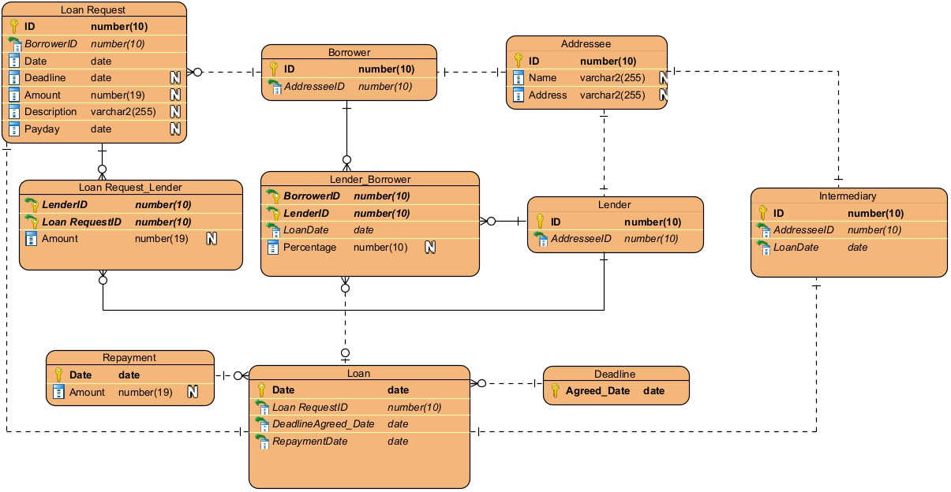

The Adjusted ERD

Slide 5

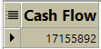
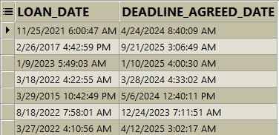
Reports
User manager from manager group and loan from audit group will generate report to find total amount of cash flow in the system from all loans Repayment every year
User loan from group audit at the end of each day will generate report
to retrieve all active loan applications

Slide 6
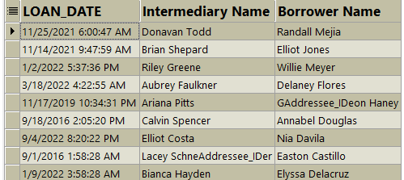
Reports
User intermediary from audit group will generate report monthly to retrieve the intermediary
name and the loan date he participated in and the borrower name

Slide 7
Features can be added in the future
Risk Assessment
Integration with Financial Services
Scheduling Repayment
Expanded Data Analysis

Slide 8

Database
Range of records in each table
is expected to be between 150,000(1year) / 600,000 (4years)

Slide 9

Tables in First year (150K record)
Table size(M) =(sum of data types size)*150K/1024/1024
Addressee = 80M per Year
Borrower = 3M per Year
Lender = 3M per Year
Intermediary = 4M per Year
Loan_Request =50M per Year
Loan_request_lender = 6M per year
Lender_borrower = 6M per year
Loan = 5M per year
Repayment = 4M per year
Deadline = 2M per year

Slide 10

Tablespaces
Default tablespace
System Tablespace
Sysaux Tablespace
Users Tablespace
Undo Tablespace (We altered 1 undo tablespace with size 100 M )
Temp Tablespace (We made 4 Temp Tablespaces, one for each group of users)
------------------------------------------------------------------------------DATA tablespaces
Data Entry Tablespace
Implementers Tablespace
( We split our tables into two ,To avoid a failure occurring)

Slide 11
Data Entry
Implementers
addresse Table
borrower Table
lender Table
intermediary Table
loan_request Table
loan_request_lender Table
lender_borrower Table
loan Table
deadline Table
repayment Table

Slide 12
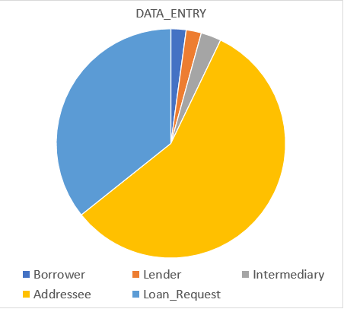
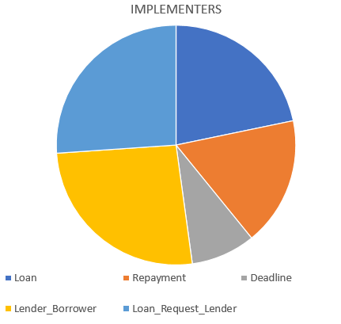
FIRST YEAR (150k)
Data Entry = 140M Implementers = 25M

Slide 13
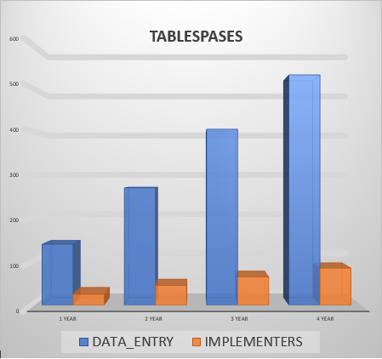
4 Years (600k)
Data Entry = 530M Implementers = 86M

Slide 14




Views
1- Borrowers_View
A join Relation between Borrower Table,Addressee Table
2- Lenders_View
A join Relation between Lender Table,Addressee Table
3- Intermediaries_View
A join Relation between Intermediary Table,Addressee Table
(We use "instead of trigger" w to make inserting operation possible)

Slide 15

Users Creation
We created 14 users in our system and 2 system DBAs,
divided normal users into 4 groups and:
Provided each user with username and password .
Assigned each user to a default TABLESPACE.
Assigned each user to a temporary TABLESPACE.
Gave each user a specific quota on TABLESPACES.
Assigned users to their required PROFILE.

Slide 16
Users and Profiles
We created 4 profiles to assign each group of users to their profile each profile specifies :
Number of concurrent session user can open.
Number of failed login attempt .
Number of days their password will expire after.
System 4 profiles created as following :
Data entry profile
Implementers profile
Audit profile
Managers profile

Slide 17
Users and Privileges
-System privileges :
Privilege to user to connect to database .
privileges to user to create users,tables,views …etc
GRANT CONNECT TO borrower_request1;
- Object privileges:
Privileges to user to select ,insert , update and delete from a system
object such as tables , views and materialized views.
GRANT SELECT,INSERT,UPDATE ON loanDBA.Intermediary TO Loan_intermediary;

Slide 18
Database Roles
- Administrative Roles
Resources ROLE
DBA ROLE
SYSDBA ROLE
GRANT CONNECT, RESOURCE, DBA,SYSDBA TO loanDBA1;
- Normal users Roles
A combination of object privileges .
CREATE ROLE loan_implementer_role;
GRANT SELECT,INSERT,UPDATE ON loanDBA.Loan_request TO
loan_implementer_role;
GRANT loan_implementer_role TO implementer1;

Slide 19

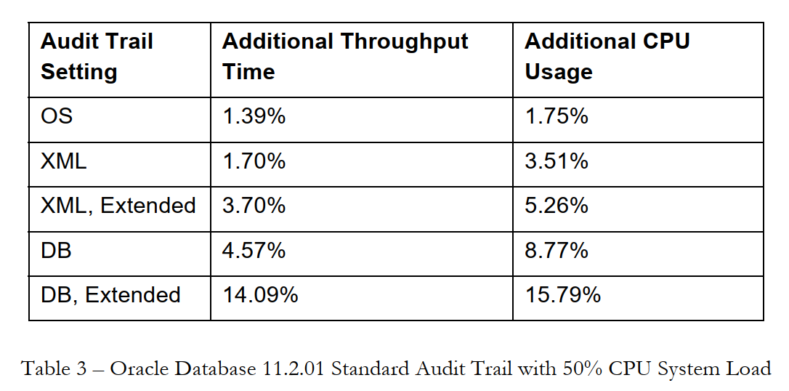
Mandatory Audit
Satisfy the security policy with low hit at performance as possible
https://www.oracle.com/technetwork/products/audit-vault/learnmore/twp-security-auditperformance-166655.pdf

Slide 20
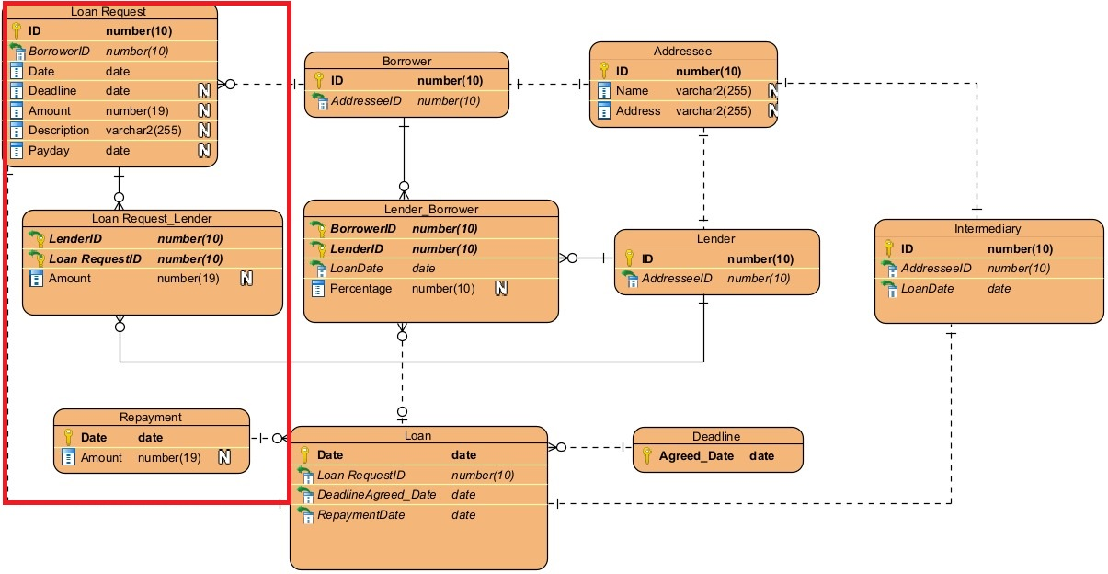
Audited tables
Notes:
Select delete insert update

Slide 21

DATA GENERATION
AND TESTING
100 records in most tables and 300 records in some tables
are generated by using DBMS_RANDOM built-in package,
TOAD, some manual written scripts and editings.
Relations between tables and constraints are considered
Data are oriented with our assumptions and equations
Helped in Testing reports, predicting sizes and evaluating performance

Slide 22

Performance Tuning
Proactive Tuning
Baseline
Top command
Tablespace size threshold
AWR
Metrics
ADDM
Schedule Gather Statistics
Dynamic Performance Views
Notes:
V$ACCESS session locking objects
V$SYSSTAT statistics
V$SQLAREA SQL CPUtime

Slide 23
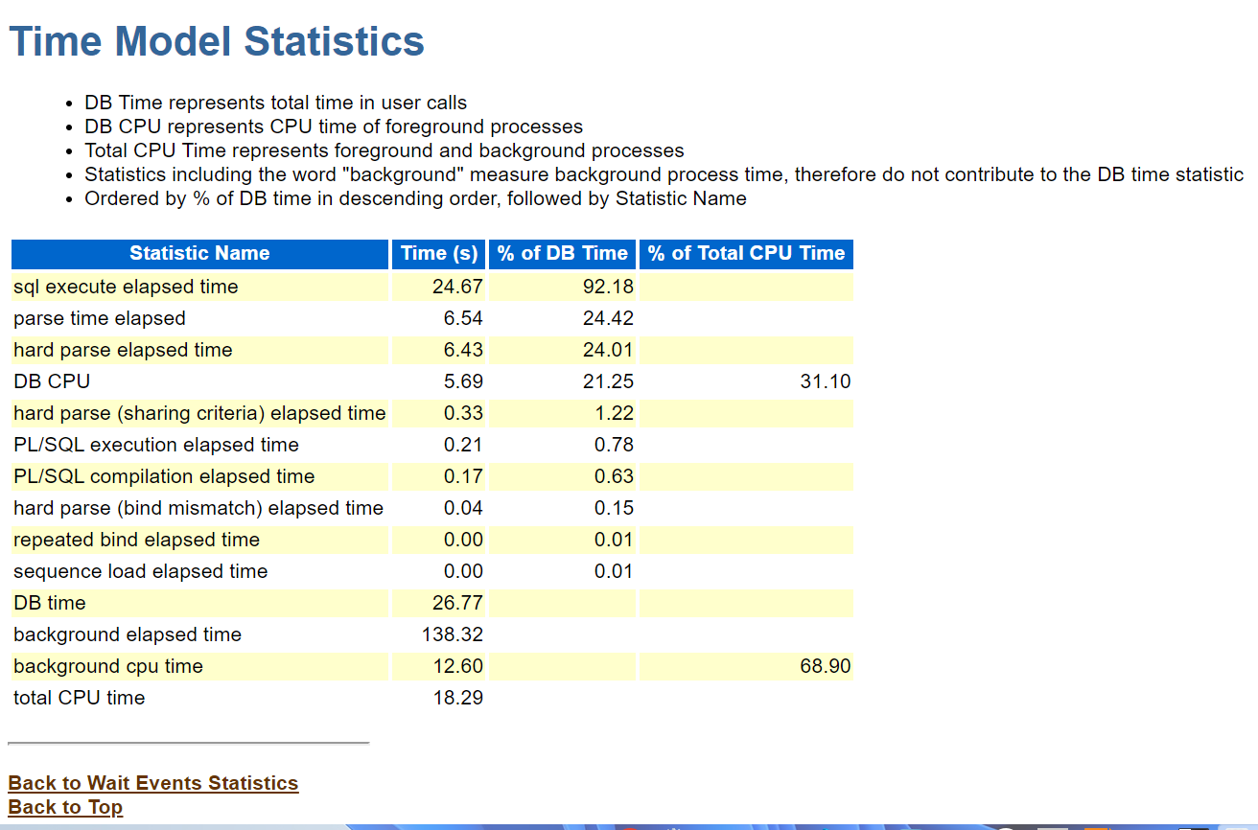

Slide 24
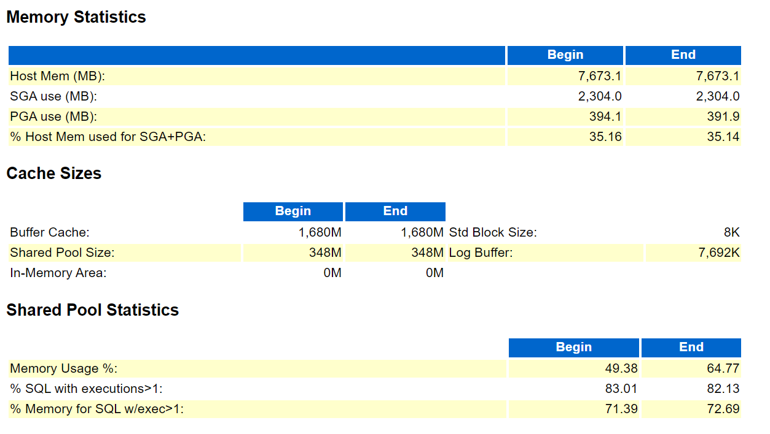

Slide 25
Reactive Tuning
Instance Parameters
Undo Retention
Max memory
Storage
Temp size

Slide 26

Backup
Why do we need backup?
When do we backup ?
Which strategy used for backup and why ?
Why Compressed Backup Sets?
Benefits of Compression
Reduced Storage Requirements:
Compression significantly reduces the storage space needed for backup files.
Faster Backup and Restore:
Smaller files mean faster backup and restore times.
How do we backup ?
Notes:
Humans errors are unavoidable, Physical or logical failure may happen, Disasters so we need backup data
Our backup strategy as follow:
We take backup when database is not under high load , every day , every Saturday
We chose compressed backup set to take only the changes that happened on data file not data file as copy
We choose incremental backup set because this backup path on every block and read the header file to know the block that have updated
Take incremntal backup lvl0 as full backup every saterday then take incremntal backup lvl1 every day at 11pm

Slide 27
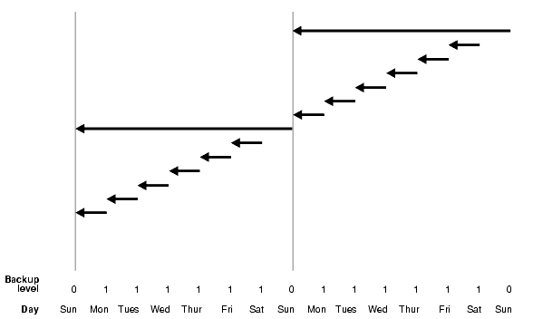
Incremental Backup

Slide 28
Backup
Scheduling backup
How do incremental backup work ?
Why do we choose Differential Incremental Backup ?
Enable auto backup
Recovery catalog
backup piece
Backup policy
Notes:
Take less time from cumulative backup , take less time for creation , less strorage
We make data base in archive mode and make recovery catalog and table space for recovery catalog named cattbs to assign paths and information about backup
We take backup piece to save data base from single point of failure
We chose backup policy to be 10 days and after that the backup will change to be obsilite backup when happened problem in space will reomve the obsilte backup

Slide 29

Data Guard
Data guard has several databases
(one primary and others standby databases).
Data guard is the recommended solution for the SITE failures.
In data guard there is no shared storage, which is common for all the sites.
Data guard can have maximum nine standby databases.

Slide 30
Data Guard
Upgrades and many other types of maintenance can happen at the standby database.
Total downtime is limited to the time required for the switchover.
Automatic Failover Oracle Data Guard includes an automatic failover capability called Fast-Start Failover.
It safeguards against split-brain conditions (where two independent databases function as primary).
Oracle Data Guard includes intelligent automation to reinstate the failed primary database as a synchronized standby.

Slide 31
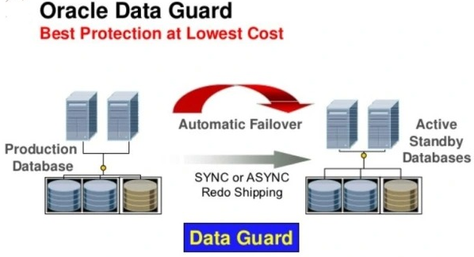
Data Guard

Slide 32
Data
Guard
Configuration
tnsnames
password file
parameter file
listener
stand_by redo log
dg_broker

Slide 33
Thanks!

