Slide 1

Facial Emotion Recognition
Omar Badran
Victor Gloria
Calvin Newcomb
Mohamed Uzair Anees

Slide 2

Problem:
Computers are wonderful and efficient but they’re really bad at dealing with images.
Unlike humans, they only see images as 0s and 1s.
They can’t perceive depth.
Most importantly for this topic, they can’t recognize human faces, nor the emotions that humans can recognize by default.
We need to “teach” them, and there are a few methods that we’ve been able to conceive so far.

Slide 3
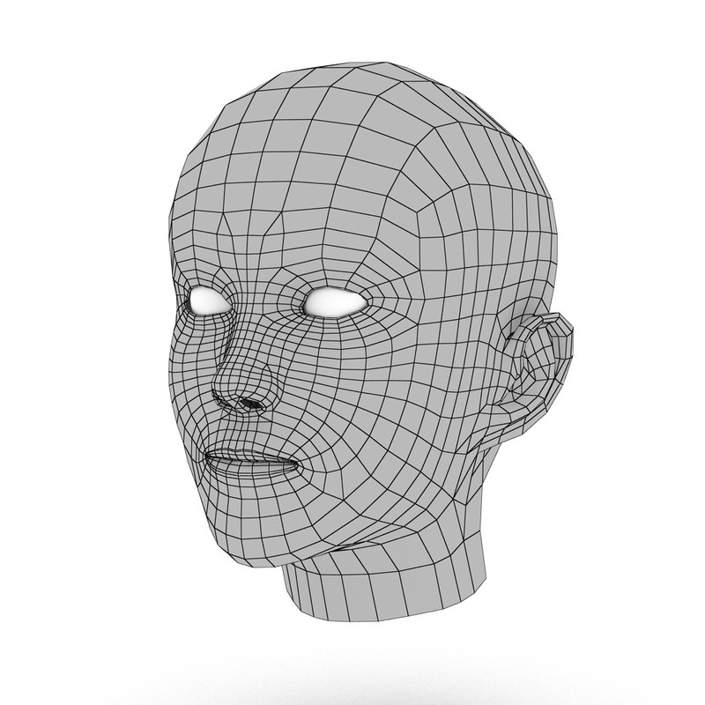
Purpose
Developing a facial emotion recognition app will allow us to understand the basics of deep learning, including neural networks, training data.
It will teach us how to collect a large dataset of labeled facial expressions to train the model, which will require an understanding of data preprocessing and cleaning.
Training the model will require us to tune various hyperparameters, such as the number of layers and epochs in the neural network, to optimize performance and so that it works better with the dataset that we’re using.
Evaluating the model's performance will give us a good understanding of metrics such as accuracy, precision, and recall.

Slide 4
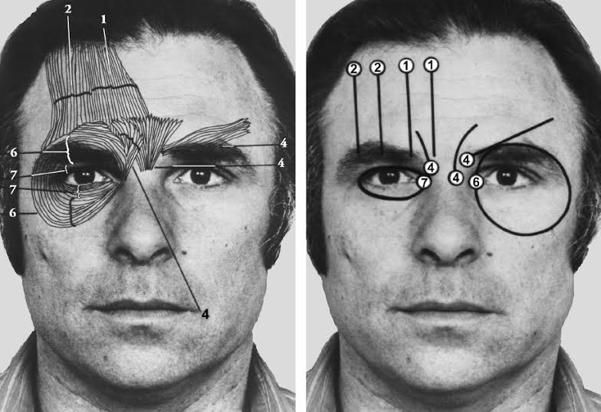
Established methods: FACS
Facial Action Coding System (FACS).
A very nuanced way of identifying subtle features of human expression, based on psychology.
It consists of 44 action units connecting to the tightening of groups of facial muscles to detect facial emotions.
Very complicated and time consuming!

Slide 5
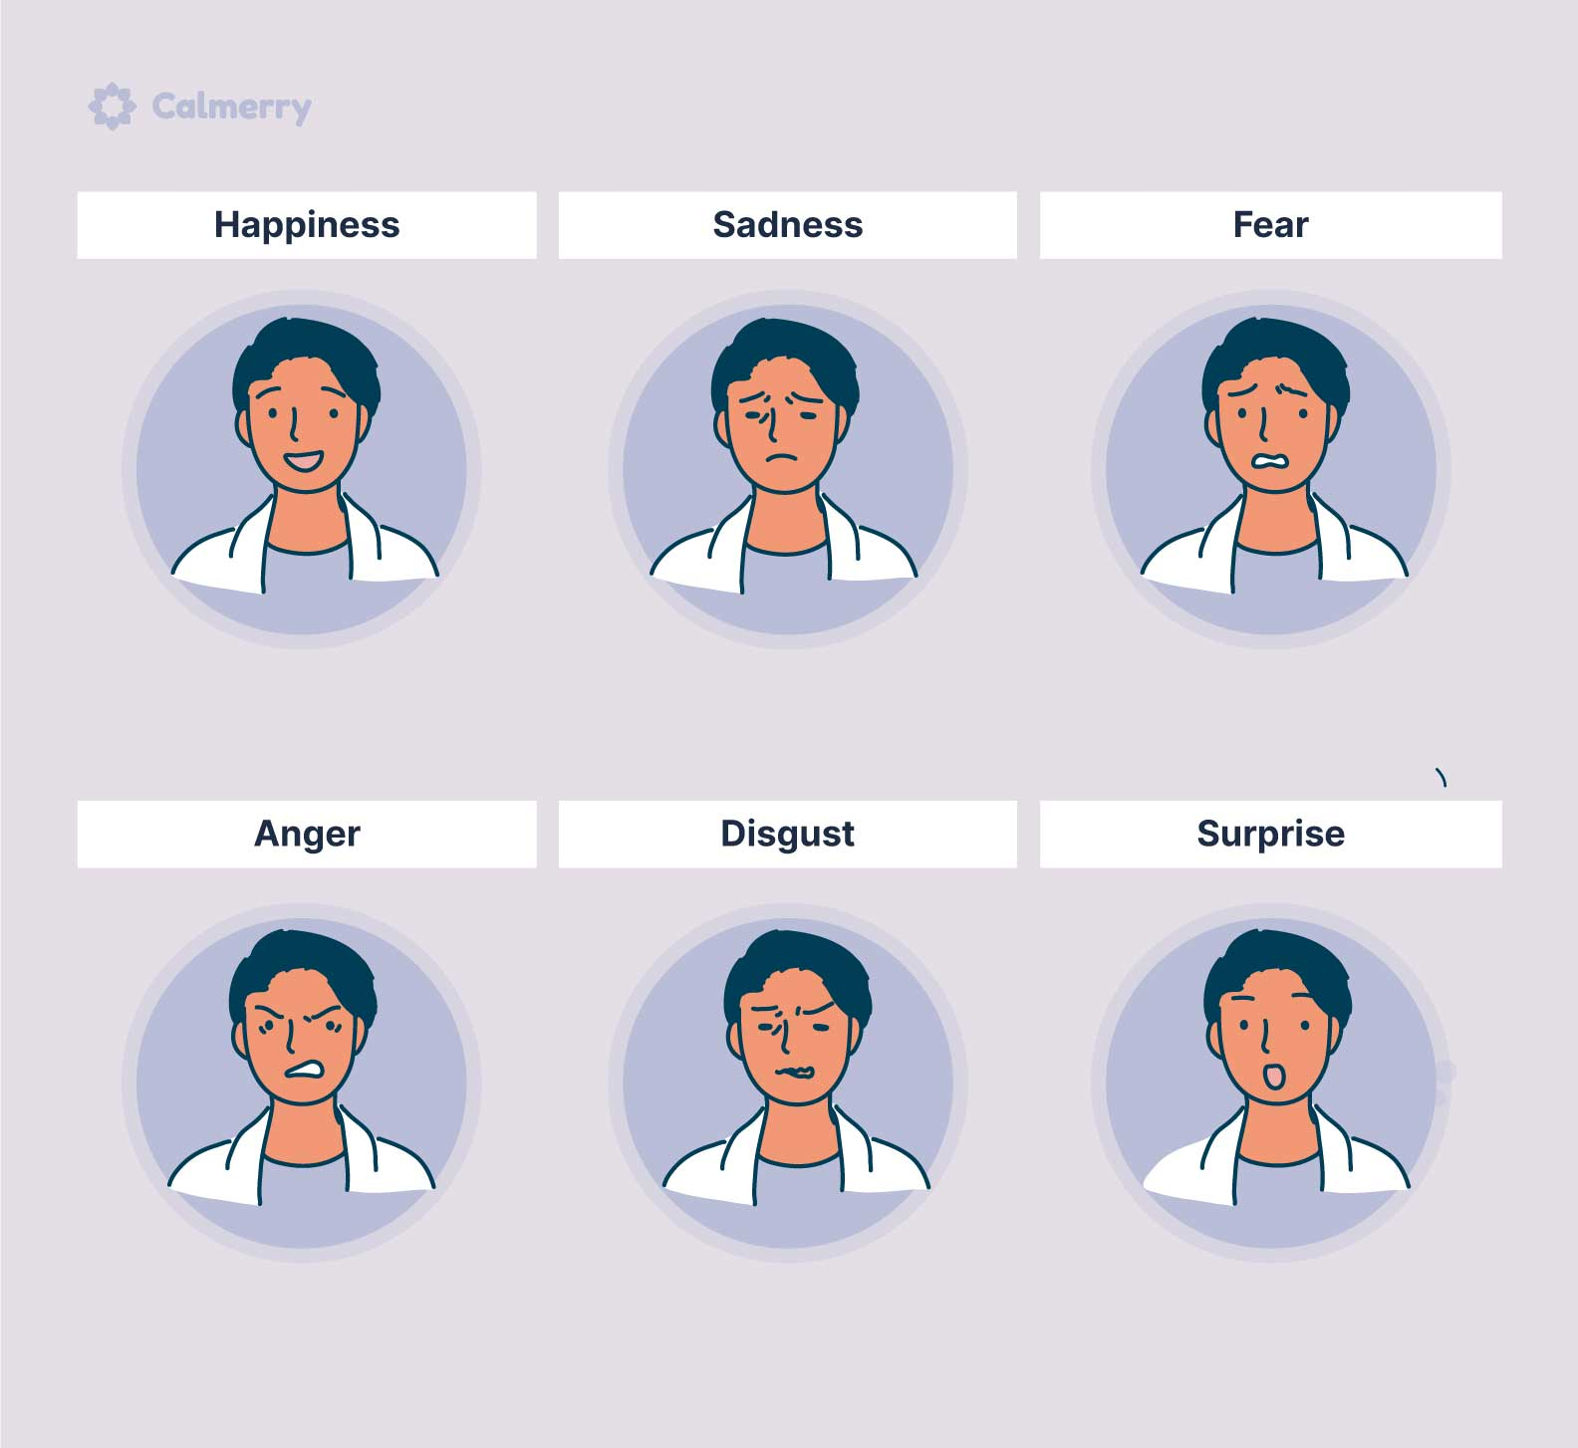
Established methods: PEE
Prototypic Emotional Expressions (PEE).
A much simpler method than the former.
7 “prototype emotions”: fear, anger, joy, sadness, disgust, surprise, and a neutral remark.
This is also a better method when considering facial emotions can slightly differ across ethnicities and cultures.

Slide 6
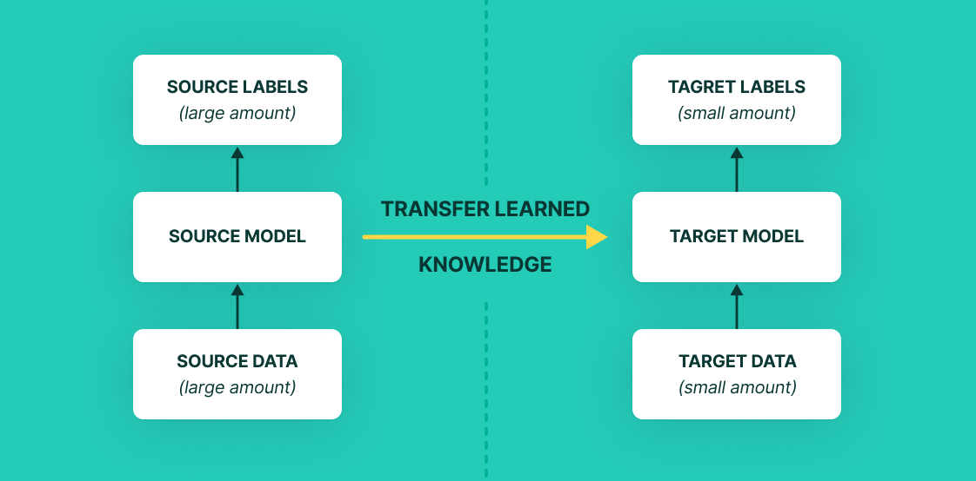
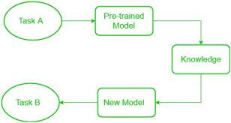
Transfer Learning
Transfer learning involves leveraging pre-trained models to improve the performance of a model on a new task. Pre-trained models are typically trained on large datasets and have learned useful features and representations. We will be using MobileNetV2 - CNN
It allows us to reuse or transfer these features to a new, related task, rather than training a new model from scratch on the new dataset.
By initializing the model with pre-trained weights and then fine-tuning it on the new dataset, transfer learning can significantly reduce training time and resource requirements, and often leads to better performance.
Transfer learning can be applied in various scenarios, such as when the new dataset is too small, related to the pre-trained dataset, or lacks labeled data.

Slide 7
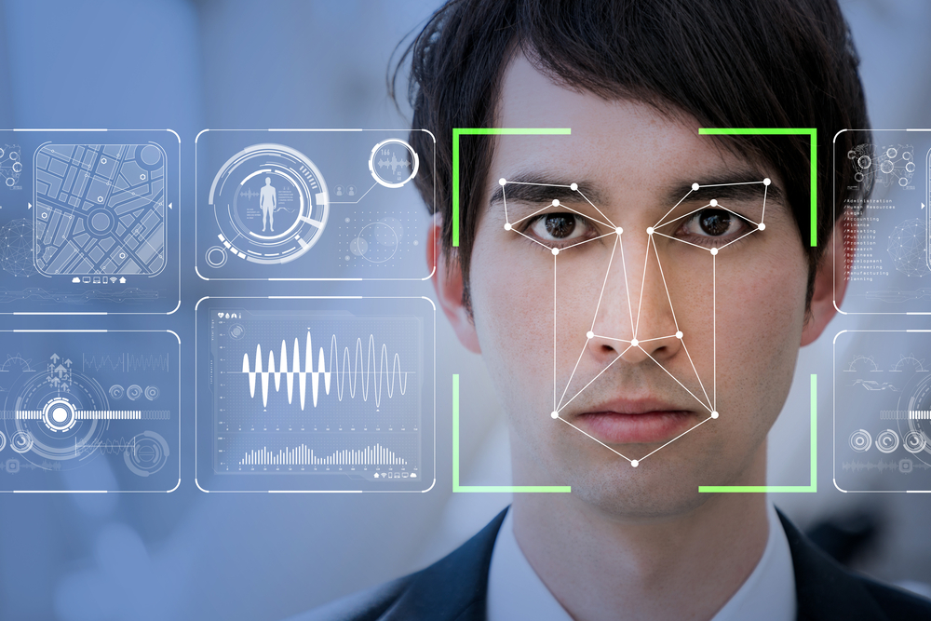
Our method
It is based on PEE and Transfer Learning.
Implement a face recognition technique, to detect for joy and anger (Initially).
We will then fine tune and train our deep learning architecture to detect emotions.
Our model would ideally classify our images as angry, happy, sad, disgusted, fearful, surprised and neutral.
Our model would return a number value which is tied to its respectful emotion (Angry == 0, Joy == 3).

Slide 8
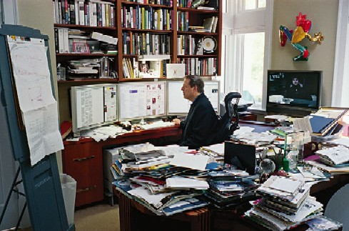
Experimental setup – Simple Anger/Joy Detection.
Import necessary libraries.
We need to set up a deep learning facial recognition model to train the data with our parameters.
We need to set up a face detection model to detect faces in the input images
We load and preprocess images (Resize, Grayscale, Scale px vals)
20 high quality images
10 images clearly displaying anger.
10 images displaying joy.
Use the facial expression recognition model to predict the emotion expressed in each detected face region.
Currently aiming for 65% accuracy for the high quality images, and 50% for the blurred images.

Slide 9

Technologies/Software Used
We will be using datasets from Kaggle, a website popular in the Data Science and Machine Learning community.
OpenCV for computer vision/photo altering purposes.
TensorFlow/Keras to allow us to train our datasets with our own personal parameters.
Numpy/Matplotlib for basic tuning purposes of our sets and displaying our pictures.

Slide 10

Challenges
Time constraints. It takes an ungodly amount of time to train datasets.
Resource constraints. Massive data sets would have to be cut down quite a bit to allow a personal computer to train the data without the program crashing.
It will be our group’s first time implementing a deep learning model. I’m sure it has a little bit of a steep learning curve to TRULY understand what we’re doing.
Making a python program that will satisfy our desired metrics might prove difficult.
Initially, collecting dataset images was difficult, as they need to be of similar size and quality, and consistent. But as we learning how to resize and fix quality this became easier.

Slide 11
Any Questions? Any suggestions?

