Slide 1
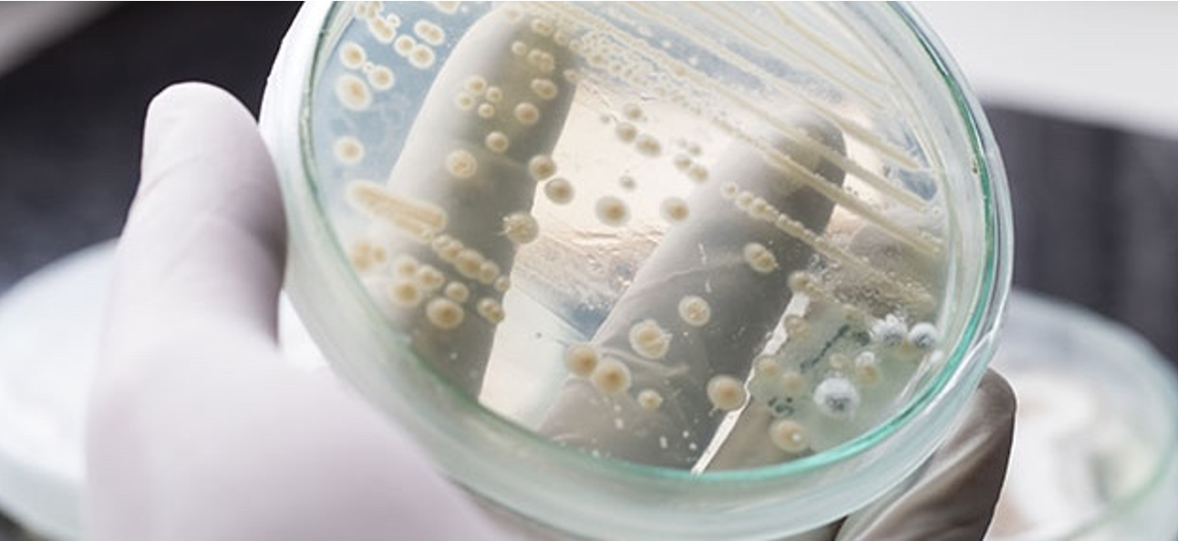
pySBOL3 – A Python implementation of SBOL 3
For IWBDA 2021
Tom Mitchell, Bryan Bartley, Jake Beal
September, 2021
This document does not contain technology or technical data controlled under either U.S. International Traffic in Arms Regulation or U.S. Export Administration Regulations.
Notes:
intro slide – say something about myself – Software engineer, how I got involved in synthetic biology

Slide 2


pySBOL3 Evolution
SBOL 2
SBOL 3
libSBOL
pySBOL
pySBOL2
pySBOL3
C++ with Python Bindings
Pure Python
Pure Python
time
Notes:
Talk about Evolving to be more pythonic
pySBOL was a window into the C++ library
pySBOL2 was a drop in replacement
pySBOL3 adopts a pythonic approach

Slide 3
pySBOL3 Implements SBOL 3
SBOL 3 is the newest iteration of The Synthetic Biology Open Language
Released April 1, 2020
pySBOL3 implements through the 3.0.1 specification (pre-release)
Follow along at https://github.com/SynBioDex/SBOL-specification

Slide 4
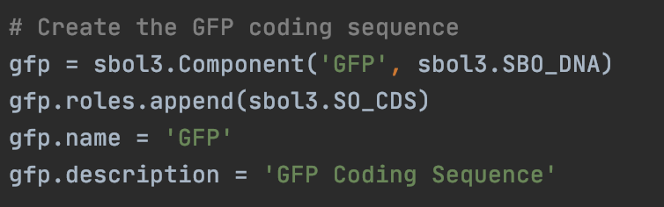
Familiar, Python-like API
pySBOL3 represents each SBOL3 entity as a Python class
Instance properties are either native types or list-like objects
Python snake case is used for properties instead of camel case
display_id instead of displayId
derived_from instead of wasDerivedFrom
https://github.com/SynBioDex/pySBOL3

Slide 5
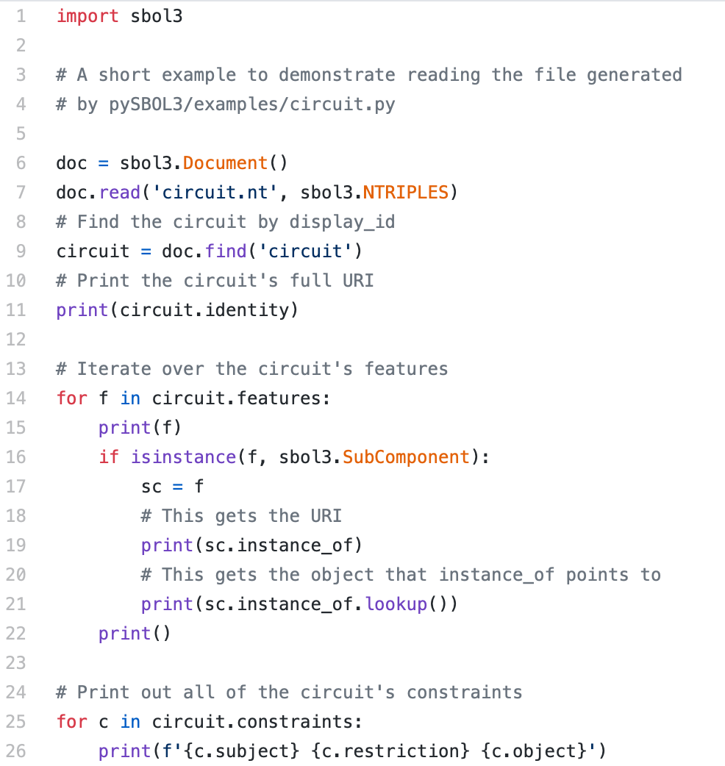
Example: Read an SBOL Document
Read the SBOL file
Find a component
Loop over the component’s features
Look up a referenced object
Print the component’s constraints
https://github.com/SynBioDex/pySBOL3/blob/master/examples/read-circuit.py

Slide 6
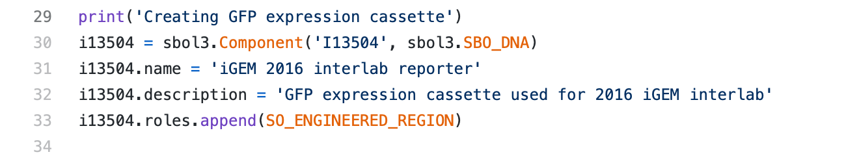
Example: Create an iGEM Component
Component
identity: iGEM#I13504
name: “iGEM 2016 interlab reporter”
description: “GFP expression cassette used for 2016 iGEM interlab”
type: SBO: DNA
role: SO: Engineered Region

Slide 7
Example: Create an iGEM Component
Component
identity: iGEM#I13504
name: “iGEM 2016 interlab reporter”
description: “GFP expression cassette used for 2016 iGEM interlab”
type: SBO: DNA
role: SO: Engineered Region

Slide 8
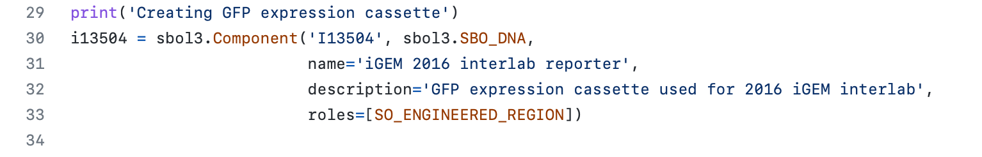
Example: Create an iGEM Component (keyword args)
Component
identity: iGEM#I13504
name: “iGEM 2016 interlab reporter”
description: “GFP expression cassette used for 2016 iGEM interlab”
type: SBO: DNA
role: SO: Engineered Region

Slide 9
Example: Create an iGEM Component (keyword args)
Component
identity: iGEM#I13504
name: “iGEM 2016 interlab reporter”
description: “GFP expression cassette used for 2016 iGEM interlab”
type: SBO: DNA
role: SO: Engineered Region

Slide 10
Example: SBOL Composition
Component: iGEM#I13504
hasFeature
SubComponent
SubComponent
SubComponent
instanceOf
instanceOf
instanceOf
RBS
CDS
Terminator
Component
identity: iGEM#B0034
name: RBS (Elowitz 1999)
type: SBO: DNA
role: SO: Ribosome Entry Site
Component
identity: iGEM#E0040
name: GFP
type: SBO: DNA
role: SO: CDS
Component
identity: iGEM#B0015
name: double terminator
type: SBO: DNA
role: SO: Terminator
10

Slide 11
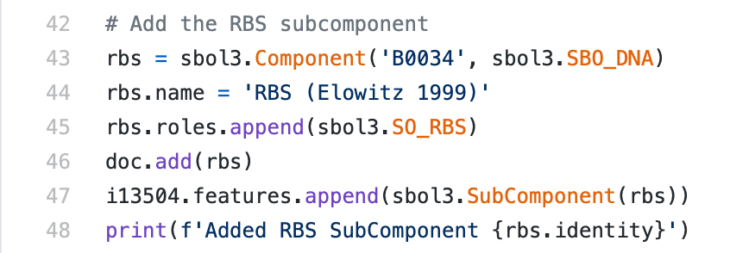
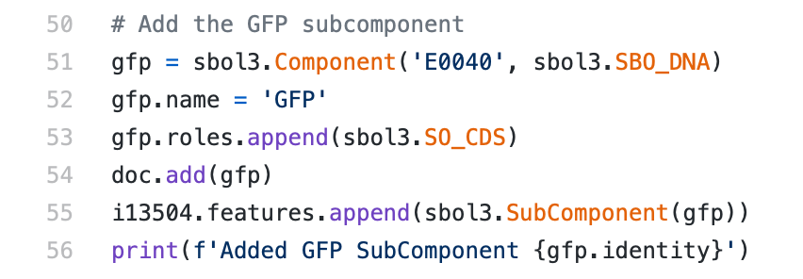
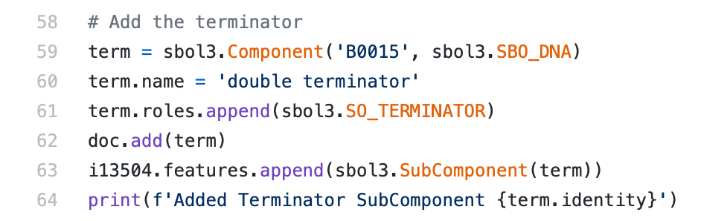
Example: SBOL Composition
RBS
CDS
Terminator

Slide 12
pySBOL3 Status
pip install sbol3
Beta release is available now
Open development on GitHub
Use issues to report bugs and request features
Contributions are welcome
https://github.com/synbiodex/pySBOL3
Notes:
Mention other implementations: libSBOLj (Java), sboljs (JavaScript), and ShortBOL, its own scripting language.

Slide 13
Questions?
SBOL 3 Tutorial
SBOL Version 3: Data Exchange throughout the Bioengineering Lifecycle
Monday, September 20
17:30 - 19:30 UTC

Slide 14
Tutorial Set-up
Git the tutorial:
[Optional] Launch a virtual environment
Install dependencies (sbol3 and tyto)
Run notebook
git clone https://github.com/SynBioDex/Community-Media.git
cd community-media/2021/IWBDA21
python –m venv iwbda
source iwbda/bin/activate
pip install -r requirements.txt
jupyter notebook tutorial.ipynb

