Slide 1

pySBOL3 – A Python implementation of SBOL 3
For IWBDA 2021
Tom Mitchell, Bryan Bartley, Jake Beal
September, 2021
This document does not contain technology or technical data controlled under either U.S. International Traffic in Arms Regulation or U.S. Export Administration Regulations.
Notes:
intro slide – say something about myself – Software engineer, how I got involved in synthetic biology

Slide 2


pySBOL3 Evolution
SBOL 2
SBOL 3
libSBOL
pySBOL
pySBOL2
pySBOL3
C++ with Python Bindings
Pure Python
Pure Python
time
Notes:
Talk about Evolving to be more pythonic
pySBOL was a window into the C++ library
pySBOL2 was a drop in replacement
pySBOL3 adopts a pythonic approach

Slide 3
pySBOL3 Implements SBOL 3.0
SBOL 3 is the newest iteration of The Synthetic Biology Open Language
Released April 1, 2020
SBOL 3.0.1 is expected very soon
Discussions are happening at COMBINE 2020
Taking place Wednesday, Thursday, and Friday
Look for breakout sessions in Room SBOL
pySBOL3 will support SBOL 3.0.1 shortly thereafter
Follow along at https://github.com/SynBioDex/SBOL-specification
What should we say about SBOL 3.0.1?
Are there other SBOL specification sessions at IWBDA?

Slide 4
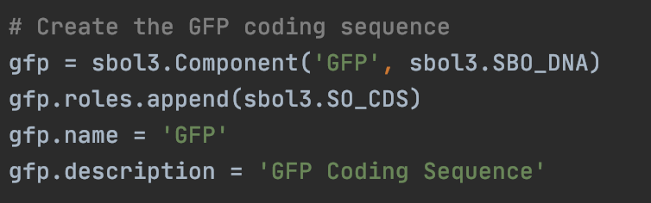
Familiar, Python-like API
pySBOL3 represents each SBOL3 entity as a Python class
Instance properties are either native types or list-like objects
Python snake case is used for properties instead of camel case
display_id instead of displayId
derived_from instead of wasDerivedFrom
https://github.com/SynBioDex/pySBOL3

Slide 5
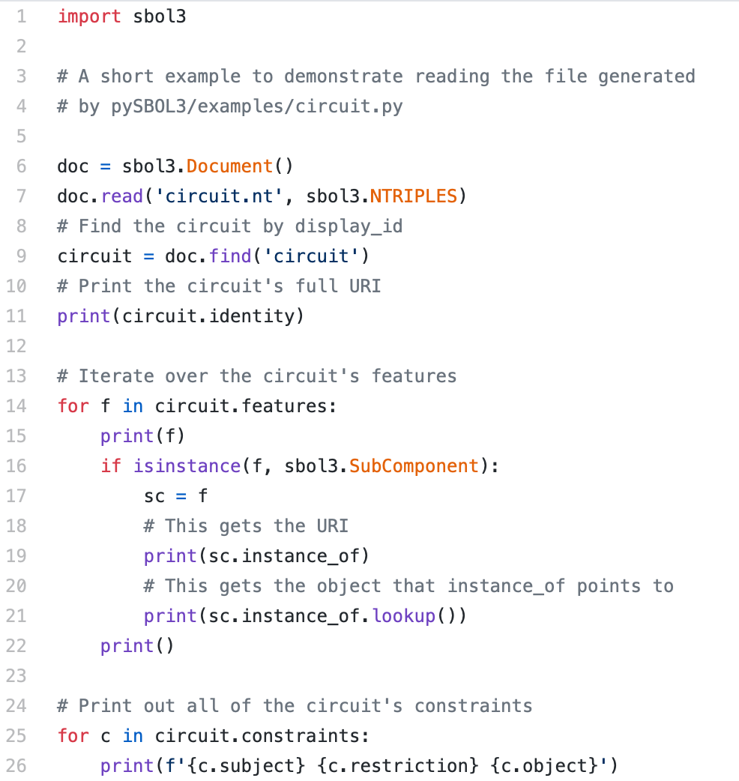
Example: Read an SBOL Document
Read the SBOL file
Find a component
Loop over the component’s features
Look up a referenced object
Print the component’s constraints
https://github.com/SynBioDex/pySBOL3/blob/master/examples/read-circuit.py

Slide 6
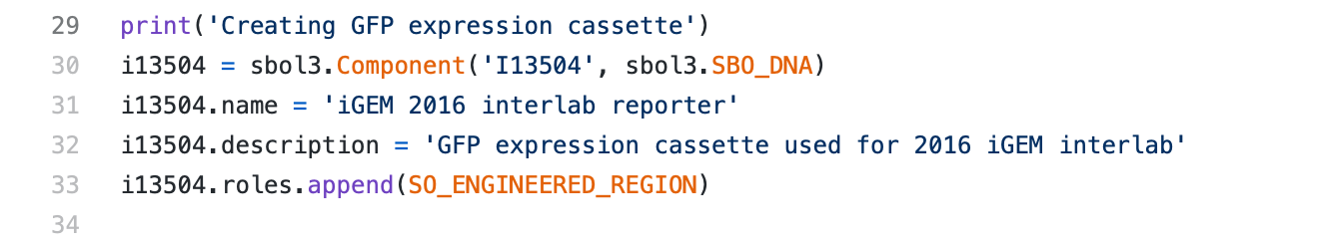
Example: Create an iGEM Component
Component
identity: iGEM#I13504
name: “iGEM 2016 interlab reporter”
description: “GFP expression cassette used for 2016 iGEM interlab”
type: SBO:0000251 (DNA)
role: SO:0000804 (Engineered Region)

Slide 7
Example: Create an iGEM Component
Component
identity: iGEM#I13504
name: “iGEM 2016 interlab reporter”
description: “GFP expression cassette used for 2016 iGEM interlab”
type: SBO:0000251 (DNA)
role: SO:0000804 (Engineered Region)

Slide 8
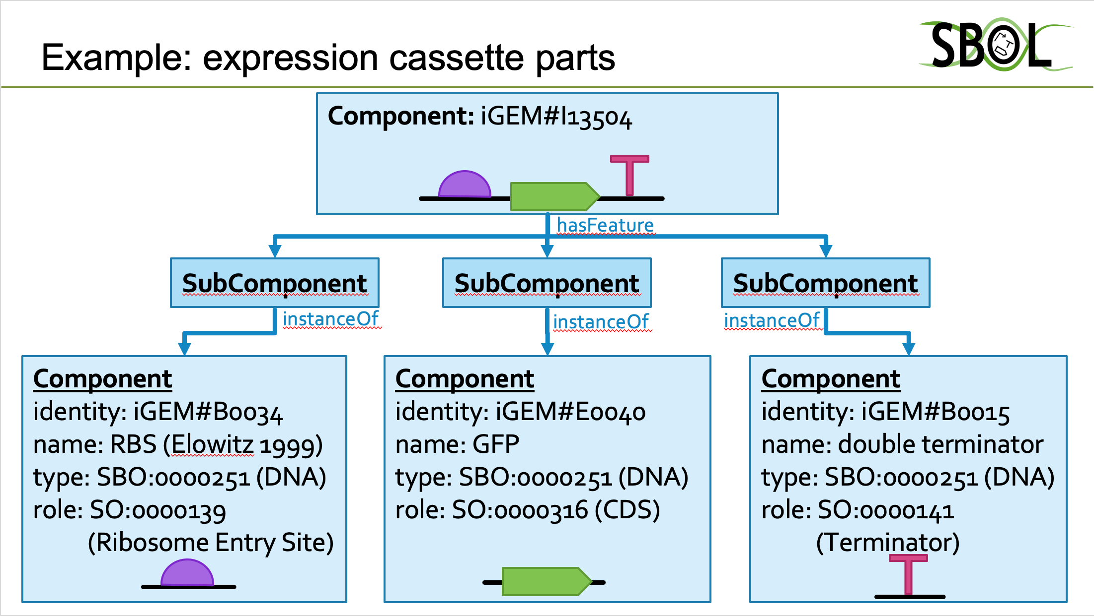
Example: SBOL Composition
RBS
CDS
Terminator

Slide 9
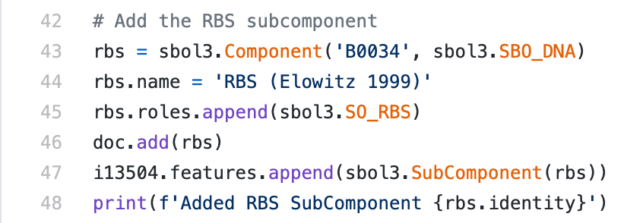
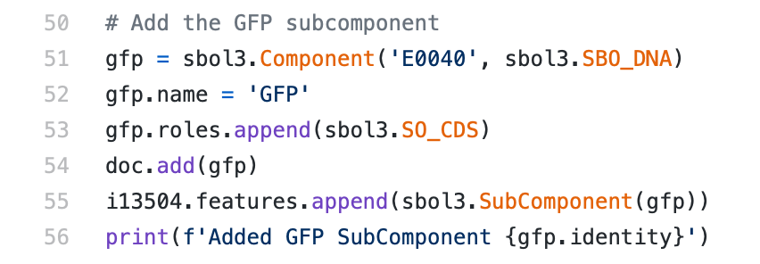
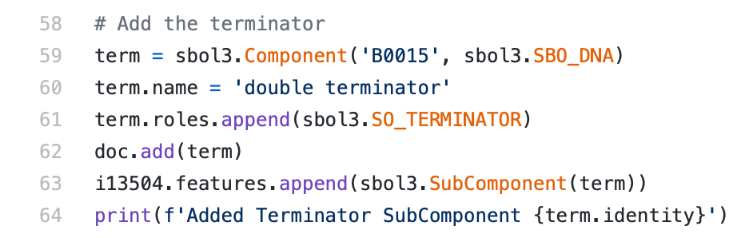
Example: SBOL Composition
RBS
CDS
Terminator

Slide 10
pySBOL3 Status
pip install sbol3
Beta release is available now
Open development on GitHub
Use issues to report bugs and request features
Contributions are welcome
https://github.com/synbiodex/pySBOL3
Notes:
Mention other implementations: libSBOLj (Java), sboljs (JavaScript), and ShortBOL, its own scripting language.

Slide 11
Questions?
SBOL 3 Tutorial
SBOL Version 3: Data Exchange throughout the Bioengineering Lifecycle
Monday, September 20
17:30 - 15:30 UTC

