Slide 1


Flapjack
A data management and analysis tool for genetic circuit characterization
Presented at SEED by:
Gonzalo Vidal and Carlos Vidal
Notes:
Hello, my name is Gonzalo Vidal and I will present Flapjack, a data management and analysis tool for genetic circuit characterization.

Slide 2
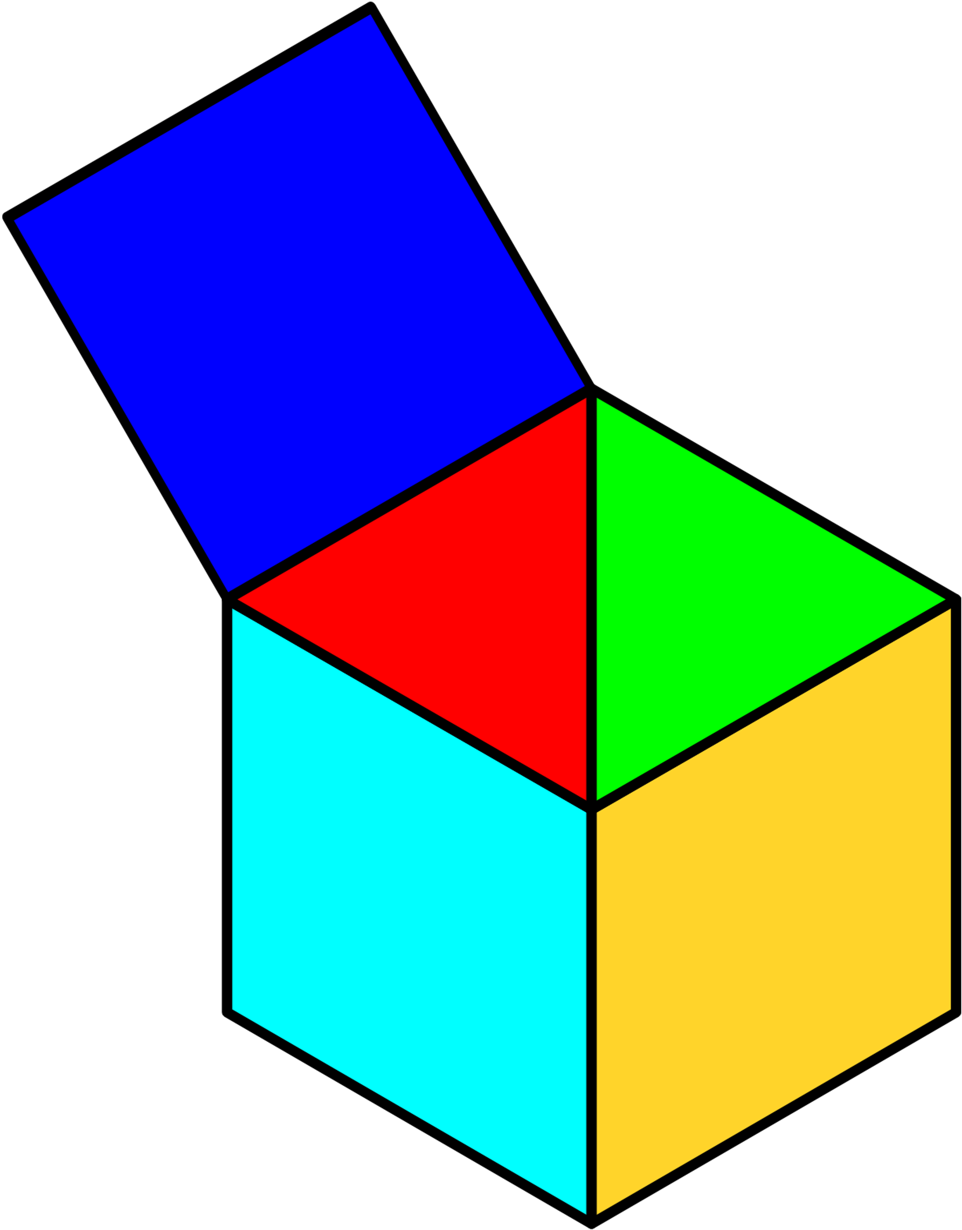
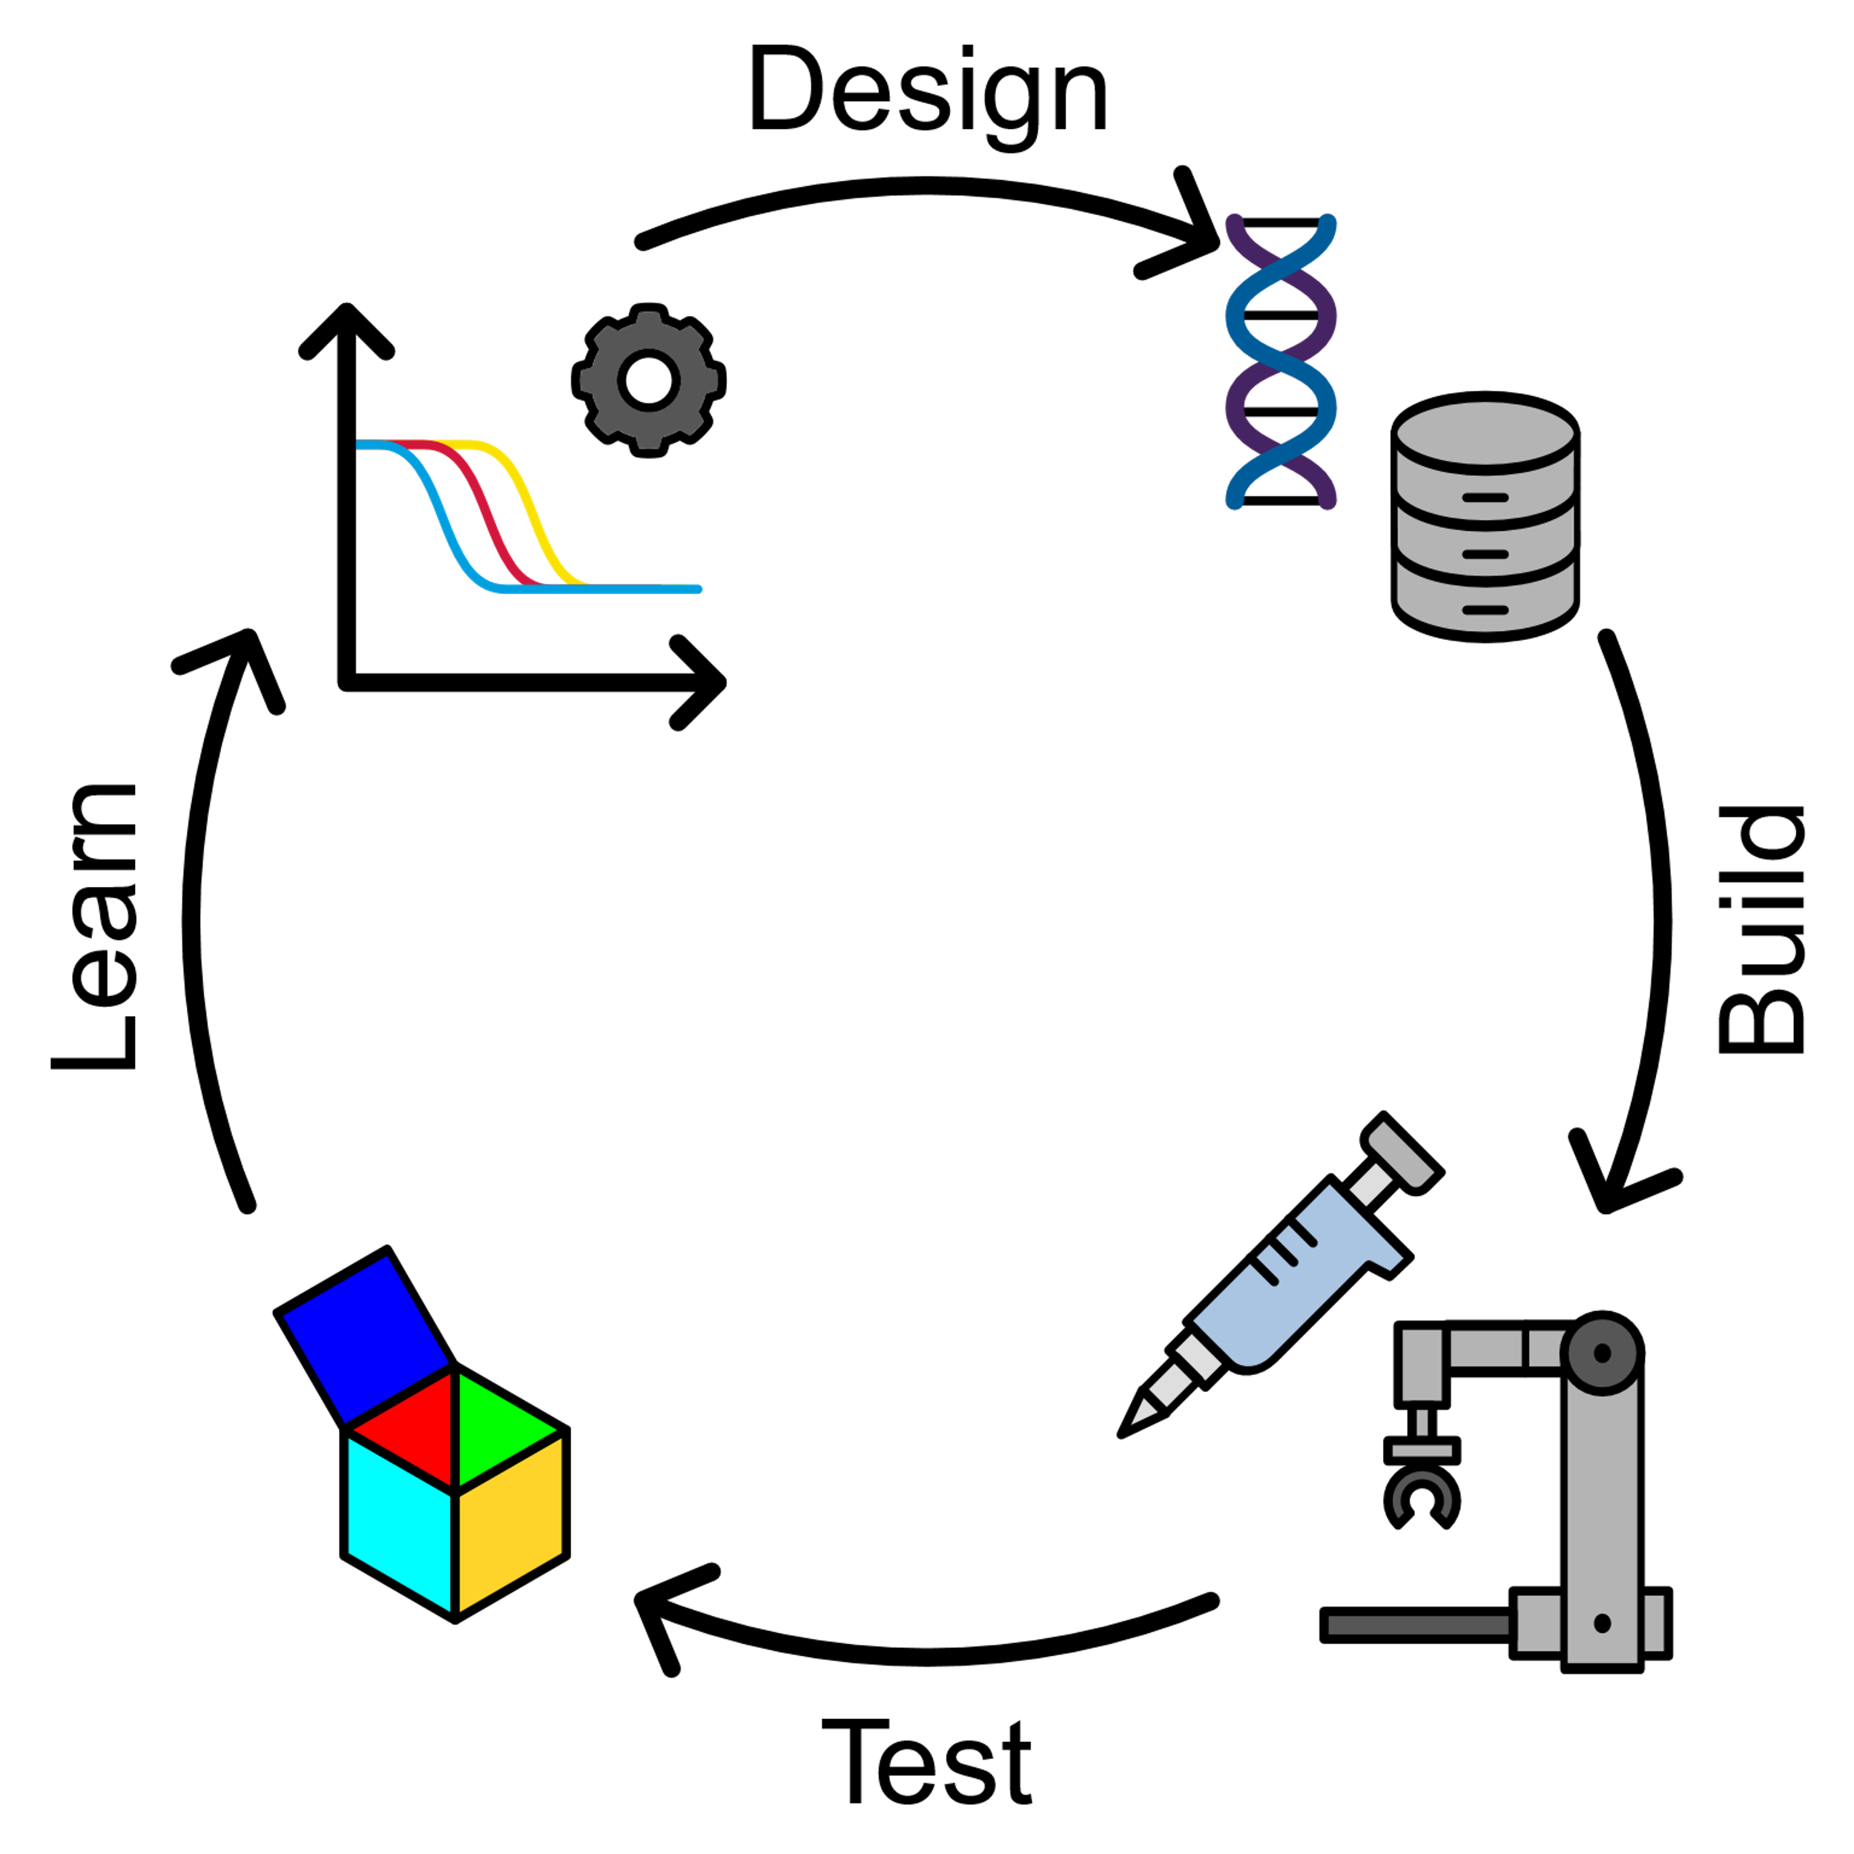
Introduction
1
Flapjack is a data management and analysis tool for synthetic biology, aimed to complete the SBOL based open-source Design, Build, Test, Learn workflow, helping to analyze data in a more visual and user-friendly way.
The system consist of a web app with a back-end data registry and analysis engine, accessible as a REST API.
The frontend provides powerful querying, plotting, and analysis tools.
Notes:
Flapjack is a data management and analysis tool for synthetic biology. It aims to complete the SBOL based open source DBTL lifecycle.
Flapjack centers on connecting the Test and Learn stages collecting and storing experimental data to make it accesible and machine readable.
The software consist in a relational database and an analysis engine as back-end accesible through a user-friendly web app front-end or through a REST API.
The frontend provides powerful querying, plotting and analysis tools.

Slide 3
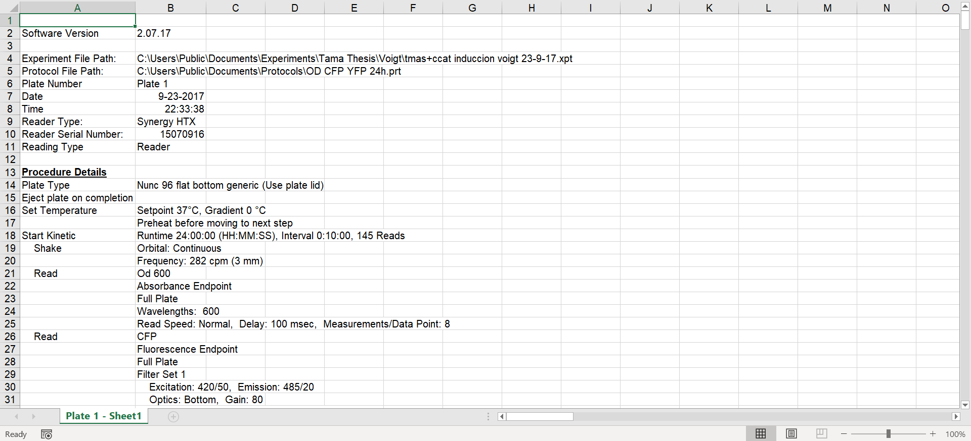
Uploading data: Plate reader
10
Flapjack allows you to upload data obtained directly from a plate reader, after little adjustment.
Notes:
Everything starts with a synthetic biologist getting experimental data.
We have created a semi-automated pipeline that uses the plate reader output.

Slide 4
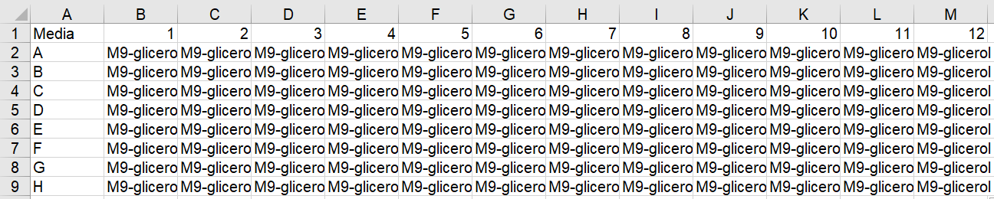
Preparing the file
11
Rename the sheet that contains the data obtained from the plate reader.
Add the following sheets: Media, Strains, DNA, Chemicals
Notes:
To create structured data from our raw data we need to provide some extra information.
To do this we rename the sheet that contains tha data in the excel obtained from the plate reader.
We also need to add the following sheets Media, Strains, DNA and Chemicals,
We fill these sheets with the contents of our 96 well plate.

Slide 5
Data objects
2
Study
A project, for example paper or report, that corresponds to a certain question a researcher wants to address.
Assay
Measurement experiments, including replicates and varying experimental conditions, performed to explore different aspects of the study.
Sample
Corresponds to the basic unit that is subject to measurement, for example a colony or a well in a microplate.
Notes:
The data is structured using Flapjack data objects, which are the following.
Study correspond to a set of experiments or assays addresing a particular hypothesis, like paper or report.
Assay correspond to a set of experimental measurements, including controls, replicates and different conditions.
Sample correspond to the basic unit that is subject to measurement.
In this regard a Sample can be a well on a 96 well plate, an Assay can be the whole 96 well plate and an study can be a set of 96-well pates.

Slide 6
Data objects
3
Measurement
The value of the raw measurement recorded for a particular sample during an assay at a particular time.
Vector
Describes the synthetic DNAs encoding a genetic circuit, including links to part composition and sequence via the corresponding SBOL URIs.
Media
Composition of the substrate which drives the genetic circuit, media in the case of live cell assays, or extract for cell-free experiments.
Notes:
Measurement correspond to the value of the raw measurement recorded for a particular sample during an assay at a particular time.
Vector is the set of DNAs encoding gentic circuits, where the individual DNA links to part composition and sequence using SynBioHub URIs.
Media is the composition of the substrate that drives the genetic circuit.

Slide 7
Data objects
4
Strain
The chassis organism, if any, hosting the genetic circuit.
Supplement
Any supplementary chemicals that interact with components of the genetic circuit.
Signal
The subject of measurements, for example a fluorescence channel with given filter bandwidths.
Notes:
Strain is the chassis or model organism that host the genetic circuit.
Supplement is any chemical added to the Media.
Signal is the subject of measurements, for example a fluorescence channel with given filter bandwidhts.

Slide 8
Data model
Media
PK: id
5
FK: owner
name
description
Strain
PK: id
FK: owner
name
description
Study
Assay
Sample
Measurement
Signal
PK: id
PK: id
PK: id
PK: id
PK: id
FK: owner
name
description
DOI
public
FK: study
name
machine
description
temperature
FK: assay
media
strain
vector
supplements
row
column
FK: sample
signal
value
time
FK: owner
name
description
color
Supplement
Chemical
PK: id
PK: id
FK: samples
owner
chemical
name
concentration
FK: owner
name
description
pubchemid
DNA
Vector
PK: id
PK: id
FK: vectors
owner
name
sboluri
FK: dnas
owner
name
Notes:
Here is the whole data model. We can appreciate how the high complexity data objects are composed by simplier ones.
As an example we can have two plasmids each one corresponds to a DNA object, both compose the Vector and this Vector is transformed into a Strain.
A fluorescent GFP Signal can be Measure on a Sample or well with a Media with a determined Supplement that may be a Chemical like IPTG.
The whole 96 well plate is stored as Assay and a set of assays may be a Study.

Slide 9
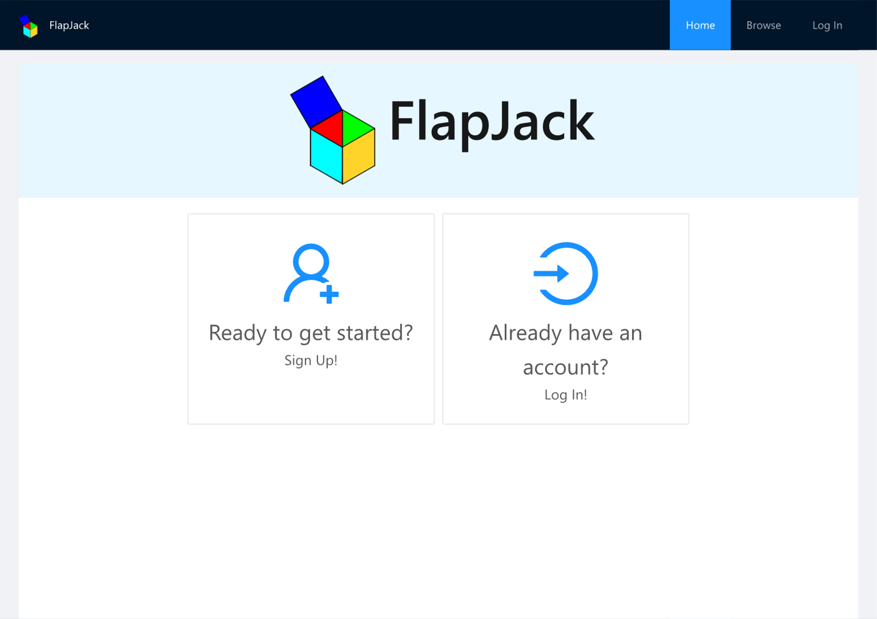
Flapjack front-end
6
Notes:
Flapjack has a web app front-end build on React.
Flapjack has 4 pages, Home, Browse, Log In, and when logged you will unlock the View Page.

Slide 10
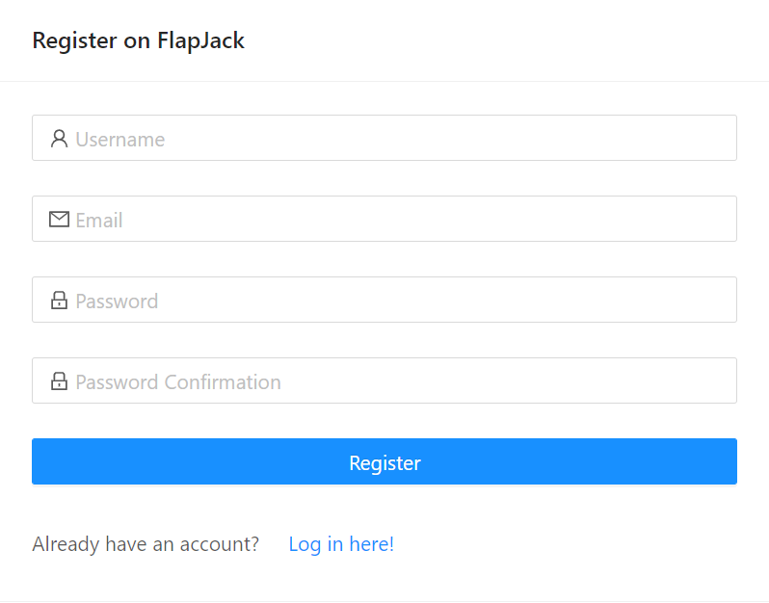
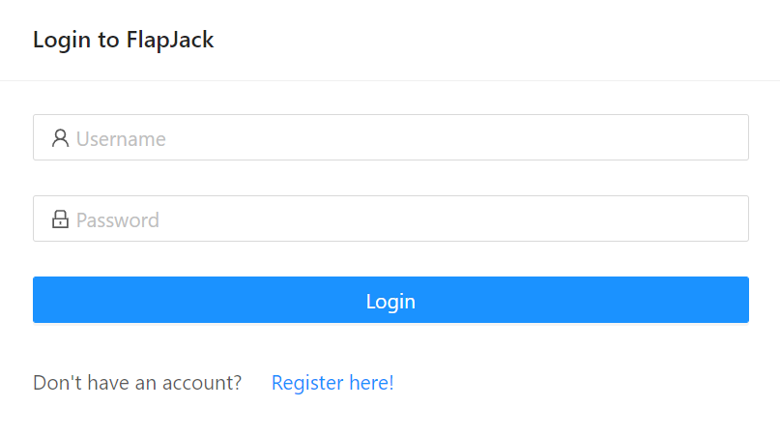
Getting started
7
To access Flapjack’s features and capabilities you have to either register or login to your existing account.
Notes:
In the Log in page you can Register for free or Log in if you have an account already.

Slide 11
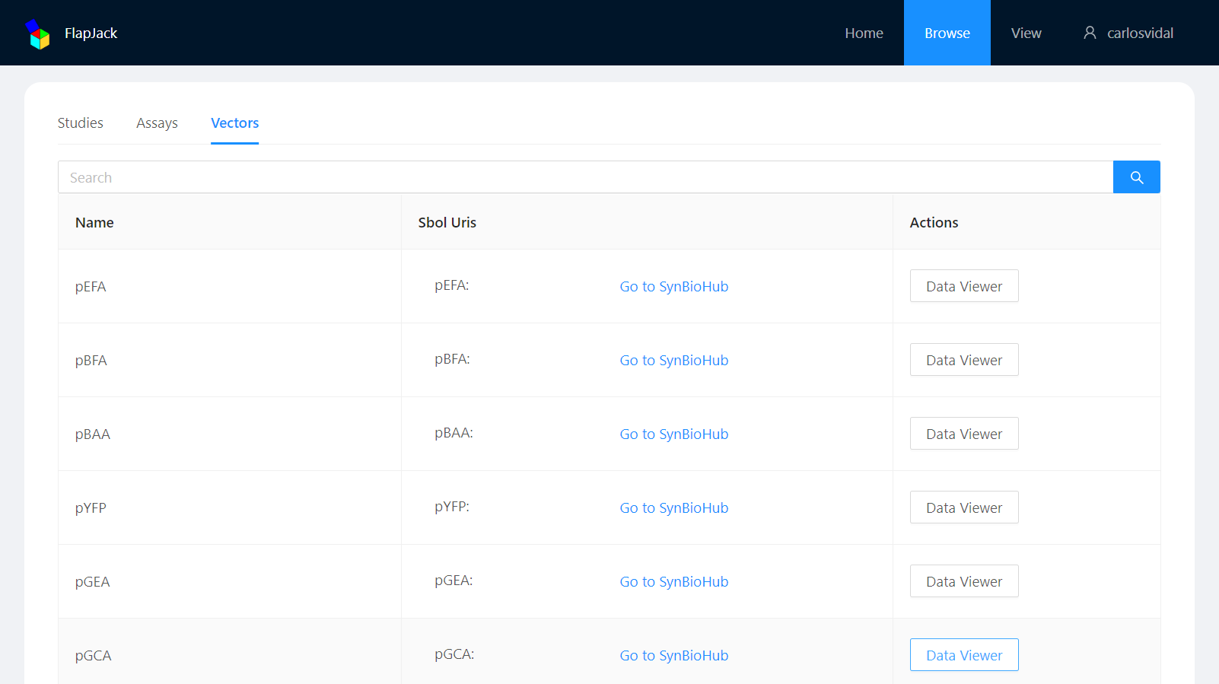
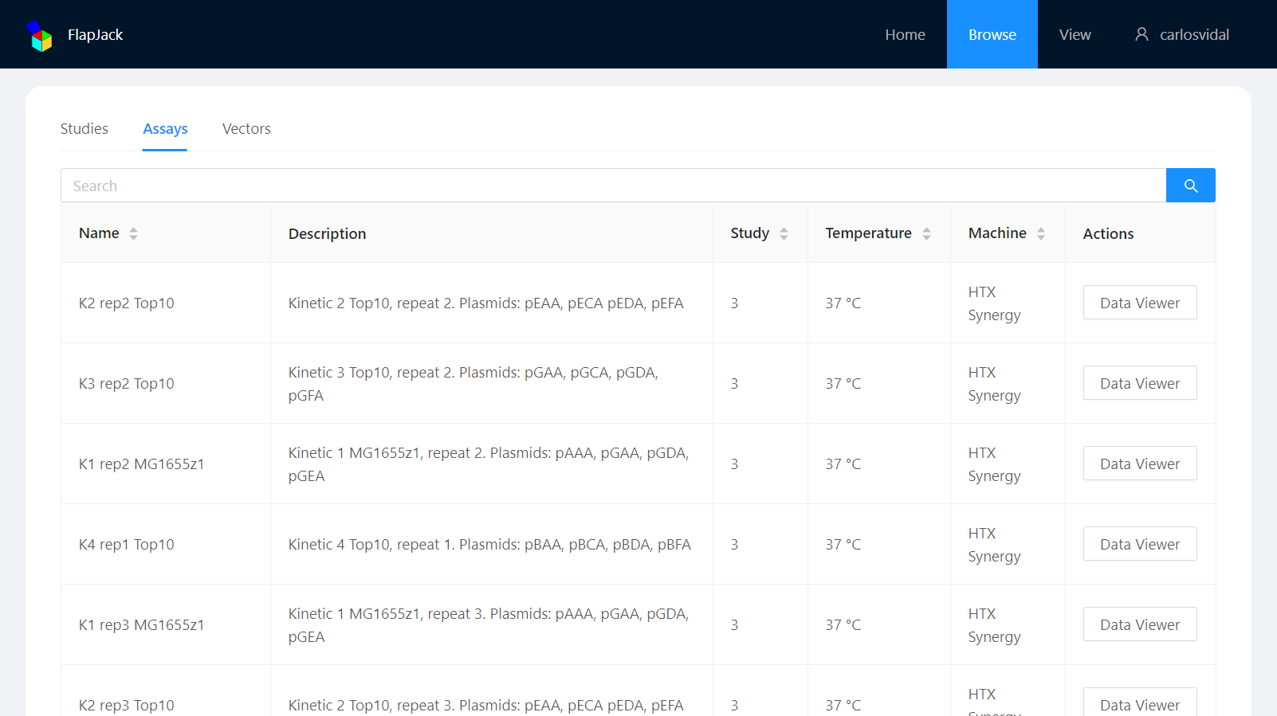
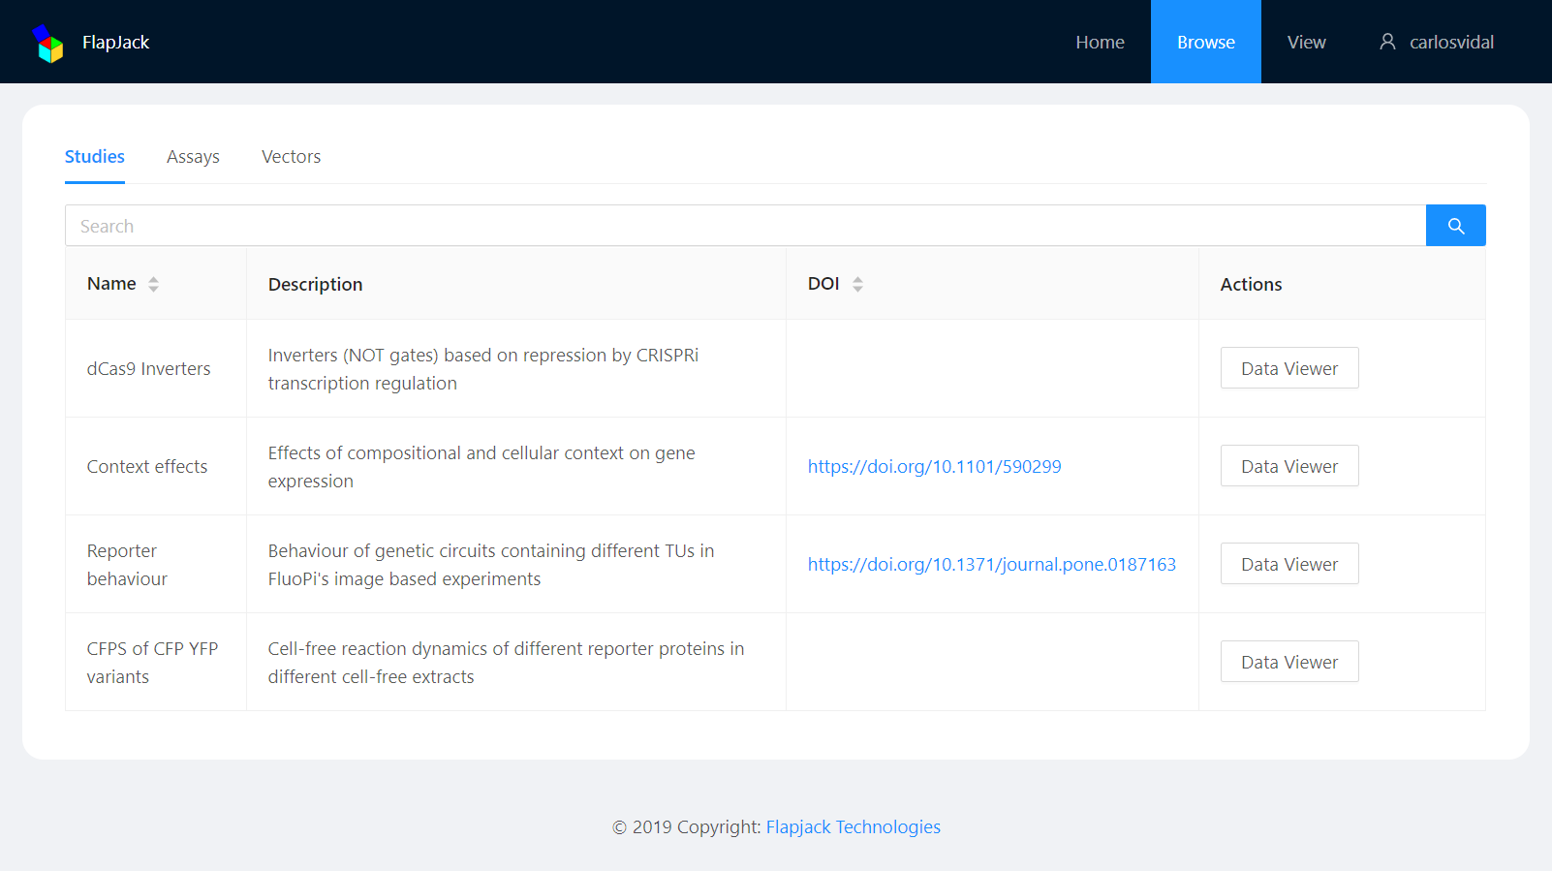
Browse page
8
Notes:
In the Browse page you can browse data sorted by Study, Assay or Vector.

Slide 12
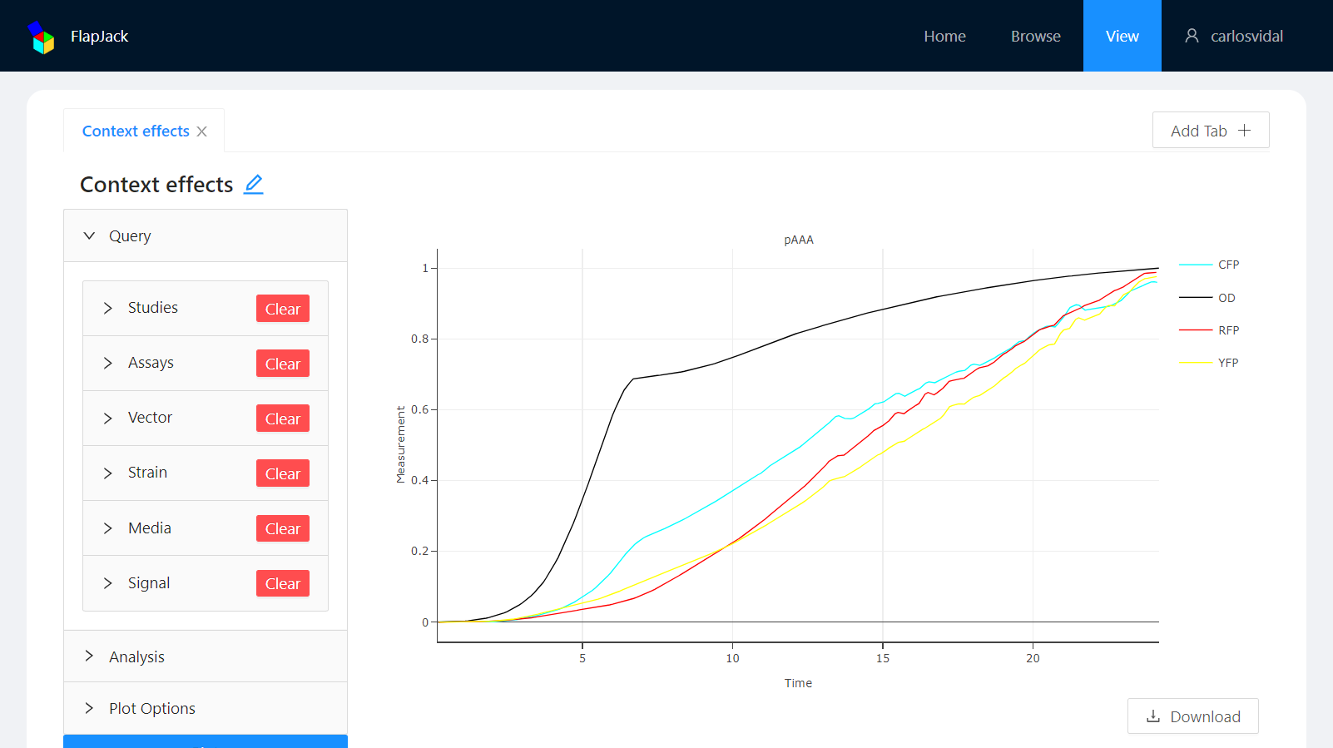
View page
9
Notes:
In the View page you can Query , analyze and visualize data in multiple tabs.

Slide 13
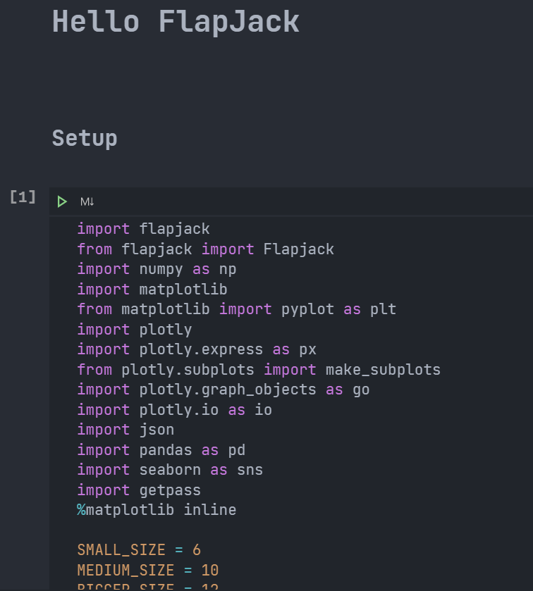
Flapjack API
13
https://colab.research.google.com/drive/1pP4lE1oNLhxGBCX4rqp3Dx6M6i2LICee?usp=sharing

Slide 14


Wrap up
15
Flapjack is a data management (data storage, sharing, visualization, interface) and analysis (characterization) tool for synthetic biologists. It structures your data to be machine readable for automation and to feed AI/ML workflows.
Flapjack enhance colaboration and reproducibility.
Create SBOL3 file with experimental data.
Help in iGEM data management and embedded visualization.
Acknowledge Anillo ANID PIA-ACT 192015
github.com/SynBioUC/flapjack
Contact: trudge@uc.cl

Slide 15
Contributors
14
Guillermo A. Yáñez Feliú¹, Benjamín Earle Gómez², Verner Codeceo Berrocal², Macarena A. Muñoz Silva², Isaac N. Nuñez¹, Tamara M. Matute¹, Anibal A. Arce Medina³, Gonzalo Vidal², Carlos Vidal Céspedes², Jonathan Dahlin⁴, Fernán Federici^{2,3}, Timothy J. Rudge^{1,2}
¹Department of Chemical and Bioprocess Engineering, School of Engineering, Pontificia Universidad Católica de Chile, Santiago, Chile
²Institute for Biological and Medical Engineering, Schools of Engineering, Biology and Medicine, Pontificia Universidad Católica de Chile, Santiago, Chile
³Department of Genetics and Molecular Biology, School of Biology, Pontificia Universidad Católica de Chile, Santiago, Chile
⁴The Novo Nordisk Foundation Center for Biosustainability, Technical University of Denmark, Kongens Lyngby, Denmark
⁵Faculty of Science, Universidad de Chile

